Slide 1

Orange OpenTech: Innovating for Customer Retention
Vishal Ramesh Babu
0832438

Slide 2
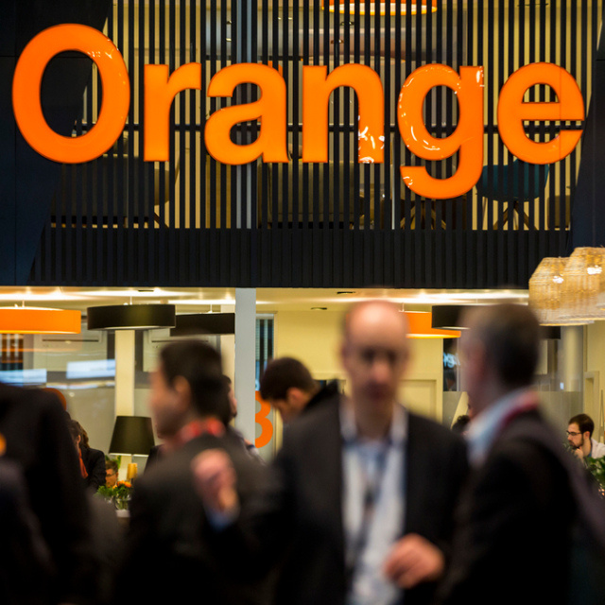
About Orange
Company Overview:
Leading global telecommunications operator with services in mobile, landline, and internet.
Operates in 29 countries with a strong presence in Europe and Africa.
Established brand since 2006, focused on innovation and customer experience.

Slide 3
Market Share:
36.9 million mobile customers in France, leading the market.
Holds approximately 45.38% market share in French mobile telecommunications.
Significant growth in emerging markets, contributing to overall market presence

Slide 4
User Base:
Total customer base exceeds 269 million worldwide.
Includes 208 million mobile, 19 million fixed broadband, and 12.5 million TV customers.
Strong focus on customer retention and loyalty initiatives.

Slide 5
Key Insights And Innovations:
AI Integration: Orange is implementing over 150 AI use cases to enhance customer experience and operational efficiency.
Predictive Cybersecurity: New innovations enable real-time detection of cyber threats, enhancing data protection and network security.
Augtera Network AI: The adoption of the Augtera platform reduces network alarm notifications by 70%, improving service reliability.
Localized Cloud Solutions: Collaboration with Google Cloud allows for AI capabilities to be deployed closer to operations, ensuring compliance and better service delivery.
Employee Training in AI: Orange is training over 40,000 employees in AI tools to empower them and improve customer interactions without replacing human roles.

Slide 6
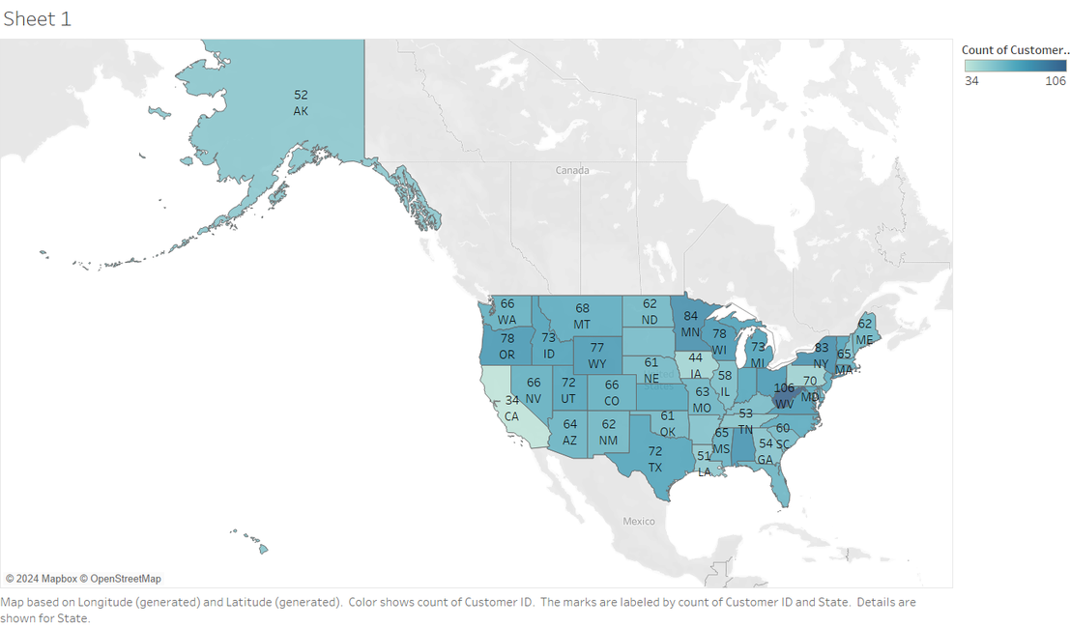

Geographical Distribution of Orange Telecom Customers Across the USA
"The highest customer concentration is observed in states like Texas (106 customers) and Minnesota (84 customers), highlighting key markets for Orange Telecom."

Slide 7
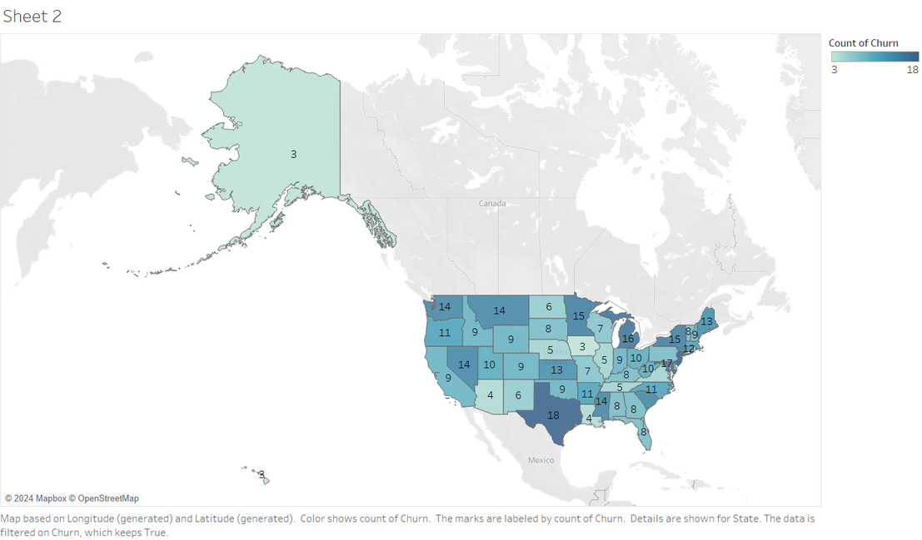
Geographical Distribution of Churned Customers Across the USA
The highest churn is observed in Texas (18 churned customers), signaling a need for targeted retention strategies in this state.

Slide 8
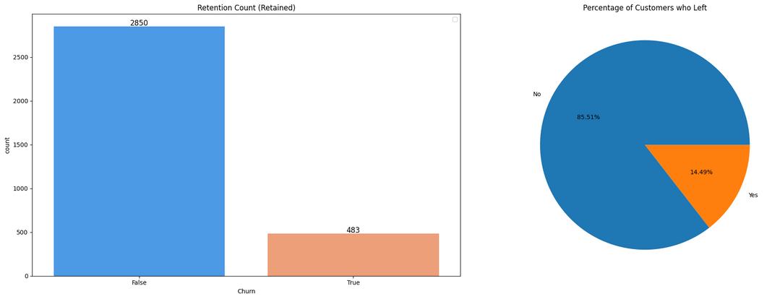
Combined Analysis :
Retention and Churn
Customer Retention: A significant majority of customers (85.51%) are retained, while only 14.49% have churned, as illustrated in the pie chart.
Retention Count: The bar chart highlights that 2,850 customers stayed with the company, compared to 483 who left.
Class Imbalance: The dataset has a notable imbalance in churn status, with retained customers dominating, which is important to consider for model development and evaluation

Slide 9
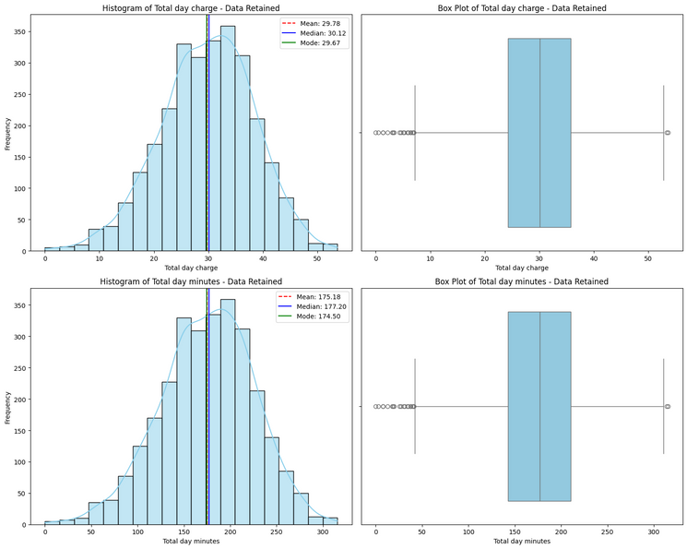
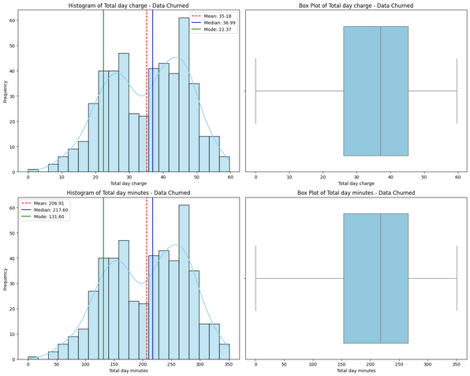
Statistical Trends in Daytime Usage: Churn vs. Retention
Higher usage correlates with churn: Churned customers show significantly higher average Total Day Charges and Minutes.
Bimodal churn pattern: Two distinct groups of churned customers - low-usage (lack of value) and high-usage (dissatisfaction or high costs)
Retained customers show stable usage: Normal distribution in charges and minutes indicates consistent patterns.
High charges indicate churn risk: Customers with larger bills are more likely to leave, highlighting the need for targeted retention strategies

Slide 10
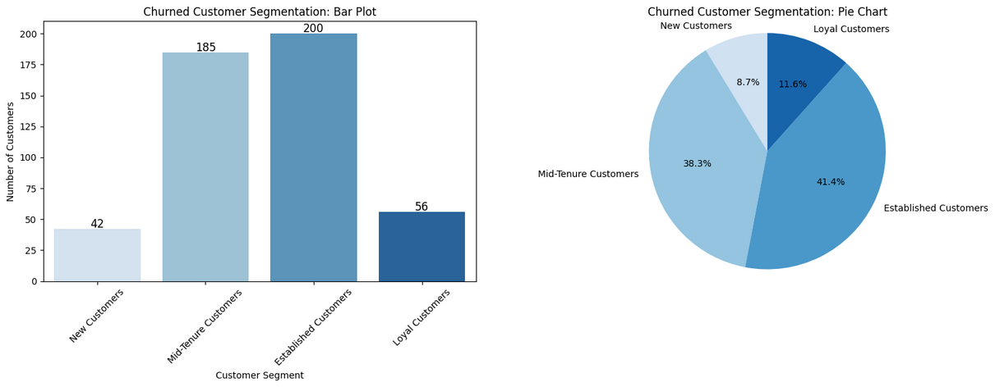
Understanding Our Lost Users
Critical Churn Segments: Mid-Tenure (185 churned; 38.3%) and Established Customers (200 churned; 41.4%) account for the majority of churn, highlighting a key focus area for retention strategies.
Loyal Customers Show Strong Retention: Loyal Customers have the lowest churn numbers (56; 11.6%), suggesting effective loyalty-building initiatives.
New Customers Have Smaller but Significant Churn: Although New Customers contribute only 42 churned customers (8.7%), addressing their early experience could further reduce churn.

Slide 11
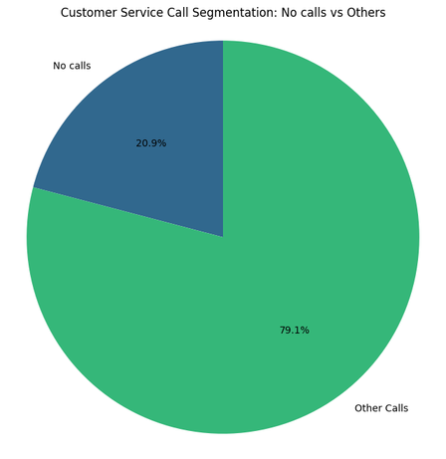
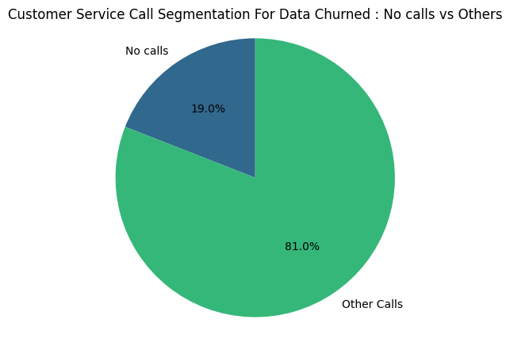
Customer Service Impact on Churn
Total Customers
Churned Customers
Customers who made no service calls account for 19.0% of churn, while those making other calls contribute 81.0%, emphasizing the need to focus on proactive customer engagement.

Slide 12
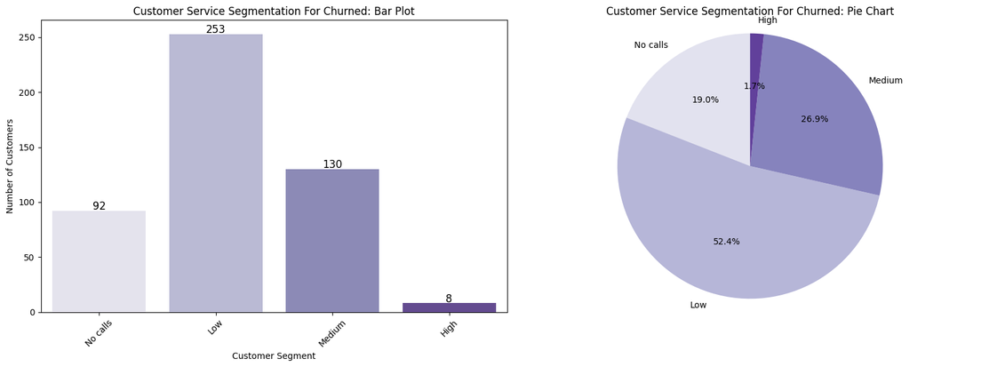
Customer Service Impact on Churn
Low Customer Service Drives Churn: The "Low" service segment has the highest churn, with 253 churned customers (52.4%), emphasizing the need to improve service for this group.
High Customer Service Reduces Churn: The "High" service segment has minimal churn, with only 8 churned customers (1.7%), showcasing the effectiveness of quality customer service.
Medium and No Calls Segments Have Moderate Churn: The "Medium" segment (130 churned; 26.9%) and "No calls" segment (92 churned; 19.0%) indicate additional areas to address for better retention outcomes.

Slide 13
S
W
O
T
Strong loyalty among established customers
Effective high-quality customer service reduces churn
Loyal customer segment shows strong retention rates
High churn rates among mid-tenure and established customers
Low customer service quality leads to significant churn
New customers show lower retention rates
Improve early-stage customer experience to reduce new customer churn
Enhance service quality for low and medium service segments
Develop targeted retention strategies for high-usage customers
High usage correlates with increased churn risk
Customer dissatisfaction due to high charges
Lack of perceived value among low-usage customers

Slide 14
Recommendations
Enhance Customer Service: Improve service quality, especially for the low and medium segments, to reduce churn rates.
Targeted Retention Programs: Develop specific strategies for mid-tenure and established customers to address their unique needs and pain points.
Usage-Based Pricing: Implement flexible pricing models to address both low-usage and high-usage customer concerns.
Proactive Engagement: Increase proactive customer engagement, particularly for those who rarely contact customer service.
Early-Stage Experience: Improve onboarding and initial customer experience to boost new customer retention rates.

Slide 15
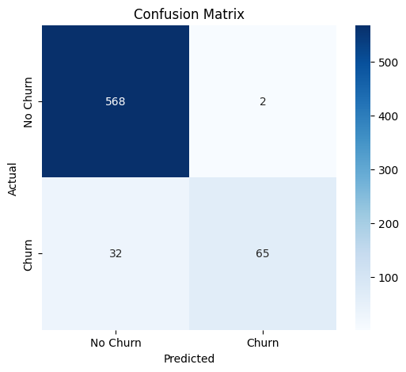
Predictive Churn Model: Random Forest Results
Critical Predictors: Features like Total Day Charge, Total Day Minutes, and Customer Service Calls are key drivers of churn.
Model Strength: The model performs well with high accuracy in predicting non-churners.
Churn Misclassification: False negatives (35 churners missed) highlight a need for better churn identification.
Low-Impact Features: Variables like Area Code and Voice Mail Plan have minimal influence on churn prediction.

Slide 16
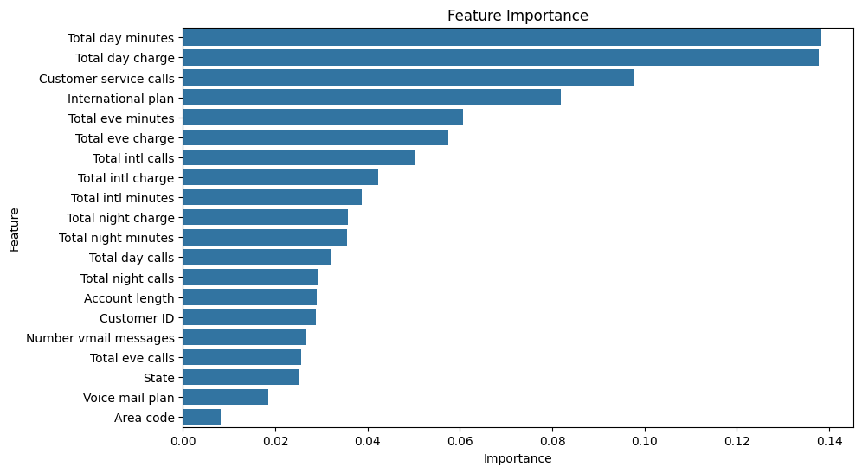
Feature Importance in Churn Prediction

Slide 17
References
Swot Analysis
Customer Churn Analysis
Reduce Customer Churn
Orange_company’s_Website

