Slide 1
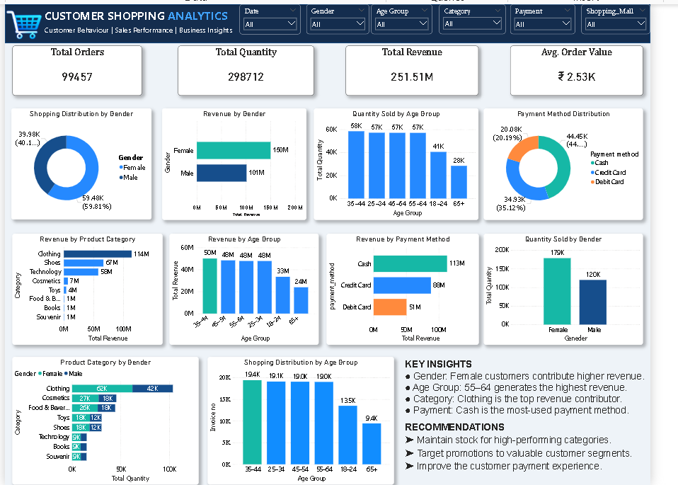
CUSTOMER SHOPPING ANALYTICS
PRDA-04 | Insights Report & Business Recommendations
Customer behaviour
Sales performance
Product & payment trends

Slide 2
Dashboard at a Glance
Headline figures shown in the submitted Power BI dashboard
Total Orders
99,457
Total Quantity
298,712
Total Revenue
₹251.51M
Avg. Order Value
₹2.53K
The dashboard consolidates order, quantity and revenue KPIs with gender, age, category and payment breakdowns.
Filters available: Date, Gender, Age Group, Category, Payment and Shopping Mall.
Use slicers to isolate segments and compare patterns before making business decisions.

Slide 3
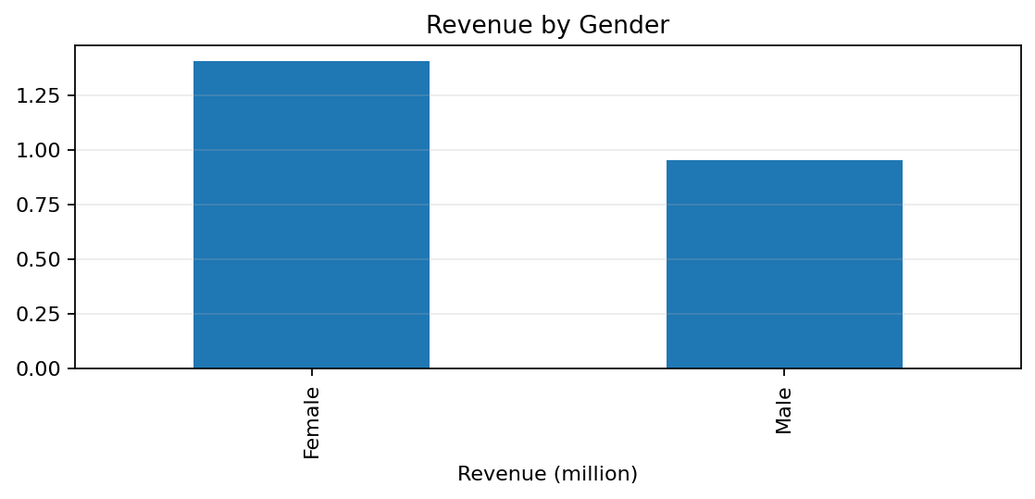
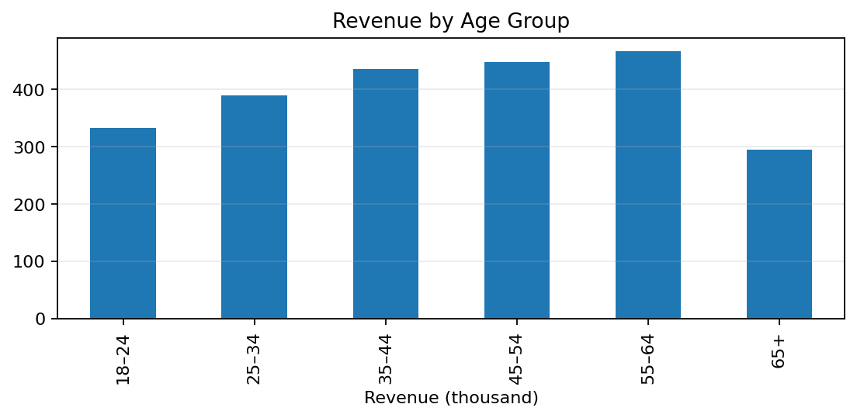
Customer & Age Insights
Interpretation from dashboard visuals
Female customers contribute about ₹150M vs ₹101M for male customers in the dashboard.
The 55–64 age group has the highest displayed revenue (~₹50M).
The 35–44 age group has the largest shopping distribution (~19.4K invoices).

Slide 4
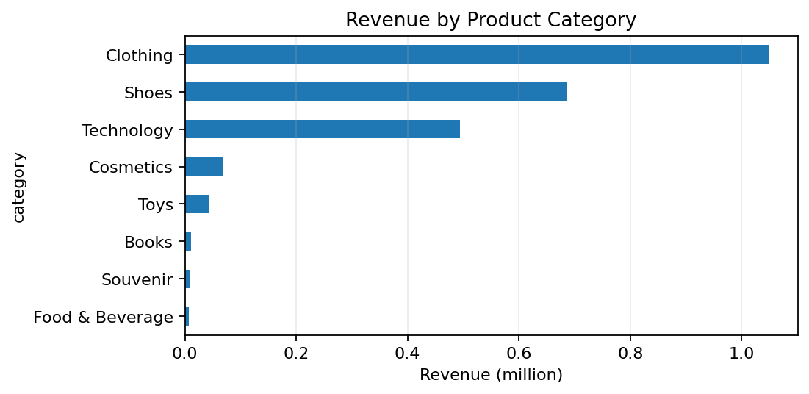
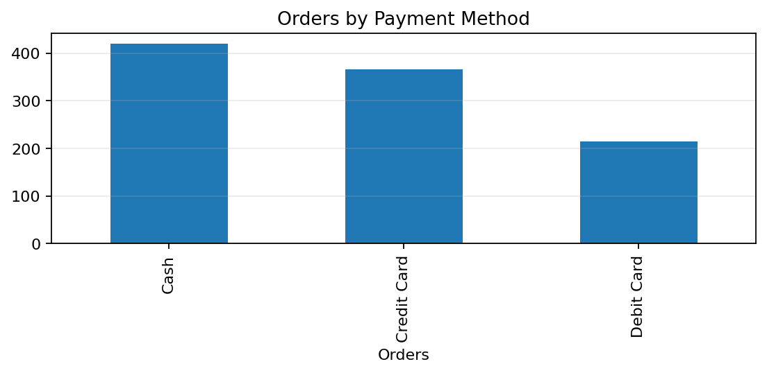
Product & Payment Insights
Revenue and payment patterns from the dashboard
Clothing leads revenue at about ₹114M; Shoes (~₹67M) and Technology (~₹50M) follow.
Cash is the most-used payment method and contributes about ₹113M revenue.
Maintain stock in leading categories and keep checkout options convenient.

Slide 5
Business Recommendations
Actions suggested by the dashboard insights
Inventory: prioritise Clothing, Shoes and Technology; monitor stock-outs and category-level sell-through.
Marketing: test targeted offers for female customers and the 55–64 age group.
Payments: maintain Cash convenience while making card payments simple and secure.
Measurement: track revenue, quantity, orders and average order value together.
Dashboard: use slicers to validate each insight by date, mall and customer segment.

Slide 6
CONCLUSION
The dashboard identifies clear customer, category and payment patterns.
Use the insights to guide stock planning and targeted promotions.

