Slide 1
JOB MARKET ANALYSIS
PRDA-04 | Insights & Recommendations
742 job postings • 343 companies • 60 industries
PRDA-04 | 1

Slide 2
Dataset at a Glance
742
Job postings
343
Companies
60
Industries
10
Job-title groups
$101.5K
Average salary
Dataset size: 742 rows and 42 columns.
Average minimum estimate: $74.8K; average maximum estimate: $128.2K.
Average company rating, excluding unavailable -1 values: 3.69/5.
Salary estimates are expressed in thousands of US dollars (USD $K).
PRDA-04 | 2

Slide 3
Where Are the Jobs?
Job postings are concentrated in a small number of states.
California (CA) leads with 152 postings.
Massachusetts (MA) has 103 postings; New York (NY) has 72.
CA, MA and NY together represent 44.1% of all records.
Recommendation: prioritize sourcing and employer outreach in these markets, while reviewing talent availability and competition in other states.
PRDA-04 | 3

Slide 4
Industries & Employers
Top groups based on the number of records in the supplied dataset.
TOP INDUSTRIES
Biotech & Pharmaceuticals: 112 postings
Insurance Carriers: 63 postings
Computer Hardware & Software: 59 postings
IT Services: 50 postings
Health Care Services & Hospitals: 49 postings
TOP COMPANIES
MassMutual: 14 postings
Reynolds American: 14 postings
Takeda Pharmaceuticals: 14 postings
Software Engineering Institute: 11 postings
Liberty Mutual Insurance: 10 postings
PRDA-04 | 4

Slide 5
Most Common Job Titles
Grouped title categories in the dataset.
data scientist: 313 postings
other scientist: 143 postings
data engineer: 119 postings
analyst: 101 postings
machine learning engineer: 22 postings
Data scientist project manager: 16 postings
Insight
Data Scientist alone accounts for 42.2% of all postings.
Recommendation: tailor candidate development and recruitment messaging to the most common role families.
PRDA-04 | 5

Slide 6
Salary Insights
Use average salary measures for fair comparisons.
Overall average estimated salary: $101.5K.
Average lower estimate: $74.8K; average upper estimate: $128.2K.
CA average salary: $123.5K; average lower/upper estimates: $92.4K / $154.6K.
Machine Learning Engineer average: $126.4K (22 records).
Recommendation: compare salary by location and role, and interpret averages for low-volume titles cautiously.
PRDA-04 | 6

Slide 7
Skills & Education Indicator
Skill flags indicate whether a skill is marked as required in a posting.
MOST REQUIRED SKILLS
Python: 392 postings (52.8%)
excel: 388 postings (52.3%)
sql_: 380 postings (51.2%)
aws: 176 postings (23.7%)
spark: 167 postings (22.5%)
AVERAGE SALARY BY DEGREE INDICATOR
P (PhD indicator): $116.0K average, 107 postings
M (Master's indicator): $105.6K average, 252 postings
Unknown / not specified: $94.7K average, 383 postings
Caution: this is a job-description indicator, not employee education attainment.
PRDA-04 | 7

Slide 8
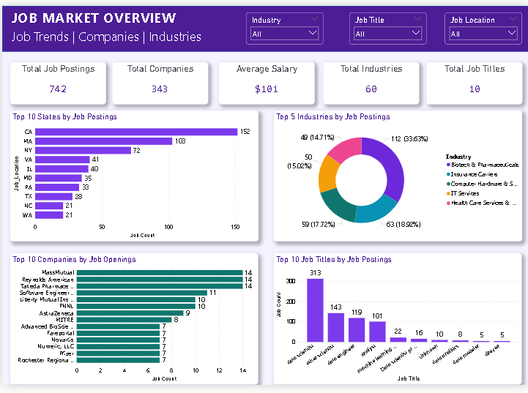
Power BI Dashboard — Page 1
Job Market Overview
PRDA-04 | 10

Slide 9
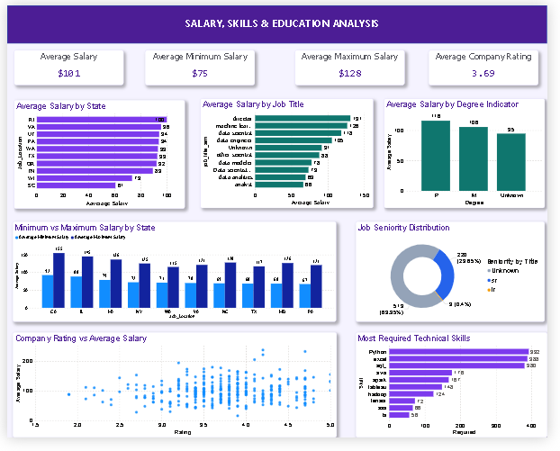
Power BI Dashboard — Page 2
Salary, Skills & Education Analysis
PRDA-04 | 11

Slide 10
Conclusion
The dataset contains 742 job-posting records across 343 companies.
Job postings are concentrated in CA, MA and NY, and Data Scientist is the most common grouped title.
Python, Excel and SQL are the leading skill flags in the dataset.
Salary comparisons are useful when average measures and clear USD ($K) labels are used.
Data gaps—especially unknown seniority and degree indicators—should be considered when making decisions.
PRDA-04 | 12

