Slide 1
STARTUP PROFIT ANALYSIS
PRDA–01 | Regression Analysis & Power BI Dashboard
Dataset: 50 startups • New York, Florida & California

Slide 2
1. Problem Understanding
How do R&D, Administration and Marketing spending relate to startup profit?
Analyze profit across three states: New York, Florida and California.
Explore spending-versus-profit patterns for R&D, Administration and Marketing.
Use regression analysis to estimate profit from spending inputs.
Communicate findings and business recommendations through Power BI.

Slide 3
2. Dataset Overview
The assignment brief describes 50 startup records.
R&D Spend — investment in research and development.
Administration — administration-related spending.
Marketing Spend — investment in marketing activities.
State — startup location.
Profit — target variable to be explained or predicted.

Slide 4
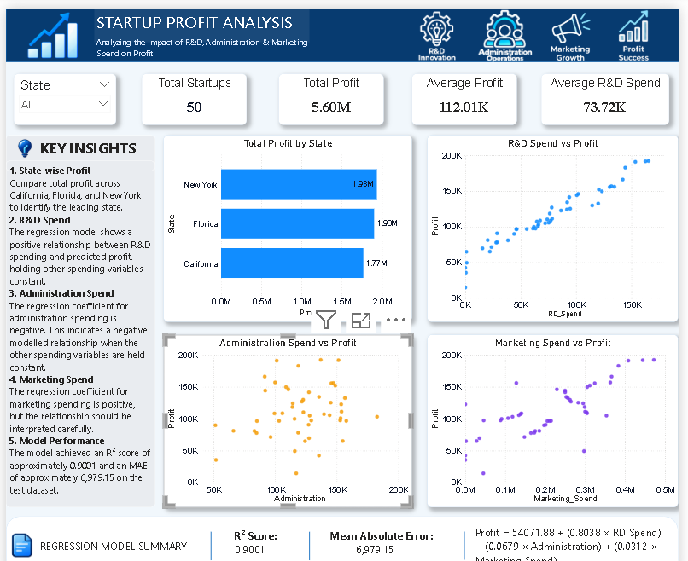
3. Power BI Dashboard
Dashboard screenshot supplied for PRDA–01

Slide 5
4. Key Results & Insights
Values below are read from the supplied dashboard.
Total Startups
50
Total Profit
5.60M
Average Profit
112.01K
Average R&D Spend
73.72K
State-wise profit: New York ≈ 1.93M; Florida ≈ 1.90M; California ≈ 1.77M.
R&D and Marketing scatter plots show generally positive associations with profit.
The dashboard's visible regression summary shows a negative Administration coefficient.
R² = 0.9001; MAE = 6,979.15 (as displayed).

Slide 6
5. Recommendations
Increase R&D investment to support innovation and profitability.
Optimize administration expenses to improve cost efficiency.
Monitor marketing spending and evaluate its return on investment.
Compare state-wise profits to identify business opportunities.
Use regression analysis to support better financial decisions.

Slide 7
6. Conclusion
This project analyzed the relationship between R&D, Administration, Marketing spending, and startup profit. The regression model achieved an R² score of 0.9001. The analysis indicates that effective spending management and data-driven decisions can help businesses improve profitability

