Slide 1
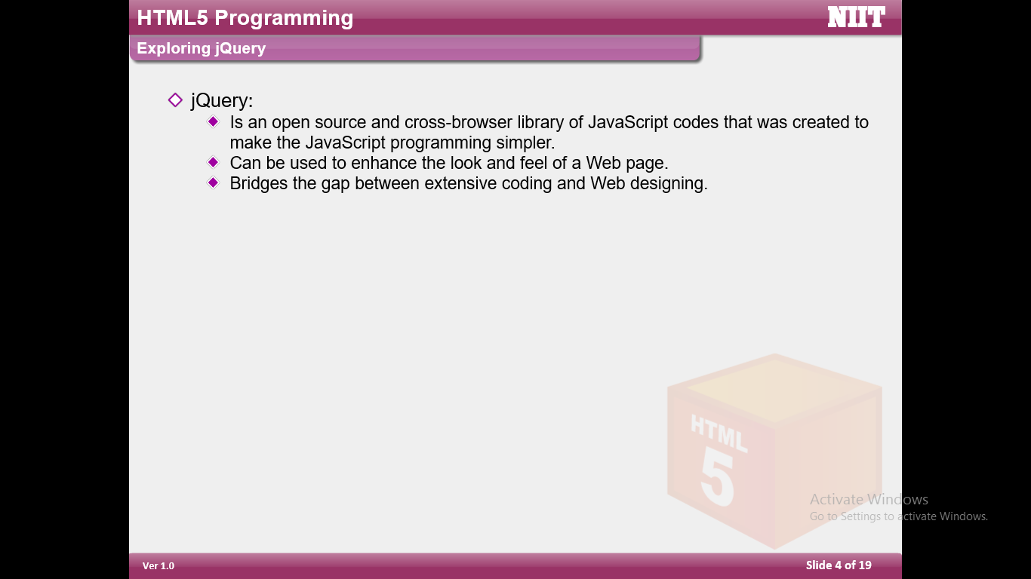

Slide 2
jQuery is a lightweight, "write less, do more", JavaScript library.
The purpose of jQuery is to make it much easier to use JavaScript on your website.
jQuery takes a lot of common tasks that require many lines of JavaScript code to accomplish, and wraps them into methods that you can call with a single line of code.
jQuery also simplifies a lot of the complicated things from JavaScript, like AJAX calls and DOM manipulation.

Slide 3
Advantages of jQuery −
DOM manipulation − The jQuery made it easy to select DOM elements, negotiate them and modifying their content by using cross-browser open source selector engine called Sizzle.
Event handling − The jQuery offers an elegant way to capture a wide variety of events, such as a user clicking on a link, without the need to clutter the HTML code itself with event handlers.
AJAX Support − The jQuery helps you a lot to develop a responsive and featurerich site using AJAX technology.
Animations − The jQuery comes with plenty of built-in animation effects which you can use in your websites.
Lightweight − The jQuery is very lightweight library - about 19KB in size (Minified and gzipped).
Cross Browser Support − The jQuery has cross-browser support, and works well in IE 6.0+, FF 2.0+, Safari 3.0+, Chrome and Opera 9.0+
Latest Technology − The jQuery supports CSS3 selectors and basic XPath syntax.

Slide 4
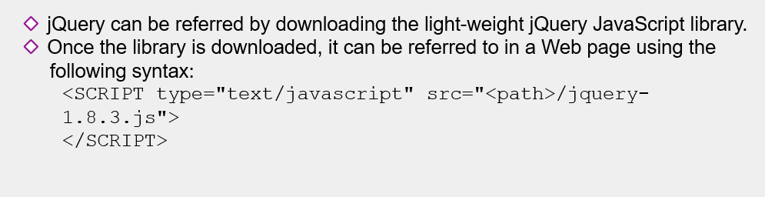

Slide 5
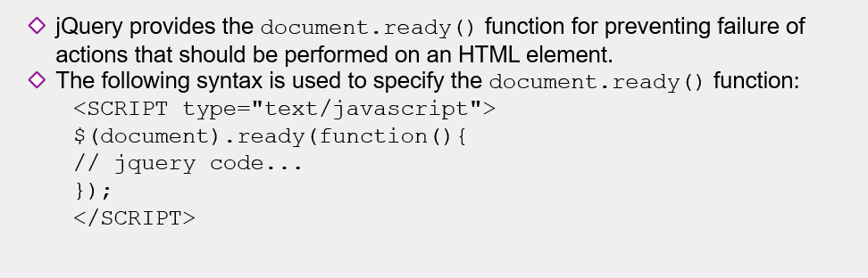

Slide 6
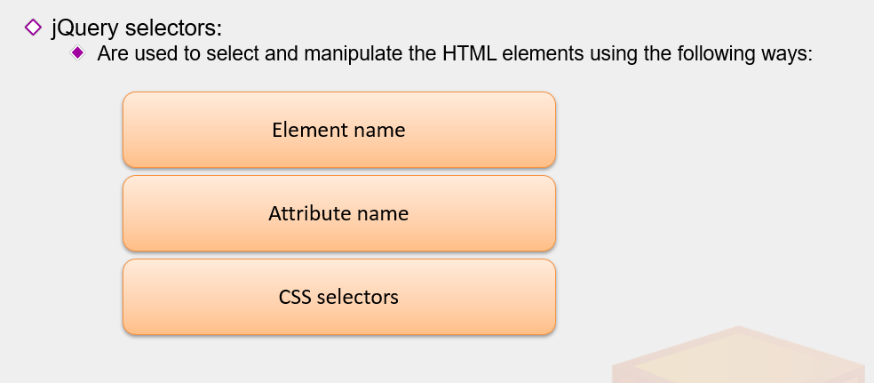

Slide 7
jQuery Syntax :-
The jQuery syntax is tailor-made for selecting HTML elements and performing some action on the element(s).
Basic syntax is: $(selector).action()
A $ sign to define/access jQuery
A (selector) to "query (or find)" HTML elements
A jQuery action() to be performed on the element(s)
Examples:
$(this).hide() - hides the current element.
$("p").hide() - hides all <p> elements.
$(".test").hide() - hides all elements with class="test".
$("#test").hide() - hides the element with id="test".

Slide 8
$("*") :- Selects all elements
Exa:-
$(document).ready(function(){
$("button").click(function(){
$("*").hide();
});
});
$(this) :- Selects the current HTML element
Exa:-
$(document).ready(function(){
$("button").click(function(){
$(this).hide();
});
});

Slide 9
$("p.ss") :- Selects all <p> elements with class=“ss“
Exa:-
$(document).ready(function(){
$("button").click(function(){
$("p.ss").hide();
});
});
$("p:first") :- Selects the first <p> element
Exa:-
$(document).ready(function(){
$("button").click(function(){
$("p:first").hide();
});
});

Slide 10
$("ul li:first") :- Selects the first <li> element of the first <ul>
Exa:-
$(document).ready(function(){
$("button").click(function(){
$("ul li:first").hide();
});
});
$("ul li:first-child") :- Selects the first <li> element of every <ul>
Exa:-
$(document).ready(function(){
$("button").click(function(){
$("ul li:first-child").hide();
});
});

Slide 11
$("[href]") :- Selects all elements with an href attribute
Exa:-
$(document).ready(function(){
$("button").click(function(){
$("[href]").hide();
});
});
$("a[target='_blank']") :- Selects all <a> elements with a target attribute value equal to "_blank“
Exa:-
$(document).ready(function(){
$("button").click(function(){
$("a[target='_blank']").hide();
});
});

Slide 12
$("a[target!='_blank']") :- Selects all <a> elements with a target attribute value NOT equal to "_blank“
Exa:-
$(document).ready(function(){
$("button").click(function(){
$("a[target!='_blank']").hide();
});
});
$("tr:even") :- Selects all even <tr> elements
Exa:-
$(document).ready(function(){
$("tr:even").css("background-color", "yellow");
});
$("tr:odd") :- Selects all odd <tr> elements
Exa:-
$(document).ready(function(){
$("tr:odd").css("background-color", "yellow");
});

Slide 13
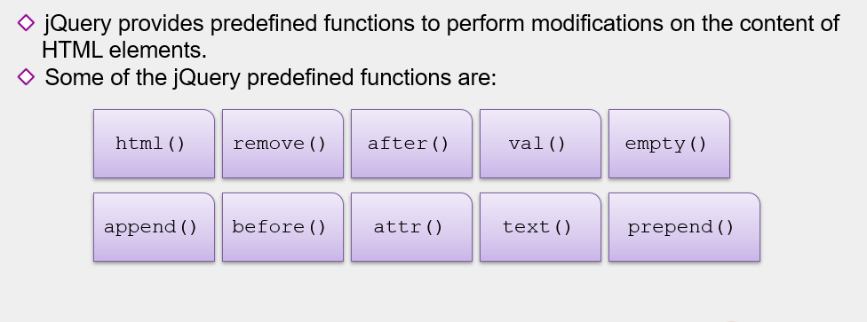

Slide 14
Html() :-Sets or returns the content of selected elements
$("button").click(function(){ $("p").html("Hello <b>world</b>!"); });
Val():-Sets or returns the value attribute of the selected elements
$("button").click(function(){ $("p").val("Hello world"); });
Empty():-Removes all child nodes and content from selected elements
$("button").click(function(){ $(“div").empty(); });
Remove():-Removes the selected elements
$("button").click(function(){ $(“div").remove(); });

Slide 15
After():-Inserts content after selected elements
$("button").click(function(){ $("p").after("<p>Hello world!</p>"); });
Before():-Inserts content before selected elements
$("button").click(function(){
$("p").before("<p>Hello world!</p>");
});
Append():-Inserts content at the end of selected elements.
$("#btn1").click(function(){
$("p").append(" <b>Appended text</b>.");
});
$("#btn2").click(function(){
$("ol").append("<li>Appended item</li>");
});

Slide 16
Prepend():- Inserts content at the beginning of selected elements
$("#btn1").click(function(){
$("p").prepend("<b>Prepended text</b>. ");
});
$("#btn2").click(function(){
$("ol").prepend("<li>Prepended item</li>");
});
Attr():-Sets or returns attributes/values of selected elements
$("button").click(function(){
$("img").attr("width", "500");
});
Text():-Sets or returns the text content of selected elements
$("button").click(function(){ $("p").text("Hello world!"); });

Slide 17
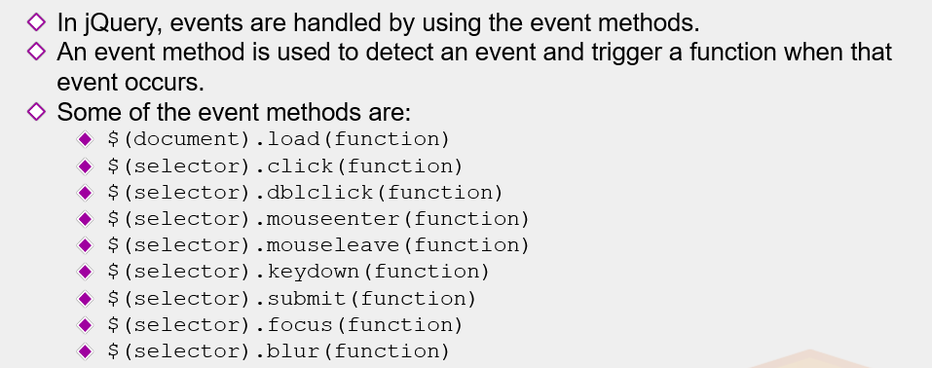

Slide 18
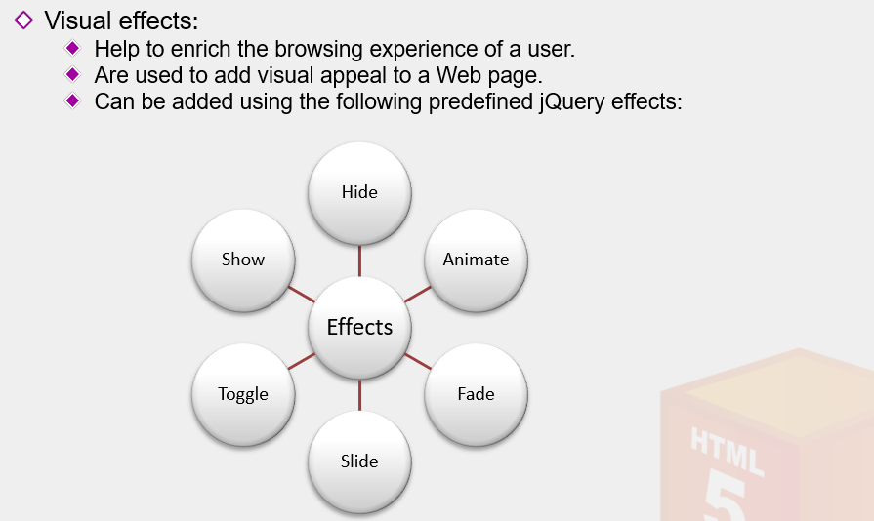

Slide 19
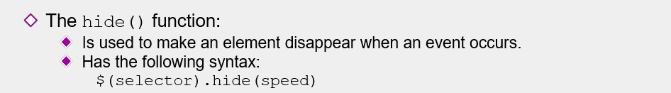
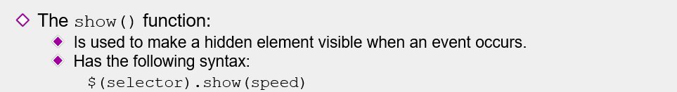
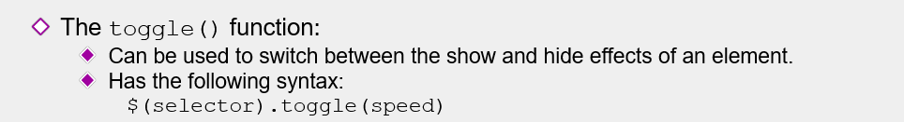

Slide 20
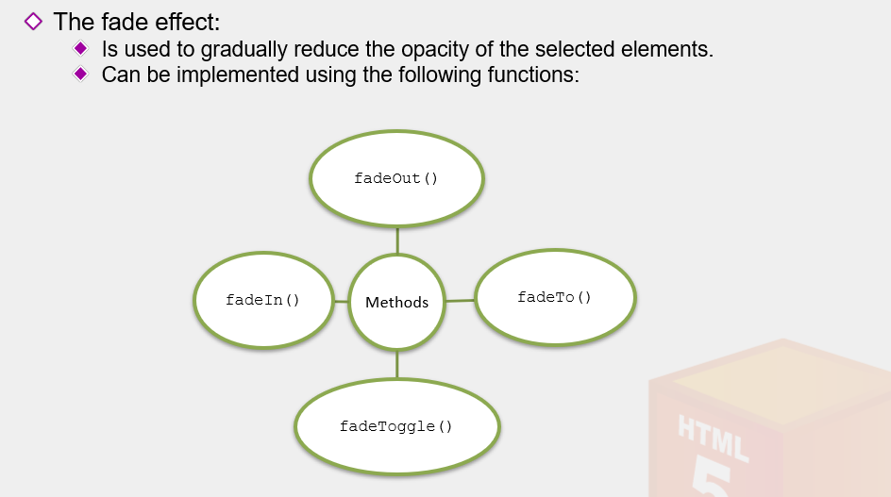

Slide 21
jQuery hide() and show() :-
With jQuery, you can hide and show HTML elements with the hide() and show() methods:
Exa:-
$("#hide").click(function(){ $("p").hide(); }); $("#show").click(function(){ $("p").show(); });
jQuery toggle() :-
You can also toggle between hiding and showing an element with the toggle() method.
$("button").click(function(){ $("p").toggle(); });

Slide 22
jQuery Fading Methods :-
With jQuery you can fade an element in and out of visibility.
jQuery has the following fade methods:
fadeIn()
fadeOut()
fadeToggle()
fadeTo()
jQuery fadeIn() Method :-
The jQuery fadeIn() method is used to fade in a hidden element.
$("button").click(function(){ $("#div1").fadeIn(); $("#div2").fadeIn("slow"); $("#div3").fadeIn(3000); });

Slide 23
jQuery fadeOut() Method :-
The jQuery fadeOut() method is used to fade out a visible element.
$("button").click(function(){ $("#div1").fadeOut(); $("#div2").fadeOut("slow"); $("#div3").fadeOut(3000); });
jQuery fadeToggle() Method :-
The jQuery fadeToggle() method toggles between the fadeIn() and fadeOut() methods.
If the elements are faded out, fadeToggle() will fade them in.
If the elements are faded in, fadeToggle() will fade them out.
$("button").click(function(){ $("#div1").fadeToggle(); $("#div2").fadeToggle("slow"); $("#div3").fadeToggle(3000); });

Slide 24
jQuery fadeTo() Method :-
The jQuery fadeTo() method allows fading to a given opacity (value between 0 and 1)
$("button").click(function(){ $("#div1").fadeTo("slow", 0.15); $("#div2").fadeTo("slow", 0.4); $("#div3").fadeTo("slow", 0.7); });
jQuery Sliding Methods :-
With jQuery you can create a sliding effect on elements.
jQuery has the following slide methods:
slideDown()
slideUp()
slideToggle()
jQuery slideDown() Method :-
The jQuery slideDown() method is used to slide down an element.

Slide 25
<script>
$(document).ready(function(){
$("#flip").click(function(){
$("#panel").slideDown("slow");
});
});
</script>
<style>
#panel, #flip {
padding: 5px;
text-align: center;
background-color: red;
border: solid 1px blue;
}
#panel {
padding: 50px;
display: none;
}
</style>
</head>
<body>
<div id="flip">Click to slide down panel</div>
<div id="panel">Hello world!</div>
</body>

Slide 26
jQuery slideUp() Method :-
The jQuery slideUp() method is used to slide up an element.
<script>
$(document).ready(function(){
$("#flip").click(function(){
$("#panel").slideUp("slow");
});
});
</script>
<style>
#panel, #flip {
padding: 5px;
text-align: center;
background-color: red;
border: solid 1px blue;
}
#panel {
padding: 50px;
}
</style>
</head>
<body>
<div id="flip">Click to slide up panel</div>
<div id="panel">Hello world!</div>

Slide 27
jQuery slideToggle() Method :-
The jQuery slideToggle() method toggles between the slideDown() and slideUp() methods.
If the elements have been slid down, slideToggle() will slide them up.
If the elements have been slid up, slideToggle() will slide them down.
<script>
$(document).ready(function(){
$("#flip").click(function(){
$("#panel").slideToggle("slow");
});
});
</script>
<style>
#panel, #flip {
padding: 5px;
text-align: center;
background-color: red;
border: solid 1px blue;
}
#panel {
padding: 50px;
display: none;
}
</style>
</head>
<body>
<div id="flip">Click to slide the panel down or up</div>
<div id="panel">Hello world!</div>
</body>

Slide 28
jQuery Animations - The animate() Method :-
The jQuery animate() method is used to create custom animations.
1.
<script>
$(document).ready(function(){
$("button").click(function(){
$("div").animate({left: '250px'});
});
});
</script>
</head>
<body>
<div style="background-color:red;height:100px;width:100px;position:absolute;"></div>

Slide 29
2.
<script>
$(document).ready(function(){
$("button").click(function(){
$("div").animate({
left: '250px‘,
height: '150px',
width: '150px'
});
});
});
</script>
<div style="background-color:red;height:100px;width:100px;position:absolute;"></div>
3.
$("button").click(function(){ var div = $("div"); div.animate({height: '300px'}, "slow"); div.animate({width: '300px'}, "slow"); div.animate({height: '100px'}, "slow"); div.animate({width: '100px'}, "slow");
div.animate({fontSize: ‘40px'}, "slow"); });

Slide 30
jQuery stop() Method :-
The jQuery stop() method is used to stop an animation or effect before it is finished.
<script>
$(document).ready(function(){
$("#flip").click(function(){
$("#panel").slideDown(5000);
});
$("#stop").click(function(){
$("#panel").stop();
});
});
</script>
<style>
#panel, #flip {
text-align: center;
background-color: #555;
color: white;
border: solid 1px #666;
}
#panel {
display: none;
}
</style>
</head>
<body>
<button id="stop">Stop sliding</button>
<div id="flip">Click to slide down panel</div>
<div id="panel">Hello world!</div>
</body>

Slide 31
jQuery Callback Functions :-
A callback function is executed after the current effect is finished.
$("button").click(function(){ $("p").hide("slow", function(){ alert("The paragraph is now hidden"); }); });
Example without Callback :-
$("button").click(function(){ $("p").hide(1000); alert("The paragraph is now hidden"); });

Slide 32
jQuery Method Chaining :-
Chaining allows us to run multiple jQuery methods (on the same element) within a single statement.
<script>
$(document).ready(function(){
$("button").click(function(){
$("#p1").css("color", "red").slideUp(2000).slideDown(2000);
});
});
</script>
</head>
<body>
<p id="p1">jQuery is fun!!</p>
<button>Click me</button>

Slide 33
jQuery Manipulating CSS :-
jQuery has several methods for CSS manipulation. We will look at the following methods:
addClass() - Adds one or more classes to the selected elements
removeClass() - Removes one or more classes from the selected elements
toggleClass() - Toggles between adding/removing classes from the selected elements
css() - Sets or returns the style attribute

Slide 34
jQuery addClass() Method :-
add class attributes to different elements. you can select multiple elements, when adding classes:
$("button").click(function(){ $("h1, h2, p").addClass("blue"); });
jQuery removeClass() Method :-
remove a specific class attribute from different elements:
$("button").click(function(){ $("h1, h2, p").removeClass("blue"); });

Slide 35
jQuery toggleClass() Method :-
This method toggles between adding/removing classes from the selected elements:
$("button").click(function(){ $("h1, h2, p").toggleClass("blue"); });
jQuery css() Method :-
The css() method sets or returns one or more style properties for the selected elements.
1. $("button").click(function(){
$("p").css("background-color"));
});
2. $(document).ready(function(){
$("button").click(function(){
$("p").css({"background-color": "yellow", "font-size": "200%"});
});
});

Slide 36
jQuery width() and height() Methods :-
The width() method sets or returns the width of an element .
The height() method sets or returns the height of an element.
$("button").click(function(){ $("#div1").width(500).height(500); });
jQuery Traversing :-
jQuery traversing, which means "move through", are used to "find" (or select) HTML elements based on their relation to other elements. Start with one selection and move through that selection until you reach the elements you desire.
The image below illustrates an HTML page as a tree (DOM tree). With jQuery traversing, you can easily move up (ancestors), down (descendants) and sideways (siblings) in the tree, starting from the selected (current) element. This movement is called traversing - or moving through - the DOM tree.

Slide 37
jQuery Traversing - Ancestors :-
Traversing Up the DOM Tree
Three useful jQuery methods for traversing up the DOM tree are:
parent()
parents()
parentsUntil()
jQuery parent() Method :-
The parent() method returns the direct parent element of the selected element.
This method only traverse a single level up the DOM tree.
The following example returns the direct parent element of each <span> elements:
$(document).ready(function(){ $("span").parent(); });

Slide 38
<style>
.d11 * {
display: block;
border: 2px solid lightgrey;
color: lightgrey;
padding: 5px;
margin: 15px;
}
</style>
<script>
$(document).ready(function(){
$("span").parent().css("background-color“, "yellow");
});
</script>

Slide 39
jQuery parents() Method :-
The parents() method returns all ancestor elements of the selected element, all the way up to the document's root element (<html>).
$(document).ready(function(){ $("span").parents(); });
jQuery parentsUntil() Method :-
The parentsUntil() method returns all ancestor elements between two given arguments.
$(document).ready(function(){ $("span").parentsUntil("div"). css("background-color“, "yellow");
});

Slide 40
jQuery Traversing - Descendants :-
With jQuery you can traverse down the DOM tree to find descendants of an element.
A descendant is a child, grandchild, great-grandchild, and so on.
Traversing Down the DOM Tree :-
Two useful jQuery methods for traversing down the DOM tree are:
children()
find()
jQuery children() Method :-
The children() method returns all direct children of the selected element.
This method only traverses a single level down the DOM tree.
$(document).ready(function(){ $("div").children(). css("background-color“, "yellow");
});

Slide 41
jQuery find() Method :-
The find() method returns descendant elements of the selected element, all the way down to the last descendant.
$(document).ready(function(){ $("div").find("span"). css("background-color“, "yellow");
});
jQuery Traversing - Siblings :-
siblings()
next()
nextAll()
nextUntil()
prev()
prevAll()
prevUntil()

Slide 42
jQuery Traversing - Filtering :-
First() :-
$(document).ready(function(){
$("div").first().css("background-color", "yellow");
});
last() :-
$(document).ready(function(){
$("div").last().css("background-color", "yellow");
});
eq() :-
$(document).ready(function(){
$("p").eq(1).css("background-color", "yellow");
});

Slide 43
filter() :-
$(document).ready(function(){
$("p").filter(".intro").css("background-color", "yellow");
});
not() :-
$(document).ready(function(){
$("p").not(".intro").css("background-color", "yellow");
});
The jQuery noConflict() Method :-
The noConflict() method releases the hold on the $ shortcut identifier.
$.noConflict(); jQuery(document).ready(function(){ jQuery("button").click(function(){ jQuery("p").text("jQuery is still working!"); }); });

