Slide 1
Health & Fitness Club
Membership Platform
Module 1 – Information Systems Foundations
Presentated By – Vishal Rathour

Slide 2
System Classification
How the Health & Fitness Club platform combines operational, managerial and analytical capabilities.
TPS
Daily transactions: member registration, membership purchase, payments and attendance.
CRM
Member profiles, plans, payment history and customer relationship information.
MIS
Management reports, KPIs and dashboards generated from operational data.
DSS
Supports decisions using churn rate, MRR, revenue trends and attendance analysis.
KMS
Captures and organizes operational and customer knowledge for management use.
AI Application
Future enhancement:
predictive churn analysis
and member recommendations.
2

Slide 3
IS Integration Flow
Operational data is transformed into management information and decision-support insights.
Members
Plans
Payments
Attendance
TPS
Transaction Processing
CRM
Member Management
MIS
Reports & KPIs
DSS
Churn & MRR
Business
Decisions
KMS
Organizational knowledge
AI (Future)
Predictive analytics
3

Slide 4
Enterprise Framework
A layered view connecting business processes, data, applications, technology and security.
Membership Management • Customer Management • Payments • Attendance • Reporting
BUSINESS LAYER
Members • Plans • Payment_History • Attendance
DATA LAYER
CRM • MIS • DSS • Power BI Dashboard
APPLICATION LAYER
MySQL • Power BI • Web / Application • Payment Gateway
TECHNOLOGY LAYER
Authentication • RBAC • Encryption • Backup & Recovery • Payment Security
SECURITY LAYER
Members • Staff • Managers • Administrators
END USERS
4

Slide 5
Module 1 – Key Takeaways
The classification establishes the role of the platform within the organization’s information-system landscape.
1
TPS captures accurate day-to-day membership, payment and attendance transactions.
2
CRM centralizes member and membership information.
3
MIS converts operational data into structured management reports and KPIs.
4
DSS enables analytical decision support through Churn Rate, MRR and trend analysis.
5
KMS preserves operational knowledge; AI can be introduced later for predictive analytics.
Overall: An integrated CRM/MIS platform with DSS capabilities for data-driven fitness-club management.
5

Slide 6
SDLC Model Selection – Agile
Agile is selected for iterative development, continuous feedback and incremental delivery.
Agile SDLC is selected because the platform contains multiple interconnected modules such as member management, membership plans, payments, attendance, dashboards and analytical reporting. Agile supports iterative development, continuous feedback and flexible requirements.
Iterative Development
Develop the platform in small, manageable increments.
Continuous Feedback
Use feedback from users, management and project stakeholders.
Flexible Requirements
Add or modify KPIs, reports and features as requirements evolve.
Early Testing
Test each increment before moving to the next sprint.
Faster Delivery
Prioritize important modules and deliver usable features earlier.
Selected Model: AGILE SDLC • Incremental + Feedback-Driven + Flexible
1

Slide 7
Agile SDLC – Project Implementation
How Agile sprints will be applied to the Health & Fitness Club Membership Platform.
Requirements
Sprint Planning
Design & Development
Testing
Review & Feedback
Improvement
↺ Next Sprint / Continuous Improvement
Sprint | Main Deliverable
Sprint 1 | Member & Plan Management
Sprint 2 | Payment & Membership Processing
Sprint 3 | Attendance Management
Sprint 4 | MIS Dashboard & Reports
Sprint 5 | DSS – Churn Rate & MRR
Sprint 6 | Security, Testing & Final Improvements
2

Slide 8
Context Diagram – Level 0 DFD
Information exchange between external entities and the Health & Fitness Club Membership Platform
MEMBER
PAYMENT GATEWAY
Registration • Membership • Payment Request
Payment Request
HEALTH & FITNESS CLUB
MEMBERSHIP PLATFORM
Confirmation • Receipt • Status
Confirmation • Transaction Status
Member / Plan / Attendance / Payment Updates
Report / Analytics Request
Single System Process • External Entities • Named Data Flows
ADMIN / STAFF
MANAGEMENT
Records • Attendance • Reports
Revenue • Churn • MRR • Attendance
3

Slide 9
Level 1 Data Flow Diagram – Health & Fitness Club Membership Platform
Member Data
1.0 Member Management
D1 – Members
MEMBER
Registration / Update
PAYMENT GATEWAY
Plan Data
Payment Request
2.0 Plan Management
D2 – Plans
Plan Data
Member Data
Payment Confirmation
3.0 Payment Processing
5.0 Analytics & Reporting
D3 – Payment_History
4.0 Attendance Management
Payment Data
Reports / KPIs
ADMIN / STAFF
MANAGEMENT
D4 – Attendance
Attendance Data

Slide 10
SQL Analytics & Revenue Analysis
Integrated into the project to connect database queries with management KPIs.
SQL • DATA ANALYTICS • POWER BI

Slide 11
EXECUTIVE SUMMARY
Project Overview
OBJECTIVE
DATA MODEL
ANALYTICS
Analyze gym membership data and convert it into decision-ready KPIs for management.
Members, Plans, Member_Plans, Payment_History and Attendance form the core relational structure.
Queries cover membership mix, revenue, MRR, engagement, churn risk and member-level actions.
DATA → SQL → KPI → DECISION
01
Validate
02
Transform
03
Measure
04
Act
Check records & structure
Join & classify
Revenue & engagement
Retention & dashboard

Slide 12
DATA MODEL
Relational Database Architecture
MEMBERS
PLANS
PAYMENT_HISTORY
PK member_id
PK plan_id
PK payment_id
full_name
plan_name
FK member_id
email
duration_months
FK plan_id
gender
monthly_fee
payment_date
date_of_birth
description
amount
city
payment_method
join_date
payment_status
status
MEMBER_PLANS
ATTENDANCE
PK membership_id
PK attendance_id
FK member_id
FK member_id
FK plan_id
attendance_date
start_date
check_in_time
end_date
check_out_time
membership_status

Slide 13
01 • FOUNDATION
Data Validation Queries
-- Source data volume
SELECT COUNT(*) AS total_records
FROM gym_membership_raw;
-- Main membership data volume
SELECT COUNT(*) AS total_records
FROM gym_membership;
-- Sample records
SELECT *
FROM gym_membership
LIMIT 10;
-- Plan distribution
SELECT
abonoment_type AS plan_name,
COUNT(*) AS total_members
FROM gym_membership
GROUP BY abonoment_type;

Slide 14
02 • CUSTOMER BASE
Membership & Plan Analysis
-- Total members
SELECT COUNT(*) AS total_members
FROM Members;
-- Gender distribution
SELECT gender, COUNT(*) AS total_members
FROM Members
GROUP BY gender;
-- Members by plan
SELECT p.plan_name,
COUNT(mp.member_id) AS total_members
FROM Member_Plans mp
JOIN Plans p ON mp.plan_id = p.plan_id
GROUP BY p.plan_name;
TOTAL MEMBERS
GENDER MIX
PLAN MIX
COUNT(*)
GROUP BY gender
JOIN + GROUP BY plan

Slide 15
03 • FINANCIAL PERFORMANCE
Revenue & Payment Analysis
-- Revenue by payment method
SELECT
payment_method,
COUNT(*) AS total_payments,
SUM(amount) AS total_revenue
FROM Payment_History
GROUP BY payment_method;
-- Revenue by plan
SELECT
p.plan_name,
COUNT(ph.payment_id) AS total_payments,
SUM(ph.amount) AS total_revenue
FROM Payment_History ph
JOIN Plans p ON ph.plan_id = p.plan_id
GROUP BY p.plan_name;
MANAGEMENT QUESTION
DASHBOARD OUTPUT
Which payment channels and plans contribute to recorded revenue?
Revenue • Payments • Plan-wise Revenue • Payment Method Mix

Slide 16
04 • RECURRING REVENUE
Monthly Recurring Revenue (MRR)
SELECT
SUM(p.monthly_fee) AS MRR
FROM Member_Plans mp
JOIN Plans p
ON mp.plan_id = p.plan_id
WHERE mp.membership_status = 'Active'
AND CURDATE() BETWEEN mp.start_date AND mp.end_date;
MRR LOGIC
WHY IT MATTERS
POWER BI KPI
Active memberships × monthly fee
Separates recurring revenue logic from historical payment totals.
Use MRR as a headline financial KPI alongside total revenue.

Slide 17
Revenue Details & Financial KPIs
Payment_History → Revenue Analysis → MRR → Power BI
TOTAL REVENUE
TOTAL PAYMENTS
PLAN-WISE REVENUE
MRR
SUM(amount)
COUNT(payment_id)
SUM(amount) by plan
Σ active monthly_fee
Recorded revenue from Payment_History
Number of recorded payment transactions
Join Payment_History with Plans
Active memberships × monthly fee
Revenue by payment method
COUNT(*) + SUM(amount) GROUP BY payment_method
Revenue by plan
JOIN Plans + SUM(amount) GROUP BY plan_name
MRR
SUM(monthly_fee) for Active memberships within dates
POWER BI REVENUE VIEW
• Revenue KPI / Total Revenue
• MRR KPI
• Plan-wise Revenue chart
• Payment Method Mix
• Revenue trend using payment_date

Slide 18
05 • BEHAVIOUR
Member Engagement Segmentation
SELECT
CASE
WHEN visit_per_week = 0 THEN 'No Visit'
WHEN visit_per_week = 1 THEN 'Low Engagement'
WHEN visit_per_week BETWEEN 2 AND 3 THEN 'Moderate Engagement'
ELSE 'High Engagement'
END AS engagement_level,
COUNT(*) AS total_members
FROM gym_membership
GROUP BY
CASE
WHEN visit_per_week = 0 THEN 'No Visit'
WHEN visit_per_week = 1 THEN 'Low Engagement'
WHEN visit_per_week BETWEEN 2 AND 3 THEN 'Moderate Engagement'
ELSE 'High Engagement'
END
ORDER BY total_members DESC;
ACTIONABLE OUTPUT

Slide 19
06 • RETENTION
Churn Risk & Churn Rate
-- Churn-risk segmentation
SELECT
CASE
WHEN visit_per_week <= 1 THEN 'High Risk'
WHEN visit_per_week = 2 THEN 'Medium Risk'
ELSE 'Low Risk'
END AS churn_risk_level,
COUNT(*) AS total_members
FROM gym_membership
GROUP BY
CASE
WHEN visit_per_week <= 1 THEN 'High Risk'
WHEN visit_per_week = 2 THEN 'Medium Risk'
ELSE 'Low Risk'
END;
-- Engagement-based churn-risk rate
SELECT
ROUND(
100.0 * SUM(
CASE WHEN visit_per_week <= 1 THEN 1 ELSE 0 END
) / NULLIF(COUNT(*),0), 2
) AS churn_rate_pct
FROM gym_membership;
This rate represents engagement-based churn risk; confirmed cancellation data is not present in the source query.
DEFINITION

Slide 20
07 • COMPARATIVE ANALYSIS
Plan-Level Engagement
SELECT
abonoment_type AS plan_name,
ROUND(AVG(visit_per_week), 2) AS avg_visits_per_week,
MIN(visit_per_week) AS minimum_visits,
MAX(visit_per_week) AS maximum_visits,
COUNT(*) AS total_members
FROM gym_membership
GROUP BY abonoment_type;
AVG VISITS
RANGE
MEMBER COUNT
Average weekly visits by plan
Minimum → maximum weekly visits
Plan-level population size

Slide 21
08 • OPERATIONAL USE
Actionable Member Lists
LOW-ENGAGEMENT MEMBERS
TOP ENGAGED MEMBERS
Filter:
visit_per_week <= 1
Use for:
• retention outreach
• reminders
• re-engagement campaigns
Sort:
ORDER BY visit_per_week DESC
LIMIT 10
Use for:
• recognition
• referrals
• testimonials
SELECT
id AS member_id,
gender,
abonoment_type AS plan_name,
visit_per_week,
avg_time_check_in
FROM gym_membership
ORDER BY visit_per_week DESC
LIMIT 10;

Slide 22
09 • KPI MAPPING
SQL → Power BI Dashboard
TOTAL MEMBERS
COUNT(*) FROM Members
PLAN MIX
Member_Plans + Plans
TOTAL REVENUE
SUM(amount) FROM Payment_History
MRR
Active memberships × monthly fee
ENGAGEMENT
visit_per_week classification
CHURN RISK
High / Medium / Low segments
CHURN RATE
High-risk members ÷ total members × 100

Slide 23
10 • QUALITY CONTROL
SQL Implementation Checklist
01
Duplicate Members INSERT
Keep one member-loading INSERT to avoid duplicate rows.
02
Duplicate Primary Key ALTER
Do not add a second primary key to Member_Plans when membership_id is already PK.
03
MRR Definition
Use active memberships × monthly fee for recurring revenue.
04
Churn Rate
Calculate a percentage from the defined high-risk population.
05
Normalized + Raw Data
Use normalized tables for relational KPIs and gym_membership for source behavioural analysis.

Slide 24
POWER BI DASHBOARD
Executive Overview
Management dashboard built from the membership, payment and engagement model in the project PBIX.
TOTAL MEMBERS
TOTAL REVENUE
PREMIUM MEMBERS
STANDARD MEMBERS
HIGH-RISK MEMBERS
1,000
₹3.99M
493
507
194
Membership Plan Mix
Revenue by Membership Plan
Gender Distribution
Premium 493
Premium
Female
Standard 507
Standard
Male
Member Engagement Analysis
Potential Churn Risk Analysis
Revenue by Payment Method
High Engagement
Digital / Online
Moderate
High Risk
Medium Risk
Low Risk
Other
Low
High-risk members: 194
Total recorded revenue: ₹3.99M

Slide 25
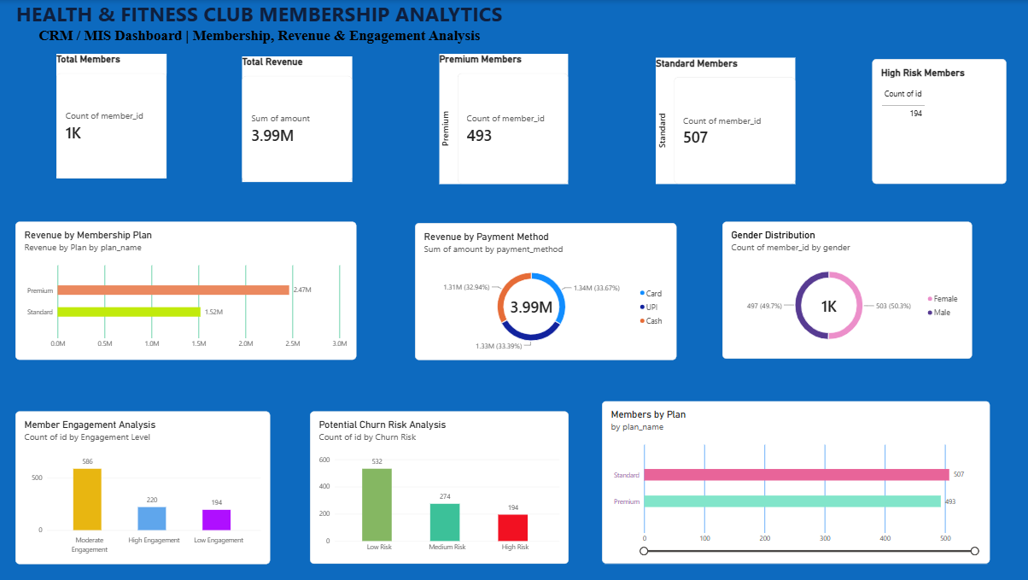

Slide 26
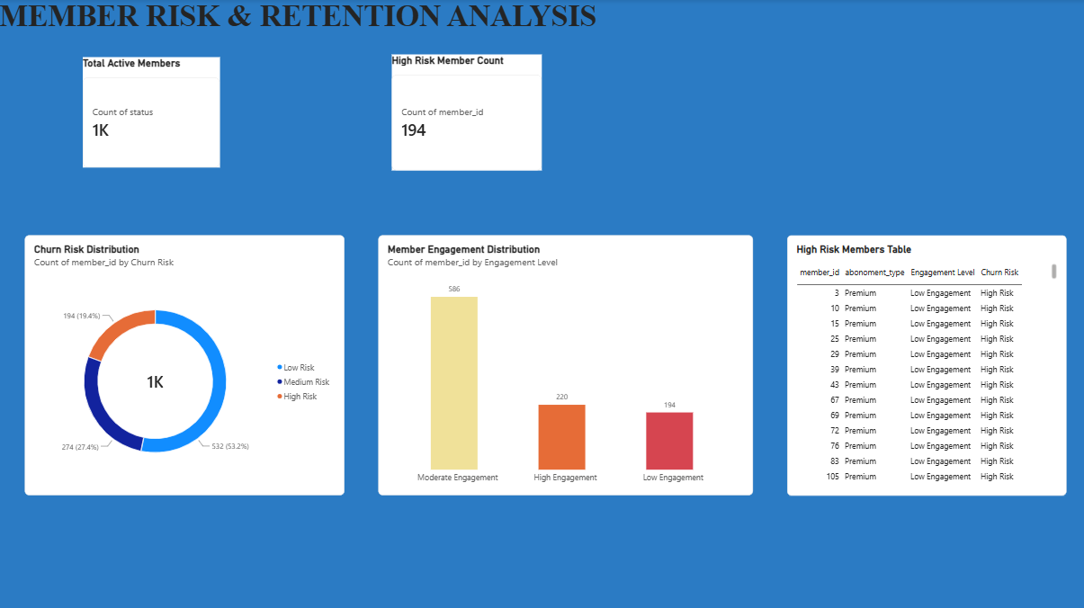

Slide 27
PROJECT TAKEAWAYS
A complete SQL-to-dashboard
analytics workflow
The project connects database structure, business queries and management KPIs into one presentation-ready analytical workflow.
DATA
SQL
KPI
ACTION
Validated source & relational tables
Business-focused analytical queries
Revenue, MRR, engagement & churn
Retention & dashboard decisions

Slide 28
Module 4 – Technology Adoption Model
Health & Fitness Club Membership Platform
1. Awareness
Users learn about the platform
2. Interest
Users explore features and benefits
3. Evaluation
Users assess ease, security and usefulness
4. Trial
Users try registration, plans, payment or attendance
5. Adoption
Users start using the platform regularly
6. Regular Use
Members and staff use digital features in daily operations
Key User Groups
Members
Registration • Plan Selection • Online Payment • Attendance
Admin / Staff
Member Management • Plan Management • Payment Verification • Attendance
Management
Dashboard • Revenue • Churn Rate • MRR • Attendance Analytics

Slide 29
Module 4 – E-Payment Integration
Secure membership payment and transaction recording flow
MEMBER
MEMBERSHIP PLAN
PAYMENT GATEWAY
PAYMENT VERIFICATION
PAYMENT
CONFIRMATION
Plan Selection
Payment Request
Transaction Status
Receipt / Status
Verified Transaction
PAYMENT PROCESSING
Transaction Data
D3 – Payment_History
Payment Security
System Output
• Secure payment gateway communication
Successful payment → Payment record → Membership confirmation / receipt
• Transaction status verification
• Payment record maintained in Payment_History
• Confirmation / receipt after successful payment

Slide 30
Module 4 – Security Architecture
Security controls for the Health & Fitness Club Membership Platform
MEMBER / ADMIN
AUTHENTICATION
AUTHORIZATION
SECURE APPLICATION
DATABASE
Key Security Controls
1
Authentication
Username/password or secure login
2
Role-Based Access Control
Different permissions for Member, Admin/Staff and Management
3
Data Encryption
Protect sensitive information during storage and transmission
4
Payment Security
Secure payment gateway and transaction verification
5
Database Access Control
Restrict direct database access to authorized applications/users
6
Backup & Recovery
Maintain backups and recovery procedures
7
Audit Logs
Record important login, payment and administrative activities

Slide 31
Module 4 – Adoption Curve
Technology adoption journey for the Health & Fitness Club Membership Platform
1. Awareness
2. Interest
3. Evaluation
4. Trial
5. Adoption
6. Regular Use
Key User Groups
Members
Registration, plan selection, payment, attendance
Admin / Staff
Member, plan, payment and attendance management
Management
Dashboard, revenue, churn, MRR and attendance analysis

Slide 32
Module 4 – Process Map
End-to-end digital membership process
1. Member Registration
2. Plan Selection
3. E-Payment
4. Payment Verification
5. Membership Activation
6. Attendance Tracking
7. Dashboard & Reports
System Records / Outputs
• Member profile and membership status
• Payment transaction stored in Payment_History
• Attendance records maintained
• Management dashboard: Revenue, Churn Rate, MRR & Attendance

Slide 33
MODULE 5
Data Privacy
●
Protecting member, payment and operational information
SECURE • TRUSTED • CONTROLLED
Data Privacy Framework
Data Collection
Access Control
Secure Storage
Responsible Use
01
Collect only information required for membership, payment and attendance.
02
03
Protect member records and payment-related data using secure storage.
04
Use role-based permissions for Members, Admin/Staff and Management.
Use data only for legitimate club operations, reporting and agreed purposes.
Key Privacy Practices
Member Personal Data
Payment Information
Name, contact details, membership and attendance information should be accessed only by authorized users.
Use secure payment processing; store transaction records appropriately and avoid unnecessary sensitive payment details.
Data Minimization
Monitoring & Accountability
Do not collect or retain information that is not needed for the stated business purpose.
Maintain access/audit records for important administrative and payment activities.
Backup & Recovery
Consent & Transparency
Maintain controlled backups so important records can be restored after accidental loss or system failure.
Inform users about how their information is collected and used, and obtain required consent.
HEALTH & FITNESS CLUB
SECURE DATA | TRUSTED MEMBERS | STRONGER COMMUNITY
YOUR PRIVACY MATTERS

Slide 34
Module 5 – Cybercrime Mitigation
Health & Fitness Club Membership Platform
Cyber Threat → Security Control → Protected Asset
PHISHING
UNAUTHORIZED ACCESS
PAYMENT FRAUD
MALWARE / DATA LOSS
Fake links / messages
Stolen or weak credentials
Invalid or manipulated transactions
Malicious software or system failure
Protection Architecture
User / Staff
Authentication
Role-Based
Access
Secure
Application
Database &
Payments
Core Mitigation Controls
1
Secure Login
2
Least Privilege
3
Payment Verification
Strong password practices and secure authentication.
Users receive only the permissions required for their role.
Confirm transaction status before updating payment records.
4
Database Protection
5
Backup & Recovery
6
Monitoring
Restrict access and protect member/transaction records.
Maintain controlled backups and recovery procedures.
Keep audit logs for critical login, payment and admin actions.

Slide 35
Cybersecurity Control Checklist
Recommended controls for the project system
CONTROL
IMPLEMENTATION IN THIS PROJECT
PURPOSE
Authentication
Strong passwords and secure login controls
Prevention
Authorization
Role-based permissions for Member / Admin / Management
Prevention
Payment Security
Secure gateway + transaction verification
Prevention
Data Security
Controlled database access and secure storage
Prevention
Backup
Regular controlled backups and recovery testing
Recovery
Audit Logs
Record important login, payment and admin events
Detection
Awareness
Train users to identify phishing and suspicious activity
Prevention
Incident Response
Identify → Contain → Report → Recover → Review
Response

Slide 36
Module 5 – Environmental & Ergonomic Audit
Workplace safety, employee comfort and responsible IT practices
Audit Areas
Workstation Ergonomics
Screen & Eye Comfort
Lighting & Ventilation
Chair height, desk position, monitor placement and comfortable working posture.
Viewing distance, screen position, brightness and regular visual breaks.
Adequate lighting, airflow and comfortable room conditions.
Electrical Safety
Energy Efficiency
E-Waste Management
Safe sockets, cables, power equipment and avoiding overloaded connections.
Use energy-efficient devices and switch off equipment when not required.
Separate obsolete electronics and use appropriate recycling/disposal channels.
Recommended Audit Checklist
☐ Workstations allow a comfortable, neutral sitting posture
☐ Monitor is positioned to reduce neck and eye strain
☐ Lighting and ventilation are adequate
☐ Electrical cables and connections are safely arranged
☐ Unused IT equipment is switched off or placed in power-saving mode
☐ Obsolete electronics are segregated for responsible e-waste handling
Audit objective: maintain a safe, comfortable and environmentally responsible digital workplace.

Slide 37
Environmental & Ergonomic Audit – Control Plan
Issue → Recommended Control → Expected Outcome
AUDIT ISSUE
RECOMMENDED CONTROL
EXPECTED OUTCOME
Poor sitting posture
Adjust chair and desk; maintain a neutral posture
Lower physical discomfort
Incorrect monitor position
Set monitor at a comfortable height and distance
Reduce neck and eye strain
Poor lighting / ventilation
Maintain suitable lighting and airflow
Improve workplace comfort
Unsafe cables / sockets
Organize cables; avoid overloaded connections
Reduce electrical hazards
Unnecessary power usage
Use energy-saving settings; switch off unused equipment
Reduce energy consumption
Improper e-waste disposal
Segregate obsolete electronics for appropriate recycling
Reduce environmental impact

Slide 38
Module 5 – Ethics Compliance Report
Ethical and responsible use of the Health & Fitness Club Membership Platform
Ethics Compliance Areas
Data Privacy & Confidentiality
Responsible IT Use
Access & Accountability
Protect member information and limit access to authorized users.
Use system resources only for legitimate club and business purposes.
Apply role-based permissions and maintain accountability for critical activities.
Cybersecurity
Payment Ethics
Environmental Responsibility
Use preventive controls, monitoring and incident-response practices.
Process transactions securely and maintain accurate payment records.
Promote energy efficiency, safe equipment use and responsible e-waste handling.
Ethical Principles Applied
• Privacy – respect and protect member information
• Security – reduce unauthorized access and cyber risk
• Transparency – communicate responsible data and system practices
• Accountability – record and review important system activities
• Fair Use – use information only for legitimate purposes
• Responsibility – consider user safety and environmental impact

Slide 39
Ethics Compliance Checklist
Project-level compliance review
ETHICS AREA
COMPLIANCE ACTION
STATUS
Data Privacy
Restrict access to member and payment-related information
Planned
Access Control
Use role-based permissions for Member, Admin/Staff and Management
Planned
Cybersecurity
Apply authentication, secure payments, monitoring and recovery controls
Planned
Payment Responsibility
Verify transaction status and maintain accurate Payment_History records
Planned
Auditability
Maintain logs for important login, payment and administrative activities
Planned
Environmental Responsibility
Follow safe workstation, energy-efficiency and e-waste practices
Planned
Compliance principle: protect people, information and systems while ensuring responsible, transparent and accountable use of technology.

Slide 40
Thank You!

