Slide 1
Neo4j
Sarvesh Nagarajan
Notes:
TODO: Perhaps add a picture here

Slide 2
Outline
What is Neo4j?
Graph Databases
Cypher
Application Domains

Slide 3

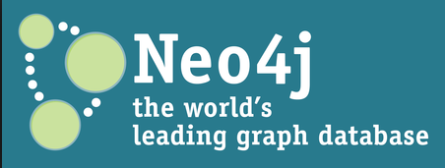
What is Neo4j
Developed by Neo Technologies
Most Popular Graph Database
Implemented in Java
Open Source
(www.neo4j.org)

Slide 4
Graph Databases
Database that uses graph structures with nodes, edges and properties to store data
Provides index-free adjacency
Every node is a pointer to its adjacent element
Edges hold most of the important information and connect
nodes to other nodes
nodes to properties
Notes:
TODO: Add pictures here

Slide 5
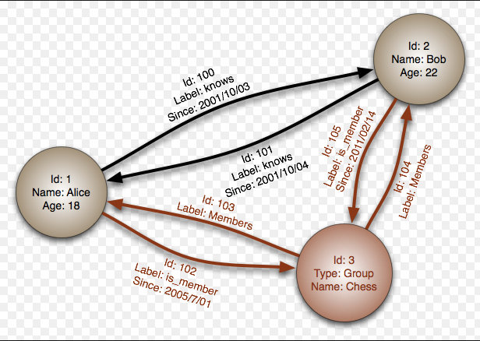
Graph Databases
(Wikipedia)

Slide 6
Advantage of Graph Databases
When there are relationships that you want to analyze Graph databases become a very nice fit because of the data structure
Graph databases are very fast for associative data sets
Like social networks
Map more directly to object oriented applications
Object classification and Parent->Child relationships

Slide 7
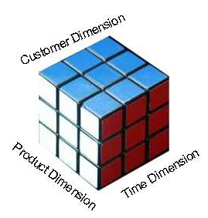
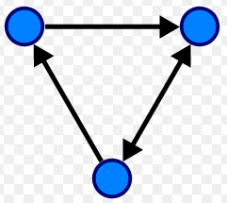
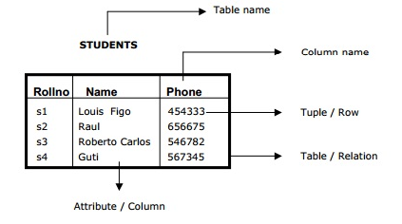
Disadvantages
If data is just tabular with not much relationship between the data, graph databases do not fare well
OLAP support for graph databases is not well developed
Lots of research happening in this area
Ease of aggregation

Slide 8
Salient features of Neo4j
Neo4j is schema free – Data does not have to adhere to any convention
ACID – atomic, consistent, isolated and durable for logical units of work
Easy to get started and use
Well documented and large developer community
Support for wide variety of languages
Java, Python, Perl, Scala, Cypher, etc
(Mistry, Deep, 2013)

Slide 9
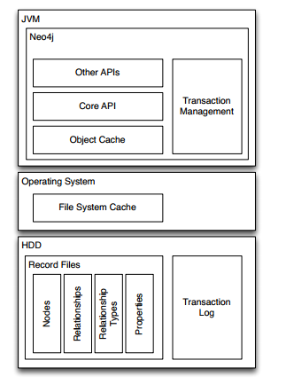
Neo4j Software Architecture
(Bachman, 2013, p.11)

Slide 10
Cypher
Query Language for Neo4j
Easy to formulate queries based on relationships
Many features stem from improving on pain points with SQL such as join tables
(Hunger, Michael 2013)

Slide 11
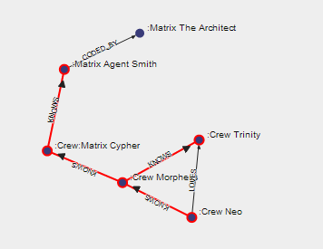
Cypher
(www.neo4j.org/learn/cypher)

Slide 12

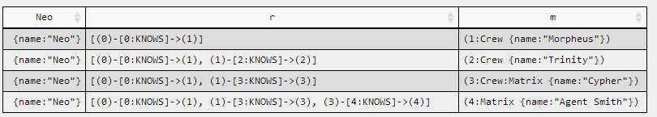
Cypher
(www.neo4j.org/learn/cypher)

Slide 13

Application Domains
(www.neo4j.org)

Slide 14
Conclusion
Key questions to ask yourself
Is my data going to have a lot of relationships?
What sort of questions would I like to ask my database?
Neo4j is a fantastic Graph Database

Slide 15
Questions?

Slide 16
References
http://www.neo4j.org
http://www.neo4j.org/learn/cypher
Bachman, Michal (2013). GraphAware: Towards Online Analytical Processing in Graph Databases
http://graphaware.com/assets/bachman-msc-thesis.pdf
Hunger, Michael (2012). Cypher and Neo4j
http://vimeo.com/83797381
Mistry, Deep (2013). Neo4j: A Developer’s Perspective
http://osintegrators.com/opensoftwareintegrators%7Cneo4jadevelopersperspective
Wikipedia (Neo4j, Graph Database)

