Slide 1
REACT WITH REDUX
State management made easy

Slide 2
Introduction to Redux
Module

Slide 3
What is Redux
By definition..
Not particularly tied to React
Can be used with React, Angular, Vue or even vanilla JavaScript
Library for JavaScript applications
“Redux is a predictable state container for JavaScript apps”

Slide 4
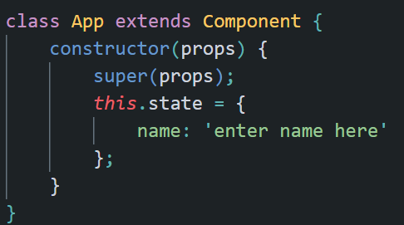
State
State…
The data and UI logic both together is the State of a component
The state of a React application is represented by the state of all individual components
Redux will store and manage this application state

Slide 5
Redux
Redux is a state container
It stores the state of your application
Predictable
The state of the application can change (such as from pending to completed)
All these state transitions are explicit in Redux and can be tracked
Hence the changes to the state of application predictable
That’s good because unpredictable changes might lead to inconsistent rendering and break the design too

Slide 6
React with Redux: Why?
Components in React have their own state
Why a third party library to manage state in React?

Slide 7
Typical Problem
Typically a large React application will have lots of components
In order share data between any two components you might need to lift the state up to the parent component
This becomes problematic when the component is pretty deep

Slide 8
Solution to The Problem
Use context API
Use useContext and useReducer hooks
Redux came at a time (August 2015) when these solutions were unavailable

Slide 9
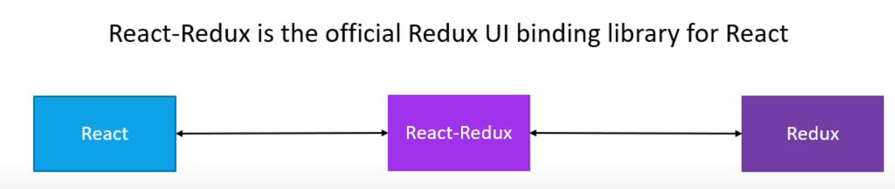
React+Redux
React-Redux is the library which provides bindings to use React and Redux together in an application

