Slide 1

React JS

Slide 2
State
Module

Slide 3
What is State?
It is an just an object
Maintained privately by the component within itself
Can influence what is rendered in the browser
Can be changed within the component

Slide 4
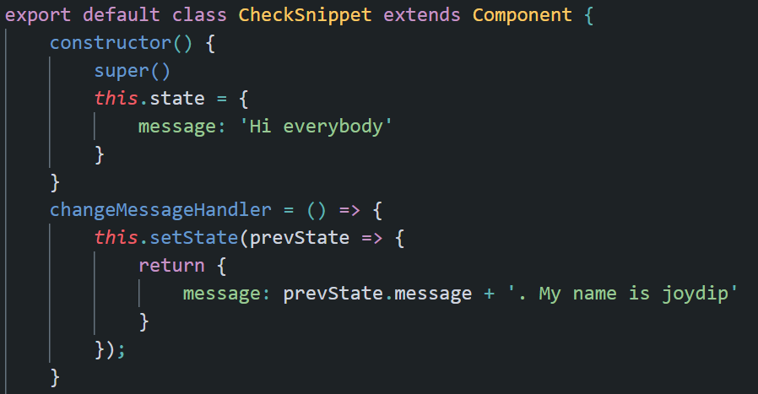
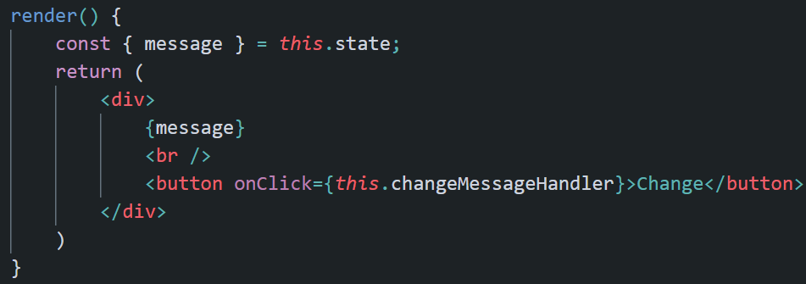
State Example

Slide 5
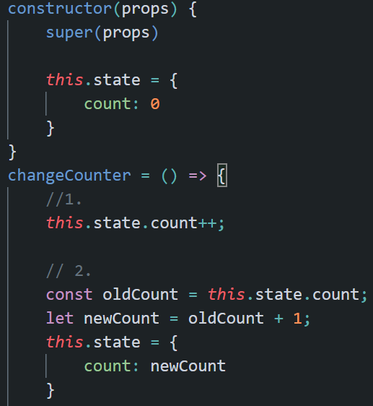
Problem with Manipulating state Directly
Manually changing state value should never be done manual modification does not notify React to re-render the component
So the UI data becomes unpredictable

Slide 6
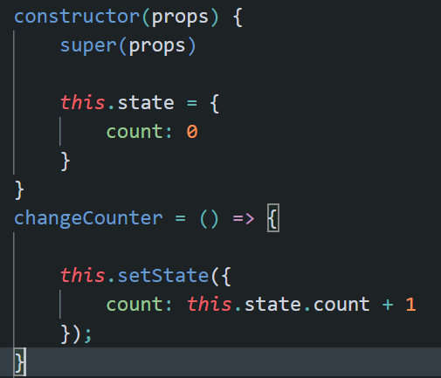
setState Method
Use setState method to update state of a component
Changes/updates the state value as well as notifies React to re-render the component

Slide 7
setState is Asynchronous
Be careful about the code you are writing involving accessing data after state change
If you want to use the changed value in the state immediately after the state has been updated, then don’t write the code after setState method, because that code will be synchronous and will not get the updated value

Slide 8
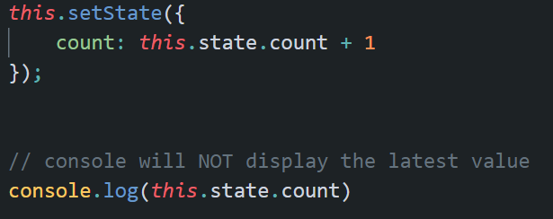
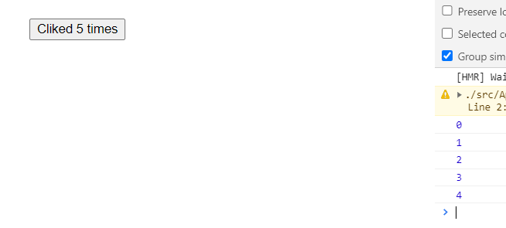
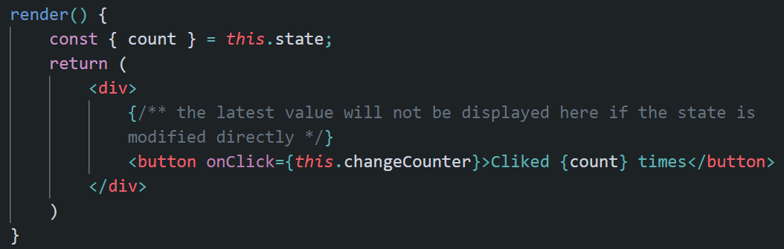
Result of Asynchronous Update of State

Slide 9
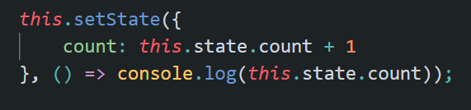
Solution to the Asynchronous Isue
Use the other version of setState function, where you pass a callback function
This function will be called right after state has been updated

Slide 10
Asynchronous Batch Update Issue
React may batch multiple setState() calls into a single update for better performance
Because props and state may be updated asynchronously, you should not rely on their values for calculating the next state

Slide 11
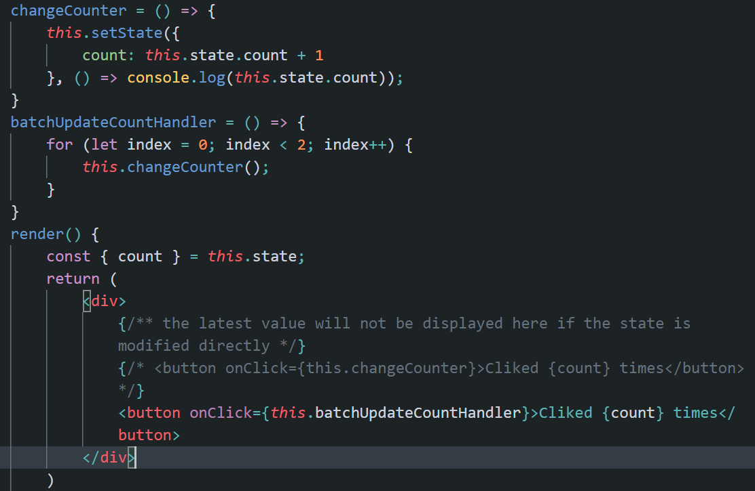
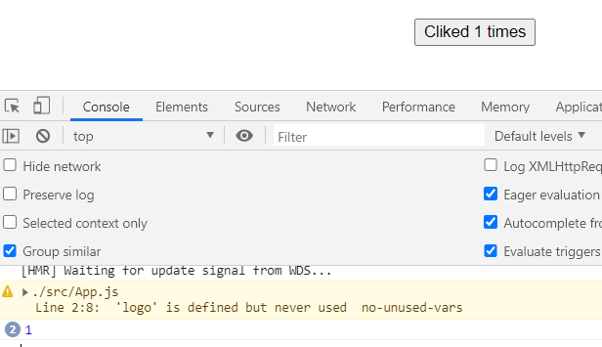
Asynchronous Batch Update Issue
Though setState has been used properly but still call to changeCounter twice displaying same result twice in the console and in the UI

Slide 12
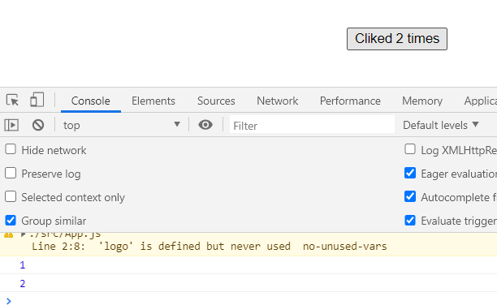
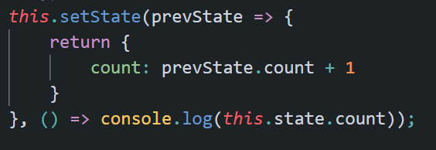
Solution to Asynchronous Issue
Use the other version of setState function, where previous state is passed as an argument.
You can use this previous state to calculate the next state

Slide 13
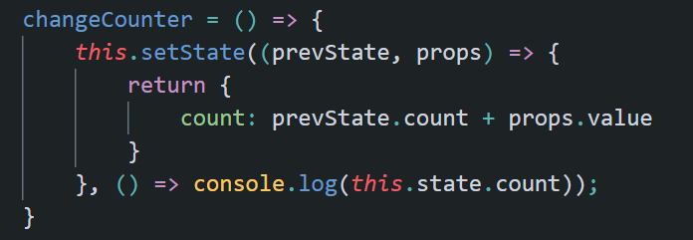
Props and State
You can use the other version of setState where you can pass previous state and previous props and use to calculate the next state value based on previous props and previous props, too

Slide 14
props vs state
props is passed to the component
It is like parameters which are passed to the function
Props are immutable, means they are owned by parent and can’t be modified by children
Functional component – “props”
Class component - “this.props”
State is managed within the component
It is like variable declared within the function body
State can be changed within the component since they are owned by the component it self
Functional component – useState hook
Class component – “this.state”

