Slide 1
Math for CP
- Srivaths P

Slide 2
Goal:
To learn:
Basic Modular Arithmetic
Why do we need modular arithmetic
GCD and LCM
Properties of GCD and LCM
OEIS

Slide 3
Modular Arithmetic
Modular Arithmetic is arithmetic operations involving taking the modulo with some modulus. It is usually given in problem statements so that the solution doesn’t overflow in case the answer is huge.
A few operations involving modulo are:
Addition
Subtraction
Multiplication
Division

Slide 4
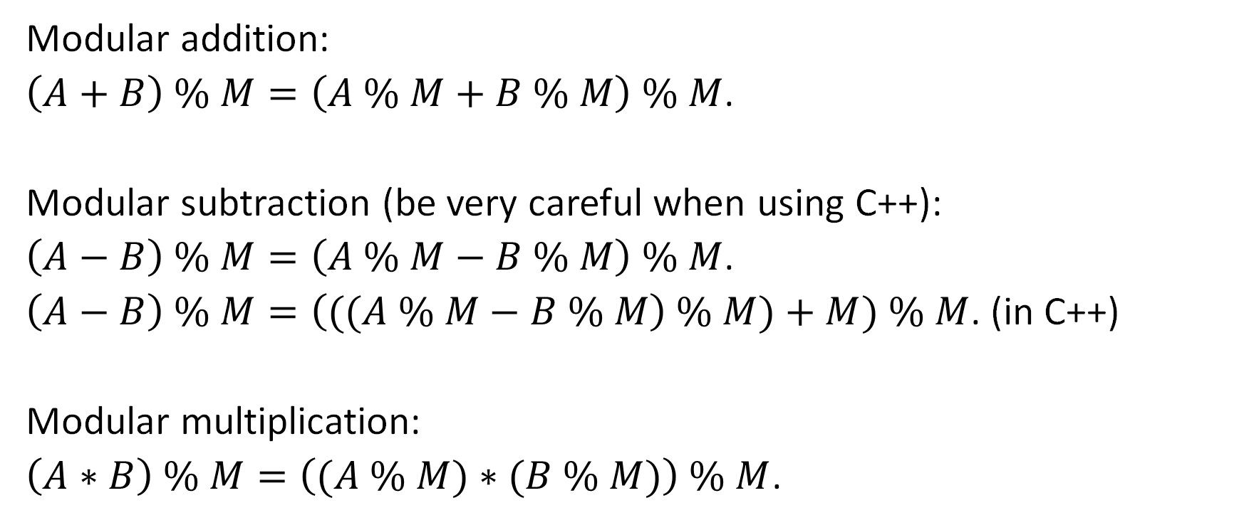
Modular Arithmetic
Modular addition:
$\left(A+B\right) \% M=\left(A \% M+B \% M\right) \% M$.
Modular subtraction (be very careful when using C++):
$\left(A−B\right) \% M=\left(A \% M−B \% M\right) \% M$.
$\left(A−B\right) \% M=\left(((A \% M−B \% M\right) \% M)+M) \% M$. (in C++)
Modular multiplication:
$\left(A∗B\right) \% M=\left((A \% M)∗(B \% M)\right) \% M$.

Slide 5
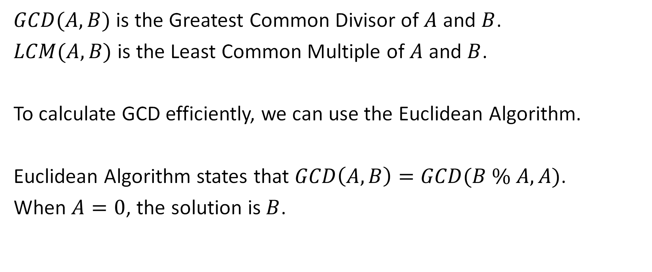
Greatest Common Divisor
$GCD(A, B)$ is the Greatest Common Divisor of $A$ and $B$.
$LCM(A, B)$ is the Least Common Multiple of $A$ and $B$.
To calculate GCD efficiently, we can use the Euclidean Algorithm.
Euclidean Algorithm states that $GCD\left(A, B\right)=GCD(B \% A, A)$.
When $A=0$, the solution is $B$.

Slide 6

Least Common Multiple
$LCM\left(A,B\right)$ can be calculated as
$$\frac{A×B}{GCD(A,B)}$$
(Only works for 2 numbers)

Slide 7
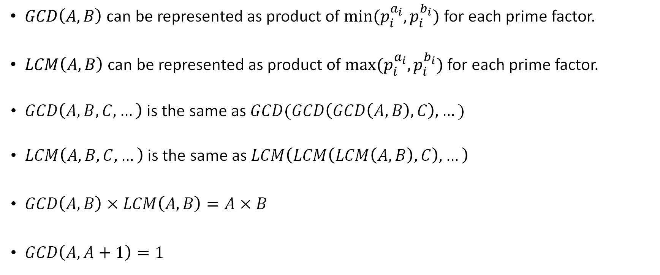
Properties of GCD / LCM
$GCD\left(A,B\right)$ can be represented as product of $min⁡(p_{i}^{a_{i}},p_{i}^{b_{i}})$ for each prime factor.
$LCM\left(A,B\right)$ can be represented as product of $max⁡(p_{i}^{a_{i}},p_{i}^{b_{i}})$ for each prime factor.
$GCD\left(A,B,C,…\right)$ is the same as $GCD(GCD\left(GCD\left(A, B\right), C\right), …)$
$LCM\left(A,B,C,…\right)$ is the same as $LCM\left(LCM\left(LCM\left(A, B\right), C\right), …\right)$
$GCD\left(A, B\right)×LCM\left(A, B\right)=A×B$
$GCD\left(A, A+1\right)=1$

Slide 8
OEIS - Online Encyclopedia of Integer Sequences
Link: https://oeis.org/
OEIS can be used to find the formula of an integer sequence with just the first few values (which could be computed using brute-force or manually by hand).

