Slide 1
Recursion
Srivaths P Profile: https://sriv.bio.link/

Slide 2
Goal:
Understand recursion
Understand and create recursive trees
Understand applications of recursion
Assess time complexity of recursive algorithms

Slide 3
Recap on Functions
A function is a block of code which runs the code inside with the parameters it is given.
Syntax:
int add(int a, int b) { return a + b; }

Slide 4
What is Recursion?
Recursion happens when a function calls itself on a different set of input parameters.
Used when the solution for current problem involves first solving a smaller sub-problem.
Example: factorial(N) = factorial(N-1) * N

Slide 5
Recursive Function
A function that calls itself is a recursive function
Example:
The above function will find the sum from 0 to the given parameter.
int sum_0_to_n(int n) {
if (n <= 0) return 0;
return sum_0_to_n(n-1) + n;
}

Slide 6
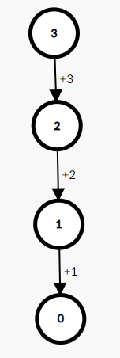
Recursive Tree
A recursive tree is similar to a “mind map” of the function call. Each node/vertex is the function call. Value inside the node is the parameter.
Recursive tree of previous example for n = 3
Recursive trees are useful to help us understand how the function acts.

Slide 7
Basic Structure of a Recursive Function
Parameters to start the function
Appropriate base case(s) to end the recursion
Recursively solve the sub-problems
Process the result and return the value

Slide 8
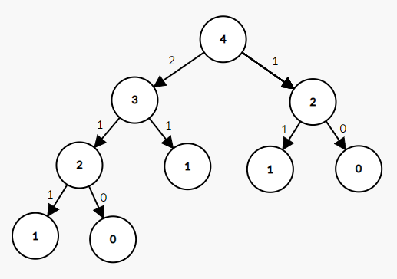
Tougher example:
Fibonacci function:
Recursive tree:
int fib(int n) { if (n == 0) return 0; if (n == 1) return 1; return fib(n-1) + fib(n-2); }

Slide 9
When do we need recursion?
Recursion is usually used in complex situations where iteration is not feasible.
Brute-force
Backtracking
Dynamic Programming
Graph/Tree Problems
Etc.

Slide 10
Quiz 1
Write a recursive function to calculate the factorial of a number.
Write an infinite recursive function that prints the number of times it has run so far.
Print a number in binary recursively.

Slide 11
Time complexity of Recursion
Can be calculated as the number of recursive calls multiplied by additional complexity of the function.
Can also be thought of as sum of time complexity of each layer of the recursive tree.
If there’s a constant no. of children, then we can say that the T.C. is the no. of leaf nodes. T.C = O(no. children ^ (depth of the tree))

Slide 12
Example functions:
void recurse(int n) { if (n == 0) return; recurse(n-1); recurse(n-1); }
void recurse(int n) { if (n == 0) return; recurse(n-1); }
void recurse(int n) { if (n == 0) return; recurse(n/2); recurse(n/2); }
void recurse(int n) { if (n == 0) return; recurse(n/2); }

Slide 13
Quiz 2
Print all N numbers such that each value can be from 0 to K.
Given N coins, print all the values you can make with some combination of coins and sum <= given K.
What is the time complexity of:
void f(int n) { if (n == 0) return; if (n % 2 == 0) f(n/2); if (n % 2 == 1) f(n-1); }

Slide 14
Resources
https://bit.ly/39lNlVT (very detailed explanation)
https://codeforces.com/blog/entry/92031 (advanced)

