Slide 1
BANKING MANAGEMENT SYSTEM BY - VISHAL SALPE - DIPAK GUPTA

Slide 2
CHAPTER 1: INTRODUCTION
1.1 Existing System
The existing bank system is slow as every task is being performed by the human being and comparing the computer task speed with a computer is not fair. The complexity of this system is increased when an increase in the number of customers and with that there will be a number of transactions will be performed now everything needs to log in to a file for reference in the future which is simply not the kind of scenario we need at this time.
1.2 Need for System
The main purpose of this software is to simplify the tedious task of banking by providing this service in a user friendly environment.
It also aims at increasing the efficiency and reducing the drawback of existing manual banking process thus making it more convenient for the customers to do banking as when they require.
This project is supported by a well designed DBMS in which customers account information is integrated together.
A friendly is also provided so that required made by the user give correct result by accessing the information stored in the database

Slide 3
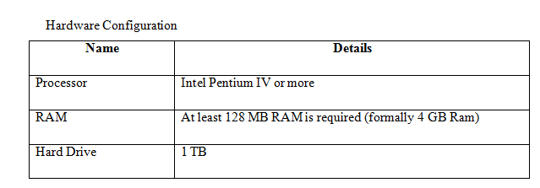
1.3 Operating Environment Hardware and Software At Server Side

Slide 4
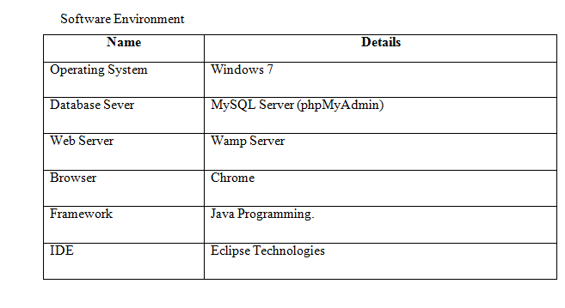

Slide 5
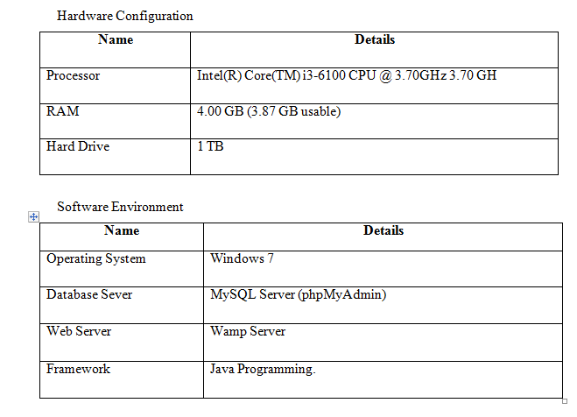
At Client Side

Slide 6
CHAPTER 2 : Proposed System
2.1 Proposed System (Introduction of system)
The bank management system is an application for maintaining a person's account in a bank the system provide the access to the customer to create an account deposit/withdraw the case from his account also to view report of all accounts present the following presentation provides the specification for the system.
2.2 Module specifications (Scope)
Customer Module: -This module allows users to Create account. View all the existing members .These are the main source of business for the bank.
Account Module: - This module allows every customer will become a customer when they open an account in the bank start depositing the money or take some other service. The account enables the customer to take advantage of the facilities provided by the bank. Every customer has their unique account number and the bank will identify you by only that account number.
Transaction Module: - This module allows every time an account holder performs some activity on the account it will be updated through transactions this is like logs but only showing the required details. Any time a customer makes any changes in an account like pay or deposit it will be through transactions. This helps in keeping the track of cash flow in the bank. Also, help in managing the correct information if there is some data loss to the bank side or if there is any query at the customer side.

Slide 7
Functional requirements
User basic graphical tool such as shapes objects, brushes, color tool, eraser etc.
Should allow free hand drawing, object shapes such as circle, ellipse, rectangle, and polygon.
Should allow the usage of different colors in the form of brushes, shapes, curves manage the picture with tool such as pencil, airbrush, clear all.
Non-Functional requirements
Must provide the program in vivid color and format.
Should have adaptable to allow of single module at time.
Must enable faster processing of operations when a module is selected.
Scope of the system
The scope of the Bank Management System extends to all the users who wish for easy banking facilities. This software product will be used for storing user’s account information and the transactions made by them.
2.3 Objectives of system
The aim of proposed system is to develop a system of improved facilities. The Proposed system can overcome all the limitations of the existing system. The System provides proper security and reduces the manual work.

Slide 8
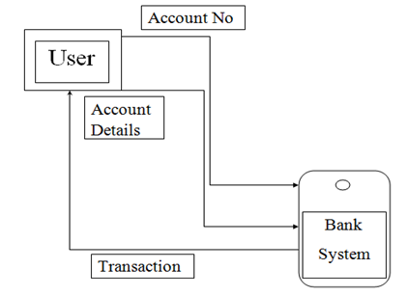
CHAPTER 3: ANALYSIS & DESIGN 3.1 0th Level DFD

Slide 9
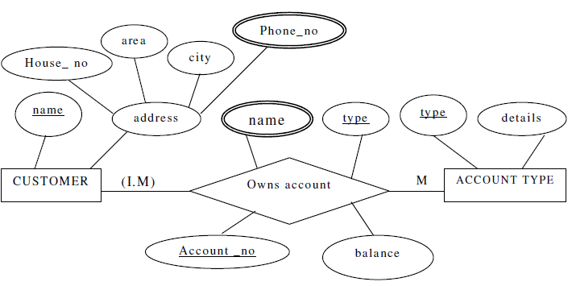
3.2 ERD (Entity Relationship Diagram)

Slide 10
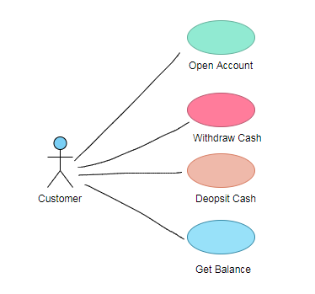
3.3 Use Case Diagrams

Slide 11
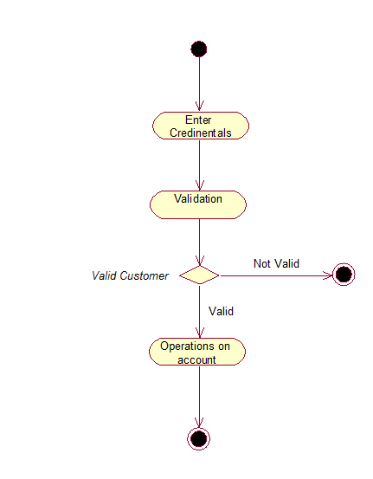
3.4 Activity Diagram

Slide 12
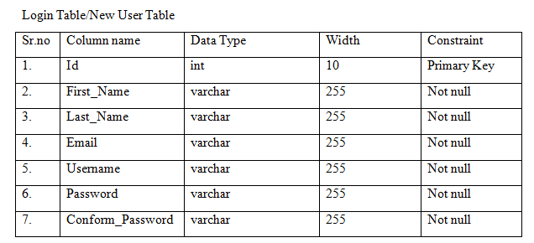
3.5 Table specifications (Database design)

Slide 13
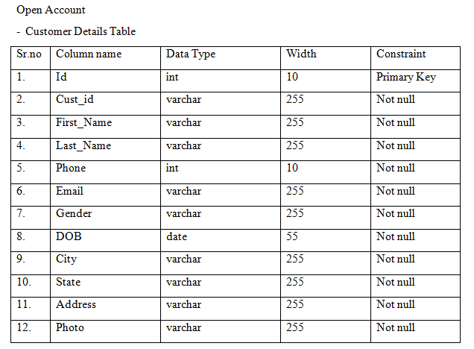

Slide 14
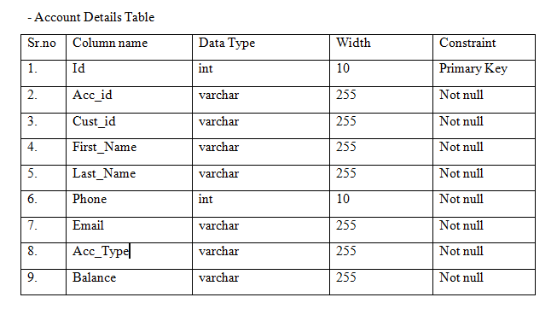
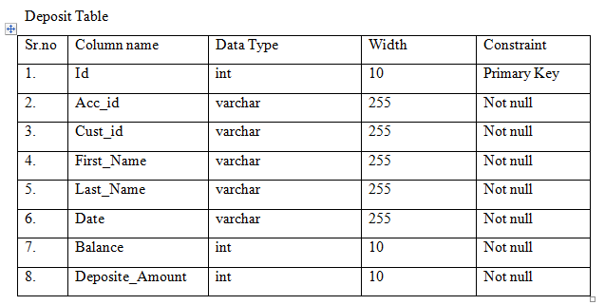

Slide 15
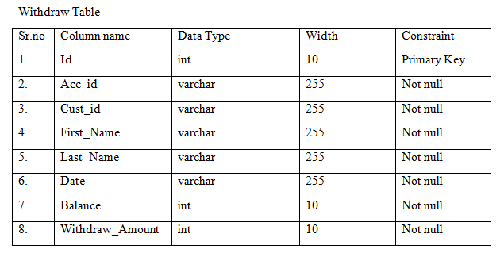
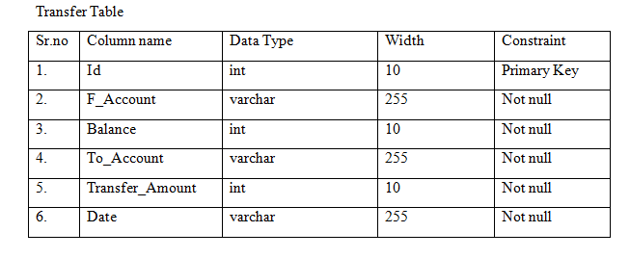

Slide 16
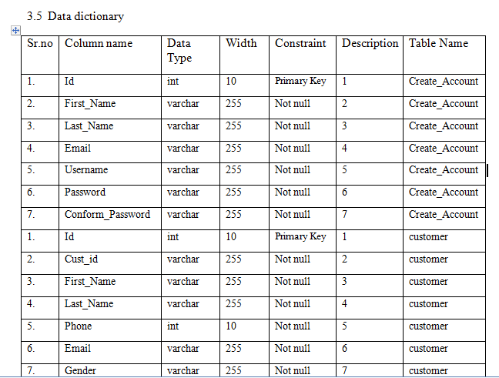

Slide 17
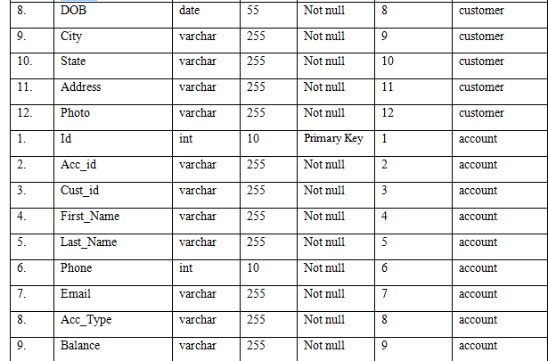

Slide 18
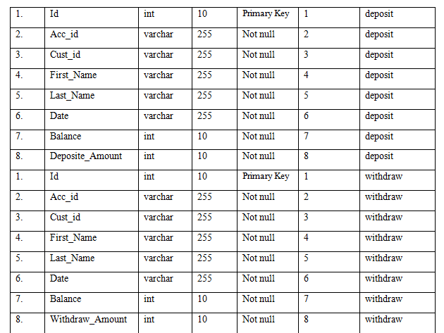
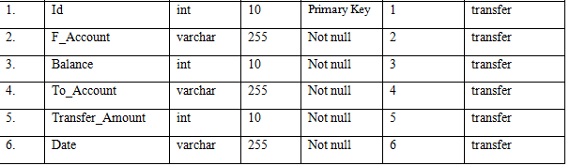

Slide 19
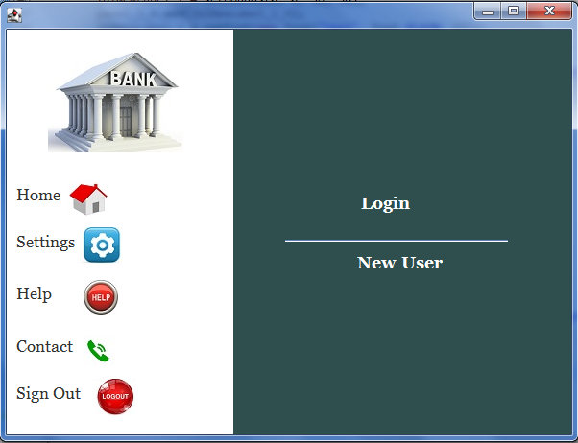
Input/Output Screens with data

Slide 20
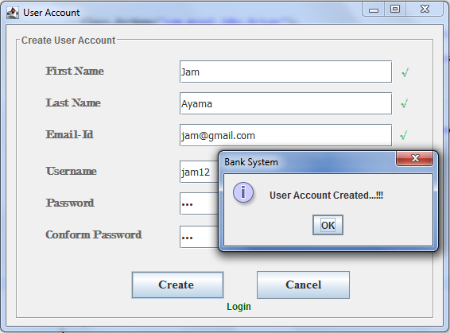
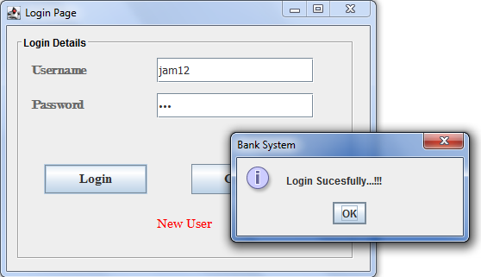

Slide 21


Slide 22
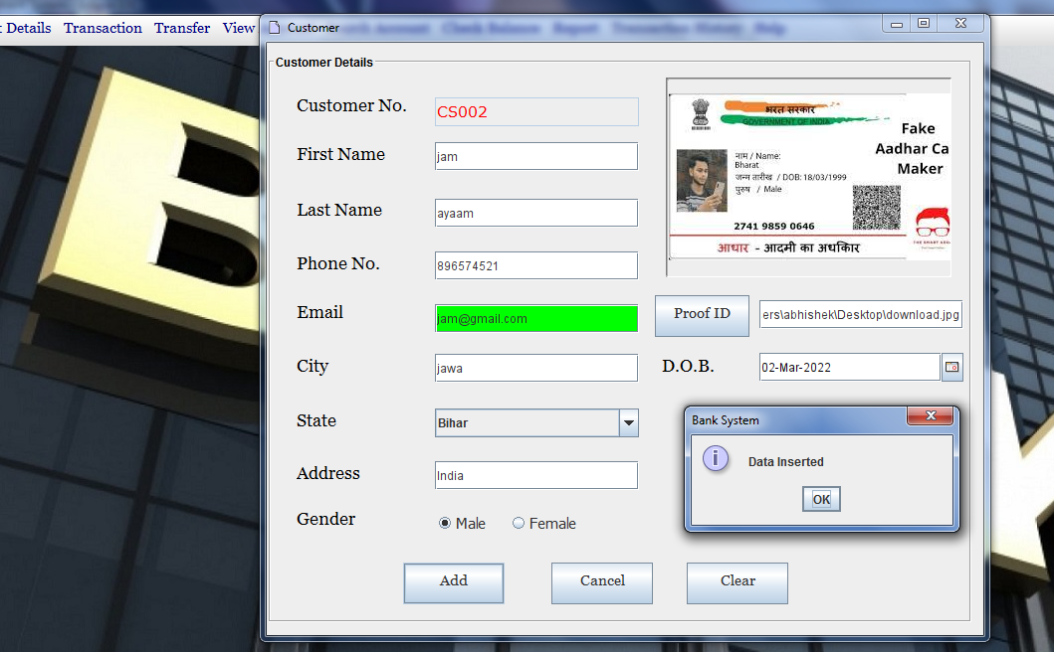

Slide 23
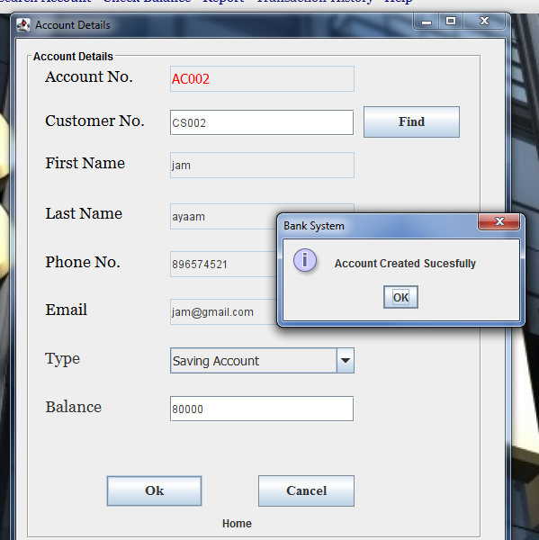

Slide 24
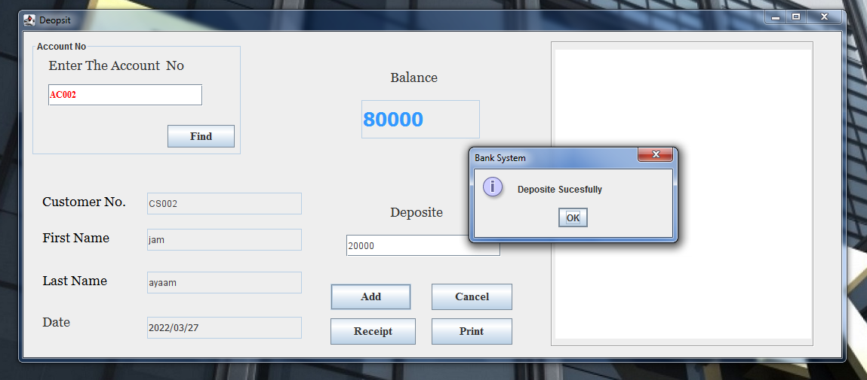
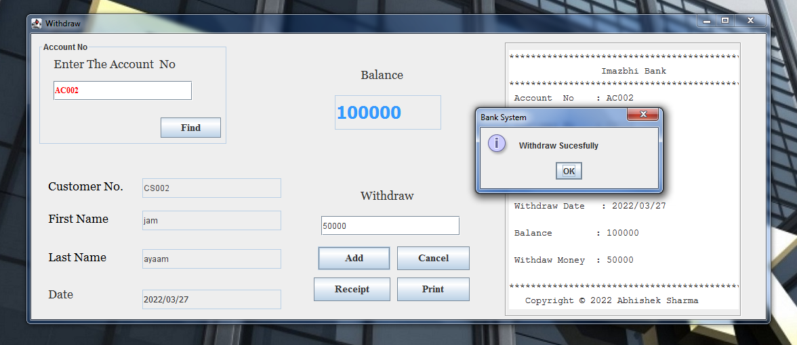

Slide 25
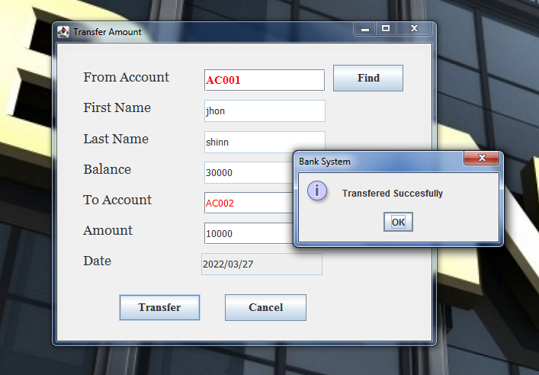
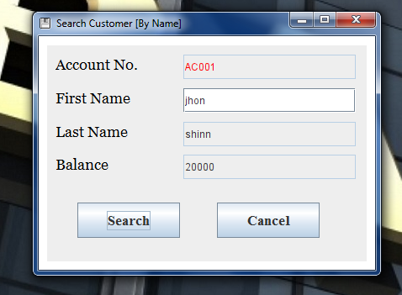

Slide 26
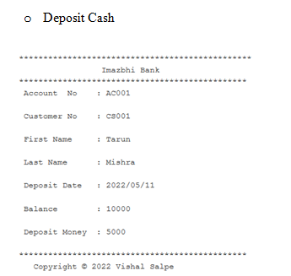
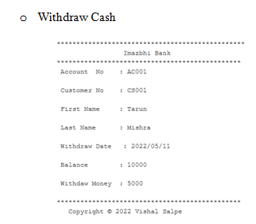
4.2 Data Reports

Slide 27
4.3 Sample Code
public void connect()
{
try
{
Class.forName("com.mysql.jdbc.Driver");
con=DriverManager.getConnection("jdbc:mysql://localhost:3306/banksystem","root","");
}
catch(Exception sq)
{ s
q.printStackTrace();
}
}
}

Slide 28
4.4 Limitations and Bibliography
Some other limitations system:
Less security of customer and bank information.
Require more physical work and manpower.
All the manual entry and editing will take more time.
No level of clearance for the different levels of employees.
Safety of paper documents from the disaster.
No backup of the information.
The by looking at disadvantages these are pretty serious for any banking system as they are capable of bringing down the whole system. By digitalization in the banking system, it will not only achieve its goals and also will give some benefits like less manual calculation will be required.

Slide 29
Bibliography
Suresh, P•&Paul,J(2012).Management of Banking and Financial Services; New Delhi,India .Pearson . Gordon,E• & Natrajan,K (2015) Banking: Theory Law and Practice, Mumbai.Himalaya Publishing House. Nigam.L (1985) Banking Law and Practice,NewDelhi, Vani Educational Books.• Yadav,S.K. (2015) Elements of Research Writing,New Delhi,UDH Publishers• & Distributors,Ltd.

