Slide 1
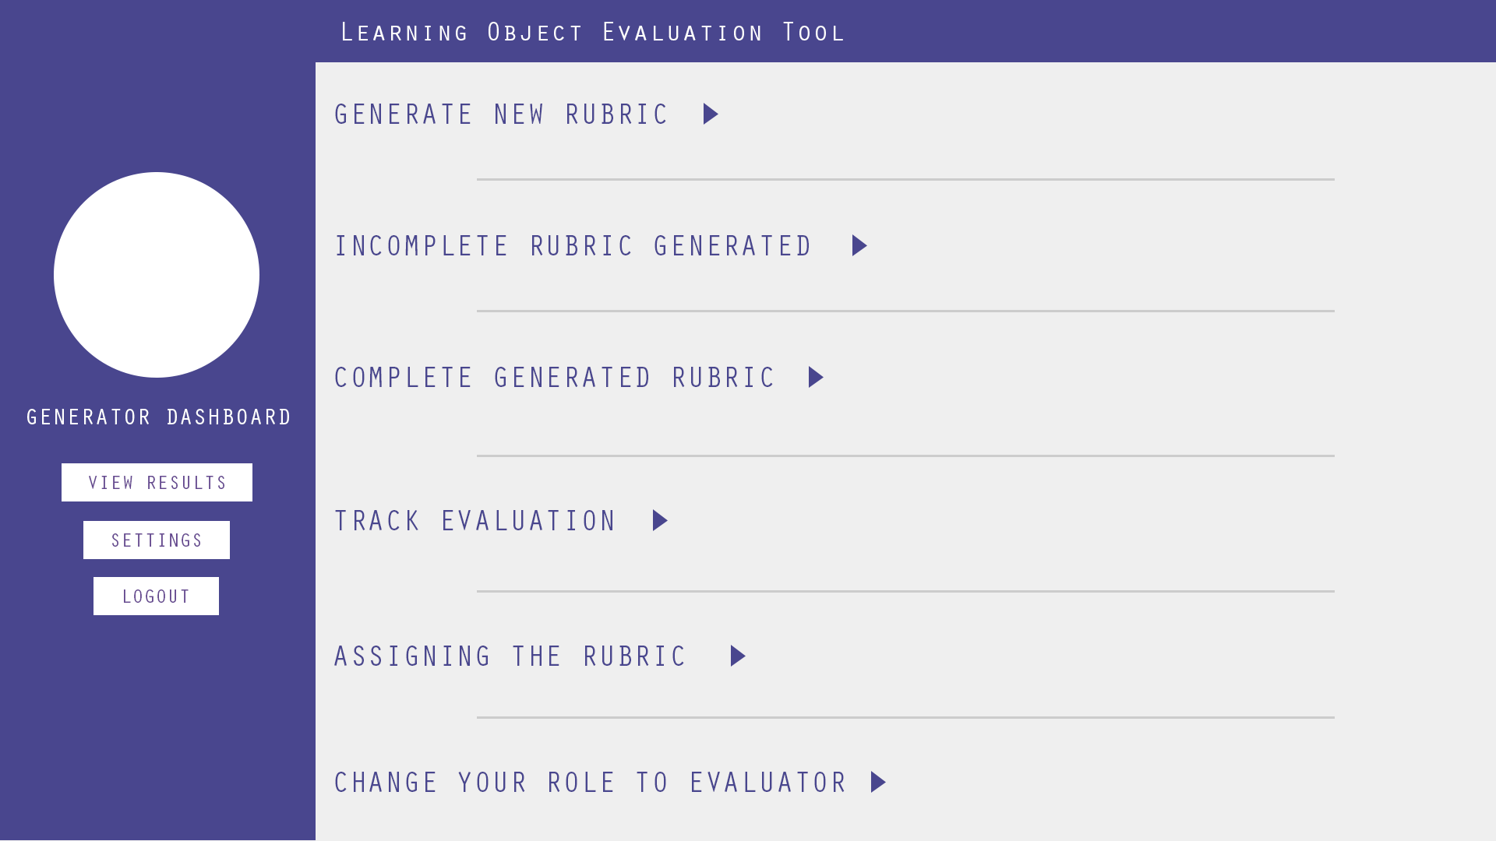

Create the dashboard as the image shown above. or refer the psd that has been shared with you
‹#›

Slide 2
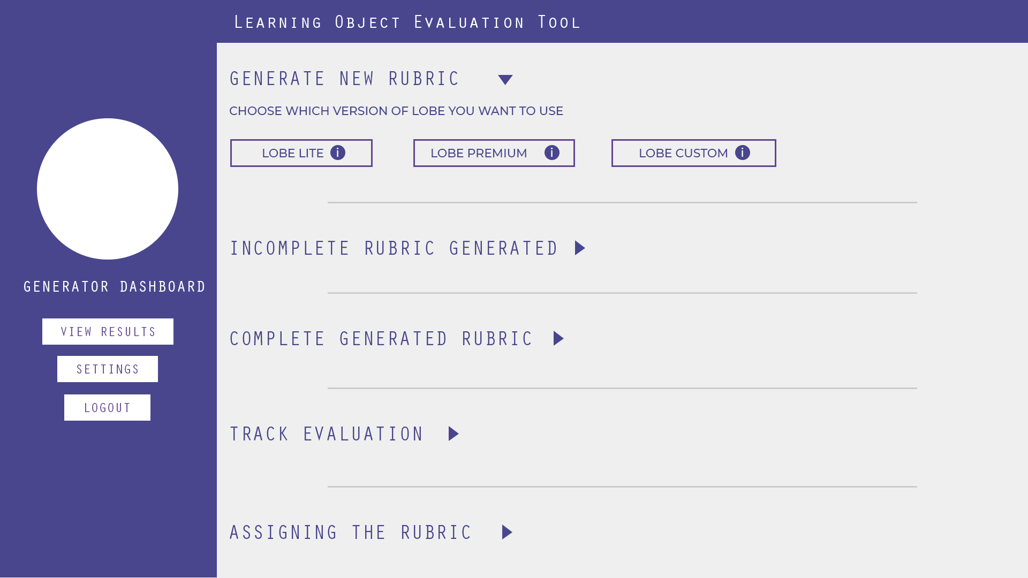
On click of ‘Generator new rubric’ which will be drop down it will show 3 radio buttons name - LOBE LITE, LOBE PREMIUM & LOBE CUSTOM which will look like button.
‹#›

Slide 3
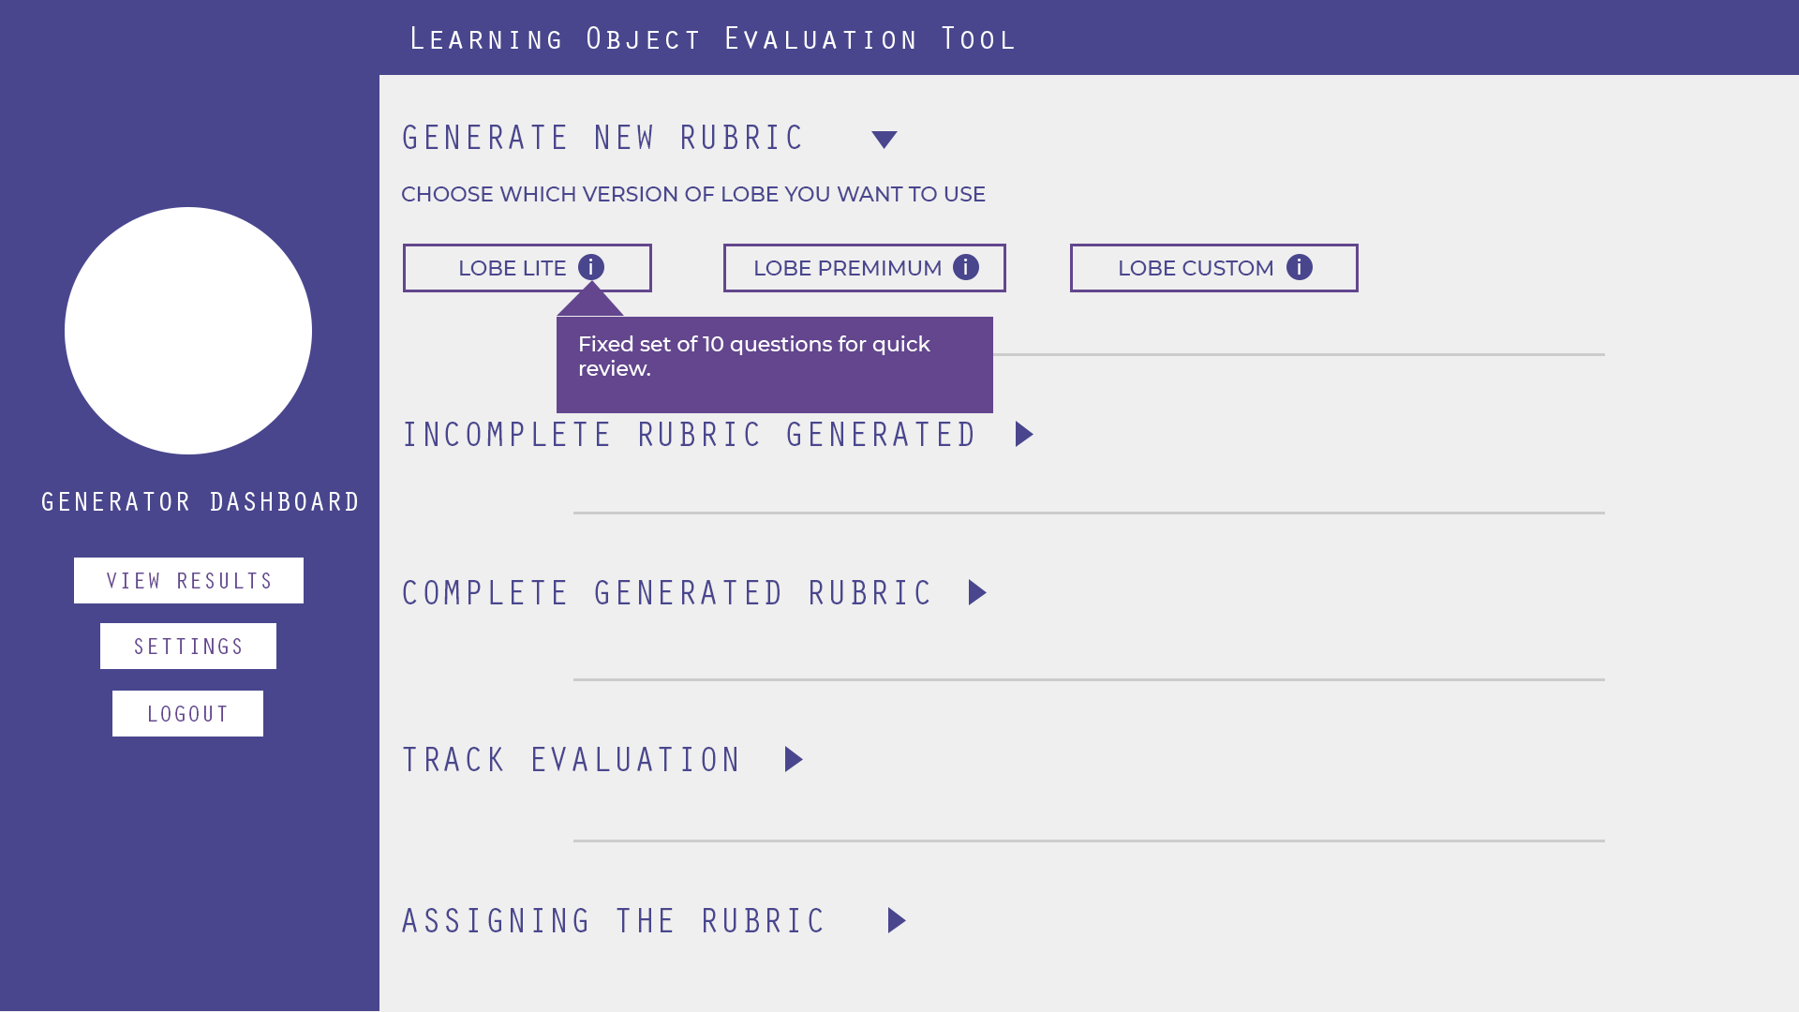
on hover of ‘i’ it would be a callout that gives information on LOBE LITE. It has 10 questions.

Slide 4
Fixed set of 39 questions for a thorough review
on hover of ‘i’ it would be a callout that gives information for LOBE PREMIUM
‹#›

Slide 5
YOU can pick & choose the questions you want for review
on hover of ‘i’ it would give a callout that gives further information about the LOBE CUSTOM.
‹#›

Slide 6
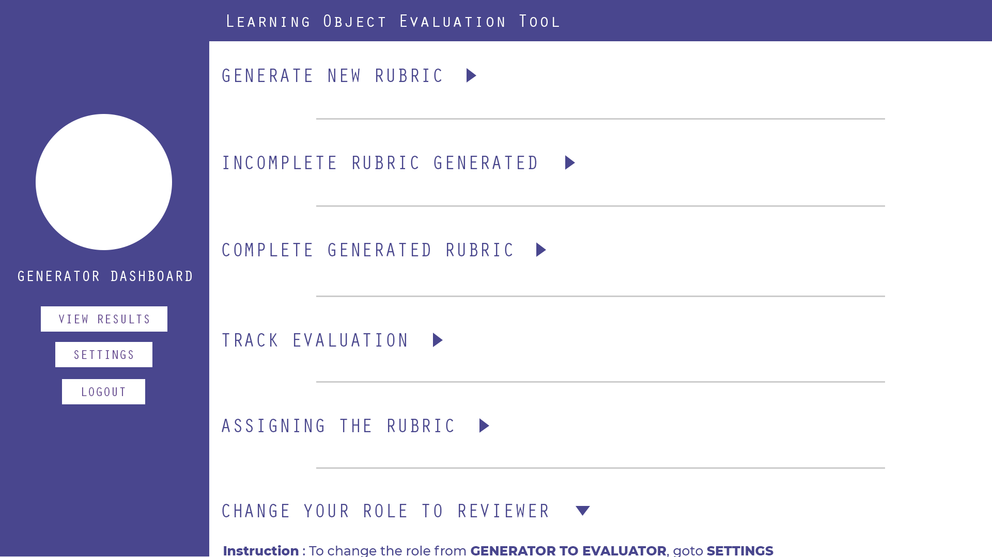
On clicking on ‘Change your role’, instruction should appear
‹#›

Slide 7
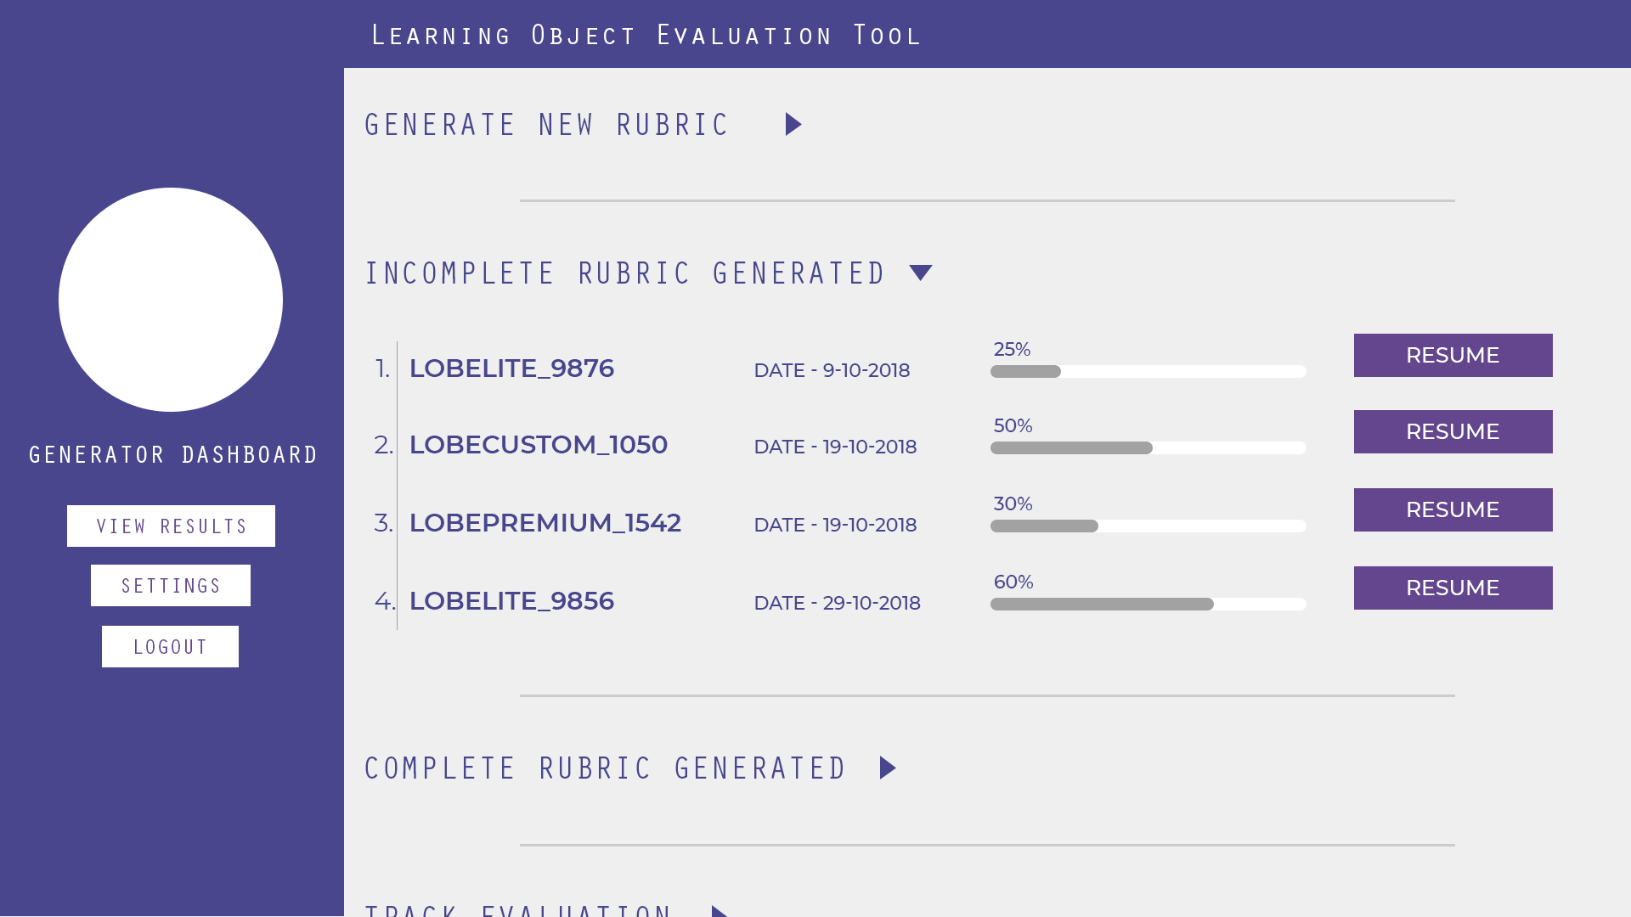
On clicking on ‘Incomplete rubric’, there should be table which consist any pseudo name like LOBELITE_9876, date, percentage bar and a resume button as shown above

Slide 8
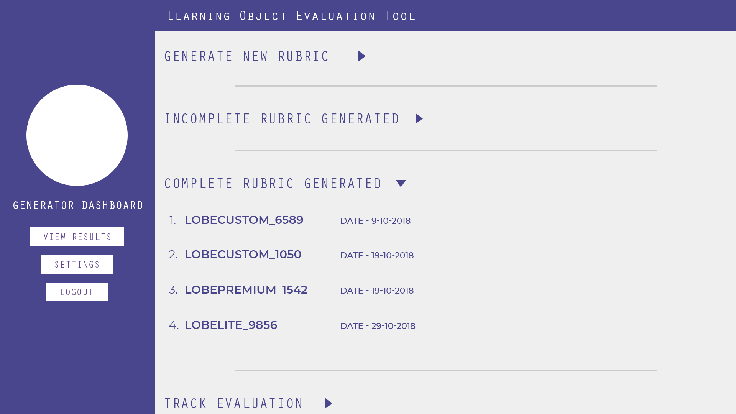
On clicking on ‘Complete rubric’, there should be table which consist any pseudo name like LOBECUSTOM_6589 & date as shown above

Slide 9
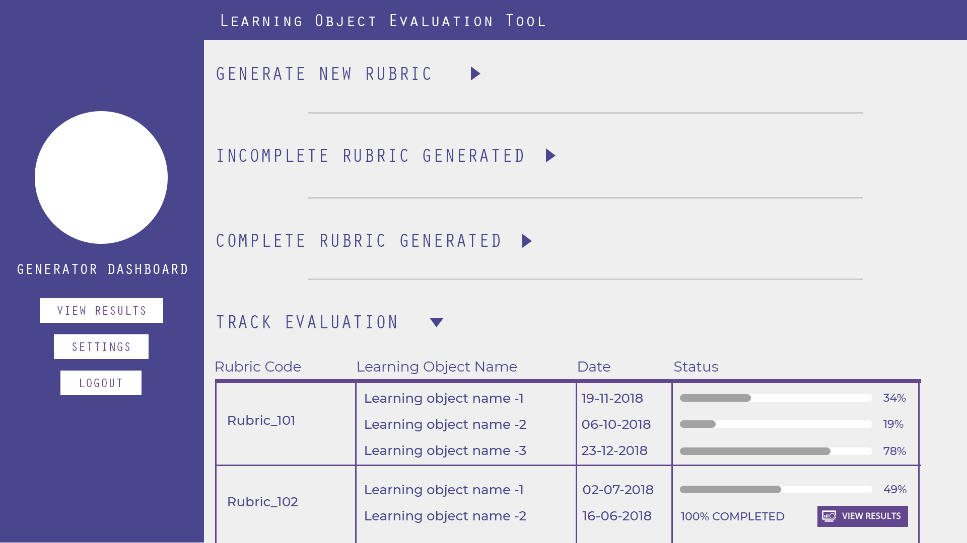
On clicking on ‘Track evaluation’ again show a table with header name Rubric Code, Learning Object Name, Date & Status, as shown above and insert data according to the image

Slide 10
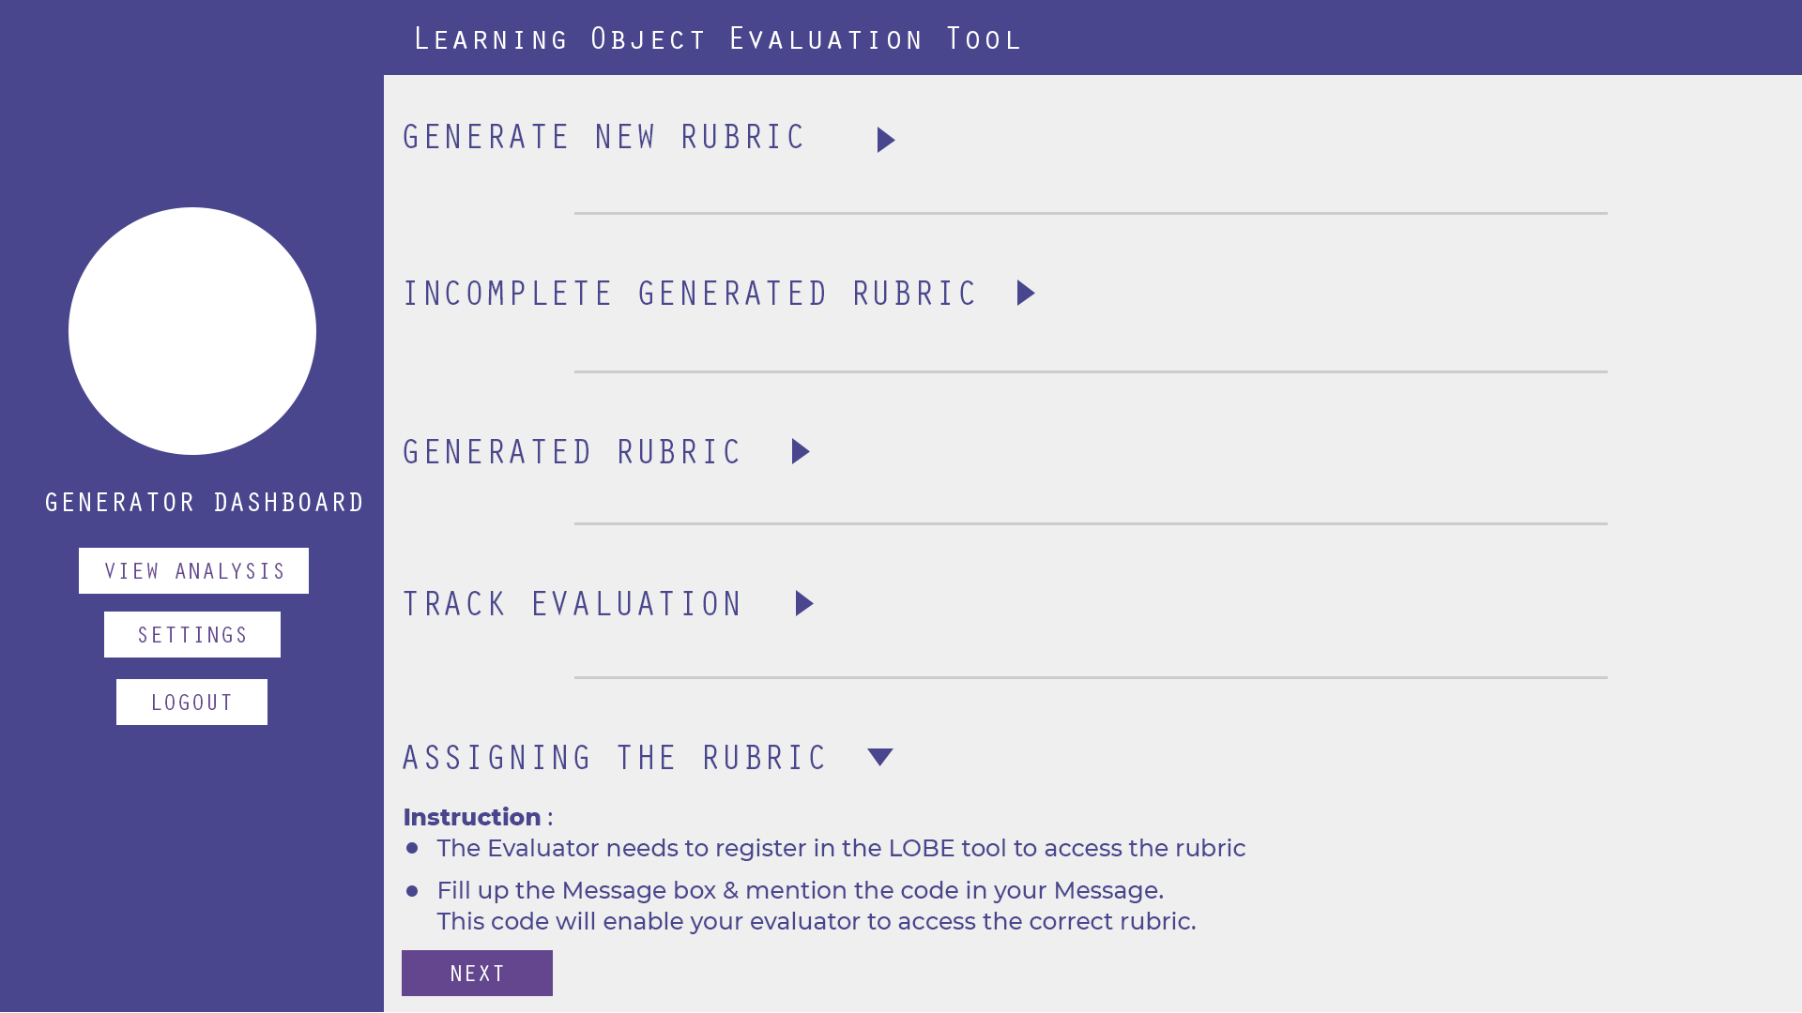
On clicking on ‘Assigning the rubric’ show the instruction and a next button.

