Slide 1
BLOOD MONK
An IOS Application for Blood Donors

Slide 2
Overview
Blood Monk is an application that caters to the need for blood donors around the world.
Donors can easily search for available appointments and schedule for an available slot.
On scheduling an appointment the donor can view a list of the scheduled appointments and can choose to view or cancel them.
Users get information about the total quantity of the blood that they have donated till date.
Donors can also see the history of their donations and get real time updates about the status of their donated pint of blood.

Slide 3
Application Flow

Slide 4
LOGIN
Users can login from the login screen or create a new account.
User has to fill out a simple form containing an email address and a password.
But if the user prefers not having the need to maintain an email account, he can use his Facebook account and login with that.
Authorization and authentication have been handled using both , Firebase authentication for email and Facebook OAuth for the Facebook login.
An option to create a new account using email authorization provided by Firebase server has also been provided.

Slide 5
HOME SCREEN
Checking Donation History
From the home screen, the user can view his donation history which is a table view containing a list of his donations.
User can view the details of the donation and can get tracking information about the status of his donated blood. (The status updates are currently being performed via a simulated random data, but in real time the blood processing team will manage the updation of the status.

Slide 6
HOME SCREEN
Scheduling
User can open the Manage Appointments section to view a list of available appointments at different blood donation centers. (Currently this data has been put into the server manually but for production purposes, this data can be sourced from an API/REST Service and displayed in the table view.
Use can Search and Select a particular donation center and view the available time slots and click Confirm Appointment to schedule it.

Slide 7
APPOINTMENT DETAILS
User can vie the details of the appointment which has a MapView integrated with the location marked using a MKAnnotation.
This makes it easier for the User to get an idea of where the blood donation center is located.
On confirmation, the user is provided with a Cancel Appointment option so that he can cancel that particular appointment.

Slide 8
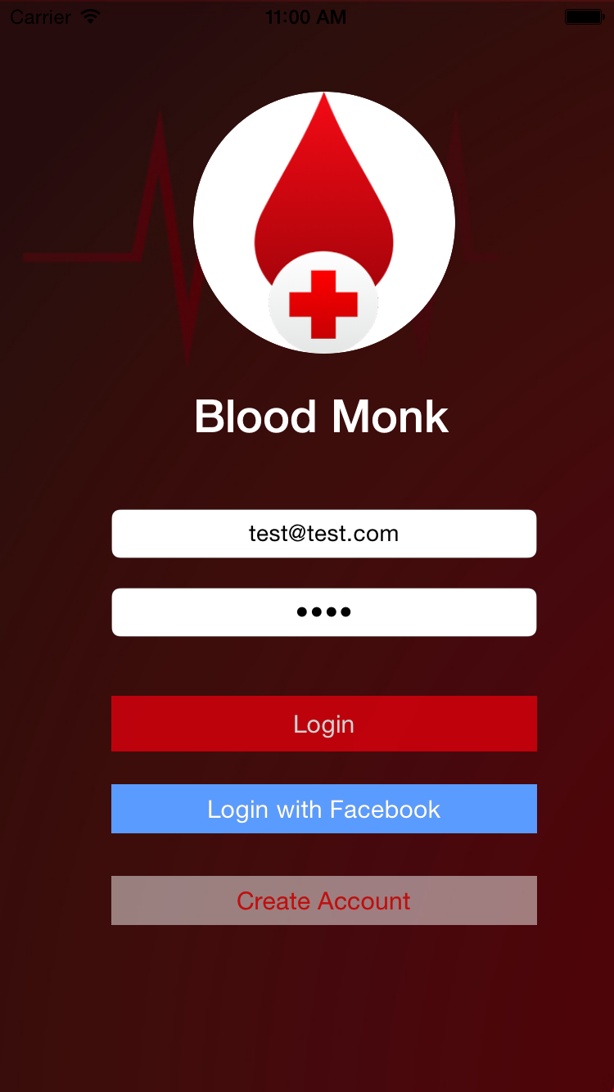
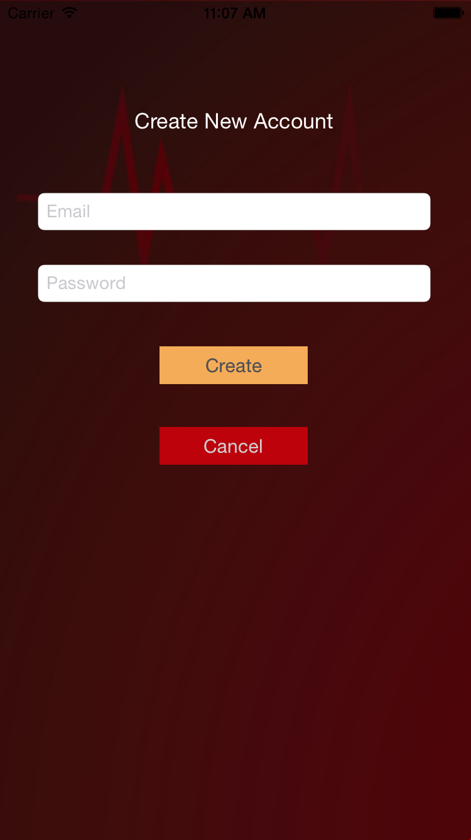
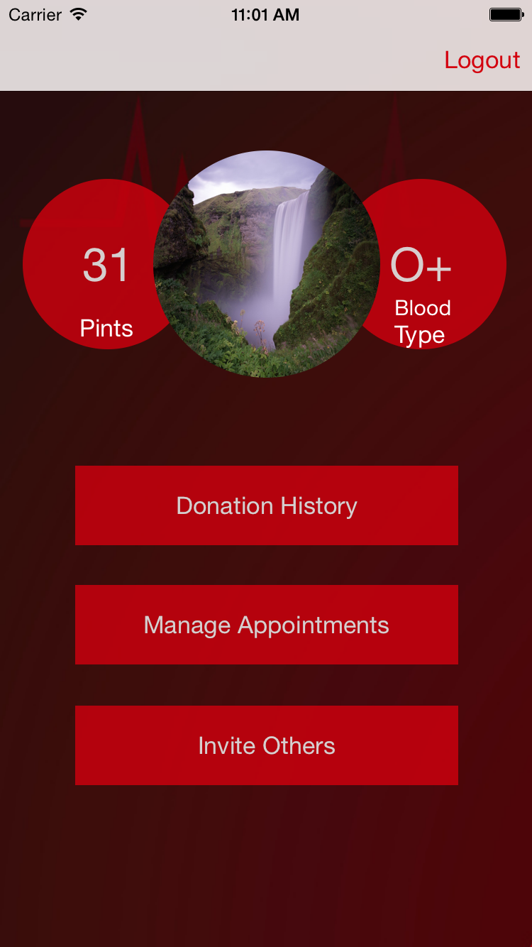

Slide 9
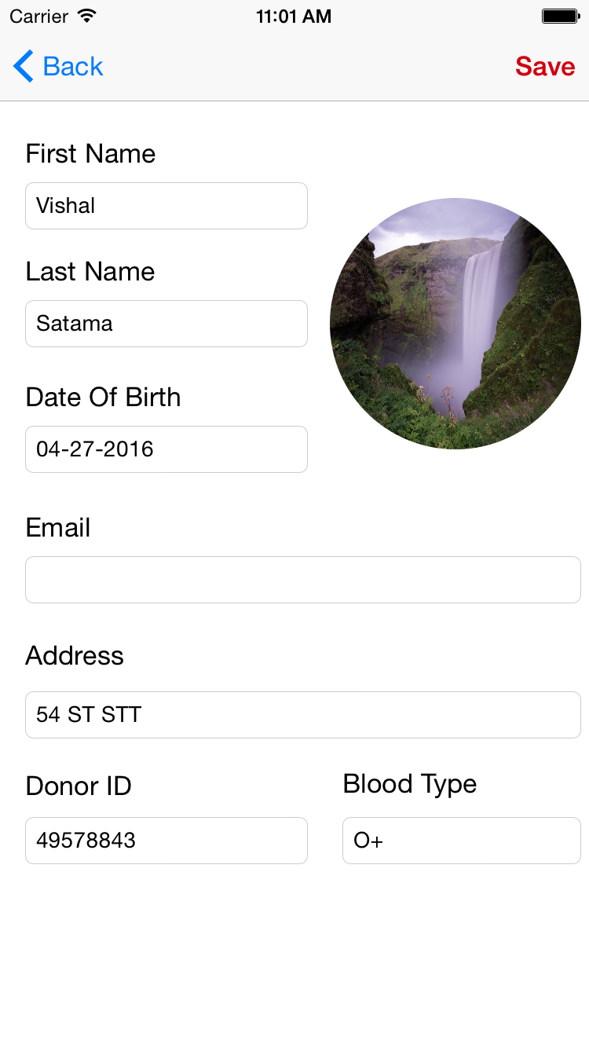
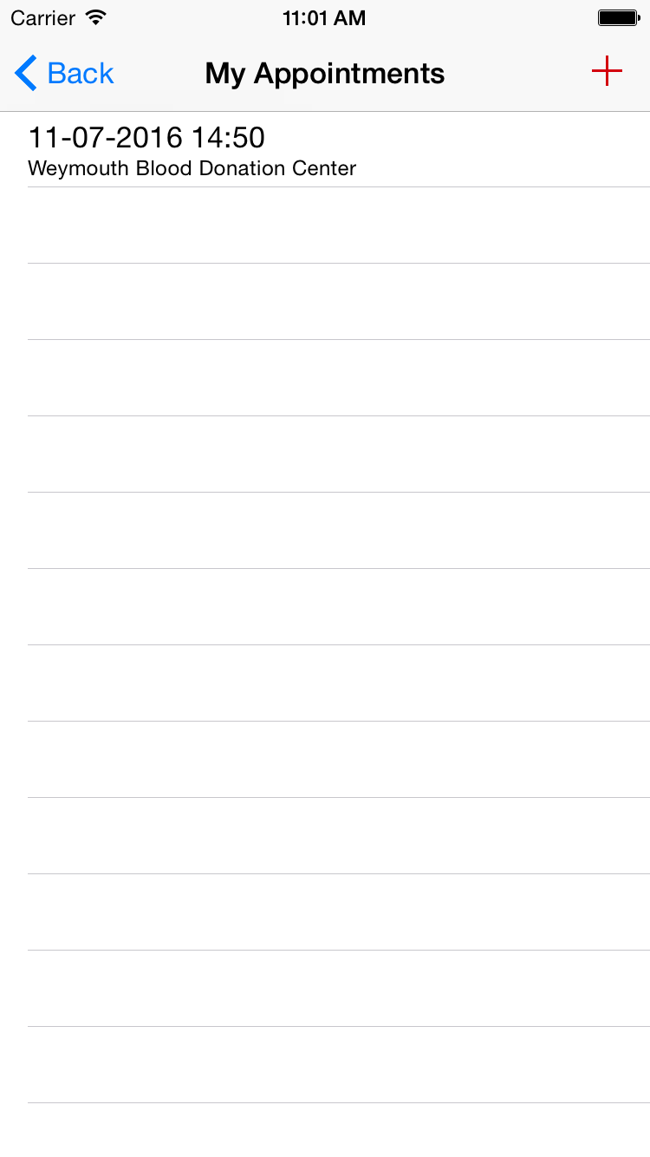
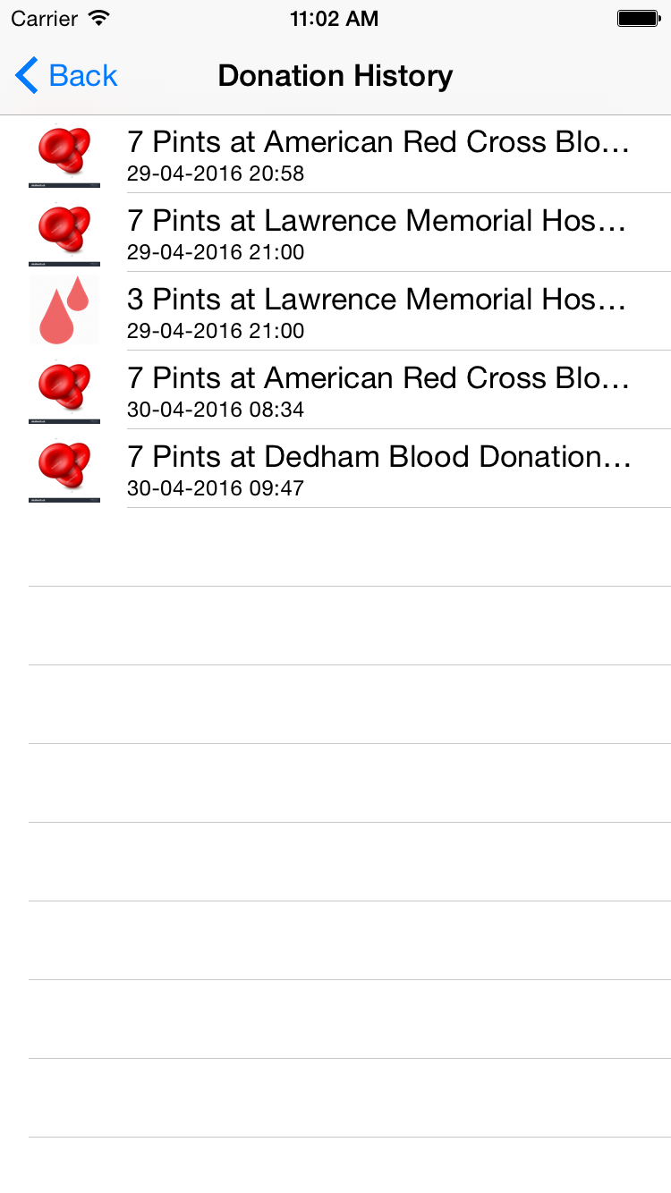

Slide 10
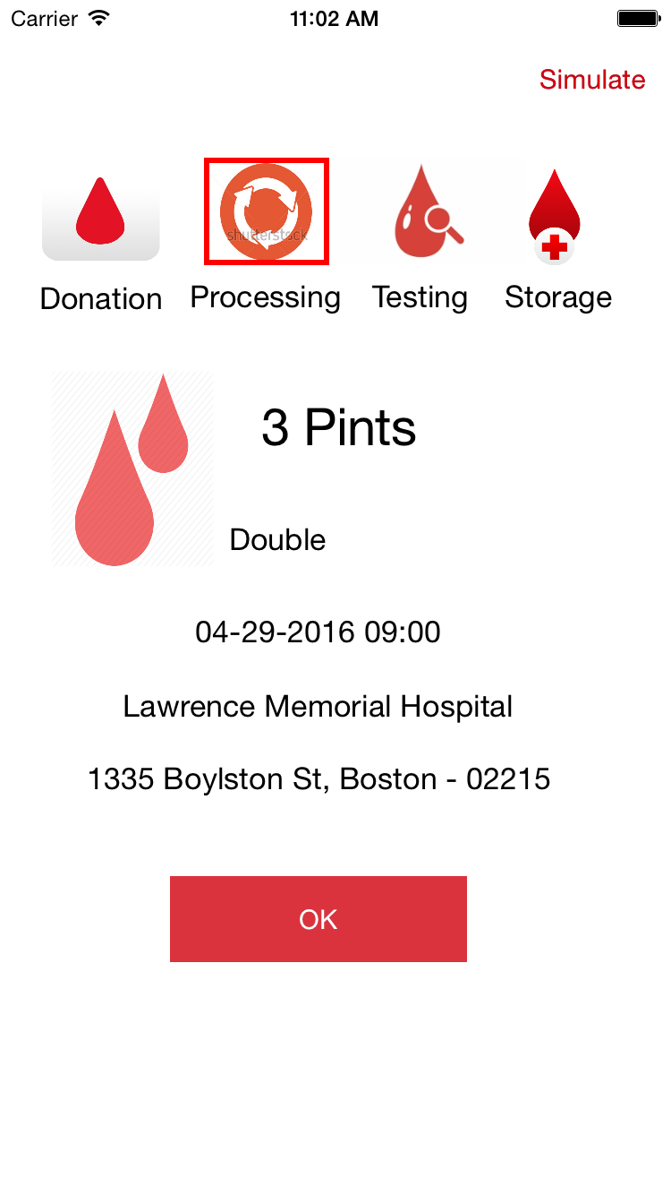
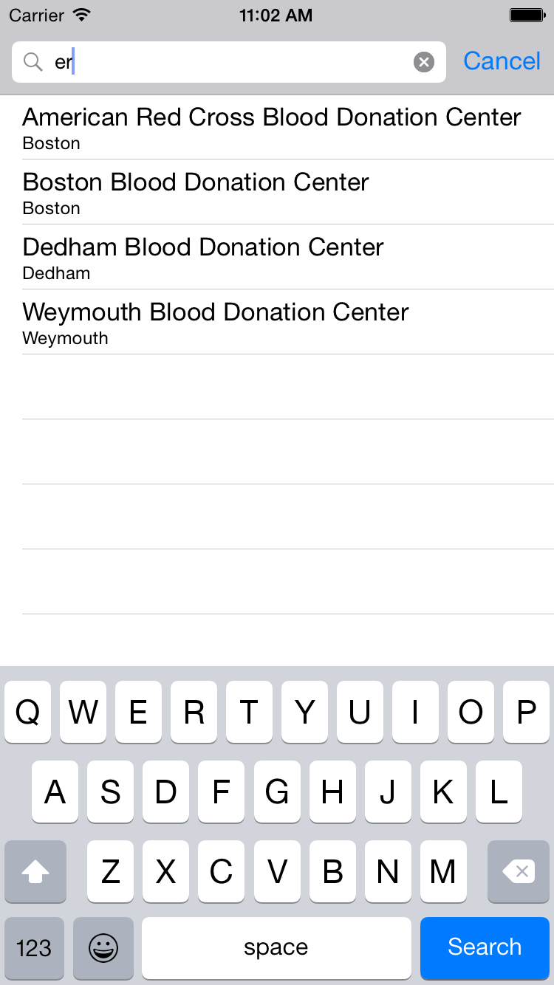
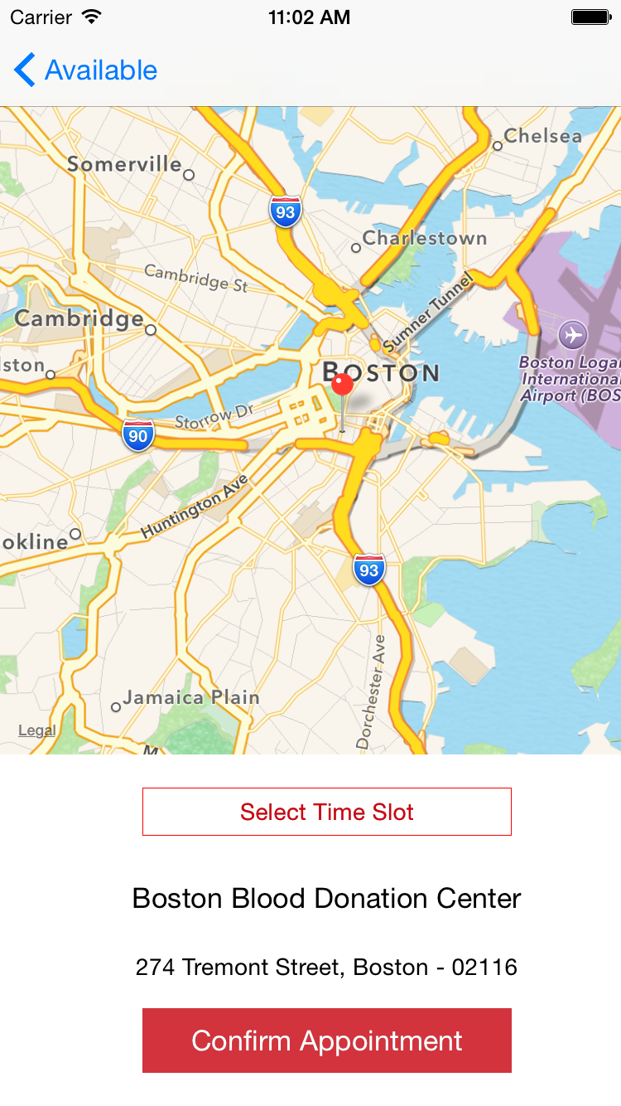

Slide 11
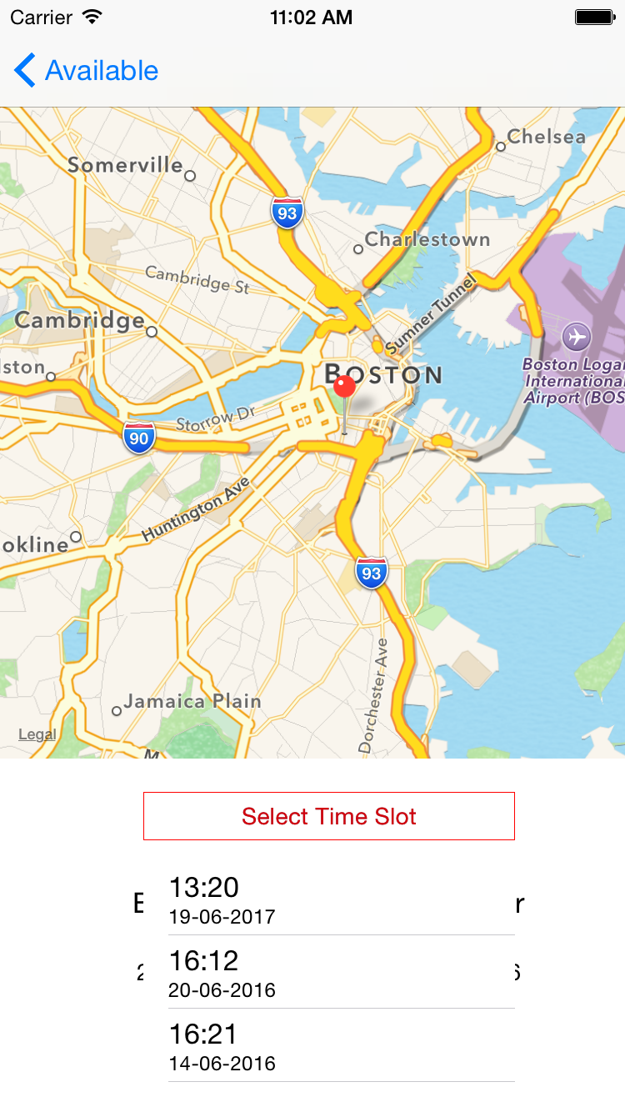
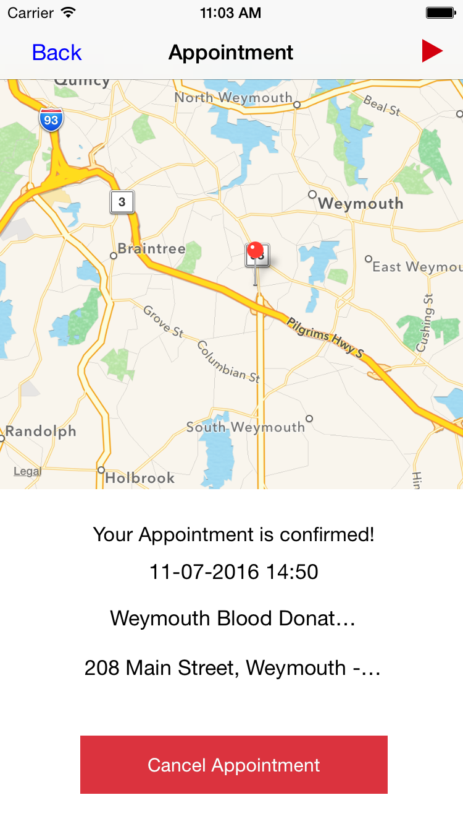
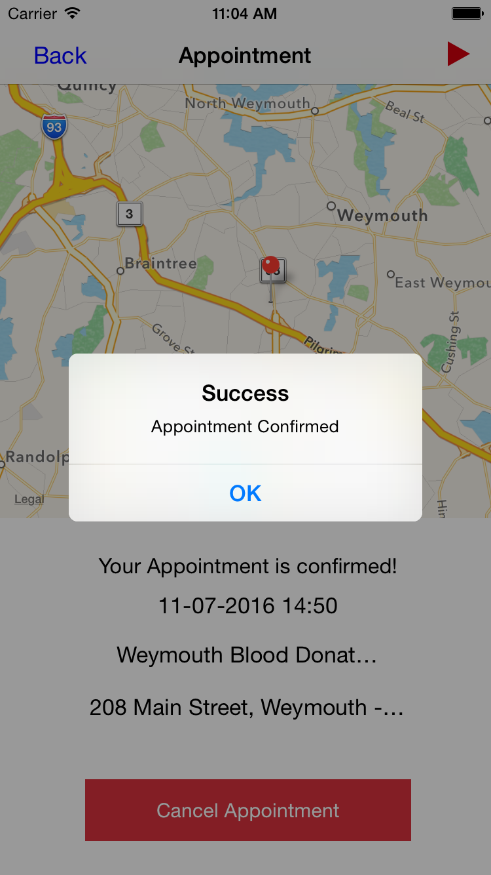

Slide 12
FUTURE SCOPE
Donor search feature can be provided with which the user can search for other users location wise if he needs to request for blood.
Rewards program can be included for people who donate more blood with incentives.
Groups can be formed so that there is more sense of community and not just an individual feeling to the blood donation.
Can be made into a social platform for the blood donating communities.
Informational material can be included for the blood donor about blood donation.

Slide 13
References
American Red Cross App.
Red Cross Website

