Slide 1
Youtube videos network analysis
Team 1
Manasi dalvi
Vishal satam

Slide 2
Introduction & problem statement
Youtube facilitates users to upload videos
Youtube generates revenue from the number of views per video
Related links are provided to improve the click rate
These links form a complex network
Nodes – Videos
Directed Edges to Related Videos
Aim is to provide an estimate of views that a new video can generate
Apply clustering algorithms on the network to generate related list

Slide 3
Dataset
Videos
video ID | an 11-digit string, which is unique
uploader | a string of the video uploader's username
age | an integer number of days between the date when the video was uploaded and Feb.15, 2007 (YouTube's establishment)
category | a string of the video category chosen by the uploader
length | an integer number of the video length
views | an integer number of the views
rate | a float number of the video rate
ratings | an integer number of the ratings
comments | an integer number of the comments
related IDs | up to 20 strings of the related video IDs
Youtube Web crawl dataset from 2007 – 2008 (School of Computing Science - Simon Fraser University British Columbia, Canada )
http://netsg.cs.sfu.ca/youtubedata/
Video File size and bitrate
video IDs | Id of the video – 11 digit string
Video length | Length of the video in minutes, numeric
Video file size | Size of the video, numeric
Bitrate | Bitrate of the video, numeric
Users
Userid | String
Number of uploaded videos | Number of videos uploaded by the user, number
Number of videos watched | Number of videos that have been watched by the user, number
Number of friends | Number of friends for this user, number

Slide 4
System architecture
DATA PIPELINE Built in Luigi / DASK
Scrape Weblinks
Download and Wrangle Data
Upload to Amazon S3
Train and develop ML Models
AWS RDS
Graphene DB (may change)
Web App Server on IBM Bluemix using Flask
Deploy trained model on Microsoft Azure ML Studio
REST API
Client (Browser) UI

Slide 5
Stakeholders
Users
Application users who upload videos and get estimated views for their videos
Get trending videos based on their category preferences
Business Users
Can get a view of the network graph
View clusters of videos
Trend of videos from 2007-2008

Slide 6
Deployment TOols
Docker for distribution
Pipelining Tool – Luigi
Data Storage – Amazon S3
Machine Learning – AWS EC2
Database as a Service - AWS and GrapheneDB(might change based on datasize)
Machine Learning as a Service – Microsoft Azure ML Studio
Web Application – Flask deployed on IBM Bluemix

Slide 7
Mock UI

Slide 8
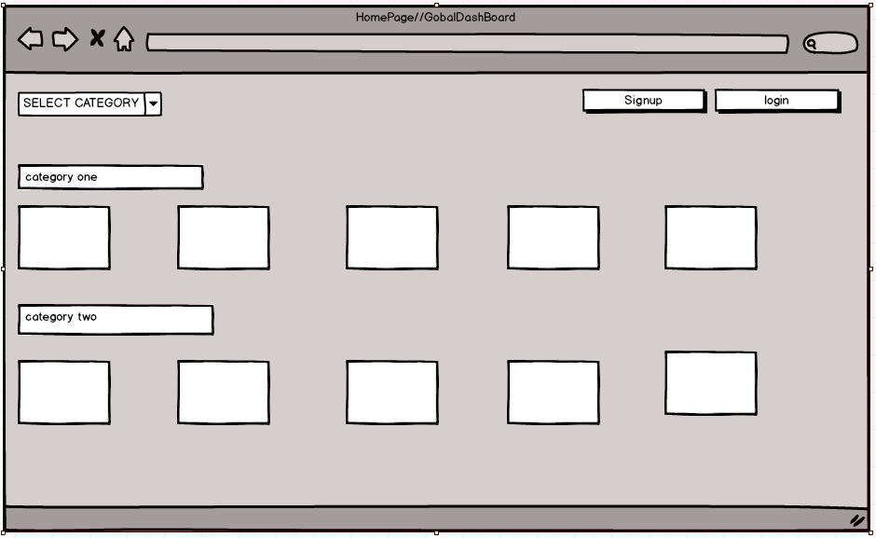
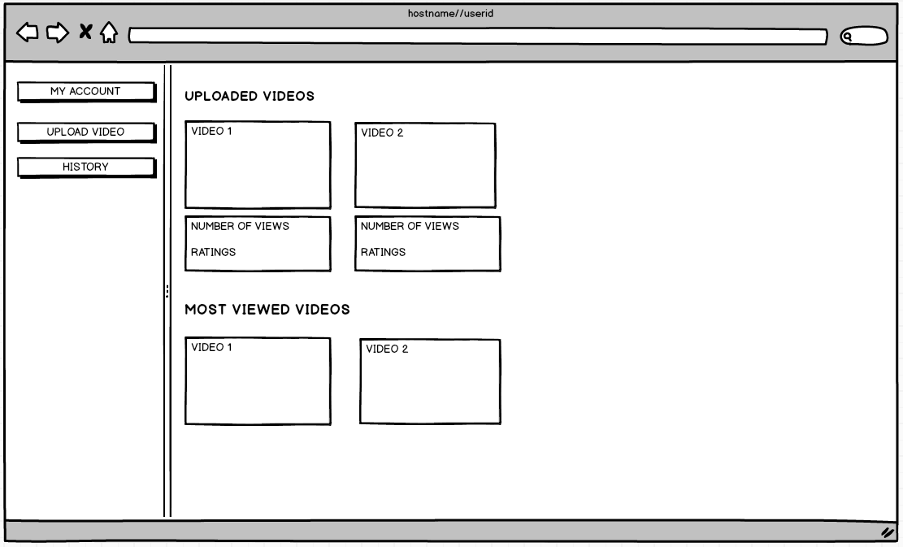
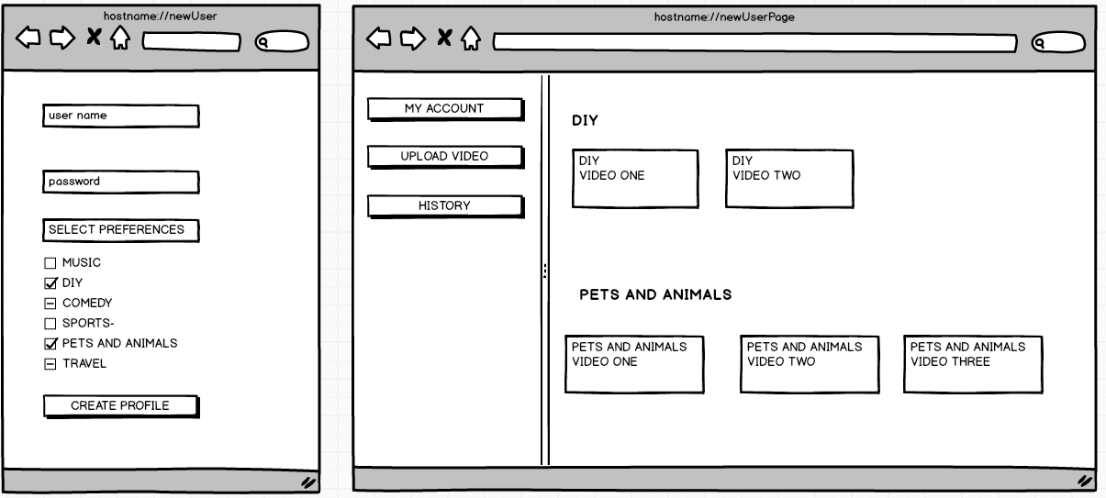
HomePage
Existing user profile
New User
Home Page

Slide 9
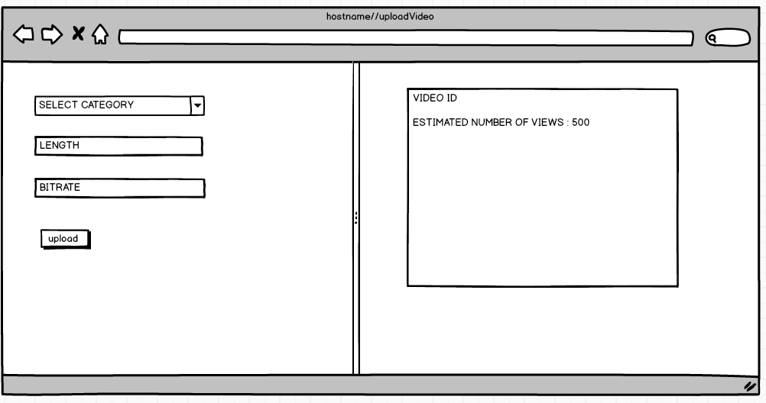
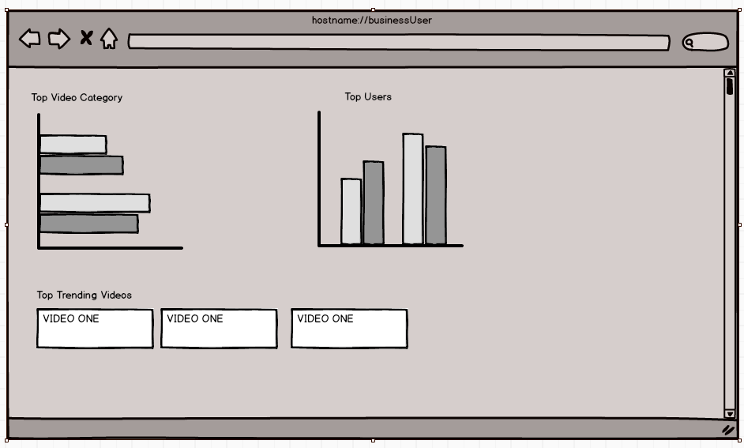
Estimated Views Prediction for New Video
Business User Profile

Slide 10
Thank you

