Slide 1
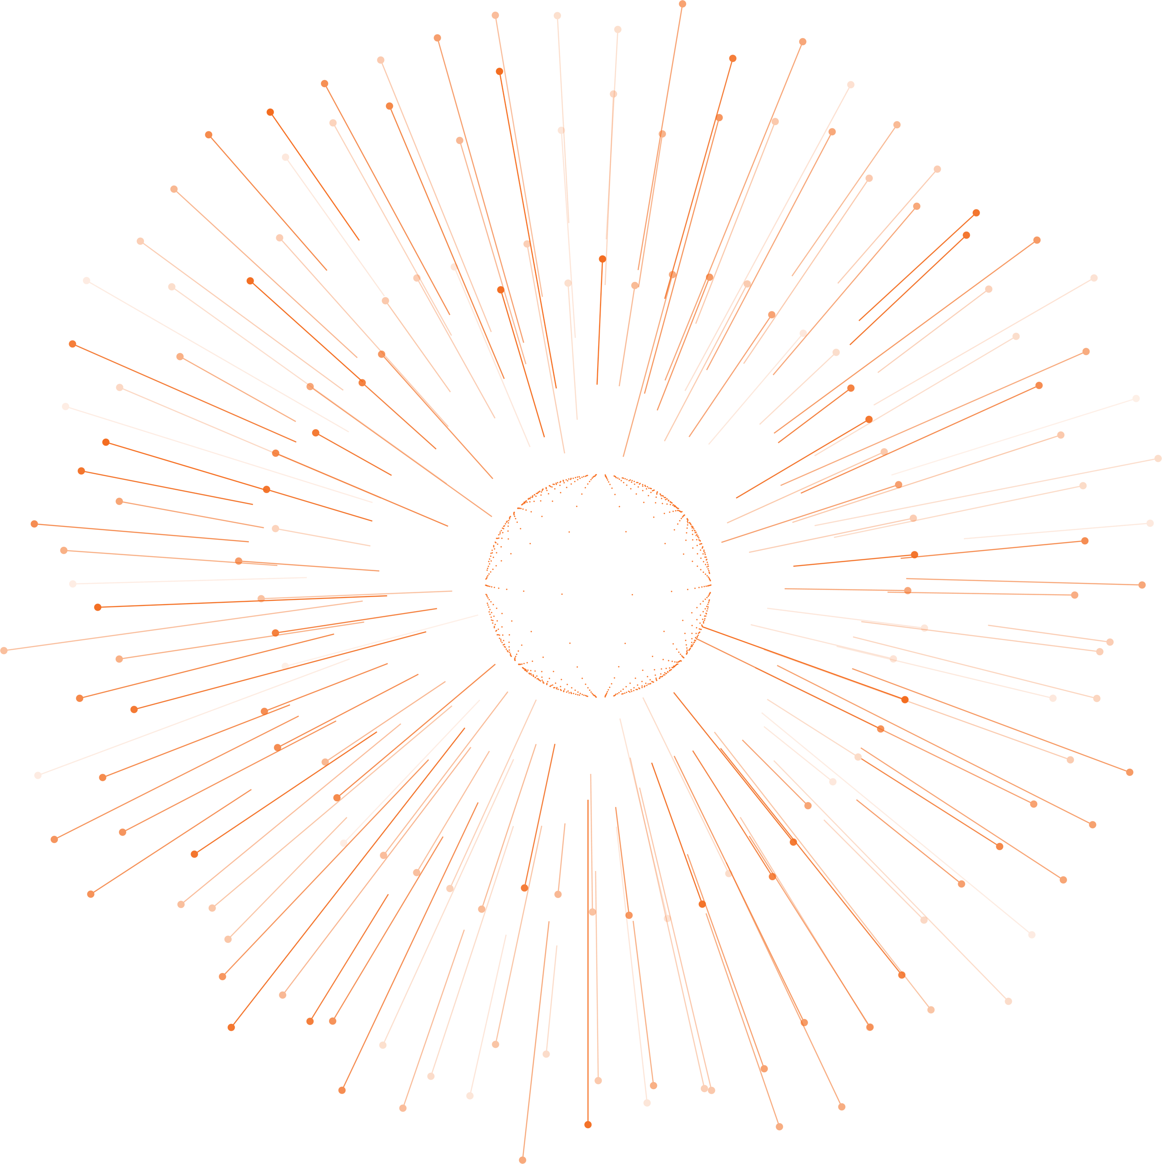


FSI Data & Analytics Specialists
Introduction
Information Insight Intelligence
www.lumiq.ai

Slide 2

MEDICAL RISK ENGINE
ELECTROCARDIOGRAM
INFORMATION. INSIGHT. INTELLIGENCE.

Slide 3
Table of Contents
What is an ECG?
04 - 06
How to interpret an ECG?
07 - 08
How does ECG effect the decision?
09 – 10
DATA
11
Model Iterations with NN's
12
​
Iterations with LLM
13
Transformer Iterations(VIT)
14
Evaluation
15
Notes:
https://www2.deloitte.com/content/dam/insights/us/articles/5191_cloud-data-modernization/DI_Data-modernization-and-the-cloud.pdf
Sinch banking Report 2022
https://www.capgemini.com/wp-content/uploads/2022/01/Final-Web-Version-Data-Masters.pdf
McKinsey Report - Catch Them If You Can: How Leaders in Data and Analytics Have Pulled Ahead.

Slide 4
Electrocardiogram
What is an ECG ?
Why do we need?
Benefits
An ECG measures the heart's electrical activity using skin electrodes.
It helps diagnose heart conditions like arrhythmias and heart attacks.
Regular ECGs monitor heart health and track treatment progress.
Notes:
https://www2.deloitte.com/content/dam/insights/us/articles/5191_cloud-data-modernization/DI_Data-modernization-and-the-cloud.pdf
Sinch banking Report 2022
https://www.capgemini.com/wp-content/uploads/2022/01/Final-Web-Version-Data-Masters.pdf
McKinsey Report - Catch Them If You Can: How Leaders in Data and Analytics Have Pulled Ahead.

Slide 5
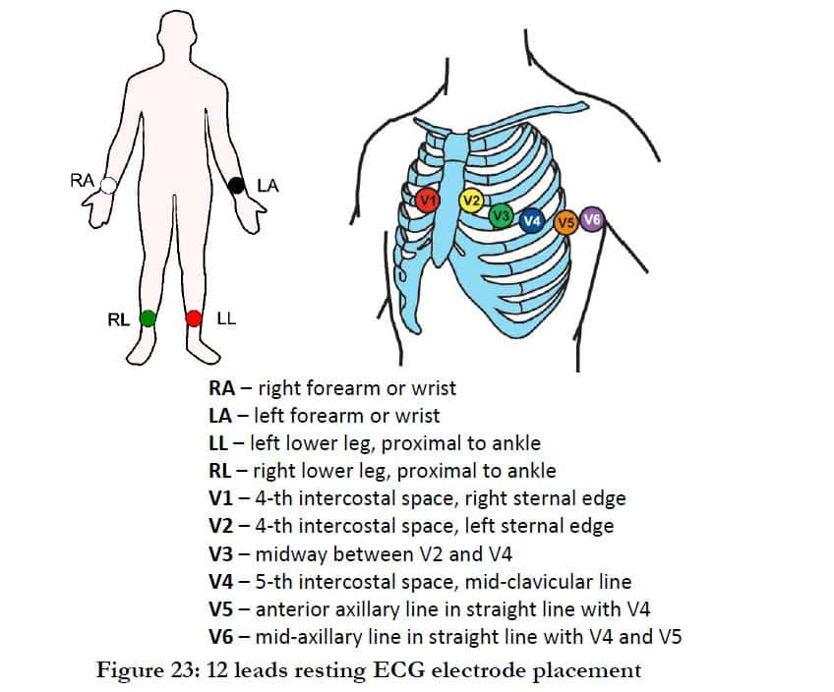
LEADS IN AN ECG
In an ECG, leads are the specific configurations of electrodes that record the heart's electrical activity from different angles.
Notes:
https://www.softkraft.co/what-is-data-maturity-and-how-to-climb-the-data-maturity-scale/– Dell Data Maturity Framework

Slide 6
Let’s have an overview of the process of ECG
Preparation: The patient lies down, and the skin is cleaned where electrodes will be placed.
“
ECG
The ECG was invented by Dutch physiologist Willem Einthoven in 1903.
Approximately 1.5 million ECGs are performed daily worldwide.
Electrode Placement: Electrodes are attached to the patient's chest, arms, and legs.
Connection: The electrodes are connected to the ECG machine via wires.
Recording: The ECG machine records the heart's electrical activity, displaying it as waveforms on a graph.
“
Monitoring: The technician monitors the recording to ensure clear and accurate signals.
Analysis: The recorded ECG is printed or saved digitally for the doctor to analyse for any abnormalities.

Slide 7
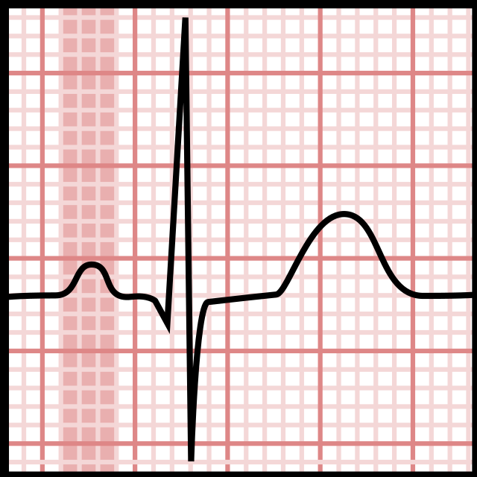
Understanding an ECG
The Parameters
The R wave
3
The S wave
The P wave
5
1
The Q wave
2
The T wave
4

Slide 8

Understanding an ECG
One large square on the graph equals 0.2 seconds (200 milliseconds) in time.
One large square equals 1 millivolt in voltage.
The Morphology
One small square equals 0.04 seconds (40 milliseconds) in time.
One small square equals 0.2 millivolts in voltage.
Large Square
1
Small square
2
amplitude of the electrical signals generated by the heart
(mV)
Time (ms)

Slide 9
The ECG effect on the decision
Underwriter’s Perspective in Insurance
Risk Assessment: ECGs help underwriters assess the risk of insuring individuals by identifying pre-existing heart conditions or irregularities.
Premium Calculation: The findings from ECGs can influence the calculation of insurance premiums based on the individual's cardiac health.
Coverage Decisions: ECG results may determine the extent of coverage or exclusions in insurance policies, particularly for life and health insurance.
Claims Management: Accurate ECG data helps underwriters manage and validate claims related to heart conditions, ensuring that claims are handled fairly.
Preventive Measures: Underwriters may use ECG data to encourage policyholders to seek preventive care, potentially reducing future claims and improving overall health outcomes.

Slide 10
The ECG effect on the client
Underwriter’s Perspective in Insurance
Accurate Risk Assessment: Studies show that using ECG data can improve the accuracy of risk assessments. For example, ECGs can detect asymptomatic heart conditions in up to 5% of individuals who might otherwise be overlooked, providing more detailed risk profiles for underwriters.
Determining Premiums: A study by the American Heart Association indicates that individuals with abnormal ECG findings have a significantly higher risk of cardiovascular events. Underwriters use this data to adjust premiums accordingly, potentially increasing them by 10-30% for those with detected abnormalities.
Policy Coverage: Research published in the Journal of Insurance Medicine shows that ECG findings can lead to more precise policy terms. For instance, individuals with abnormal ECGs might face exclusions or higher deductibles, impacting coverage decisions.
Claims Validation: ECG data helps validate claims by providing objective evidence of pre-existing conditions. According to a report by the Society of Actuaries, accurate ECG data can reduce fraudulent claims by up to 20% due to more reliable diagnosis and documentation.
Health Management: A study in the European Heart Journal found that early detection of heart conditions through ECG can lead to a 15-20% reduction in overall health care costs due to preventive measures and early treatment. This reduction in claims is beneficial for insurers.

Slide 11
Data
The dataset contains different cases of ECG images of 4 classifications
A normal ECG shows a regular, rhythmic pattern with clearly defined P waves, QRS complexes, and T waves, indicating a healthy heart rhythm and function
A myocardial Infraction ECG typically refers to an ECG that reveals signs of a myocardial infarction (heart attack), such as ST-segment elevation or depression, indicating damage to the heart muscle.
Normal
In COVID-19 patients, an ECG might show abnormalities such as changes in heart rhythm, ST-segment elevation or depression, and T-wave inversions, reflecting possible myocarditis or other cardiac complications related to the virus
Abnormal
Myocardial Infraction
Covid-19
Anything that that doesn’t satisfy the above classes is classified as
Abnormal

Slide 12
MODEL ITERATIONS
Approach : Neural Networks.
Model : ResNet 50, Linet, Mobilnet
Valuable findings
The Neural Networks are tuned by a TPE.
The TPE (Tree-structured Parzen Estimator) algorithm is a Bayesian optimisation technique used for hyper-parameter tuning. It models the distribution of good hyper-parameters and uses this model to select new hyper-parameters to evaluate
CHALLENGES:
Resources and time
Nearly 34% mis classifications.
The NN’s perform poorly on these use cases as the data contains images of frequencies of different morphologies where the model failed to detect these patterns efficiently
Therefore, The approach was changed.

Slide 13
MODEL ITERATIONS
Approach : Tuning an LLM to diagnose and classify an ECG graph.
Model : Claude Sonnet 3, Gemini, Sonnet 3.5
Valuable findings
While large language models (LLMs) have advanced capabilities in processing and generating text, they are not equipped to diagnose ECGs accurately
Diagnosing ECGs requires specialised medical knowledge and expertise, including the ability to interpret complex patterns and correlate them with clinical conditions
CHALLENGES:
Inconsistent responses even after tuning the llm’s temperature
Nearly 40% mis classifications.
Complex and large prompting has a toll on the model’s attention to detail.
LLMs lack the clinical experience and nuanced understanding of cardiac physiology necessary for accurate diagnosis
Therefore, The approach was changed.

Slide 14
MODEL ITERATIONS
Approach : Using a Transformer.
Model : VIT base 16.
Valuable findings
The VIT literally outperformed the LLM’s classification of ECG’s.
CHALLENGES:
The resources and maintenance.
Giving an accuracy of 99%.
Google's Vision Transformer (ViT) is a model based on the transformer architecture, which was initially designed for natural language processing.
Unlike convolutional neural networks (CNNs), which use convolutions to process spatial hierarchies in images, ViT divides an image into fixed-size patches, embeds these patches into vectors, and then applies self-attention mechanisms to capture relationships between different patches.

Slide 15
ECG Evaluation
Sample Size | Class | Accuracy of classification and justificstion
28 | NORMAL | 99%
28 | ABNORMAL | 99%
28 | MYOCARDIAL INFRACTION | 99%
28 | HISTORY OF MI | 99%
28 | COVID_19 | 99%
Evaluation strategy: There are labelled datasets of different classes existing already, which can be used for evaluation.

