Slide 1
Deep Neural Framework for Continuous Sign Language Recognition by Iterative Training
RNS INSTITUTE OF TECHNOLOGY
BENGALURU - 98
DEPARTMENT OF INFORMATION SCIENCE & ENGINEERING
Final Year Project Work Presentation
Suprith Satish : 1RN19IS161
Vijay Payyavula : 1RN19IS174
Vishal Veeraraj Shetty : 1RN19IS178
Yash S Sindhe : 1RN19IS186
Internal Guide
Ms. Shyla N
Asst. Prof, Dept of ISE, RNSIT

Slide 2
AGENDA
Abstract
Introduction
Literature Review
Analysis
System Design
Implementation
Testing
Discussion of Results
National Conference Paper
Conclusion and Future Enhancements
References
Q & A

Slide 3
ABSTRACT
A deep learning algorithm used for image recognition is called a CNN.
They have been successfully employed in a number of applications, such as gesture, face, and object identification.
CNNs can be trained to recognize the hand motions that correspond to each letter of the ASL alphabet in the context of understanding ASL gestures.
CNNs can identify American Sign Language (ASL) motions and convert them into written or spoken words, improving accessibility and communication for people with hearing and speaking impairments.
This technology can be incorporated into various devices such as laptops, tablets, and smartphones, making it easily accessible.

Slide 4
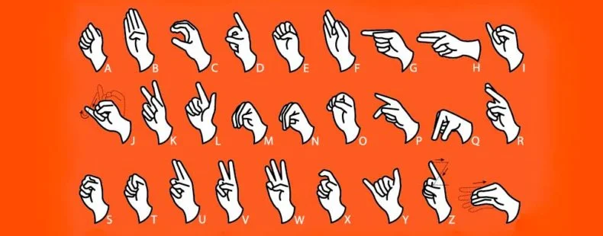
Introduction
Sign Language Alphabets use hand and facial gestures to bridge the communication gap between people with speaking and hearing disabilities.
Technology can convert sign gestures into readable text, reducing the communication gap between people with disabilities and the general public.

Slide 5
Literature Survey
Sl. No. | Reference Paper | Literature Review | Merits | Demerits
1. | Real-Time Hand Gesture Recognition Using Finger Segmentation Author: Zhi-hua Chen,¹ Jung-Tae Kim,¹ Jianning Liang,¹ Jing Zhang,^{1,2} and Yu-Bo Yuan¹ Year: 2014 | Hand gesture recognition is very significant for human-computer interaction. In this work, we present a novel real-time method for hand gesture recognition. In our framework, the hand region is extracted from the background with the background subtraction method. Then, the palm and fingers are segmented so as to detect and recognize the fingers. Finally, a rule classifier is applied to predict the labels of hand gestures. The experiments on the data set of 1300 images show that our method performs well and is highly efficient. Moreover, our method shows better performance than a state-of-art method on another data set of hand gestures. | Accurate prediction. | Difficulty in analyzing the hand gesture with few images dataset.

Slide 6
Sl. No. | Reference Paper | Literature Review | Merits | Demerits
2. | User-Independent American Sign Language Alphabet Recognition Based on Depth Image and PCANet Features Author: ASIF KARIM , SAMI AZAM , BHARANIDHARAN SHANMUGAM , KRISHNAN KANNOORPATTI , AND MAMOUN ALAZAB Year: 2019 | Sign language is the most natural and effective way for communications among deaf and normal people. Hand region can be segmented by applying a simple preprocessing algorithm over depth image. Feature learning using convolutional neural network architectures is applied instead of the classical hand-crafted feature extraction methods | Accurate prediction. | Time consuming if dataset is improper.

Slide 7
Sl. No. | Reference Paper | Literature Review | Merits | Demerits
3. | Dog Breed Classifier for Facial Recognition using Convolutional Neural Networks Author: Kriti Agarwal, T. Kumar Year: 2021 | This paper dealt with the breed classification of dogs. A set of sample images of a breed of dogs and humans are used to classify and learn the features of the breed. This research work has used principal component analysis to shorten the most similar features into one group to make an easy study of the features into the deep neural networks. And, the facial features are stored in a vector form. | Accurate prediction. | Complex algorithms in processing images

Slide 8
Sl. No. | Reference Paper | Literature Review | Merits | Demerits
4. | User-Independent American Sign Language Alphabet Recognition Based on Depth Image and PCANet Features Author: Walaa Aly, Saleh Aly, Sultan Almotairi Year: 2019 | In this paper, we propose a new user independent recognition system for American sign language alphabet using depth images captured from the low-cost Microsoft Kinect depth sensor. Exploiting depth information instead of color images overcomes many problems due to their robustness against illumination and background variations.Hand region can be segmented by applying a simple preprocessing algorithm over depth image. | Less complex | Time consuming if data set is improper.

Slide 9
Sl. No. | Reference Paper | Literature Review | Merits | Demerits
5. | User-Independent American Sign Language Alphabet Recognition Based on Depth Image and PCANet Features Author: Shradhanjali Prof. Toran Verma Year: 2017 | Exploiting depth information instead of color images overcomes many problems due to their robustness against illumination and background variations. Hand region can be segmented by applying a simple preprocessing algorithm over depth image. Feature learning using convolutional neural network architectures is applied instead of the classical hand-crafted feature extraction methods. | High Accuracy. | If dataset is improper it may take long time to preprocess.

Slide 10
Problem Statement
The problem statement is to develop a machine learning model that can accurately recognize and interpret sign language gestures. This involves analyzing and processing video data of hand gestures and converting it into meaningful language output. The challenge lies in overcoming the complexity and variability of hand motions, as well as the diversity of sign languages used across different regions and cultures.

Slide 11
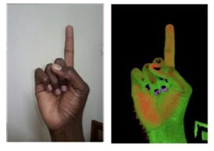
Existing System
Existing color-based sign language recognition systems suffer from many challenges such as complex background, hand segmentation, large inter-class and intra-class variations, and Principal Component Analysis Network (PCANet) deep learning architecture.

Slide 12
Proposed System
We are recognizing and predicting sign language using the CNN algorithm. Implementing the CNN model in a real-time system that can recognize user-inputted gestures.
The system will employ pass input photos to capture the user's hand motions and feed them to the CNN model for recognition.
Some of the advantages of using the proposed method are: High accuracy, Time Saving, Faster process.

Slide 13
Analysis
Objectives
Accurately recognize and classify hand gestures
Robustness to variations
Real-time processing
Multilingual support
Accessibility

Slide 14
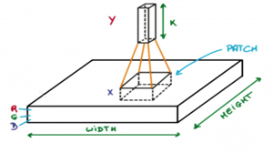
Methodology
Convolutional Neural Networks or covnets are neural networks that share their parameters.
Imagine you have an image. It can be represented as a cuboid having its length, width (dimension of the image) and height (as image generally have red, green, and blue channels).
Now imagine taking a small patch of this image and running a small neural network on it, with say, k outputs and represent them vertically. Now slide that neural network across the whole image, as a result, we will get another image with different width, height, and depth. Instead of just R, G and B channels now we have more channels but lesser width and height. This operation is called Convolution. If patch size is same as that of the image it will be a regular neural network. Because of this small patch, we have fewer weights.

Slide 15
Methodology
CNNs have 5 layers :
Input Layer: This layer holds the raw input of image with width 32, height 32 and depth 3.
Convolution Layer: This layer computes the output volume by computing dot product between all filters and image patch. Suppose we use total 12 filters for this layer we’ll get output volume of dimension 32 x 32 x 12.
Activation Function Layer: This layer will apply element wise activation function to the output of convolution layer. Some common activation functions are RELU: max(0, x), Sigmoid: 1/(1+e^-x), Tanh, Leaky RELU, etc. The volume remains unchanged hence output volume will have dimension 32 x 32 x 12.

Slide 16
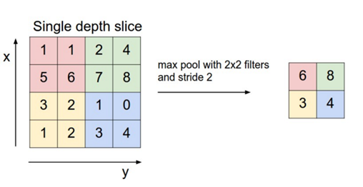
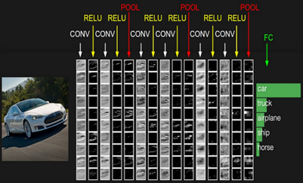
Methodology
Pool Layer: This layer is periodically inserted in the covnets and its main function is to reduce the size of volume which makes the computation fast reduces memory and also prevents from overfitting. Two common types of pooling layers are max pooling and average pooling. If we use a max pool with 2 x 2 filters and stride 2, the resultant volume will be of dimension 16x16x12.
Fully-Connected Layer: This layer is regular neural network layer which takes input from the previous layer and computes the class scores and outputs the 1-D array of size equal to the number of classes.

Slide 17
Analysis
System Requirement Specification
HARDWARE REQUIREMENTS:
Processor: Dual Core
Processor Speed: 1.1 GHz
RAM: 8 GB
HDD: 20 GB
GPU: NVIDIA GTX 1060
SOFTWARE REQUIREMENTS:
Operating System: Windows 7 or above
Software: Jupyter Notebook or Pycharm
Technology: Machine Learning
Programming Language: Python 3.7 and higher

Slide 18
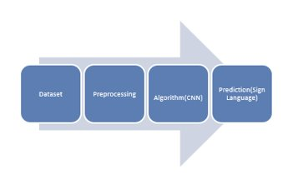
System Design
Input:
The input to the system is a video or sequence of images of a person making a sign.

Slide 19
Preprocessing
We begin by converting the RGB image to a grayscale image. It aids in reducing visual complexity and making the process easier.
The grey scale values are then converted to binary values using the min-max scalar approach.
In the obtained binary matrix consider one value region as white and zero value region black.
By using these values, the region of interest can be identified. So that the values are useful for feature extraction and identification of regions of interest.

Slide 20
Feature Extraction
In this stage extract the required feature from the identified region which is obtained from the previous step. That region is compressed by converting a reduced size matrix to control over fitting.
The reduction of the matrix size helps in reducing the memory size of the images.
Then the flattening process is applied to the reduced matrix, in which the reduced matrix is converted to a one-dimension array, which is used for final detection.

Slide 21
Machine Learning Model
The extracted features are fed into a machine learning model, such as a support vector machine (SVM), decision tree, or neural network.
The model is trained on a labeled dataset of sign language gestures, allowing it to learn and recognize different signs.

Slide 22
Output
The machine learning model outputs a prediction of the sign being made in the input video or images.
This prediction can be used to generate text or audio output, allowing individuals who do not understand sign language to access the information being communicated.

Slide 23
Evaluation
The performance of the system is evaluated using metrics such as accuracy, precision, and recall. The system can be fine-tuned and improved based on these results.

Slide 24
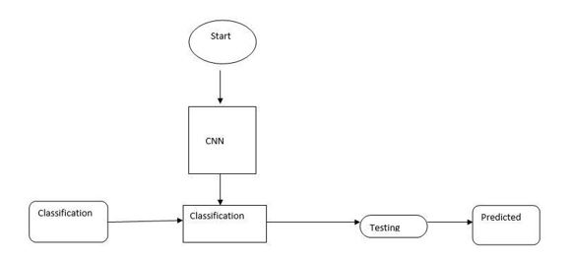
System Design
System Architecture:

Slide 25
System Design
The input image is preprocessed and converted to gray scale image to get the clear vision of the image. Then it will be converted into binary values.
In the next step identify the part which needs to proceed further. Then required features are extracted by In the CNN convolution layer.
By passing those features into different layers of CNN we get a compressed image, that feature is used for detection of sign language.

Slide 26
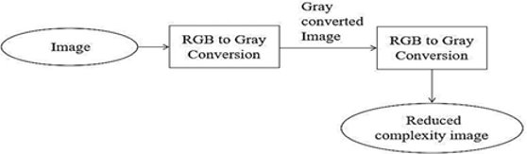
System Design
Specifications using use case diagrams:
As we give the color image so that RGB image is converted into gray scale values to reduce complexity in the image.
For efficient feature extraction gray scale values are converted into binary values. Then the image with reduced complexity is sent to the next process.

Slide 27
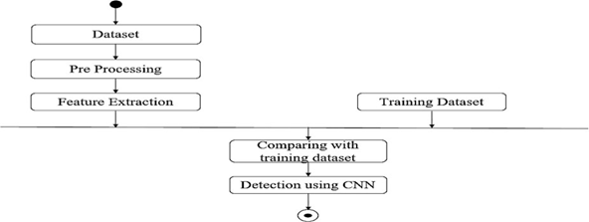
System Design
Activity Diagram
Here the preprocessing of the image by converting the RGB to grayscale image and feature extraction is done by the first layer that is the convolution layer of the neural network and detection done by using fully connected layers of the convolutional neural network

Slide 28
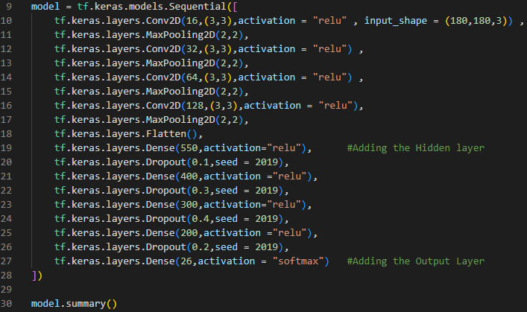
Implementation/Coding
Training the model

Slide 29
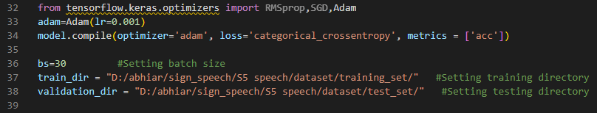

Slide 30
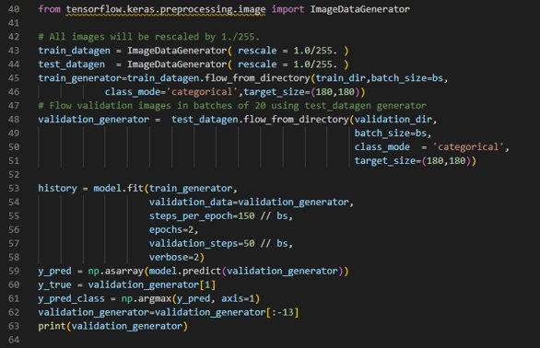

Slide 31
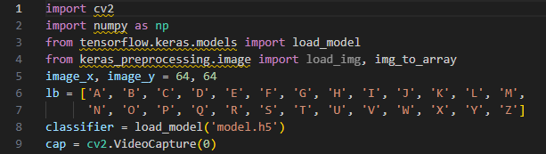
Image prediction

Slide 32
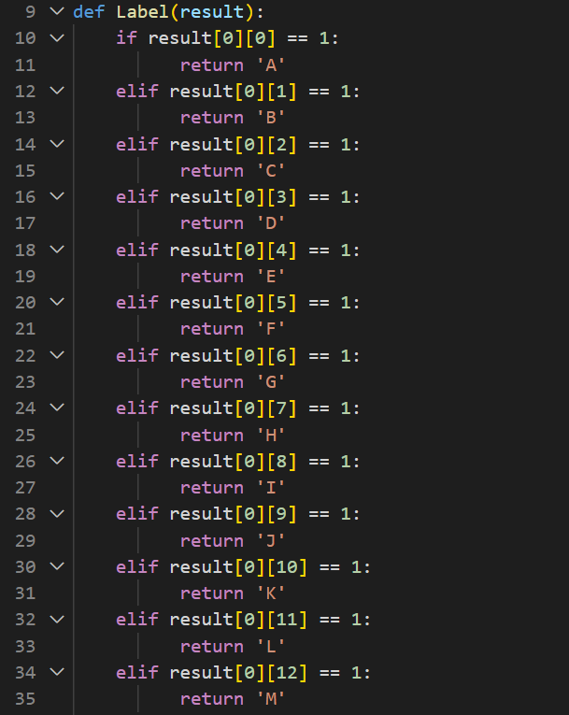
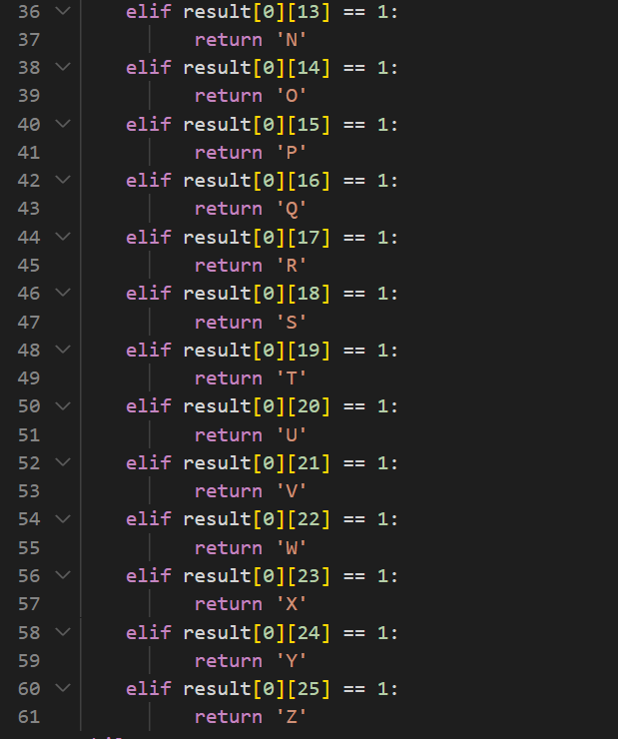

Slide 33
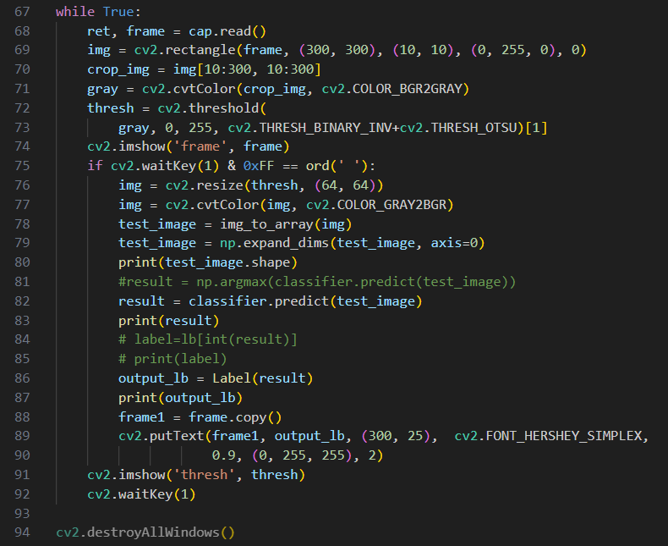

Slide 34
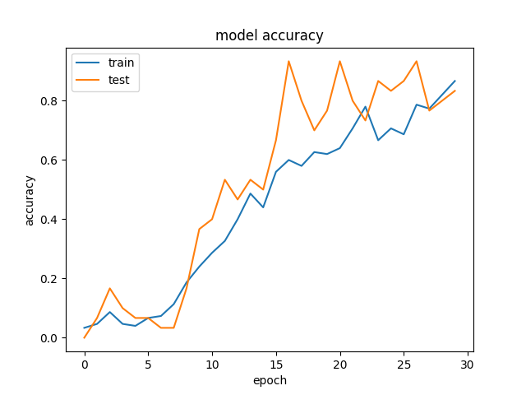
Graphs

Slide 35
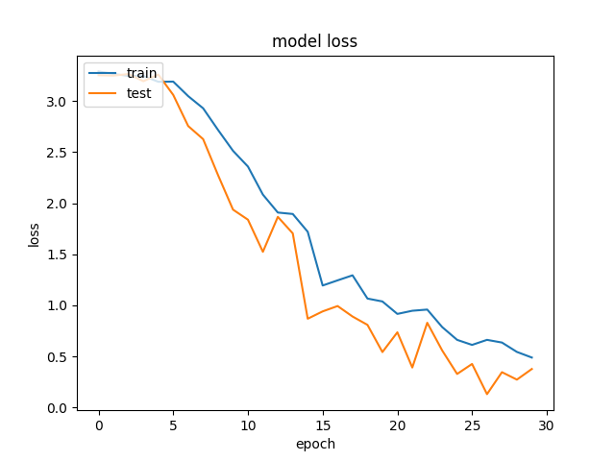

Slide 36
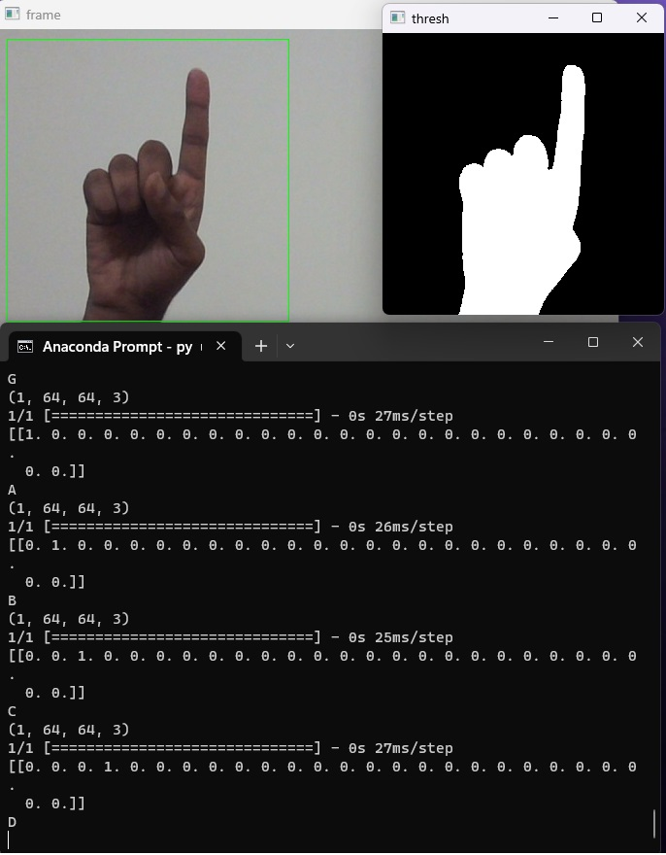
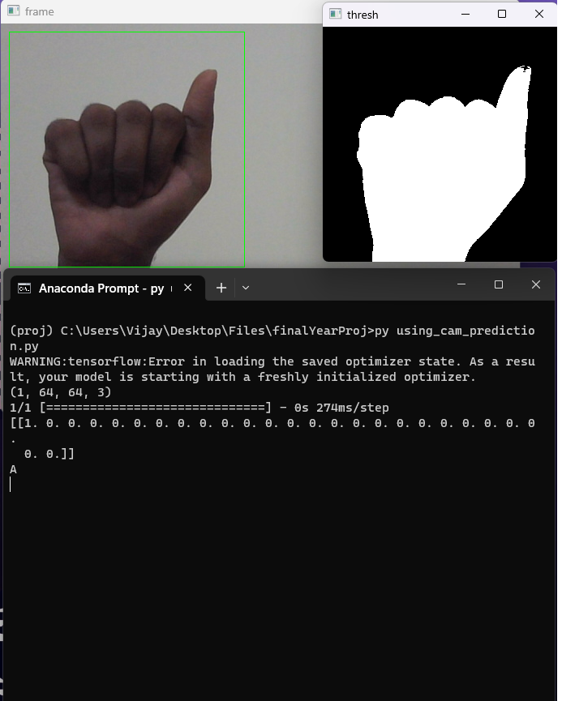
Results and Discussion

Slide 37
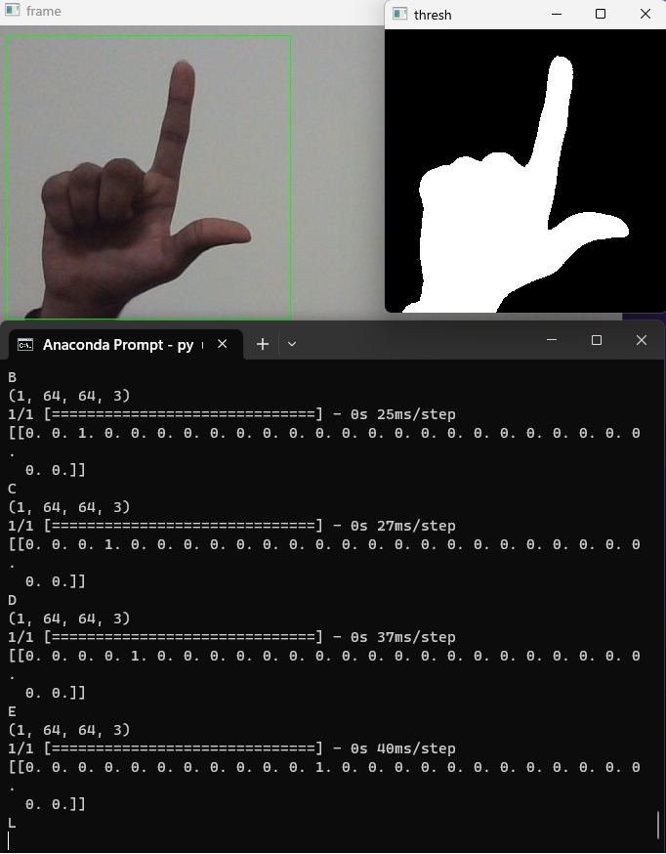
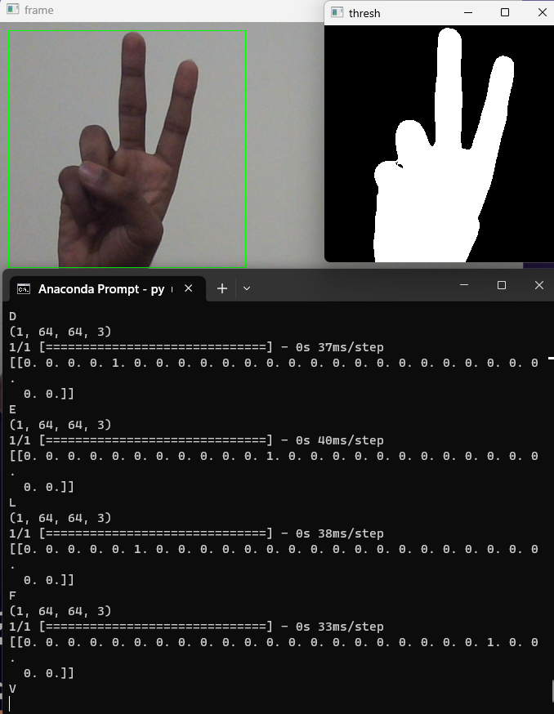

Slide 38
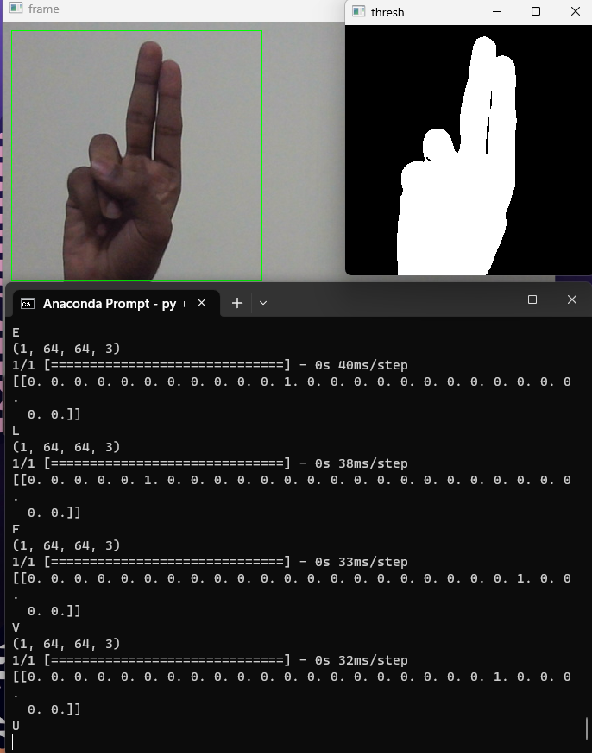

Slide 39
CONCLUSIONS
Convolution Neural Networks (CNNs) are being utilized in this work to recognize alphabets in sign language.
Sign language is a visual language that communicates using gestures, facial expressions, and body language.
The CNN method is used to recognize and categories sign language hand motions, which may subsequently be mapped to particular letters of the alphabet.
In this scenario, the CNN algorithm is being trained on a dataset of sign language motions and their accompanying alphabet letters to learn how to recognize and categorize new movements.

Slide 40
Future Enhancements
The system could interpret the meaning of complete sentences or phrases by incorporating Natural Language Processing (NLP), making it more efficient at enabling conversation.
Developing a comprehensive library of sign language gestures could help improve the accuracy of the system and enable it to recognize a wider range of gestures from different sign languages.

Slide 41
REFERENCES
[1] S. Y. Kim, H. G. Han, J. W. Kim, S. Lee, and T. W. Kim, “A hand gesture recognition sensor using Proceedings of the Fifth International Conference on Intelligent Computing and Control Systems (ICICCS 2021) IEEE Xplore Part Number.
[2] Y. Cui and J. Weng, “A learning-based prediction and-verification segmentation scheme for hand sign image sequence,” IEEE Trans. Pattern Anal. Mach. Intell., vol. 21, no. 8, pp. 798–804, 1999, doi: 10.1109/34.784311.
[3] A. Kumar and A. Kumar, “Dog Breed Classifier for Facial Recognition using Convolutional Neural Networks,” pp. 508–513, 2020.
[4] K. L. Bouman, G. Abdollahian, M. Boutin, and E. J. Delp, “A low complexity sign detection and text localization method for mobile applications,” IEEE Trans. Multimed., vol. 13, no. 5, pp. 922–934, 2011, doi: 10.1109/TMM.2011.2154317.
[5] J. Wu, L. Sun, and R. Jafari, “A Wearable System for Recognizing American Sign Language in RealTime Using IMU and Surface EMG Sensors,” IEEE J. Biomed. Heal. Informatics, vol. 20, no. 5, pp. 1281–1290, 2016, doi: 10.1109/JBHI.2016.2598302
[6] C. Zhang, W. Ding, G. Peng, F. Fu, and W. Wang, “Street View Text Recognition With Deep Learning for Urban Scene Understanding in Intelligent Transportation Systems,” IEEE Trans. Intell. Transp. Syst., pp. 1–17, 2020, doi: 10.1109/tits.2020.3017632.
[7] M. Safeel, T. Sukumar, K. S. Shashank, M. D. Arman, R. Shashidhar, and S. B. Puneeth, “Sign Language Recognition Techniques- A Review,” 2020 IEEE Int. Conf. Innov. Technol. INOCON 2020, pp. 1–9, 2020, doi: 10.1109/INOCON50539.2020.9298376.
[8] W. Aly, S. Aly, and S. Almotairi, “User independent American sign language alphabet recognition based on depth image and PCANet features,” IEEE Access, vol. 7, pp. 123138–123150, 2019, doi: 10.1109/ACCESS.2019.2938829.

Slide 42
Question and Answer

Slide 43
THANK YOU

