Slide 1
Attribution Modeling
Introduction
Multi-source attribution
Google MCF
Reporting
1

Slide 2
Introduction
In Analytics, conversions and ecommerce transactions are credited to the last campaign, search, or ad that referred the visitor when he or she converted.
What role did prior website referrals, searches and ads play in that conversion? How much time passed between the visitor's initial interest and his or her purchase? These questions are answered by Multi-channel attribution reports.
It shows how your marketing channels (i.e. sources of traffic to your website) work together to create sales and conversions.

Slide 3
Introduction
Conversion Paths: Multi-Channel Funnels reports are generated from conversion paths, the sequences of interactions, i.e. clicks/referrals during the 30 days that led up to each conversion and transaction. Conversion path data include interactions with virtually all digital channels. These channels include, but are not limited to:
  paid and organic search
  referral sites
  Affiliates
  social networks
  email newsletters
  custom campaigns that you’ve created

Slide 4
Why use Multi-source, Multi-channel attribution?
View all of your digital marketing channels in one place
Better understand the value of your marketing efforts
See a complete picture of the steps your customers take before purchasing or converting
Improve your marketing based on channel performance
Make the right digital marketing budgeting decisions

Slide 5
Multi-source
Following Sources provide raw data and metrics via APIs:
  Google Adwords
  DoubleClick –
  Bing Search / Atlas
  Yahoo Search
  Omniture
  Facebook
Standard reports display Clicks, Impressions and Conversions
Assisted Conversion is additional parameter reported by attribution modeling
The process of calculating Assisted Conversion involves marrying various raw data points and perform ETL in order to derive various metrics

Slide 6
Data Aggregation & Sources
Data | Source | Data
Unique identifier | Cookie data | Unique user ID User information on subsequent logons IP address and time stamp
Transactional data | Google Analytics and Cookie data | IP address Time stamp Geo-location
Ad data | Third parties | Campaign data Average position Clicks Impressions CTR CPC Cost Conversions Conversion rate Cost per conversion Revenue ROAS
Conversion path data | Google MCF reporting API | Average number of clicks to conversion Average lead time per click Average time spent on page Break down by geo-location
Conversion tracker | Pixel and Cookie data | User unique identifier Pixel data
Email data | Email service provider | Clicks Impressions (open rate) Conversions Associated email data as required

Slide 7
Google MCF
Google started providing Multi-Channel Funnel Reporting APIs in September 2012
MCF APIs offer pre-calculated metrics on assisted conversion which could be used for attribution modeling and reporting
Google Multi-Channel Attribution Reporting is part of Google Analytics Premium. It costs US$1,50,000 yearly recurring.
However, MCF APIs are free to use with standard quota limits

Slide 8
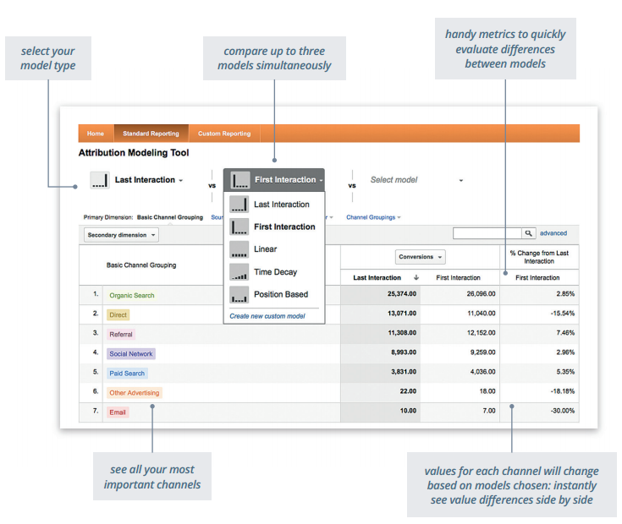
Google MCF

Slide 9
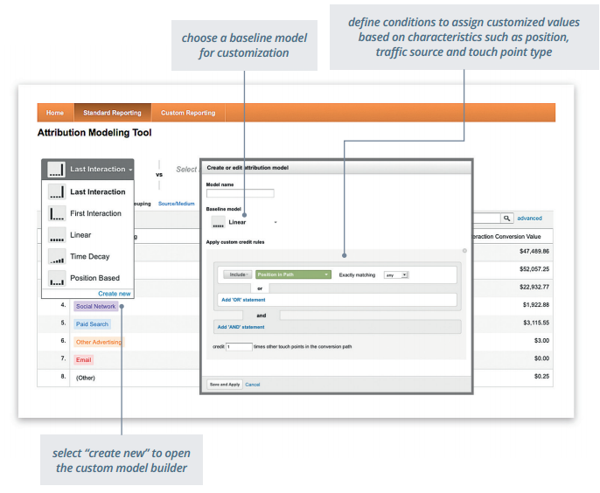
Google MCF

Slide 10
Attribution Models
Model | Descriptions
Last click or interaction | This attribution model would allot 100 percent of the credit of the conversion to the last click or interaction made by the user.
First click or interaction | This attribution model would allot 100 percent of the credit of the conversion to the first click or interaction made by the user.
Linear attribution | All clicks and interactions in the conversion path would be provided equal credit for the conversion.
Time decay | In this model, the click or the interaction closest to the conversion time would be given higher credit.
Reverse time decay | This model, similar as the earlier one, would give clicks or interactions at the start of the conversion path higher credit for the conversion.
Position based | This model would attribute credit based on the position of the click or the interaction.
Custom attribution | This would be a configurable model that could be used in conjunction with linear, time, or position-based attribution.

Slide 11
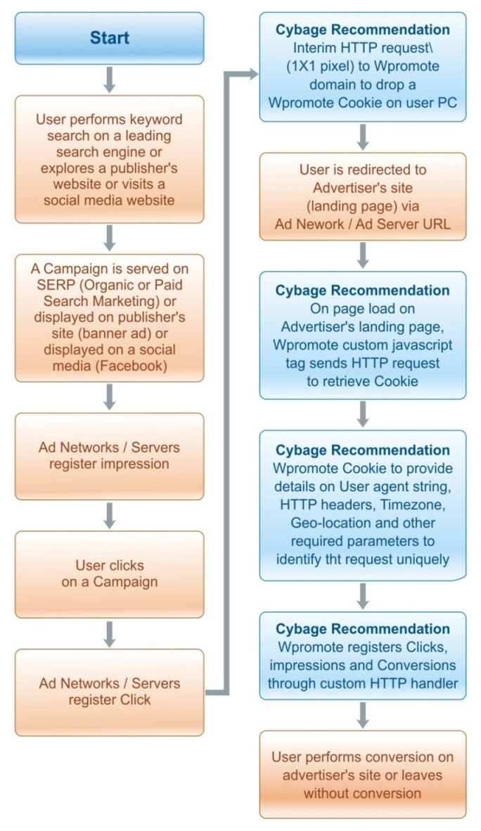
Custom approach

Slide 12
Attribution Reports
Overview Report - A snapshot of total clicks, impressions and conversions
Interaction Report - A snapshot of No. of Interactions by users resulting in conversion
Time Lag Report - A snapshot of No. of days taken for conversion
Conversion Path Report - A snapshot of No. of Top Conversion Paths - includes group by conversion medium, keyword, Campaign
Attribution Report - User could give weights to each channel and re-generate report. First Interaction, Last Interaction, Linear, Time Decay, Position Based. User could select attribution type (First interaction, linear, last interaction, time decay, custom)

Slide 13
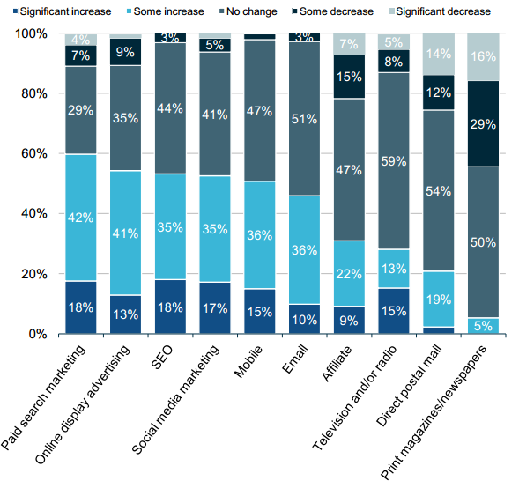
Changes to Channel investments Resulting from Attribution

Slide 14
References
1. Beginners guide to multi-source attribution
http://searchenginewatch.com/article/2064773/Beginners-Guide-to-Multi-Source-Attribution-Modeling
2. How to get past last touch attribution with Google analytics
http://www.seomoz.org/blog/how-to-get-past-last-touch-attribution-with-google-analytics
3. Google Analytics Multi-Channel Attribution
API: https://developers.google.com/analytics/devguides/reporting/mcf/v3/reference#q_summary
4. Omniture SiteCatalyst
SAINT SiteCatalyst Attribute Importing and Naming Tool
http://blogs.adobe.com/digitalmarketing/analytics/classifications-aka-saint-inside-omniture-sitecatalyst/
http://blogs.adobe.com/digitalmarketing/analytics/unified-sources-the-db-vista-solution-that-makes-other-vista-solutions-cower-in-fear/
SAINT API:
http://blogs.adobe.com/digitalmarketing/analytics/web-services-api-series-saint-api-your-new-best-friend/
API Docs:
http://microsite.omniture.com/t2/help/en_US/sc/saint/oms_sc_saint.pdf
7. DoubleClick: Attribution Modeling in DFA
http://doubleclickadvertisers.blogspot.in/2012/09/making-better-decisions-attribution.html
Path to conversion report:
http://doubleclickadvertisers.blogspot.in/2012/06/introducing-path-to-conversion-report.html
API: https://developers.google.com/doubleclick-advertisers/reporting/v1.1/dimensions
5. Yahoo Traffic Attribution
http://help.yahoo.com/l/us/yahoo/ywa/faqs/campaigns/trafficattribution/
Yahoo Search Marketing API:
http://developer.searchmarketing.yahoo.com/docs/index.php

