Slide 1
Search Marketing
Authored / Presented by: Darshan Radia
Date: Nov 8, 2026

Slide 2
This is Agenda slide
Search Engines - Introduction
Workings of a Search Engine
SEO – Overview
SEM - Overview

Slide 3
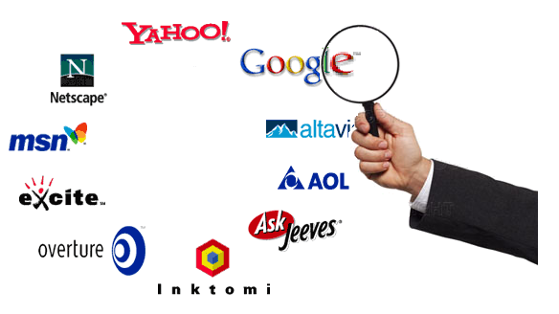
Search Marketing overview
Some Facts…
  Searching is the second most popular online activity following email.
  Statistics reveal that 85% of all internet users rely on search engines to find information on the web.
  In addition, 80% of all searchers won’t click past the first page and 90% won’t click past the third page of search results.
  The top 10 search engines account for more than 90% of all search traffic.
Conclusion…
Searching is big business; and the Search Engines are the key to drive users to sites.

Slide 4
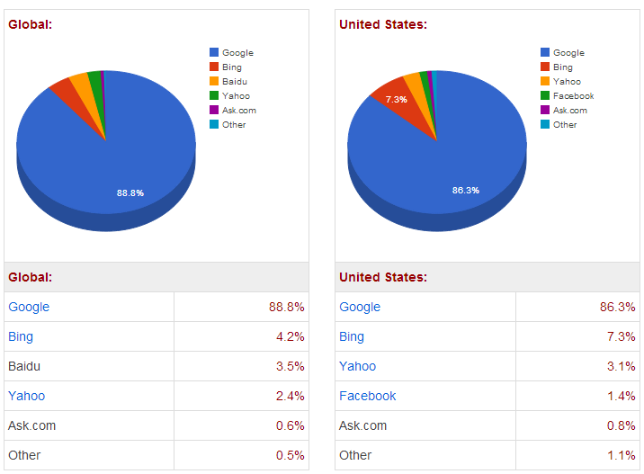
Search Engine Usage Statistics

Slide 5
Search Marketing
“ It is very important to be found under the search terms that people are using to find the products and services you deal with. ”
Search Marketing is the process and strategy of using search engines results as an advertising vehicle.
SM is needed to increase a site’s rank and visibility in search engines
Search Marketing
Natural Search
Search Engine Optimization
Paid Search
PPC / Keyword Bidding

Slide 6
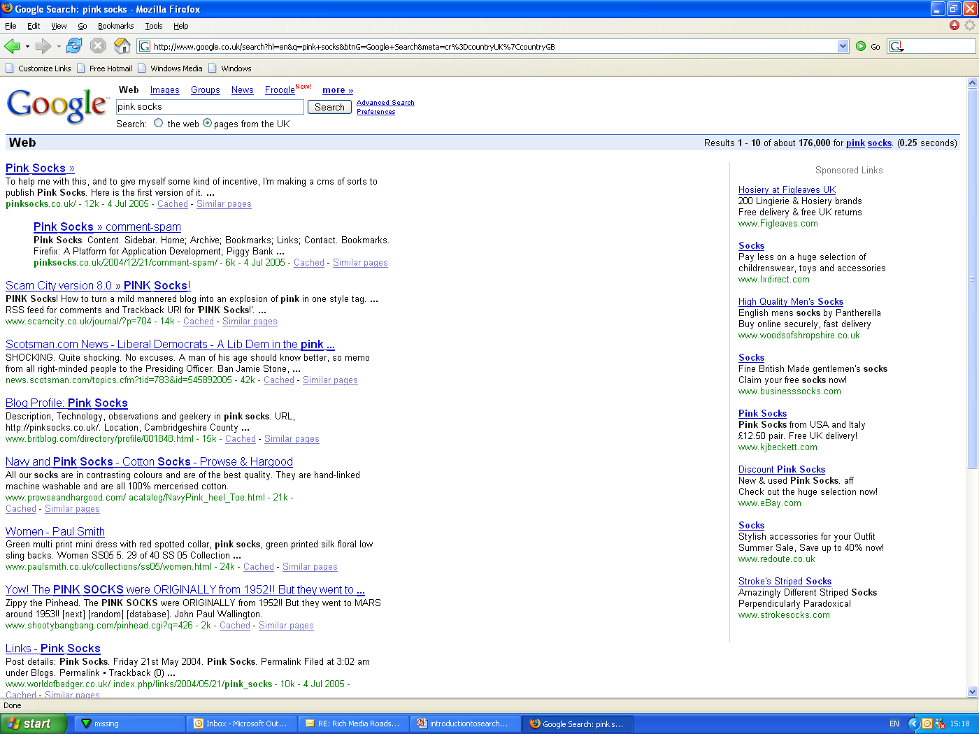
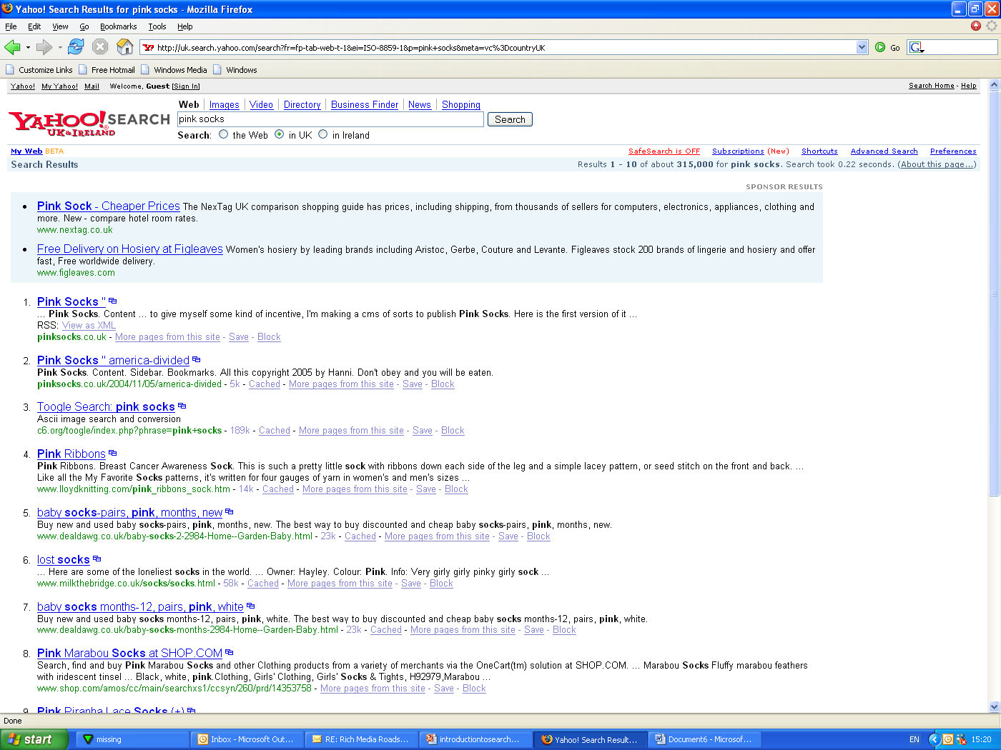
Natural Search Vs. Paid Search
Sites appear in Natural listings because the site has been indexed by the search engine as being of relevance to the search term.
Search Engine Optimisation is the process whereby a site can be optimised to be ‘search engine friendly’ in order to improve its natural position
Sites appear in the sponsored links
because they have paid search engines to appear here
‘Pay per Click’ (PPC) is the buying model for this whereby the advertiser bids on certain keywords and pays for each click on their link

Slide 7
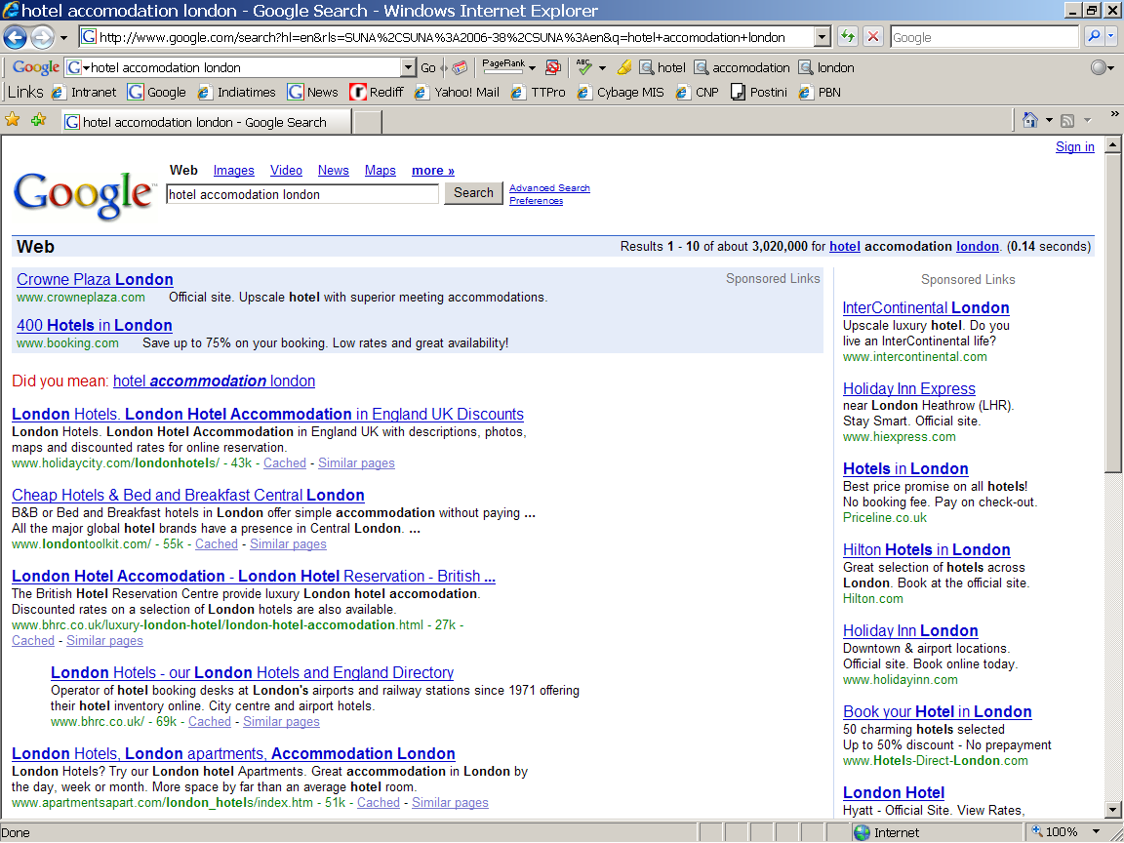
Natural search vs. Paid search
Organic (Natural Search)
Approach from the ground up.
Your site fights it out.
No special financial consideration.
In-Organic (Paid Search)
PPC Campaigns
Adwords
Incur financial cost

Slide 8






Search Marketing entities
owner of the websites
Publisher
the websites the Publisher is interested in being seen in SERPs.
Web Sites
the keywords; search phrases that users use to locate services / products being offered by the Publisher (Paid Listing).
PPC
the process used to naturally optimize the web sites.
SEO
the search engines people use to search for information.
Search Engines
the users who are interested in locating specific product / service information.
Search Users

Slide 9

SEM Workflow
Publisher
Web Sites
Search Marketing
SEO
PPC
Optimized Sites
Search Engines
Search Users

Slide 10
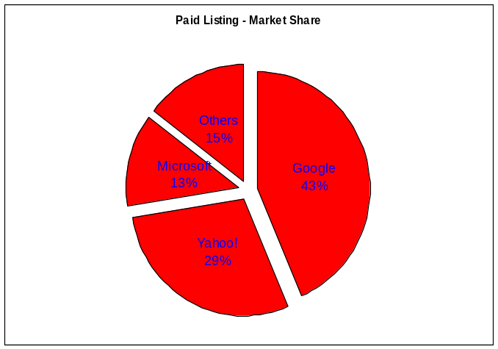
SEM key players
Paid Listing
  Google – AdWords
  Yahoo! – Search Engine Marketing
  Microsoft – Bing ads
Natural Search

Slide 11
Technology
Natural Listing (Search Engine Optimization)
Refers to the process of “optimizing” both the on-page and off-page ranking factors in order to achieve high search engine rankings for targeted search terms or phrases.
What is the Ranking Algorithm?
Top Secret! Only select employees of a search engines company know for certain
Reverse engineering, research and experiments gives SEOs (search engine optimization professionals) a “pretty good” idea of the major factors and approximate weight assignments
The Ranking algorithm is constantly changed, tweaked & updated
Websites and documents being searched are also constantly changing
Varies by Search Engine – some give more weight to on-page factors, some to link popularity

Slide 12
Technology
Search Engine Optimization – Page Ranking Factors…
On-Page Factors (Code & Content)
    Content, Content, Content (Body text) <body>
    Keyword frequency & density
    Title tags <title>
    ALT image tags
    Header tags <h1>
    Hyperlink text
    Meta-tags
Off-Page Factors
    Anchor text
    Link Popularity (“votes” for your site) – adds credibility
The 5 core components of a paid search marketing campaign include keywords, bidding, budgeting, ad creatives, and landing page. Each component contributes in its own way to the overall performance of your search engine marketing campaign.

Slide 13
SEM campaign objectives
Increasing and optimizing traffic to their site
Increasing brand awareness and image
Being found when somebody makes more than one search
Creation of keywords listings according to local markets
Budget assignment among various countries and search engines
Listings optimization
Bid strategies optimization

Slide 14
Client benefits
Co-relation of disparate data.
Aggregate indicators and detail-level metrics for campaigns, search engines, and keywords, including keyword margins and campaign value statistics.
Critical analysis into which campaigns, keywords and search engines attract the most valuable visitors and which ones generate the lowest margins.
Identification of top performing and underperforming search engines.
Identification of most profitable, least profitable keywords.
Optimization of content as well as landing pages

Slide 15
Conclusion
Search Marketing strategy involves utilizing search engines results as an advertising vehicle. This may include improving the Web site rank in organic listings, purchasing paid listings, or a combination of methods, all designed to increase visibility and clicks.
Ads can be placed on Web pages that show the results of search engine queries as well as on Web pages that display published content.
The ads placed using this form of interactive advertising are targeted to match the keywords entered on search engines.
The Search Advertising segment is highly metrics-driven. CPM, CTR, CPA, CPC, and TM are the most widely used metrics to measure ad efficiency.

