Slide 1
Separation of Double Exposure
Recovering Two Source Images from a Single Blended Image
Vishal Singh · Angelina Sun
CS585 Image and Video Computing · Boston University
Notes:
Welcome. Today we present our CS585 project: Separation of Double Exposure. We built an end-to-end framework to recover two source images from a single blended double-exposure photograph. We will cover the problem, our synthetic data pipeline, model, results, and next steps.

Slide 2
Problem & Goal
Double-exposure images combine two scenes into one photograph.
Goal: recover both original source images from a single mixture.
This is an ill-posed inverse problem — many image pairs could produce the same blend.
Real double exposures lack ground-truth layers, so we use synthetic supervision.
[Insert: double-exposure example image]
Source 1
+
Source 2
→
Mixture
→
Model
→
Pred Src 1
Pred Src 2
Notes:
Double exposure is when two scenes are superimposed into one image. Reversing this is ill-posed because infinitely many pairs can create the same mixture. Since real double-exposure photos don't come with ground-truth layers, we generate synthetic training data with known source images.

Slide 3
Synthetic Data Pipeline
Places365 Clean Images
Sample Image Pairs
Apply Blending
Save Mixture + Targets + Metadata
→
→
→
Supported Blending Modes
• α · source₁ + (1−α) · source₂ (linear alpha)
• Gradient mask blending
• Gaussian blur on one source
• Gamma correction on mixture
• Spatial translation / shift
• Additive Gaussian noise
Key Design Decisions
Supervised data is entirely synthetic — real double exposures lack ground-truth.
Rich metadata (α, mode, blur, γ) enables interpretable, fine-grained evaluation.
Train / val splits ensure no image leakage.
Each sample saves: mixture.png, source_1.png, source_2.png, manifest row.
Notes:
We cannot train with real double-exposure photos because we have no ground-truth source layers. Instead we synthetically generate mixtures from Places365 images. The pipeline samples two images, applies configurable blending, and saves the mixture, both source targets, and rich metadata. This metadata lets us later evaluate model performance by alpha range, blending mode, and scene similarity.

Slide 4
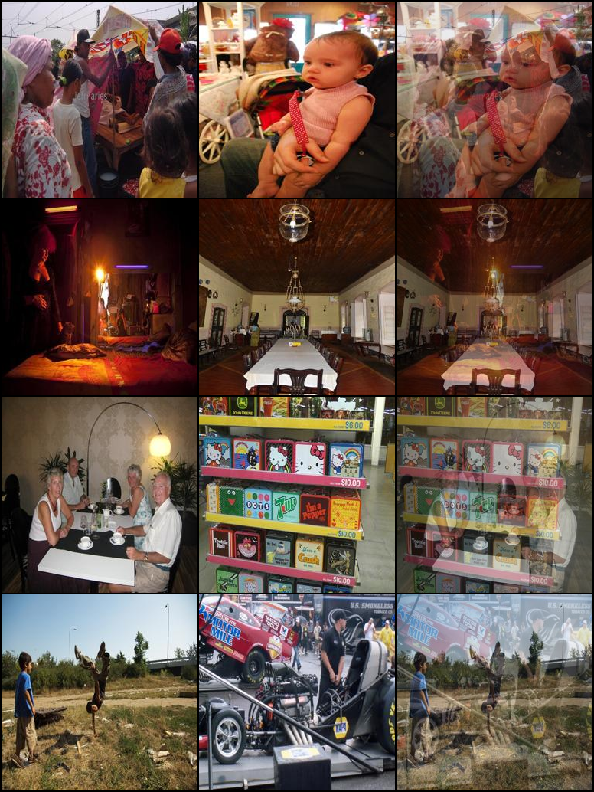
Dataset Examples
Each training sample: Source 1 | Source 2 | Mixture
The model receives the mixture as input and must predict both sources.
Source ordering is ambiguous — permutation-invariant loss handles this.
Metadata records alpha, blending mode, blur, and gamma for each pair.
Notes:
This grid shows examples from our synthetic dataset. Each row has two source images and the resulting blended mixture. The model's task is to take the mixture and predict the two source images. Note that the ordering is ambiguous — the model could output either source as pred_1 or pred_2, which is why we use permutation-invariant loss.

Slide 5
Baseline Model: Dual-Head U-Net
Shared Encoder 4 ↓ stages
Shared Decoder 4 ↑ stages
6-ch output
Mixture 3 × 256 × 256
→
→
→
split
Pred Src 1
Pred Src 2
← skip connections →
Architecture Details
Input: 1 mixture image (3 × 256 × 256)
Encoder: C → 2C → 4C → 8C → 16C (max-pool)
Decoder: transposed conv + skip connections
Final 1×1 conv → 6 channels → split to 2×RGB
Sigmoid activation → outputs in [0, 1]
Configurable base channels (16, 32, 64)
Permutation-Invariant L1 Loss
loss_a = L1(p₁, s₁) + L1(p₂, s₂)
loss_b = L1(p₁, s₂) + L1(p₂, s₁)
final_loss = min(loss_a, loss_b)
Handles output-order ambiguity.
The model is free to assign either source to either output head.
Notes:
Our baseline is a Dual-Head U-Net. A shared encoder-decoder processes the mixture image. The final 1×1 conv produces 6 channels which are split into two 3-channel RGB predictions. Because the two sources are unordered, we use a permutation-invariant L1 loss: we compute the loss for both possible assignments and take the minimum. This lets the model freely assign either source to either output head.

Slide 6
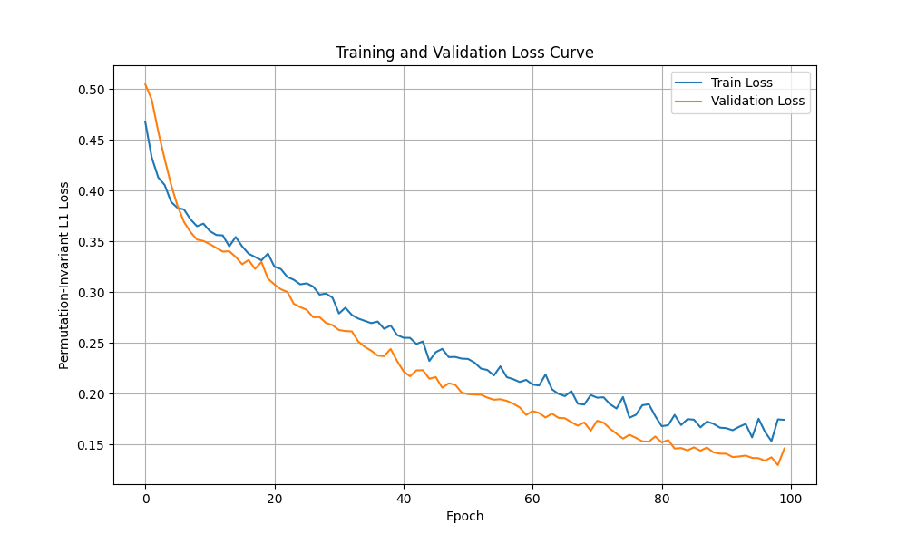
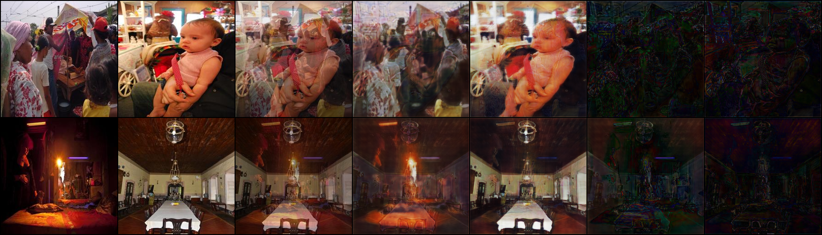
Results & Findings
Pipeline Validation
✓ Dataset diagnostics passed — tensors RGB, float32, [0, 1]
✓ End-to-end training + evaluation pipeline functional
Overfit Sanity Check (100 epochs · 16 samples · base_ch=32)
Train L1: 0.467 → 0.174
Best Val L1: 0.130
Model memorises small dataset → confirms pipeline correctness
Quick Baseline (5 epochs · base_ch=16 · full data)
Val L1: 0.421 | PSNR: 12.24 dB | SSIM: 0.286
The baseline produces separated predictions showing early layer separation.
Results are preliminary — stronger training is planned.
Epoch 100 predictions (S1 · S2 · Mix · P1 · P2 · Err1 · Err2)
Notes:
We ran a 100-epoch overfit sanity check on 16 samples with base_channels=32. The loss dropped from 0.467 to 0.174 and the best validation L1 reached 0.130. The epoch 100 visual shows the model learning to separate structure and color. We also ran a quick 5-epoch baseline on the full dataset with base_channels=16 which achieved 12.24 dB PSNR and 0.286 SSIM. These are preliminary results — the model learns meaningful structure but output quality remains preliminary. The framework is ready for stronger training.

Slide 7
Next Steps & Conclusion
Planned Improvements
Scale to base_channels = 32 → 64
Train for 30+ epochs on larger dataset
Scale to 1,000–5,000 synthetic pairs
Add reconstruction-consistency loss
α · p₁ + (1−α) · p₂ ≈ mixture
Evaluate by alpha range and synthesis mode
Compare harder blending: blur, mask, γ, shift
Conclusion
We implemented an end-to-end separation framework for double-exposure images.
The baseline successfully produces separated output predictions.
The outputs show early layer separation behavior.
Key Contribution
A controlled synthetic framework for studying double-exposure separation and analysing which visual factors make separation difficult.
Thank you · Questions?
Notes:
Moving forward, we will scale our training with more data and a larger model. We plan to add a reconstruction-consistency loss and evaluate against harder blending regimes. The key contribution is the controlled synthetic framework itself, which lets us precisely measure what makes separation difficult. Thank you for listening — happy to take questions.

