Slide 1
AI Stock Market Assistant
Multi-agent system with LangChain + LangGraph
Price analysis · RAG over financial news · simulated Buy / Sell / Hold
Assignment 1.1 | Vishal Singh | Advanced Data Analytics & Gen AI, IIT Roorkee

Slide 2
Objective: one assistant, four capabilities
Analyze price data
Retrieve news with RAG
yfinance history; SMA20/50, RSI14, MACD, volatility and 52-week range computed in Python.
Google News RSS → chunks → embeddings → vector store → retriever → grounded sentiment summary.
Reason with an LLM
Simulated recommendation
Pydantic structured outputs on Groq (gpt-oss-20b) for the analysis, confidence and recommendation.
BUY / SELL / HOLD with confidence, justification, key risks and time horizon.
Built with LangChain (LLM, prompt templates, tools, LCEL chains) and LangGraph (state, nodes, edges, conditional edges)

Slide 3
System architecture: five specialised agents
1. Data agent
2. News agent
3. Analyst agent
4. Recommender
5. Fallback
Fetch prices, compute indicators, technical summary
›
Fetch news, build retriever, RAG sentiment summary
›
Merge both views, output analysis + confidence
›
Structured BUY / SELL / HOLD + risks
›
Safe HOLD when data is missing
Where each requirement is met
LangChain: get_llm() factory, ChatPromptTemplate per agent, @tool functions, LCEL chains (retriever | prompt | llm | parser)
LangGraph: AgentState (TypedDict), 5 nodes, normal edges, 2 conditional edges, compiled graph run with stream()
Provider-agnostic: Groq, Gemini, OpenAI or Anthropic selected by one environment variable

Slide 4
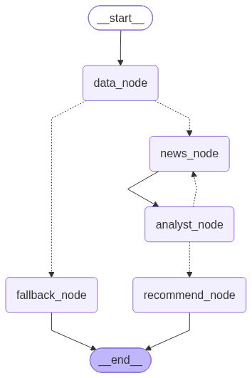
LangGraph design: state, nodes and conditional edges
State (AgentState)
ticker, price_data, technical_summary, news_articles, news_summary, analysis, confidence, retry_count, error, recommendation
Conditional edges
After data_node: error → fallback_node, else news_node
After analyst_node: confidence < 0.5 → back to news_node with a new query (max 3 fetches), else recommend_node

Slide 5
Data agent: Python computes, the LLM interprets
Indicator | How it is used
SMA 20 / 50 | Trend: price above or below moving averages
RSI (14) | Momentum zone: overbought > 70, oversold < 30
MACD vs signal | Momentum direction and crossovers
Volatility (30d, annualised) | Risk level of recent price swings
52-week high / low | Support and resistance reference
Design choices
@tool get_price_snapshot returns a clean dict
LLM never does the maths, so no calculation errors
Rule-based signals added as hints
Bad ticker returns an error → fallback edge

Slide 6
News agent: Retrieval-Augmented Generation
Fetch
Chunk
Embed
Retrieve
Generate
Google News RSS + Yahoo Finance via @tool
›
Text splitter, 500-character chunks with overlap
›
MiniLM sentence embeddings (local, free)
›
InMemoryVectorStore retriever, k = 5
›
LCEL chain: retriever | prompt | LLM | parser
Grounding and retry
Prompt says: use only the retrieved context, state sentiment (Positive / Negative / Neutral / Mixed), list developments and risks
If the analyst's confidence is low, news_node runs again with a different query and merges new articles with the old ones

Slide 7
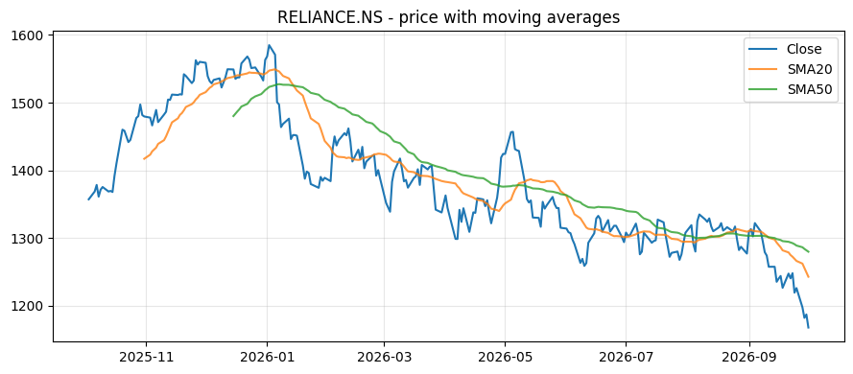
Demo run: RELIANCE.NS (1-year view)
HOLD
confidence 60%, short term (1-3 months)
Close 1,167.7 = 52-week low; below SMA20 (1,242.8) and SMA50 (1,279.8)
RSI 27.9 oversold; MACD -28.8 below signal -22.0
Bearish trend but possible rebound if support holds
Risks: new debt, sustained low streak
News (RAG): Mixed. Earnings beat (21 Jul) and a rally, against a 52-week low streak and new private-placement debentures.

Slide 8
Testing across tickers, including a bad one
Ticker | Key evidence | Result
RELIANCE.NS | At 52-week low, RSI 27.9, MACD bearish, news mixed | HOLD (60%)
TCS.NS | Below SMA20 2,155 and SMA50 2,276; RSI 36.0; MACD -61.9 below signal | HOLD
AAPL | Close $333.69 above SMA20 331.89 and SMA50 322.36; MACD 3.82 below signal 4.84 | HOLD
NOTAREALTICKER | No price data found → data error → fallback_node | HOLD (fallback, 0%)
The invalid ticker ends gracefully through the conditional edge instead of crashing. HOLD is the expected outcome when technical and news signals conflict, as the prompt instructs.

Slide 9
Challenges faced and how they were fixed
LLM invented numbers
The justification once quoted SMA values that differed from the computed ones. Fix: raw Python metrics are passed to the recommendation prompt, with an instruction to use only those numbers. The re-run now matches.
API limits and outages
Gemini returned 503 / quota errors and Groq has token limits. Fix: provider switch through get_llm(), retry wrapper run_agent_safe, and a smaller model.
Retired model names
A hard-coded model returned 404. Fix: model name read from the LLM_MODEL environment variable.

Slide 10
Limitations, future scope and deliverables
Limitations
Future scope
RSS news is headline-level and can lag
Confidence is self-reported by the LLM
No fundamentals or backtesting; simulated, not advice
Fundamentals agent (P/E, balance sheet)
Backtesting and risk / portfolio agent
Persistent vector DB (Chroma) for news memory
Deliverables
Jupyter notebook (run end-to-end on Colab) · Streamlit app deployed from GitHub · this presentation

