Slide 1




Analysing Performance of Hypervisor type 2
Name:- Vishal Kumar Singh
x18201687

Slide 2
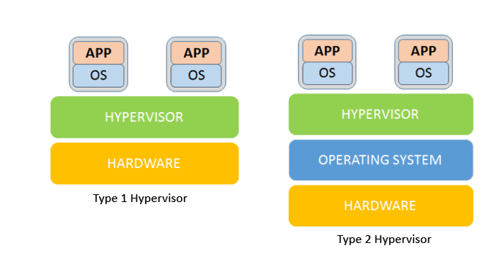
Hypervisor Types

Slide 3


Top 2 Hypervisor type 2 Players
VMware Workstation Pro
Oracle Virtual Box

Slide 4
Virtual Machine Configurations
Tool Name. | CPU | Memory | Storage | OS
VMware workstation pro | Intel i5-8250U 2-cores | 4 GB | 30 GB | Windows 10 64bit
Oracle virtual box | Intel i5-8250U 2-cores | 4 GB | 30 GB | Windows 10 64bit

Slide 5
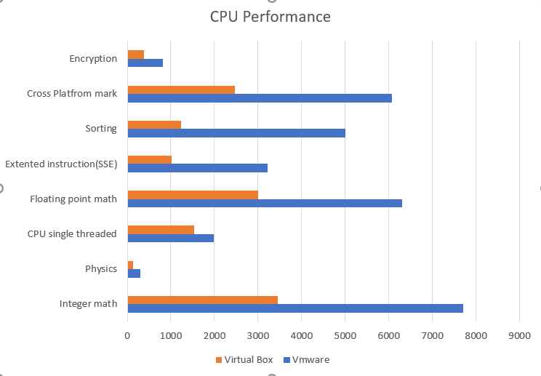
CPU Perfromance
These test were conducted using Passmark Benchmark Tool.
VMware performs better is all the tasks.

Slide 6

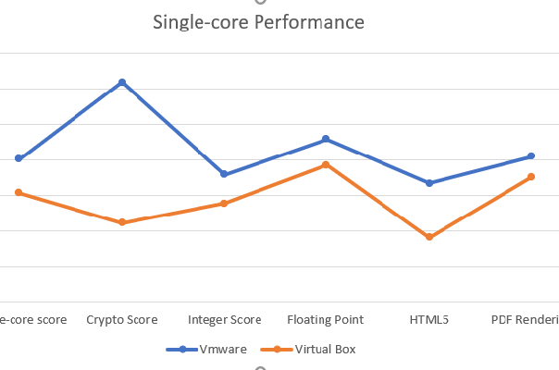
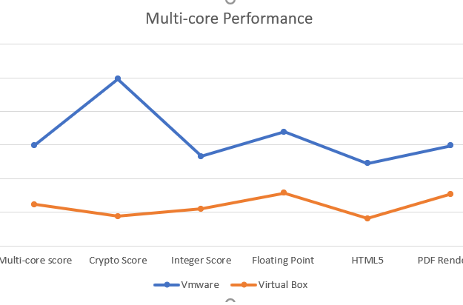

CPU Core Performances

Slide 7
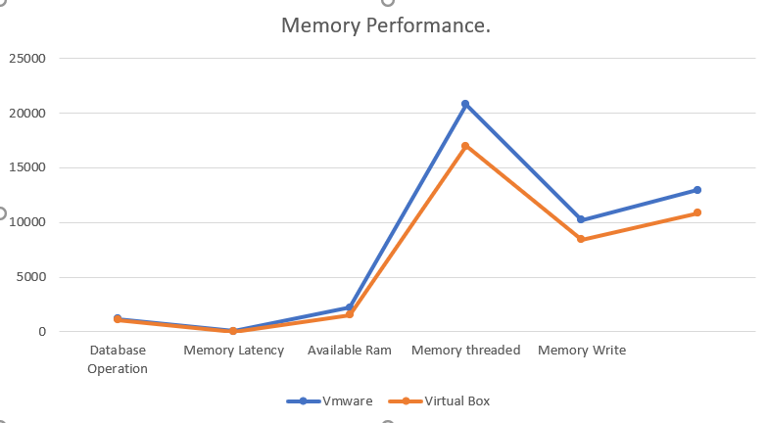
Memory Performance
VMware performs better in this test as well

Slide 8
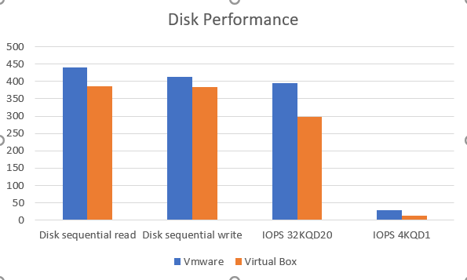
Disk Performance
This test was also conducted using Passmark Benchmark tool.
VMware performs better than Virtual box.

Slide 9

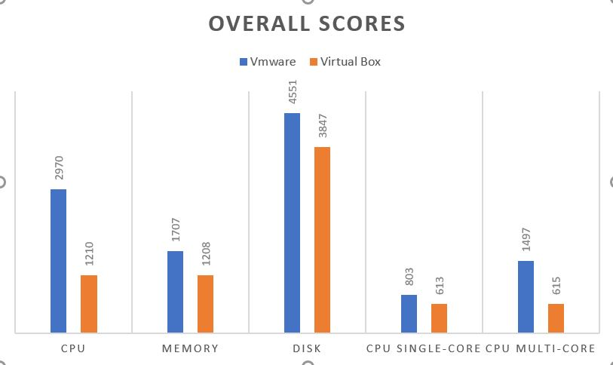
Overall Performance
To conclude VMware workstation pro performs better than virtual box in all aspects of CPU, memory, disk.
VMware and Virtual Box are the two top players in the market for hypervisor type 2 solutions.
From my research I conclude VMware workstation is the best tool in the market.

Slide 10

Thank You.

