Slide 1

Face Mask Detection
Members: guided by:
Vishal Srivastava (csjma18001390175) er. pRateek Srivastava
Ashwani singh (csjma17001390133) (Asst. Prof. -IT dept.)

Slide 2
LIBRARIES USED Technology Used
Google Collab
NUMPY
PANDAS
OPENCV
KERAS
TENSORFLOW
MATPLOTLIB

Slide 3
Algorithm used
CNN (Convolutional Neural Network):
  CNN is a Supervised machine learning algorithm ,widely used in image recognition.
  Convolutional Neural Network are designed to process data through
  multiple layers of arrays.

Slide 4
Convolutional Neural Network

Slide 5
Convolution , Pooling and dense layer
Convolution Layer : Generate more and different form of layer by a single input image, using filters.
Pooling layer: Since images formed by convolution layer are not in optimized size so in pooling layer generally we reduce the size of images.
Dense Layer: By using flatten function we convert all in 1D and perform dropout again and again
And finally we got the fully connected Neural Network which have an output layer consisting of each neuron for every class of element.

Slide 6
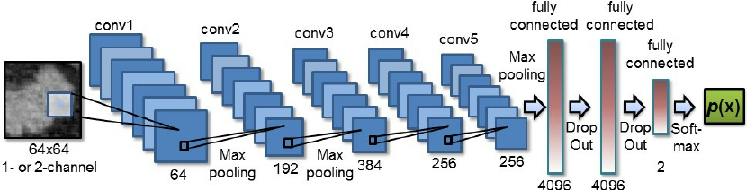

Slide 7
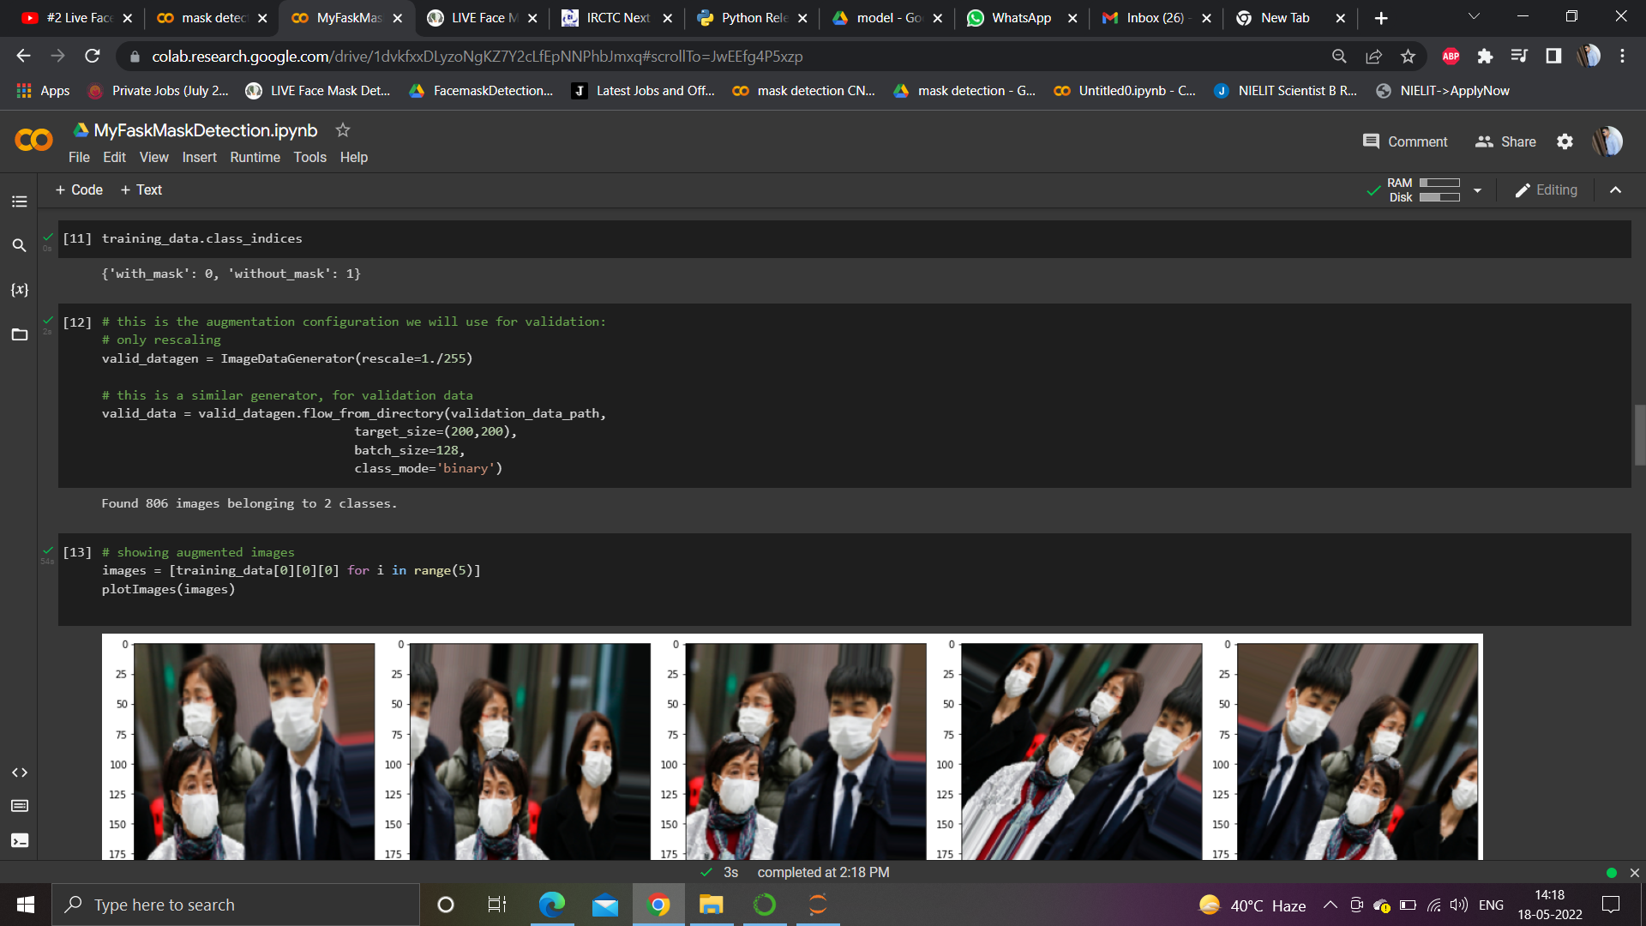
Image Data generate

Slide 8
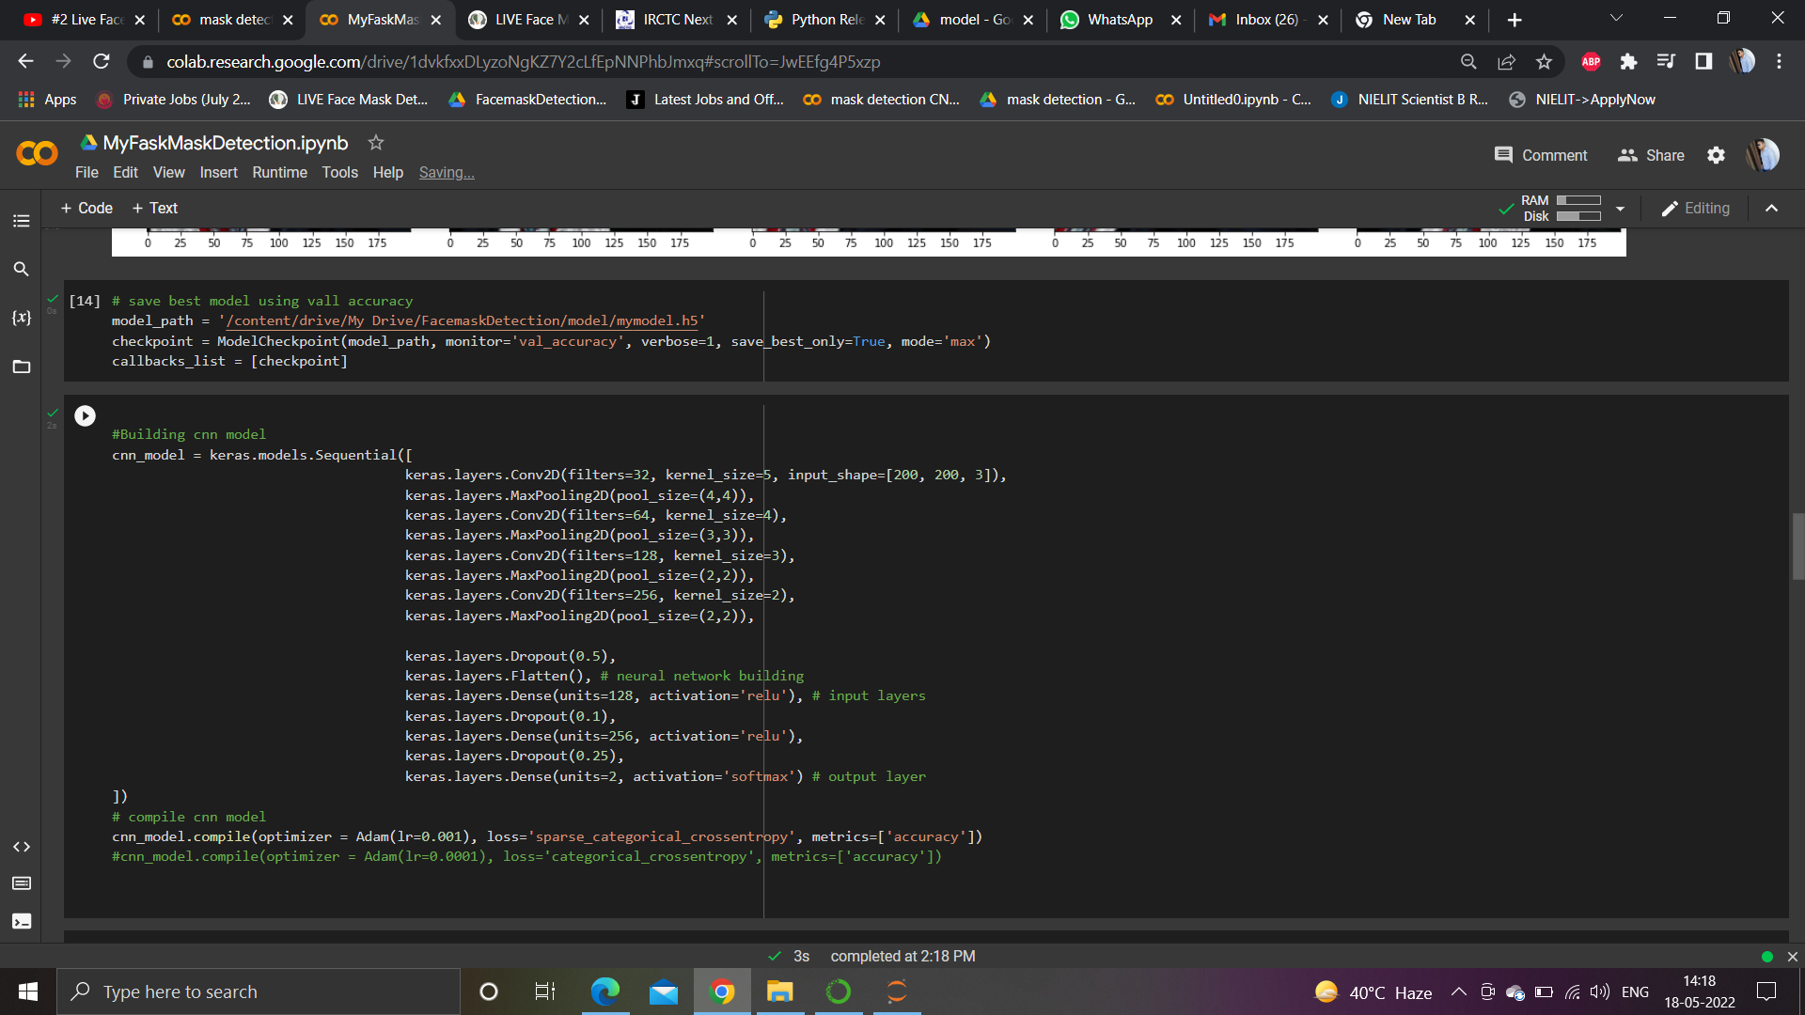
Code snippet
Building CNN Model

Slide 9
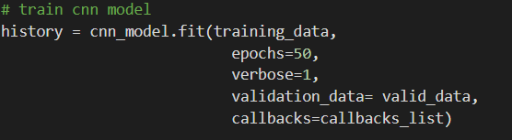
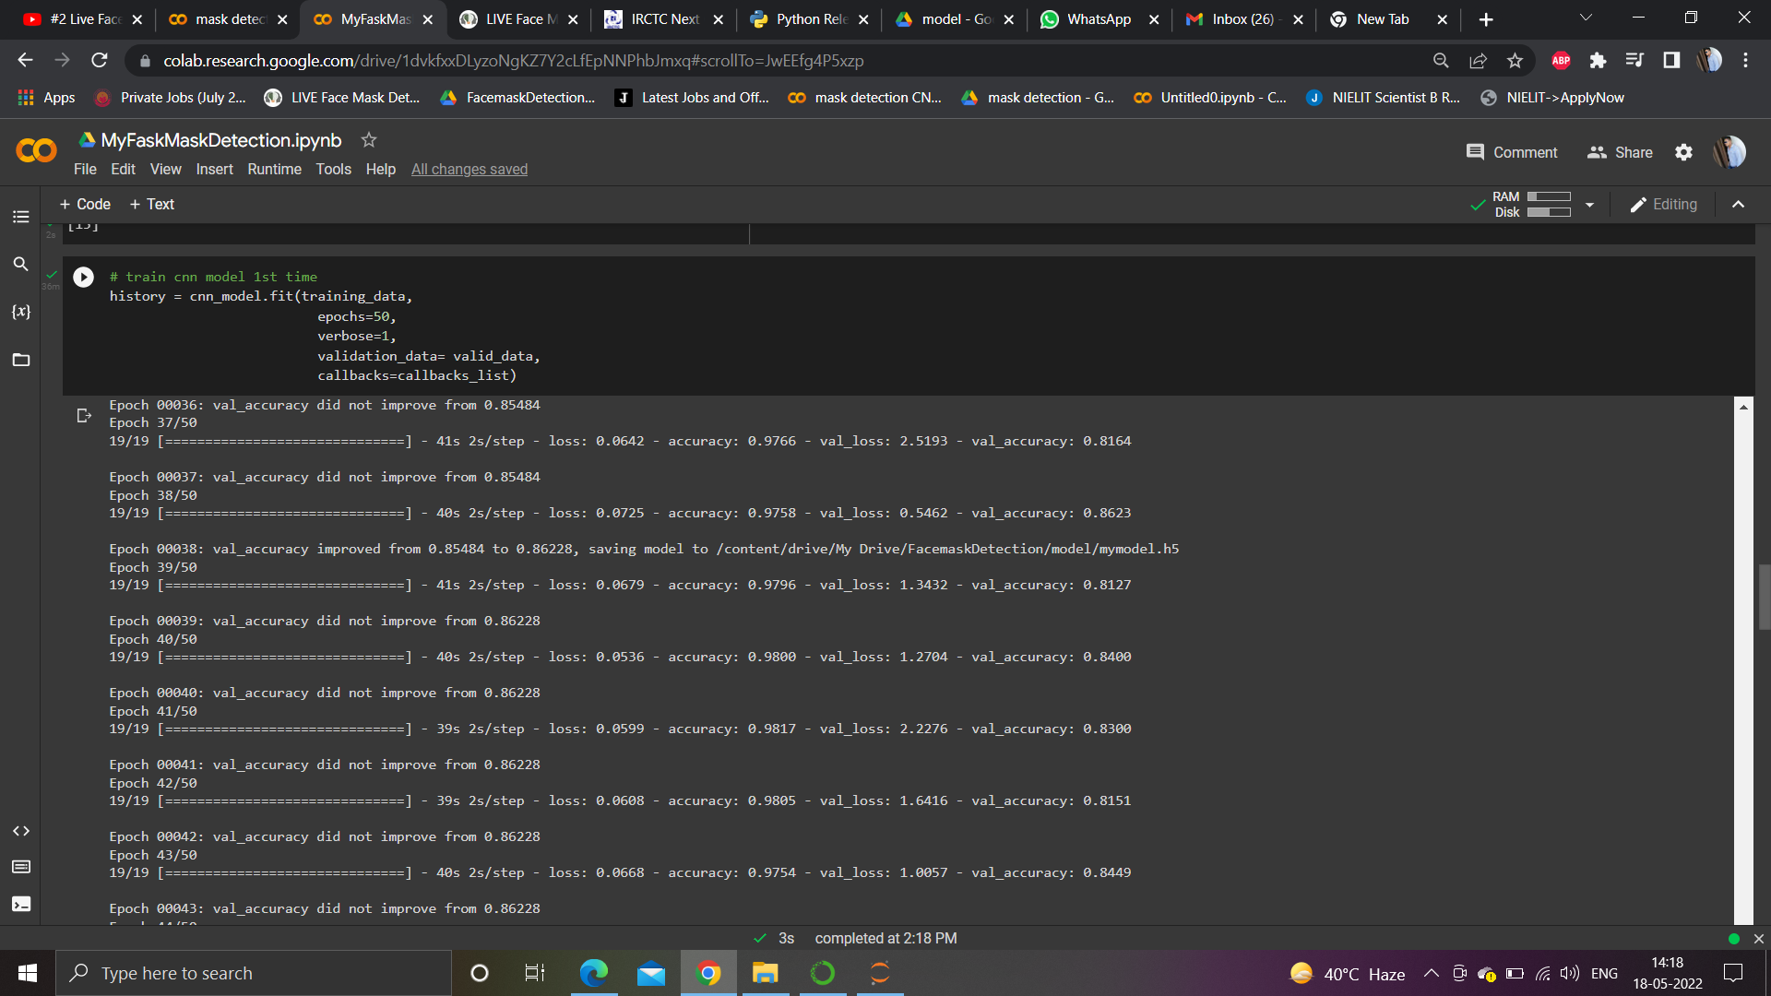
Training phase

Slide 10
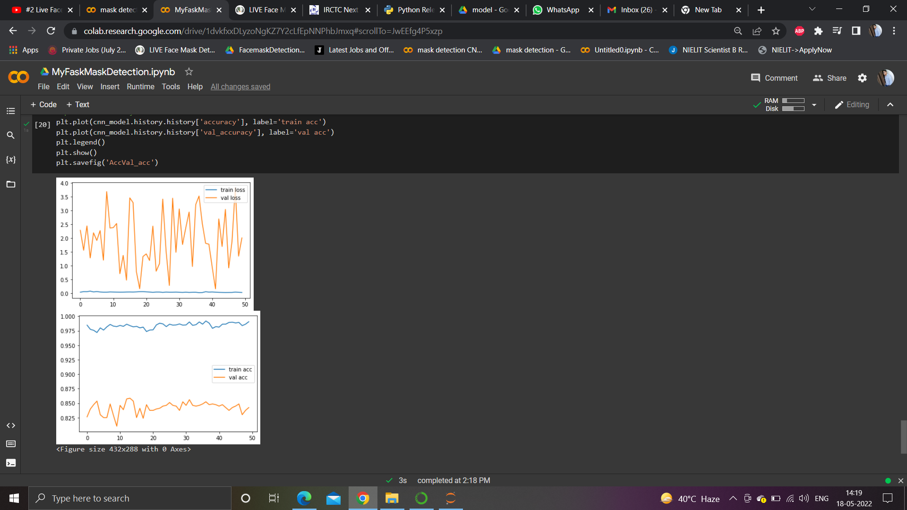
Result After training

Slide 11
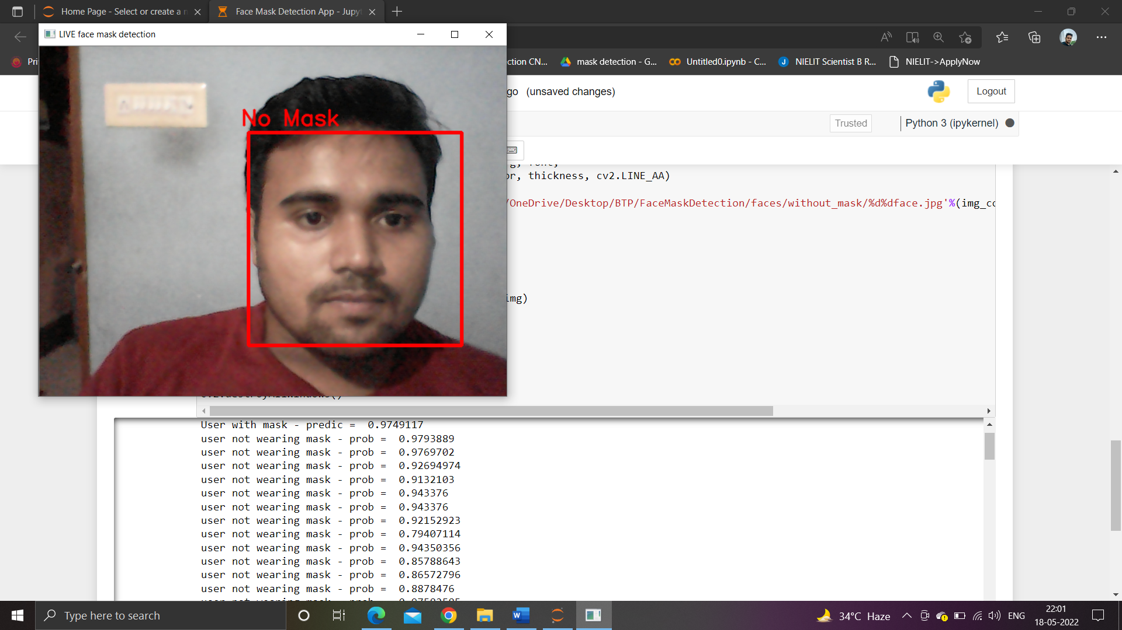
Final prediction

Slide 12
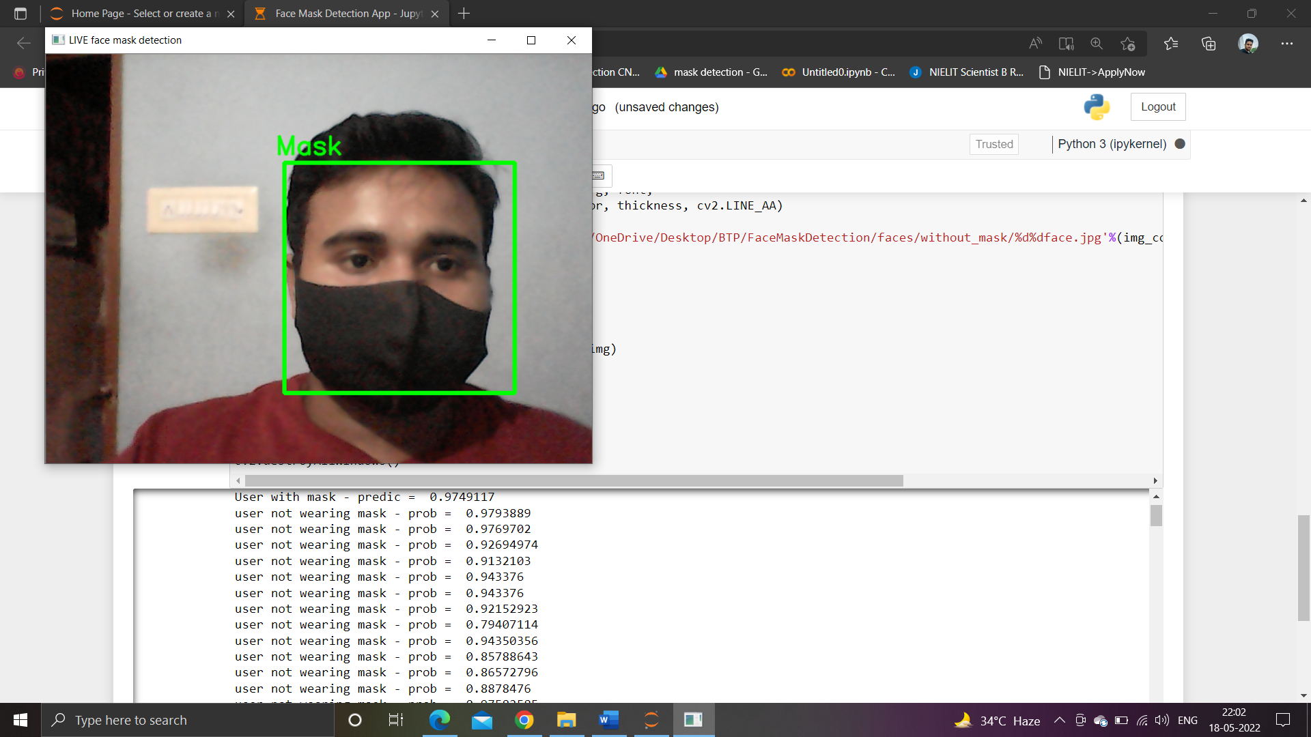

Slide 13
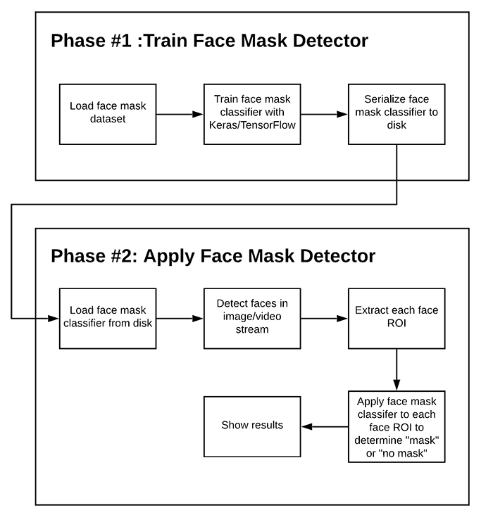
How the model work

Slide 14
application
In this pandemic situation of COVID-19 global virus everyone want to be safe and hence they want that every person entering in their environment should wear mask and for checking them they can be use Face Mask Detection on Entry Gate of any Organization.
To detect weather the person wearing mask or not.
As traffic police also make penalty for not wearing mask so by using this their work got easier.

Slide 15
Work done
Data gathering
Data analysis
Form architecture and work plan
Build CNN Model
Train CNN Model
Image capturing and Detecting
Image processing and detect face
Apply face mask classifier
Show result if a person wore mask or not
Deployment of project
Re-analysis of whole project

Slide 16
Thank you

