Slide 1
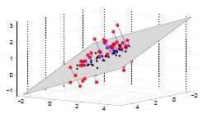
Every point represents a face image in an N-dimensional space (We have shown it in 3D for visualization purpose)
The term “face” is common to all these images .
Therefore, the location of these images in the N-dimensional space follows a certain pattern.
So, it is possible to find a subspace which is the best possible representation of the pattern such that every element of that space is an approximate representation of a face.
This subspace may be called the “Face Space”.
In the above representation, the “Face Space” is represented by the plane (approximately).

Slide 2
Before going any further, we take a bit of a diversion and review a bit of Linear Algebra.(Don’t worry !!!!!! Just some basics)

Slide 3
Linear Combinations and Span
Linear Combinations: Let V denote a vector space, and v ϵ V. We say that v is a linear combination of the vector u₁,u₂,……,u_{n} if v can be written in the form
v = c₁u₁ + c₂u₂ + …… + c_{n}u_{n}
= ∑ c_{i}u_{i}
where c₁, c₂, …., c_{n} are scalars.
Span: Let V denote a vector space and S = { u₁,u₂,…..u_{n}} a subset of V then, the span of S, denoted span (S), is the set of all linear combinations of vectors in S. In other words,
span(S) = { ∑ c_{i}u_{i}|c_{i} ϵ R and u_{i} ϵ S}

Slide 4
Linear Independence and Subspaces
Linear Independence: In simple words, a set of vectors S = {u₁,u₂,…,u_{n}} is said to be linearly independent if none of the vectors of S can be expressed as a linear combination of the remaining (n-1) vectors.
If any of the vector in S can be expressed as a linear combination of the others, the set is said to be linearly dependent.
Subspaces: In simple words, a linear subspace (or vector subspace) is a vector space that is a subset of some other (higher-dimension) vector space. More formally, If V is a vector space , and W is a subset of V. Then W is a subspace if and only if W satisfies the following three conditions:
The zero vector, 0, is in W.
If u and v are elements of W, then the sum u + v is an element of W.
If u is an element of W and c is a scalar from K, then the product cu is an element of W.

Slide 5
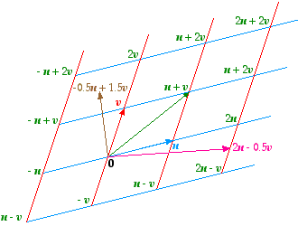
Basis of a Subspace
Basis: A basis for a subspace S is a set of linearly independent vectors whose span is S. The number of elements in a basis is always equal to the geometric dimension of the subspace.
For example: A plane (2D) is a subspace in 3D space whose basis is a set of two linearly independent vectors. Every point in the plane can be represented as a linear combination of these two basis vectors.

Slide 6
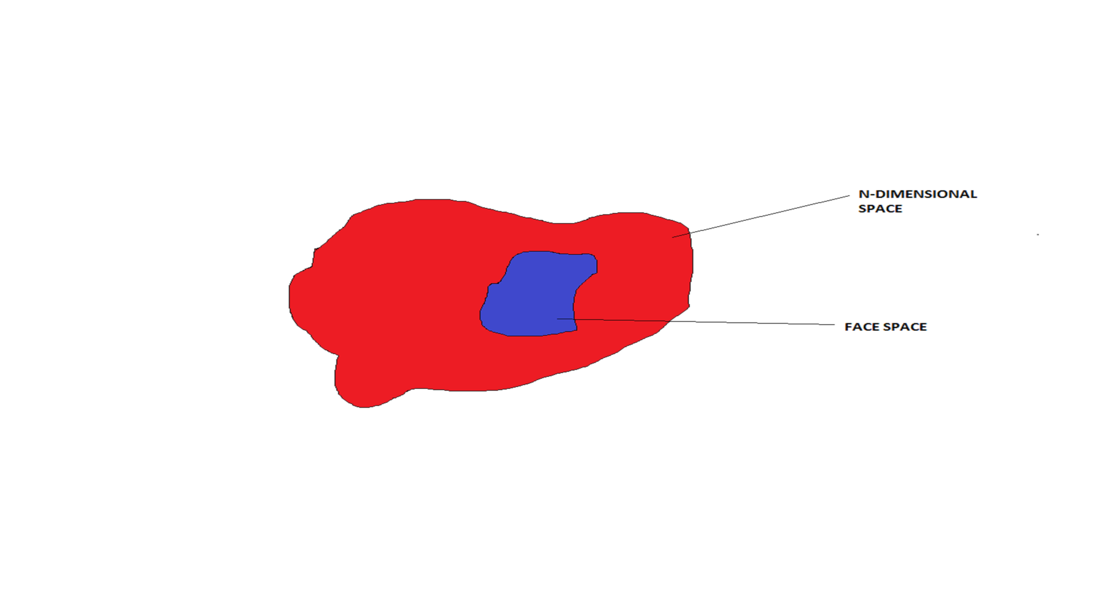
A rough representation of a subspace.
A “Face space” is a subset of the N-dimensional space.
A “Face space” can be represented as a linear combination of k linearly independent N-dimensional vectors (Basis).
Therefore, our job would be to find a basis for our “Face space”

Slide 7
WHY DO WE NEED TO FIND THE BASIS??????

Slide 8
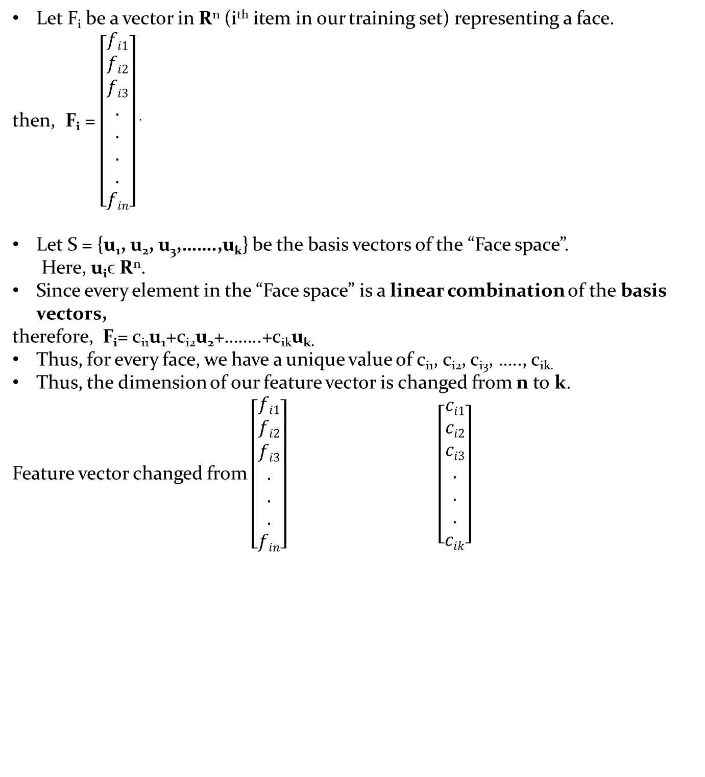
Let F_{i} be a vector in R^{n} (i^{th} item in our training set) representing a face.
then, F_{i} = $\left[\begin{aligned}fi1 \\ fi2 \\ fi3 \\ . \\ . \\ . \\ . \\ fin\end{aligned}\right]$ .
Let S = {u₁, u₂, u₃,…….,u_{k}} be the basis vectors of the “Face space”.
Here, u_{i}ϵ R^{n}.
Since every element in the “Face space” is a linear combination of the basis vectors,
therefore, F_{i}= c_{i1}u₁+c_{i2}u₂+……..+c_{ik}u_{k.}
Thus, for every face, we have a unique value of c_{i1}, c_{i2}, c_{i3}, ….., c_{ik.}
Thus, the dimension of our feature vector is changed from n to k.
Feature vector changed from $\left[\begin{aligned}fi1 \\ fi2 \\ fi3 \\ . \\ . \\ . \\ fin\end{aligned}\right] \left[\begin{aligned}ci1 \\ ci2 \\ ci3 \\ . \\ . \\ . \\ cik\end{aligned}\right]$

Slide 9
THIS IS WHAT OUR AIM WAS…..
DIMENSION REDUCTION!!!!!

Slide 10
HOW DO WE FIND THE BASIS??????

Slide 11
Aim: To find the “Face space” or equivalently find its basis.
What we have?
Lots of face images.
These images are stored as vectors whose dimensionality is n.
We have to find a pattern in the given data and thus find a suitable subspace that fits the data.
In other words, from the n features of the image, we choose the “principle” k features and thus reduce its dimensionality.
This is done through a statistical procedure called Principle Component Analysis (PCA).

Slide 12
PCA

Slide 13
Introduction
PCA is a useful statistical technique that has found application in fields such as face recognition and image compression, and is a common technique for finding patterns in data of high dimension.
It is a way of expressing the data in such a way as to highlight their similarities and differences.
The other main advantage of PCA is that once you have found these patterns in the data, and you compress the data ie. by reducing the number of dimensions, without loss of much information.

Slide 14
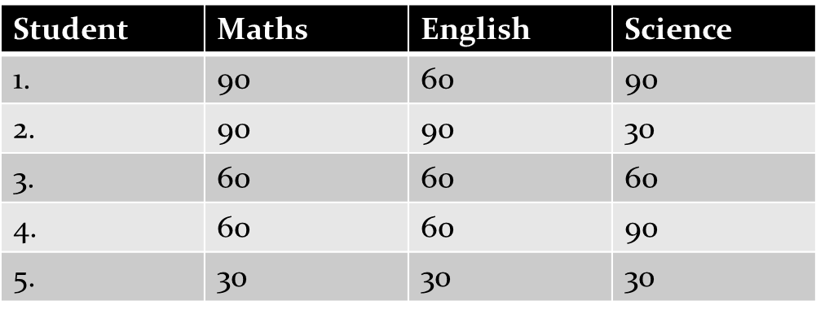
Covariance Matrix:
Standard deviation and variance only operate on 1 dimension, so that you could only calculate the standard deviation for each dimension of the data set independently of the other dimensions. However, it is useful to have a similar measure to find out how much the dimensions vary from the mean with respect to each other.
Consider the following table:

Slide 15
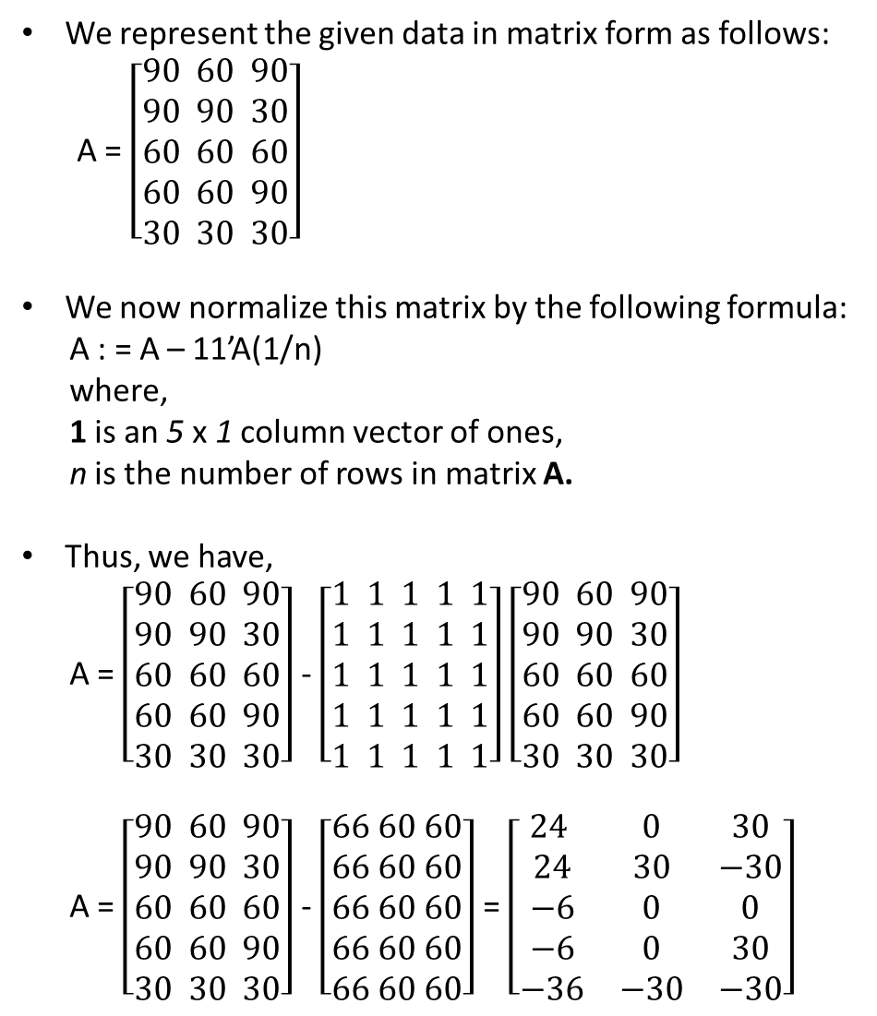
We represent the given data in matrix form as follows:
A = $\left[\begin{aligned}90 60 90 \\ 90 90 30 \\ 60 60 60 \\ 60 60 90 \\ 30 30 30\end{aligned}\right]$
We now normalize this matrix by the following formula:
A : = A – 11’A(1/n)
where,
1 is an 5 x 1 column vector of ones,
n is the number of rows in matrix A.
Thus, we have,
A = $\left[\begin{aligned}90 60 90 \\ 90 90 30 \\ 60 60 60 \\ 60 60 90 \\ 30 30 30\end{aligned}\right]$ - $\left[\begin{aligned}1 1 1 1 1 \\ 1 1 1 1 1 \\ 1 1 1 1 1 \\ 1 1 1 1 1 \\ 1 1 1 1 1\end{aligned}\right]\left[\begin{aligned}90 60 90 \\ 90 90 30 \\ 60 60 60 \\ 60 60 90 \\ 30 30 30\end{aligned}\right]$
A = $\left[\begin{aligned}90 60 90 \\ 90 90 30 \\ 60 60 60 \\ 60 60 90 \\ 30 30 30\end{aligned}\right]$ - $\left[\begin{aligned}66 60 60 \\ 66 60 60 \\ 66 60 60 \\ 66 60 60 \\ 66 60 60\end{aligned}\right]$ = $\left[\begin{matrix}24 & 0 & 30 \\ 24 & 30 & −30 \\ −6 & 0 & 0 \\ −6 & 0 & 30 \\ −36 & −30 & −30\end{matrix}\right]$

Slide 16
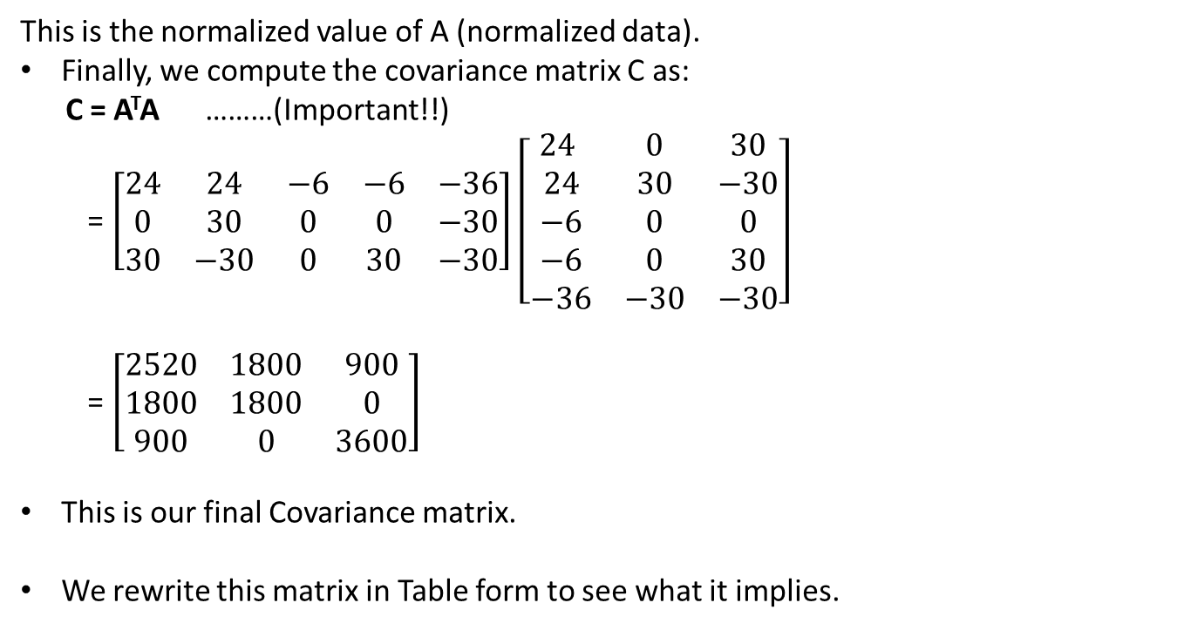
This is the normalized value of A (normalized data).
Finally, we compute the covariance matrix C as:
C = A^{T}A ………(Important!!)
= $\left[\begin{matrix}24 & 24 & −6 & −6 & −36 \\ 0 & 30 & 0 & 0 & −30 \\ 30 & −30 & 0 & 30 & −30\end{matrix}\right]\left[\begin{matrix}24 & 0 & 30 \\ 24 & 30 & −30 \\ −6 & 0 & 0 \\ −6 & 0 & 30 \\ −36 & −30 & −30\end{matrix}\right]$
= $\left[\begin{matrix}2520 & 1800 & 900 \\ 1800 & 1800 & 0 \\ 900 & 0 & 3600\end{matrix}\right]$
This is our final Covariance matrix.
We rewrite this matrix in Table form to see what it implies.

Slide 17
 | Maths | English | Science
Maths | 2520 | 1800 | 900
English | 1800 | 1800 | 0
Science | 900 | 0 | 3600
Shown in orange along the diagonal, we see the variance of scores for each test.
The covariance between math and English is positive (1800), and the covariance between math and science is positive (900). This means that as scores on math go up, scores on science and english also tend to go up.
The covariance between English and science, however, is zero. This means there tends to be no predictable relationship between the movement of English and science scores.
If the covariance between any tests had been negative, it would have meant that the test scores on those tests tend to move in opposite directions.

Slide 18
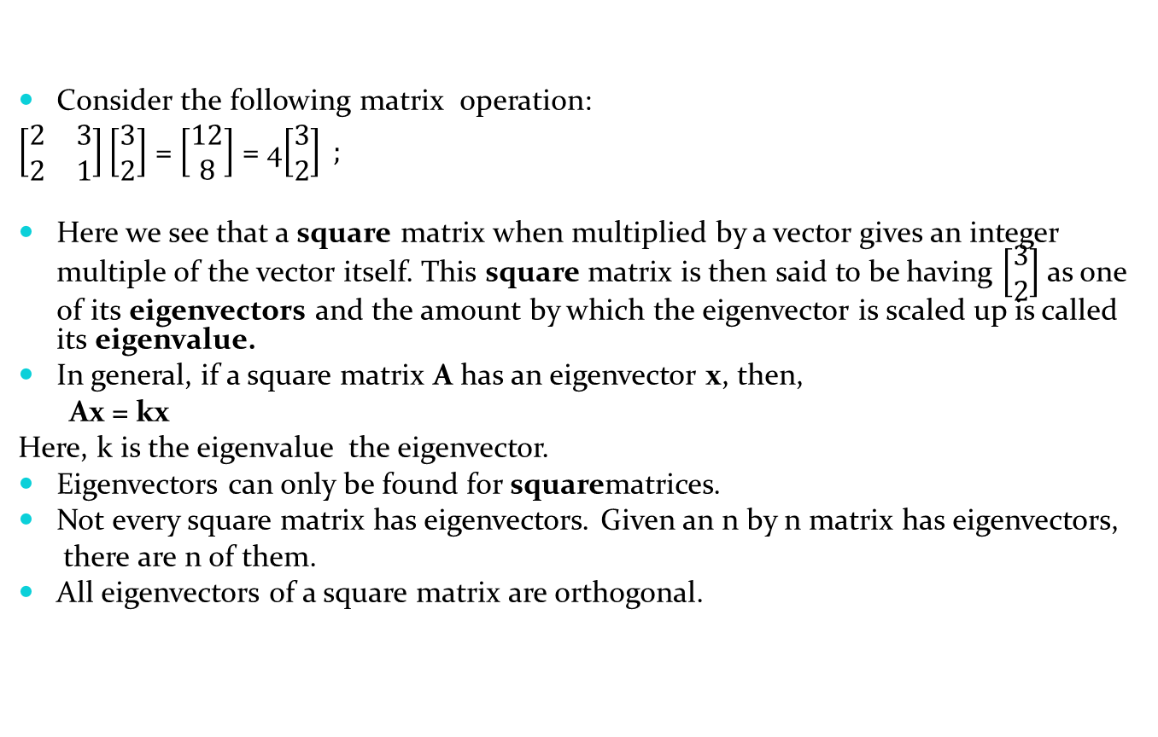
Eigenvectors and Eigenvalues:
Consider the following matrix operation:
$\left[\begin{matrix}2 & 3 \\ 2 & 1\end{matrix}\right]\left[\begin{matrix}3 \\ 2\end{matrix}\right]$ = $\left[\begin{matrix}12 \\ 8\end{matrix}\right]$ = 4$\left[\begin{matrix}3 \\ 2\end{matrix}\right] ;$
Here we see that a square matrix when multiplied by a vector gives an integer multiple of the vector itself. This square matrix is then said to be having $\left[\begin{matrix}3 \\ 2\end{matrix}\right]$ as one of its eigenvectors and the amount by which the eigenvector is scaled up is called its eigenvalue.
In general, if a square matrix A has an eigenvector x, then,
Ax = kx
Here, k is the eigenvalue the eigenvector.
Eigenvectors can only be found for squarematrices.
Not every square matrix has eigenvectors. Given an n by n matrix has eigenvectors,
there are n of them.
All eigenvectors of a square matrix are orthogonal.

Slide 19
PCA in action (Finally!!!!) :
Step 1: Get the face data.
We will be using the ORL face dataset.
It consists of a total of 400 images of 40 subjects, 10 images of each subject with some variations in the facial expressions.
Each image will be a 50 by 50 matrix. We unroll this matrix to get a 2500 dimensional feature vector.
We use 6 images of each subject as our training set. Thus we get a total of 240 images in our training set.
We represent our training set in the form of a 240 by 2500 matrix.

Slide 20
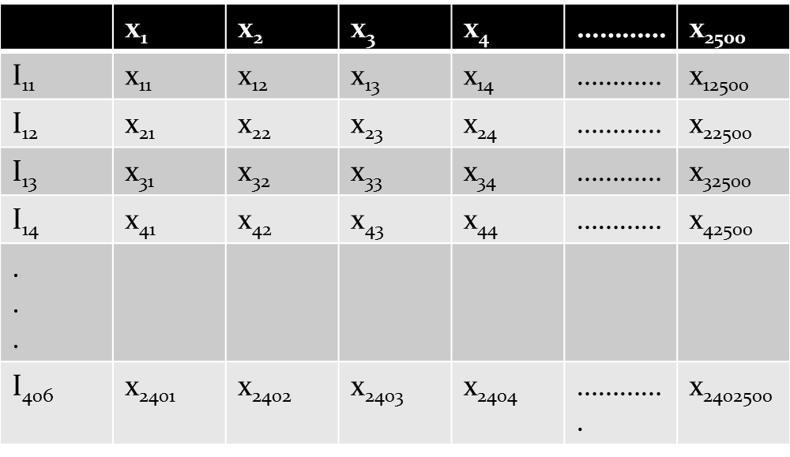
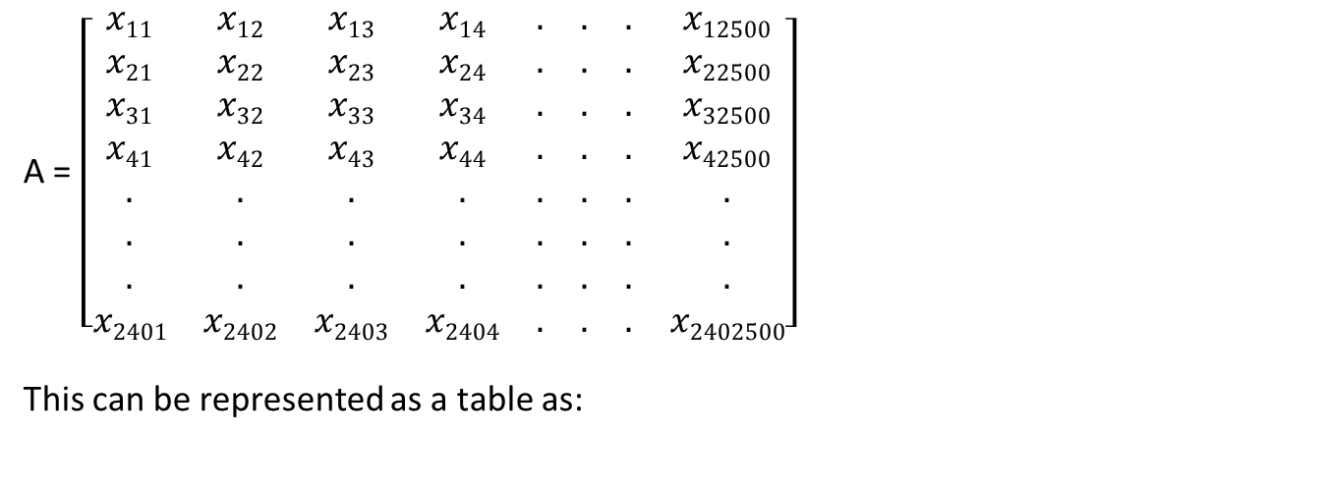
A = $\left[\begin{matrix}x11 & x12 & x13 & x14 & . & . & . & x12500 \\ x21 & x22 & x23 & x24 & . & . & . & x22500 \\ x31 & x32 & x33 & x34 & . & . & . & x32500 \\ x41 & x42 & x43 & x44 & . & . & . & x42500 \\ . & . & . & . & . & . & . & . \\ . & . & . & . & . & . & . & . \\ . & . & . & . & . & . & . & . \\ x2401 & x2402 & x2403 & x2404 & . & . & . & x2402500\end{matrix}\right]$
This can be represented as a table as:
FEATURES
IMAGES

Slide 21
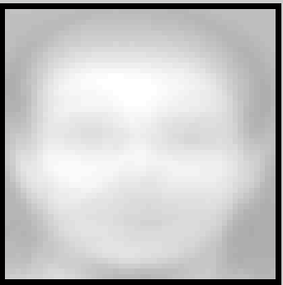
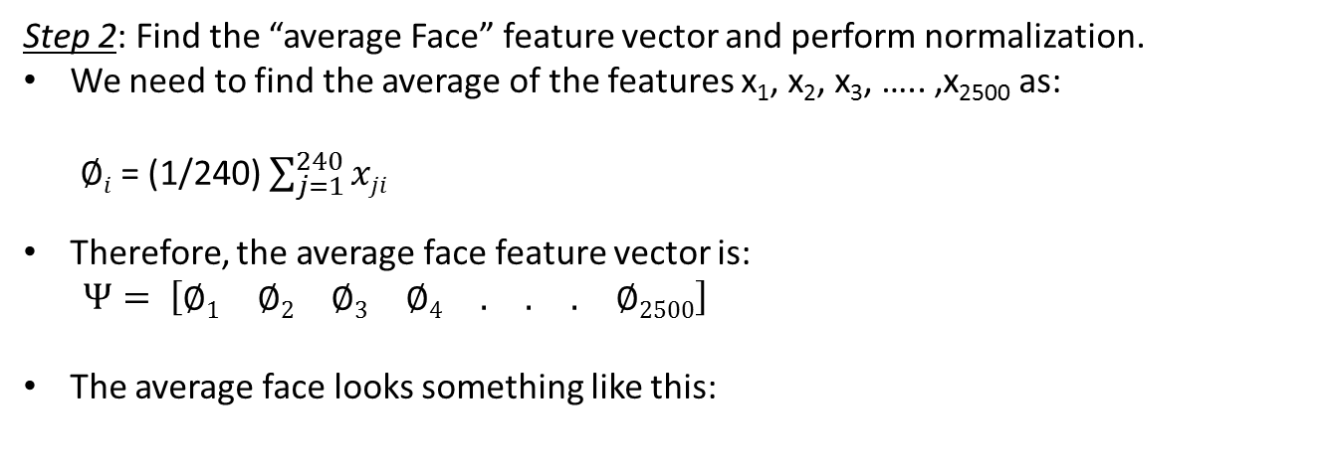
Step 2: Find the “average Face” feature vector and perform normalization.
We need to find the average of the features x₁, x₂, x₃, ….. ,x₂₅₀₀as:
$∅i$ = (1/240) $\sum_{j=1}^{240}{xji}$
Therefore, the average face feature vector is:
$$Ψ= \left[\begin{matrix}∅1 & ∅2 & ∅3 & ∅4 & . & . & . & ∅2500\end{matrix}\right]$$
The average face looks something like this:

Slide 22
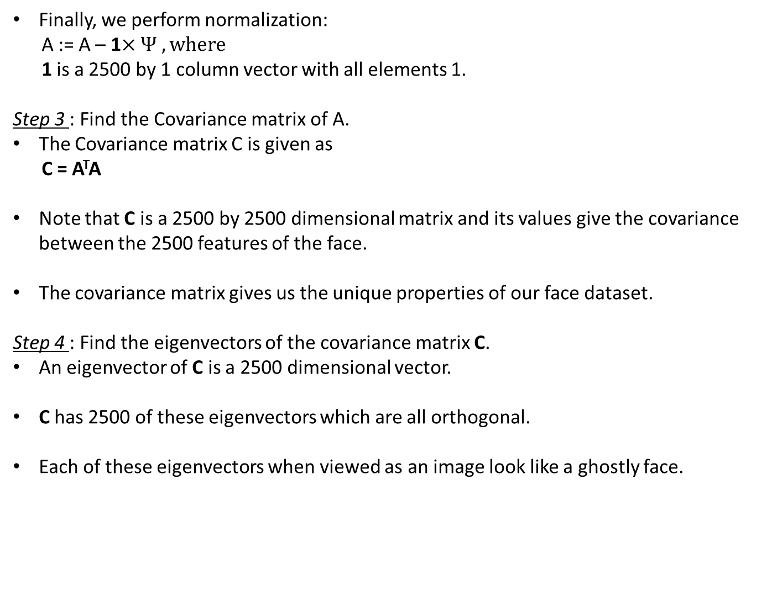
Finally, we perform normalization:
A := A – 1$×Ψ , where$
1 is a 2500 by 1 column vector with all elements 1.
Step 3 : Find the Covariance matrix of A.
The Covariance matrix C is given as
C = A^{T}A
Note that C is a 2500 by 2500 dimensional matrix and its values give the covariance between the 2500 features of the face.
The covariance matrix gives us the unique properties of our face dataset.
Step 4 : Find the eigenvectors of the covariance matrix C.
An eigenvector of C is a 2500 dimensional vector.
C has 2500 of these eigenvectors which are all orthogonal.
Each of these eigenvectors when viewed as an image look like a ghostly face.

Slide 23
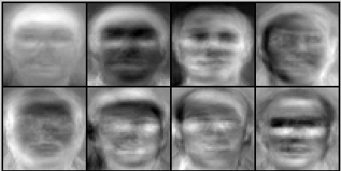
Eight of these eigenfaces are shown below:
THESE EIGENFACES SERVE AS A BASIS FOR OUR FACE SPACE !!!!!!!
Any face in our dataset can be expressed as a linear combination of these eigenfaces.

Slide 24
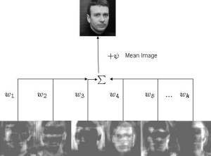
We use the svd command in MATLAB to get the eigenvectors.
svd(C) gives a 2500 by 2500 matrix where each column is an eigenvector.
We choose the first k columns as the basis for our face space.
We construct another matrix E from these k columns.

Slide 25
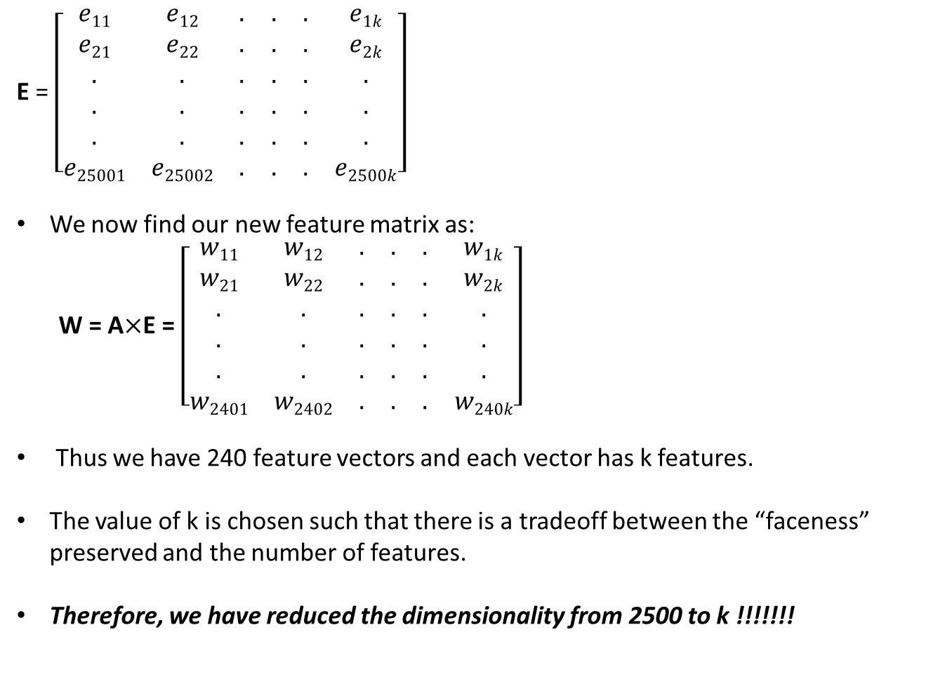
E = $\left[\begin{matrix}e11 & e12 & . & . & . & e1k \\ e21 & e22 & . & . & . & e2k \\ . & . & . & . & . & . \\ . & . & . & . & . & . \\ . & . & . & . & . & . \\ e25001 & e25002 & . & . & . & e2500k\end{matrix}\right]$
We now find our new feature matrix as:
W = A$×$E = $\left[\begin{matrix}w11 & w12 & . & . & . & w1k \\ w21 & w22 & . & . & . & w2k \\ . & . & . & . & . & . \\ . & . & . & . & . & . \\ . & . & . & . & . & . \\ w2401 & w2402 & . & . & . & w240k\end{matrix}\right]$
Thus we have 240 feature vectors and each vector has k features.
The value of k is chosen such that there is a tradeoff between the “faceness” preserved and the number of features.
Therefore, we have reduced the dimensionality from 2500 to k !!!!!!!

Slide 26
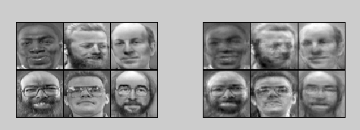
We can view the “faceness” preserved by projecting our images in our subspace of dimensionality k by the following formula:
P = (EE^{T})X
We can visualize P by using the displayData() function.
For k = 50, the projection of a random set of 6 faces is:

Slide 27
DISTANCE
CLASSIFIER
APPROACH

Slide 28
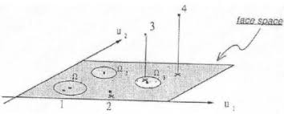
Now that we have our “Face space”, every subject of our training set is represented by a specific patch of area on the face space. Each of these patches may be called a Class.
Each of the class is denoted by Ω₁, Ω₂, Ω₃ in the above figure.
An incoming image may belong to any one of the following classes depending upon the Euclidean distance of its projection on the face space from the above classes.
An image I belongs to a class k if: norm(P(I) - Ω_{k}) is minimum. Here P(I) is the projection of I onto the face space.
This is a simple but inefficient approach, for better efficiency, we can use ARTIFICIAL NEURAL NETWORKS.

Slide 29
FEEDING THE NEURAL NETWORK

Slide 30
You will give the following input to the neural network function named Training() that will be provided to you:
Input Layer Size
Hidden Layer Size
Number of classes
Image feature matrix
Output of the training data
Overfitting parameter
The output of the neural network will give us Theta1 and Theta2.

