Slide 1
FINAL PROJECT REVIEW · M.TECH(INT) CSE
CraftProof: Authenticity Tracking for Handmade Goods
Tamper-evident digital certificates and ownership history using hash chains, Ed25519 signatures and Merkle checkpoints
Vishal C Tantri · Register no. [24MIC0068]
Notes:
Introduce the project: CraftProof brings tamper-evident digital custody tracking to artisans and buyers without requiring blockchain accounts, cryptocurrency, or specialized hardware.

Slide 2

PROBLEM & OBJECTIVE
Anyone should be able to check a handmade piece is genuine
Artisans issue a digital certificate and QR tag for each piece; every handover (maker, gallery, buyer) is signed and recorded.
Anyone scans the QR to see the maker, ownership history and authenticity, with no login or app.
Users see only “Verified”, “Certificate” and “Ownership History”, never hash or signature jargon.
Problem: handmade goods are easy to counterfeit or mis-attribute; paper certificates can be forged and seller records silently edited.
Verification is out of reach for ordinary buyers; how do we make history checkable in seconds and any alteration detectable?
Notes:
Frame the core tension: artisanal items command premiums, but buyers lack reliable tools to prove provenance without incurring massive technical overhead.

Slide 3
Existing systems are forgeable, editable or too heavy
Existing approach | Limitation
Paper certificates, receipts, hallmarks | Forgeable, copyable, easily lost; no history after first sale
Seller-run database or spreadsheet | Records can be silently edited; buyer must trust the seller
Blockchain / NFT provenance | Wallets, gas fees and key management; jargon-heavy; everyone needs an account
Serial numbers / QR codes alone | A QR is a cloneable link; says nothing about altered history
Research gap: tamper-evident without blockchain complexity; no buyer account; operator is checkable; pinpoints which step was tampered with. General domain knowledge, to be verified with the team's own literature.

Slide 4
A signed, hash-chained custody ledger anyone can verify
Register, Transfer, Seal, Verify
O1 · Unique certificate and QR per piece — 8-char code, 36^8 ≈ 2.8 × 10^12 codes, collision-checked
O2 · Signed, hash-linked handovers — Each transfer is hashed (SHA-256), linked to the previous record, and signed by the outgoing custodian with Ed25519; Genesis plus one record per transfer.
O3 · Detect tampering — 4 attack classes tested, all caught
O4 · Verify with zero login — Public GET /c/{code}; buyers need no account. Every certificate page re-verifies the chain: green VERIFIED AUTHENTIC, or red WARNING: ALTERED RECORD naming the step.
O5 · Public ledger — Records are sealed under public Merkle checkpoints with inclusion proofs.
O6 · No need to trust the server — verify_cli.py re-checks locally; public API and verifier CLI need no trust in the server.
O7 · Hide jargon — Plain-language UI; keys generated invisibly at sign-up.
Notes:
Explain the core pipeline: Register, Transfer, Seal, Verify. Highlight that all 7 design objectives are grounded directly in technical implementation.

Slide 5
THEORETICAL FOUNDATION
Strong primitives exist, but no lightweight provenance workflow
CraftProof bridges foundational cryptographic literature with the operational constraints of craft supply chains.
Ref | Work | Contribution | Link to CraftProof
[1] | Haber & Stornetta, 1991 | Hash-linked digital timestamping | Underpins per-piece sequential hash chain
[2] | Merkle, 1987 | Tree-based cryptographic integrity proofs | Enables batch checkpoint inclusion verification
[3] | Bernstein et al., 2012 / RFC 8032 | High-speed Ed25519 digital signatures | Provides fast, secure outgoing-custodian signing
[4] | Laurie et al., RFC 6962, 2013 | Public append-only Merkle transparency logs | Inspires checkpoint transparency; tailored for physical goods
[5] | Crosby & Wallach, 2009 | Tamper-evident, publicly auditable logs | Allows external verification without trusting server operator
[6] | Nakamoto, 2008 | Consensus-backed decentralized ledger | Demonstrates blockchain weight; informs elimination of mining/gas
[7] | Kshetri, 2018 | Blockchain architectures for supply chains | Exposes adoption hurdle when universal onboarding is mandated
Research gap: Prior work either targets digital TLS certificates [4] or assumes universal wallet onboarding [6, 7].
Notes:
Ground CraftProof in established literature. We combine Haber-Stornetta chains, Merkle trees, and Ed25519 signatures, discarding unnecessary consensus overhead.

Slide 6
COMPARATIVE NOVELTY
The novelty is the protocol combination, not the primitives
Feature | Paper | DB | NFT | CraftProof
Tamper-evident history | ✗ | ✗ | ✓ | ✓
Buyer needs no account | ✓ | ✓ | ✗ | ✓
No wallet / gas jargon | ✓ | ✓ | ✗ | ✓
Zero-trust verification | ✗ | ✗ | ✓ | ✓
Pinpoints altered step | ✗ | ✗ | ✗ | ✓
01
Outgoing-custodian-only signing
Custodians sign upon releasing goods; the terminal buyer needs no account, keys, or technical background.
02
Triple-check pinpoint diagnostics
Independent verification of content hash, back-linkage, and signature isolates the exact compromised step.
03
Domain-separated Merkle checkpoints
Prefixing leaves with 0x00 and internal nodes with 0x01 prevents second-preimage collision vulnerabilities.
04
Public API & standalone verifier
REST endpoint and standalone Python CLI allow external validation without relying on the web application.
Notes:
Emphasize that CraftProof's innovation lies in its protocol design: solving the onboarding problem while preserving tamper-evidence and pinpoint diagnostics.

Slide 7
SYSTEM IMPLEMENTATION
Three layers and a six-step verification method
Architecture & Storage
6-Step Verification Protocol
Frontend: React 19 + Vite SPA, 7 modular views with QR decoding.
Backend: FastAPI REST engine, PyJWT auth, canonical crypto pipeline.
Database: SQLite with strict foreign keys across 4 core tables:
01
Canonical JSON: Sort keys, strip whitespace across 8 schema fields.
02
Record Hashing: Generate record hash via SHA-256 of canonical bytes.
03
Chain Linkage: Record 0 links to SHA-256("GENESIS"); record n to n-1.
04
users (Ed25519 keypairs, roles)
pieces (metadata, 8-char code)
custody_records (hashes, sigs)
merkle_batches (root hashes, state)
Ed25519 Signature: Sign digest using outgoing custodian private key.
05
Integrity Audit: Verify content hash match, chain link, and custodian sig.
06
Merkle Tree Sealing: Hash leaves SHA-256(0x00‖h), nodes SHA-256(0x01‖L‖R).
End-to-end custody workflow: Register piece → Genesis record & QR → Maker-to-Gallery transfer → Buyer sale → Checkpoint published → Public scan.
Notes:
Walk through the architecture: the 3 distinct application tiers, the 4 SQLite schema tables, and the exact 6-step cryptographic verification sequence.

Slide 8
Python backend, React frontend, 13 endpoints, deployed on Render
Area | Details
Backend | Python 3.10+, FastAPI, Uvicorn, Pydantic
Crypto | cryptography (Ed25519), hashlib SHA-256, bcrypt, PyJWT
Database | SQLite, foreign keys on, unique (piece_id, seq_index)
Frontend | React 19, Vite, React Router 7, qrcode.react, lucide-react
Area | Details
Deployment | Render Blueprint: Python service plus static SPA
Key modules | crypto_utils, record, core, merkle, auth, main, verify_cli, seed, tamper_demo, test_crypto
Roles | Two roles: maker and seller (gallery); buyers are external
Demo | No external dataset; seeded demo of 3 makers, 2 galleries, 5 pieces

Slide 9
EXPERIMENTAL EVALUATION
12 of 12 security tests pass, and tampering is pinpointed
Test coverage
Public ledger
Deterministic hashing; Ed25519 round-trip; Merkle proofs; domain separation; edit, rename and deletion detection; checkpoint evolution.
Strongest attack: a re-hashed forgery still fails on signature or linkage.
Checkpoint #4 sealed over 23 records.
Limitations
QR can be re-attached to another object; private keys held server-side; piece metadata not signed; tail truncation undetected without a signed head; checkpoints in the same DB; demo-grade hardening (hard-coded JWT secret, open admin endpoints); no performance benchmarks yet.
Tamper demonstration
Altering record 1's note: [FAIL] content hash mismatch; records 0 and 2 pass; result NOT AUTHENTIC.
Notes:
Present test results: all 12 test suites pass. Walk through the tamper demo output showing exact step isolation, and openly discuss the real-world physical and architectural limitations.

Slide 10
Tamper-evident provenance works without blockchain or technical users
Working, deployed system
Future scope
All seven objectives O1–O7 met, with 12/12 tests including re-hash forgery.
Client-side or hardware-backed keys; sign piece metadata and a chain head; external anchoring of checkpoint roots; NFC or tamper-evident tags.
Also: PostgreSQL and rate limiting, marketplace plug-in, multi-language UI, benchmarks and a usability study.
References (IEEE, to verify): [1] Haber & Stornetta, J. Cryptology, 1991. [2] Merkle, CRYPTO '87. [3] Bernstein et al., J. Cryptographic Eng., 2012. [4] RFC 8032. [5] RFC 6962. [6] Crosby & Wallach, USENIX Security 2009. [7] Nakamoto, 2008. [8] Kshetri, Int. J. Inf. Manage., 2018. [9] FastAPI, React, SQLite, cryptography docs. [10] V. C. Tantri, CraftProof, GitHub.
Notes:
Summarize the conclusions: CraftProof proves that cryptographic custody tracking does not require blockchain complexity. Outline the clear roadmap for production hardening and NFC physical binding.

Slide 11
WORKFLOW WALKTHROUGH
The maker: registering a piece

Slide 12
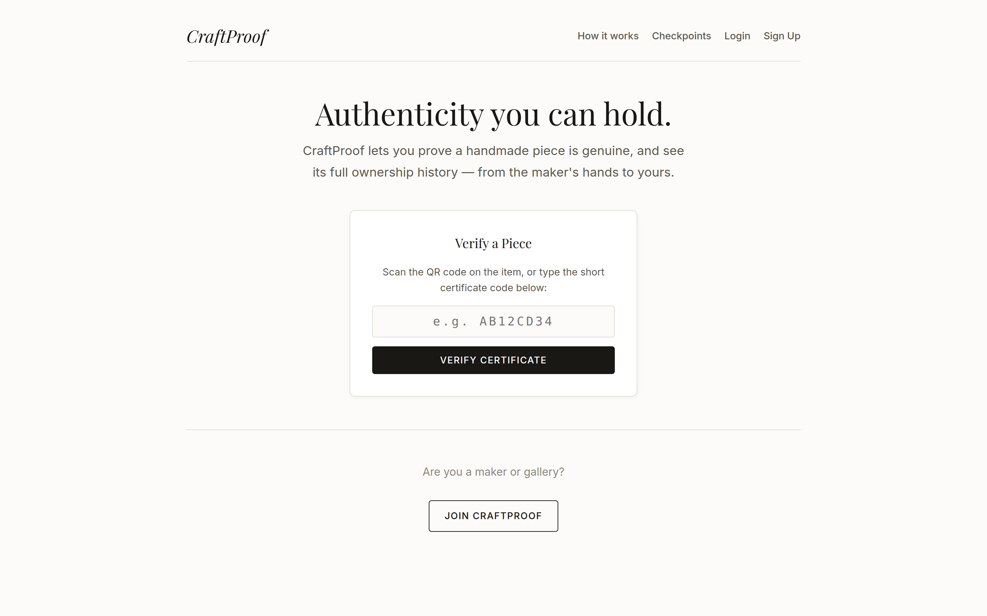
Part: The maker: registering a piece • Step 1
Landing page

Slide 13
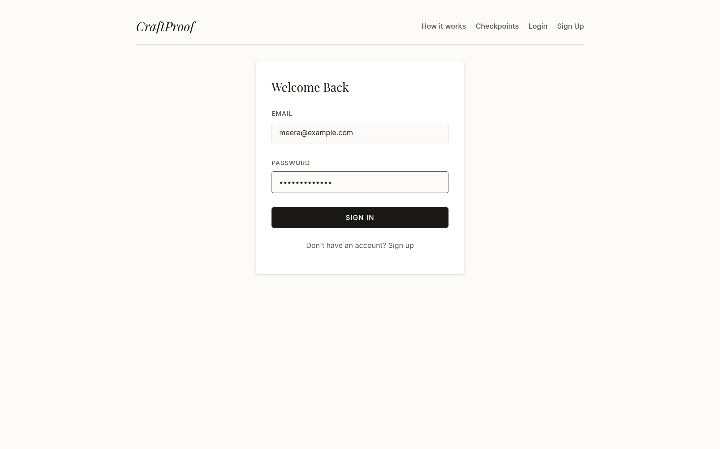
Part: The maker: registering a piece • Step 2
The maker logs in

Slide 14
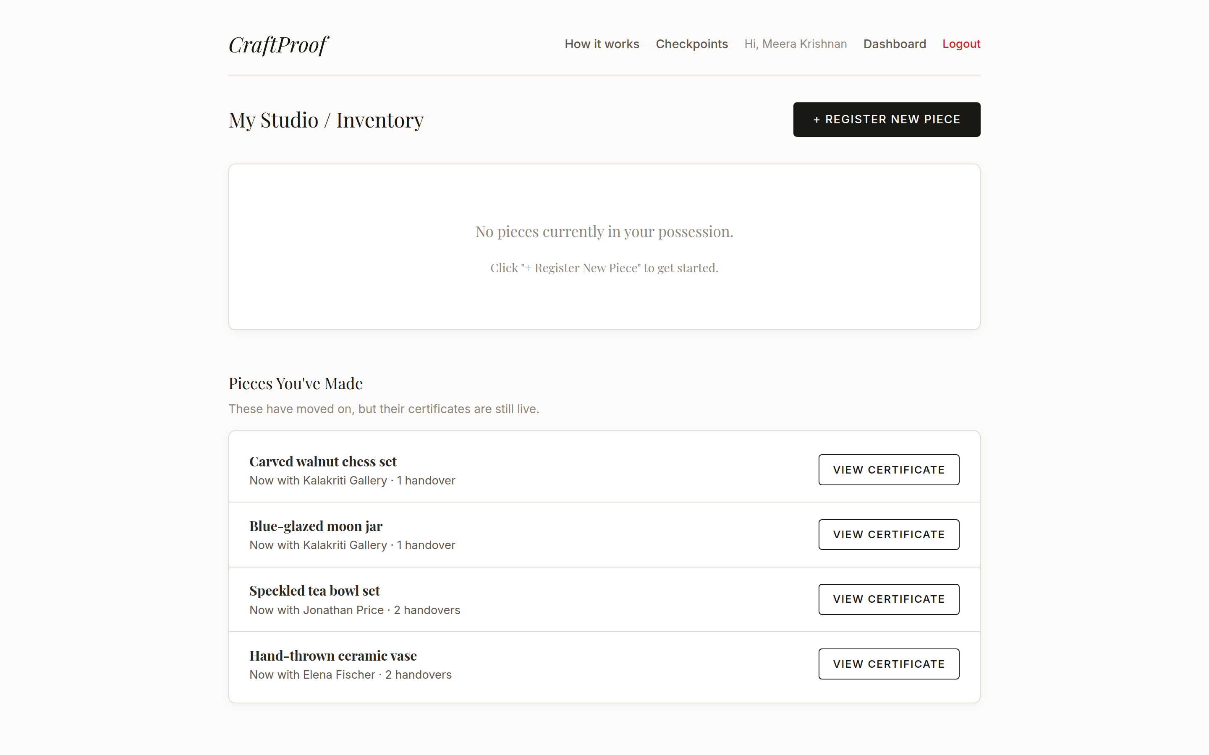
Part: The maker: registering a piece • Step 3
Her studio dashboard

Slide 15
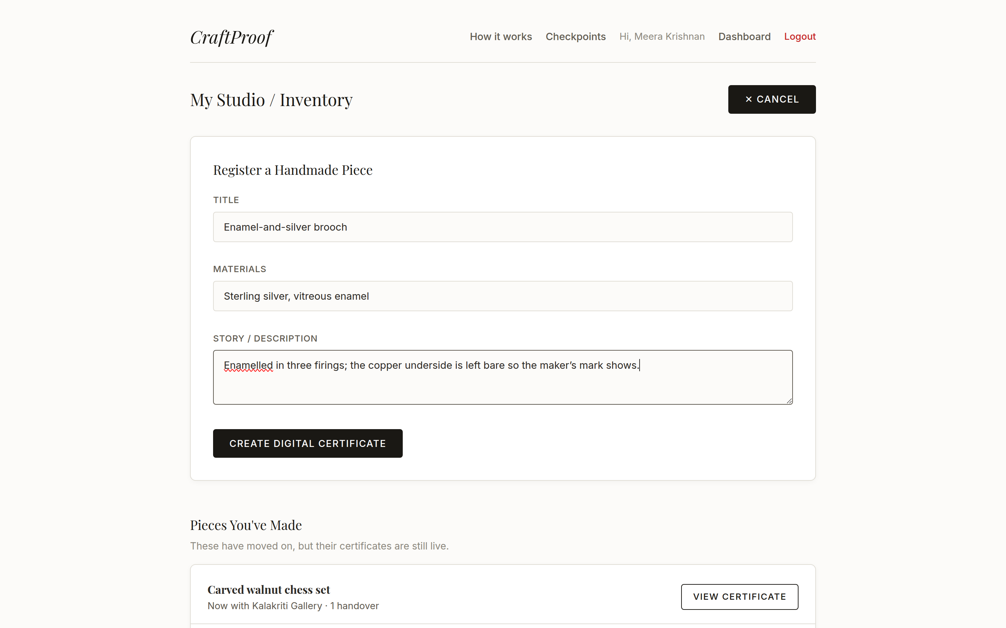
Part: The maker: registering a piece • Step 4
Registering a new piece

Slide 16
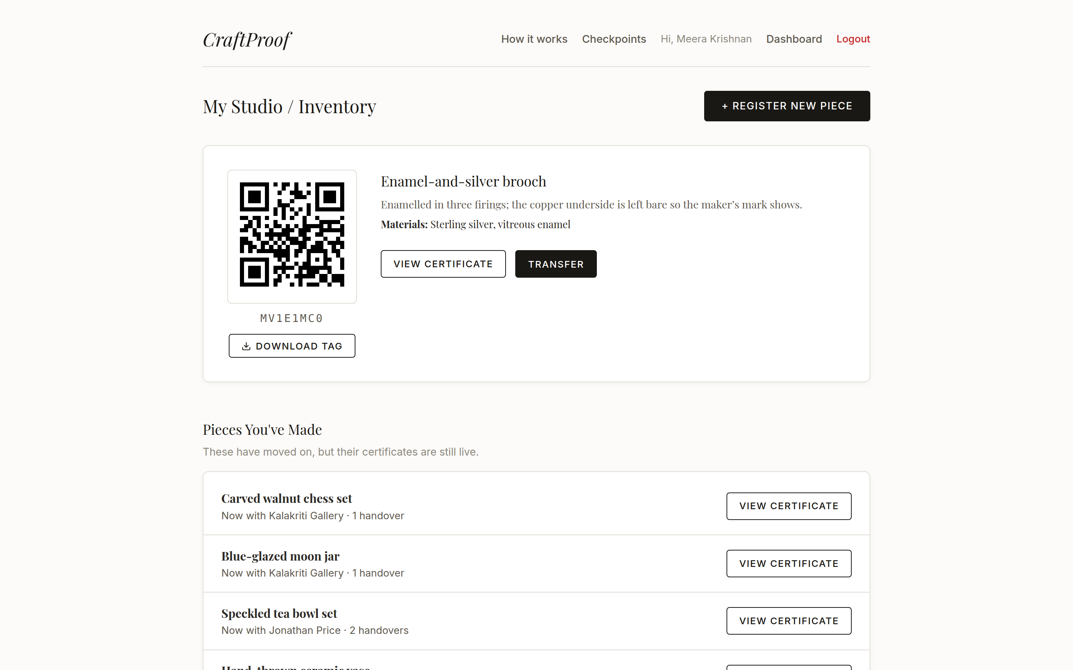
Part: The maker: registering a piece • Step 5
Certificate created

Slide 17
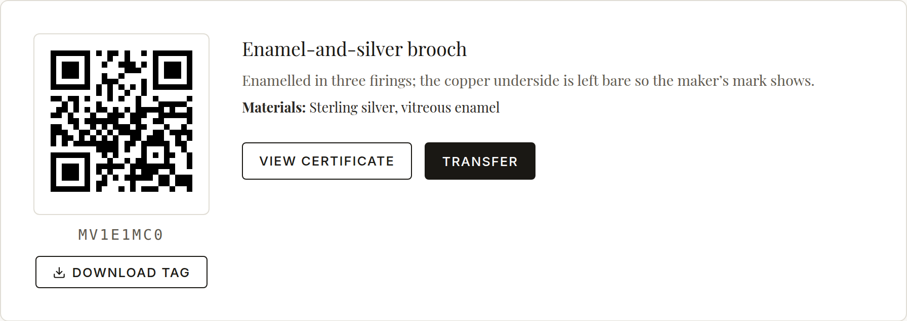
Part: The maker: registering a piece • Step 5
Certificate created

Slide 18
WORKFLOW WALKTHROUGH
The handover: maker → gallery

Slide 19
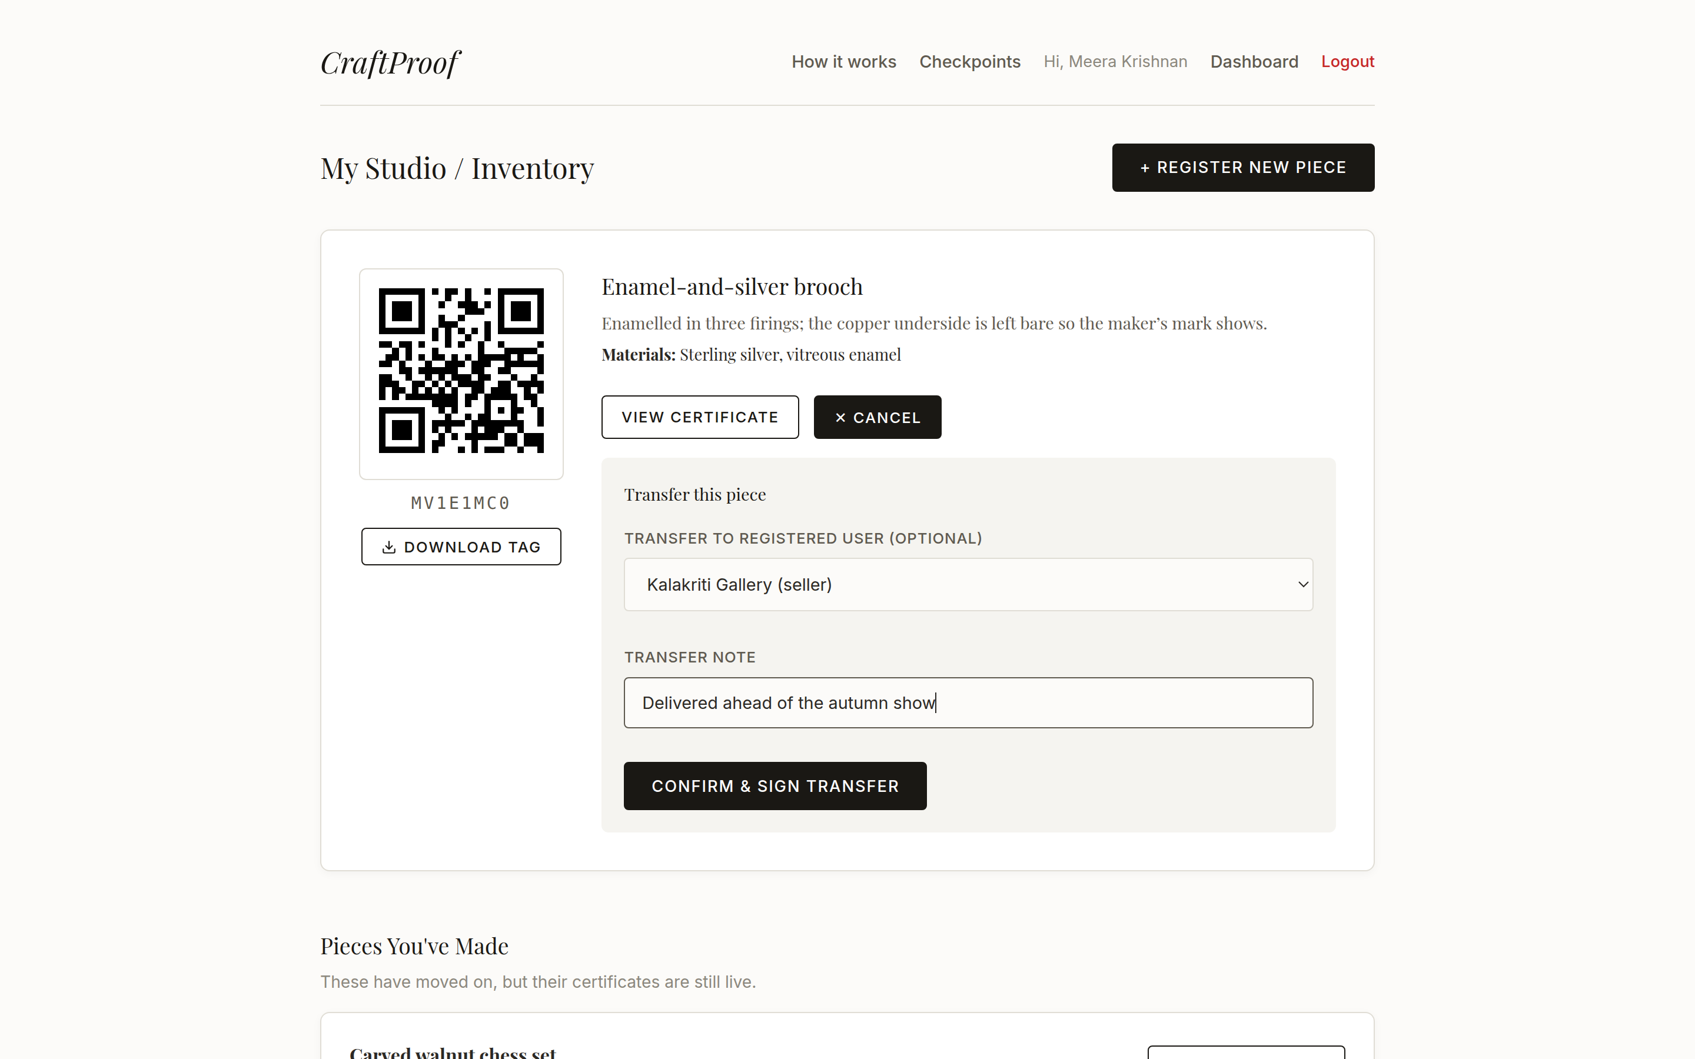
Part: The handover: maker → gallery • Step 6
Transferring to a gallery

Slide 20
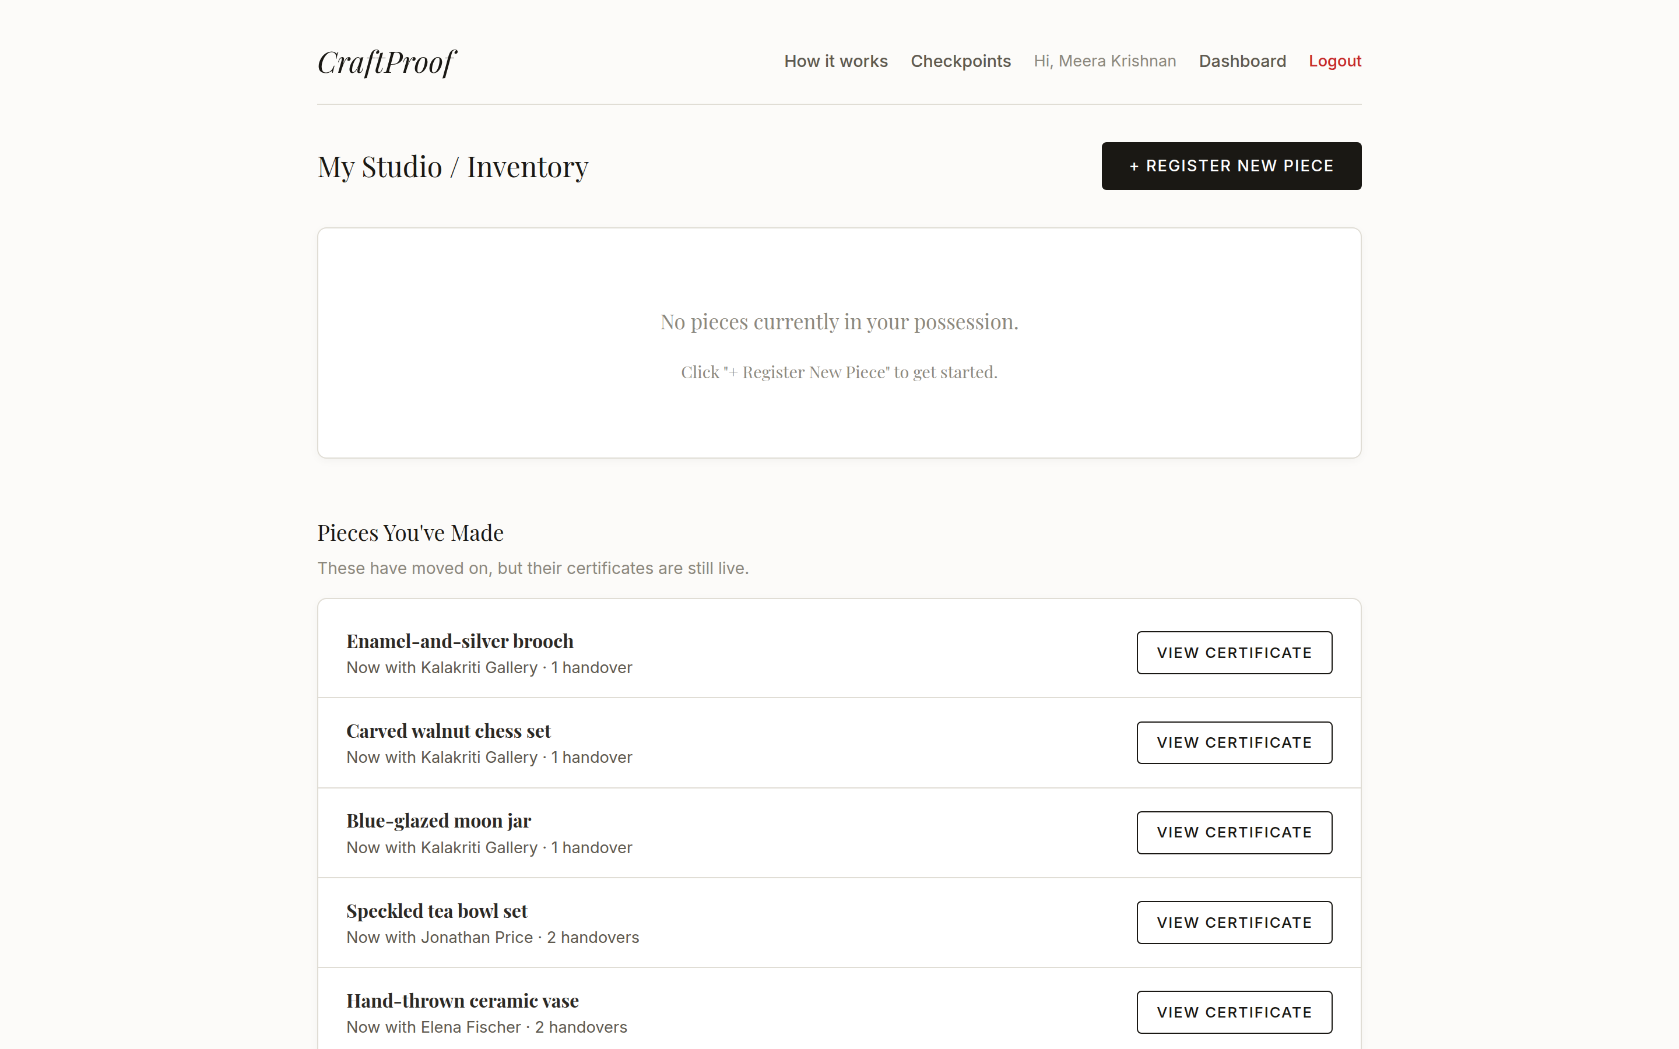
Part: The handover: maker → gallery • Step 7
It's out of her hands

Slide 21
WORKFLOW WALKTHROUGH
The gallery: selling to a customer

Slide 22
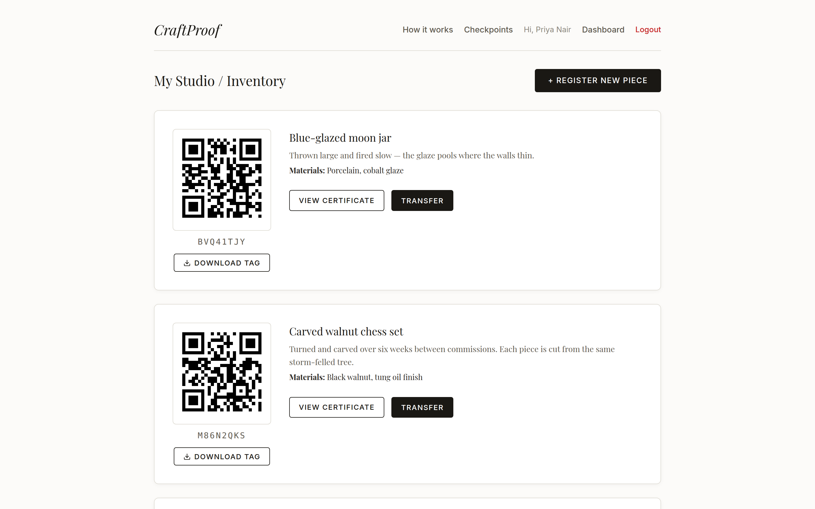
Part: The gallery: selling to a customer • Step 8
The gallery logs in

Slide 23
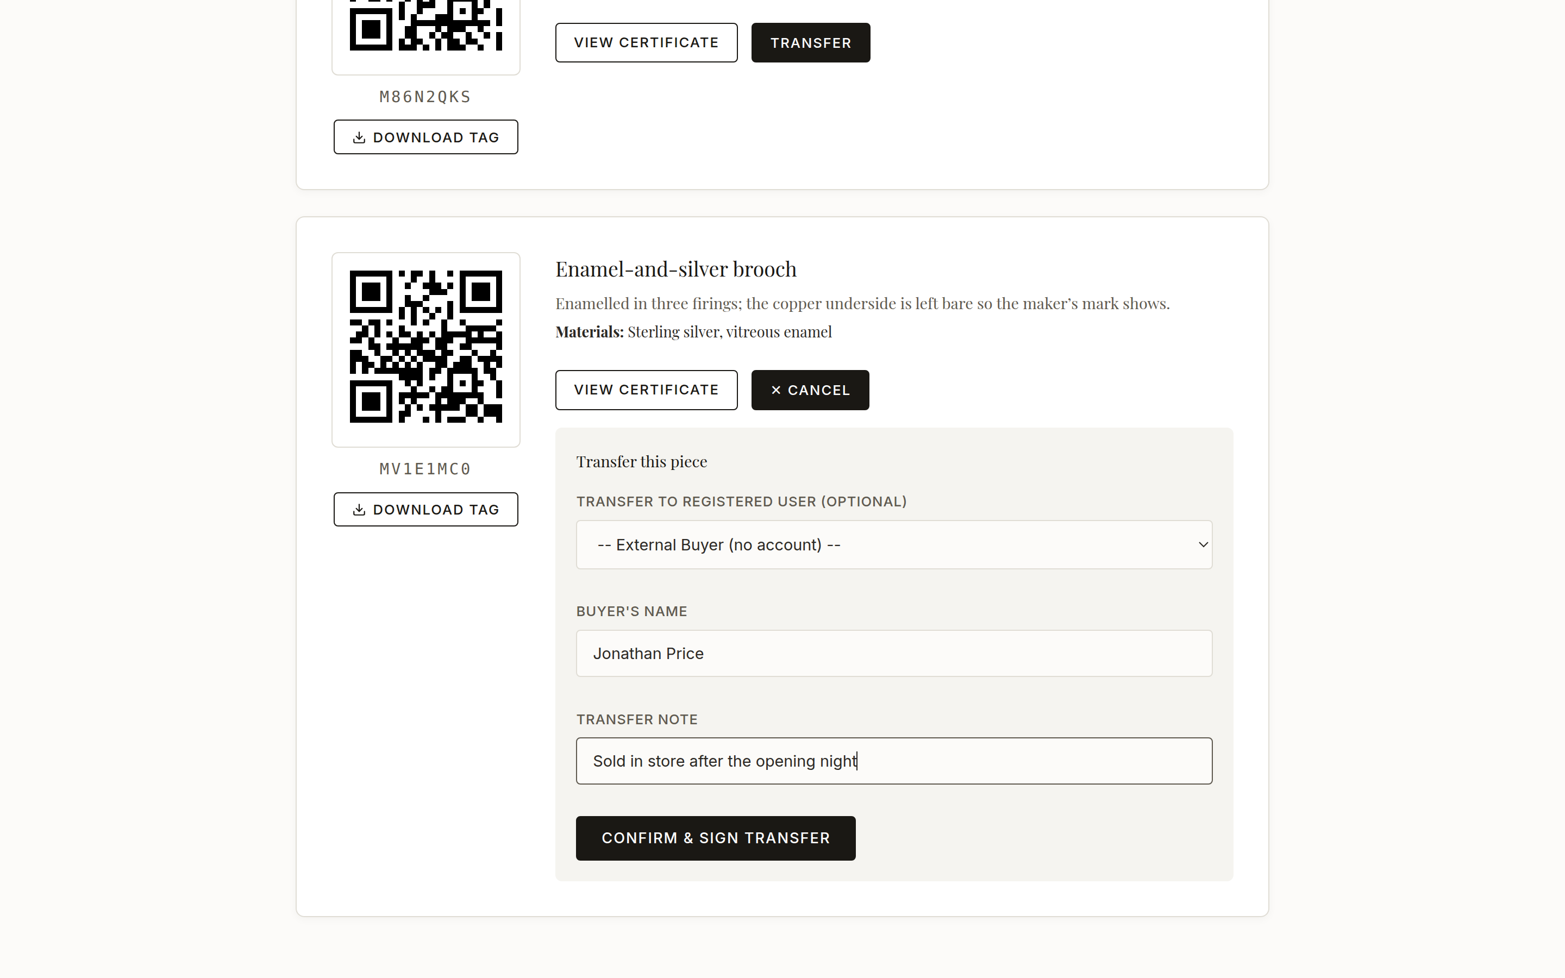
Part: The gallery: selling to a customer • Step 9
Selling to a buyer with no account

Slide 24
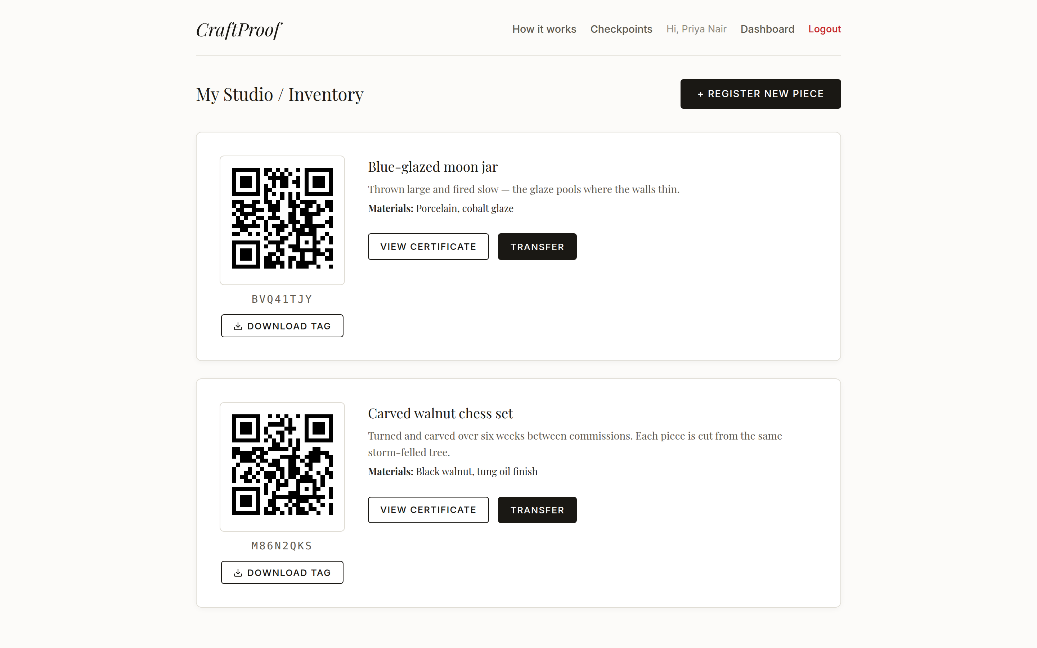
Part: The gallery: selling to a customer • Step 10
Sale recorded

Slide 25
WORKFLOW WALKTHROUGH
Sealing history: the public ledger

Slide 26
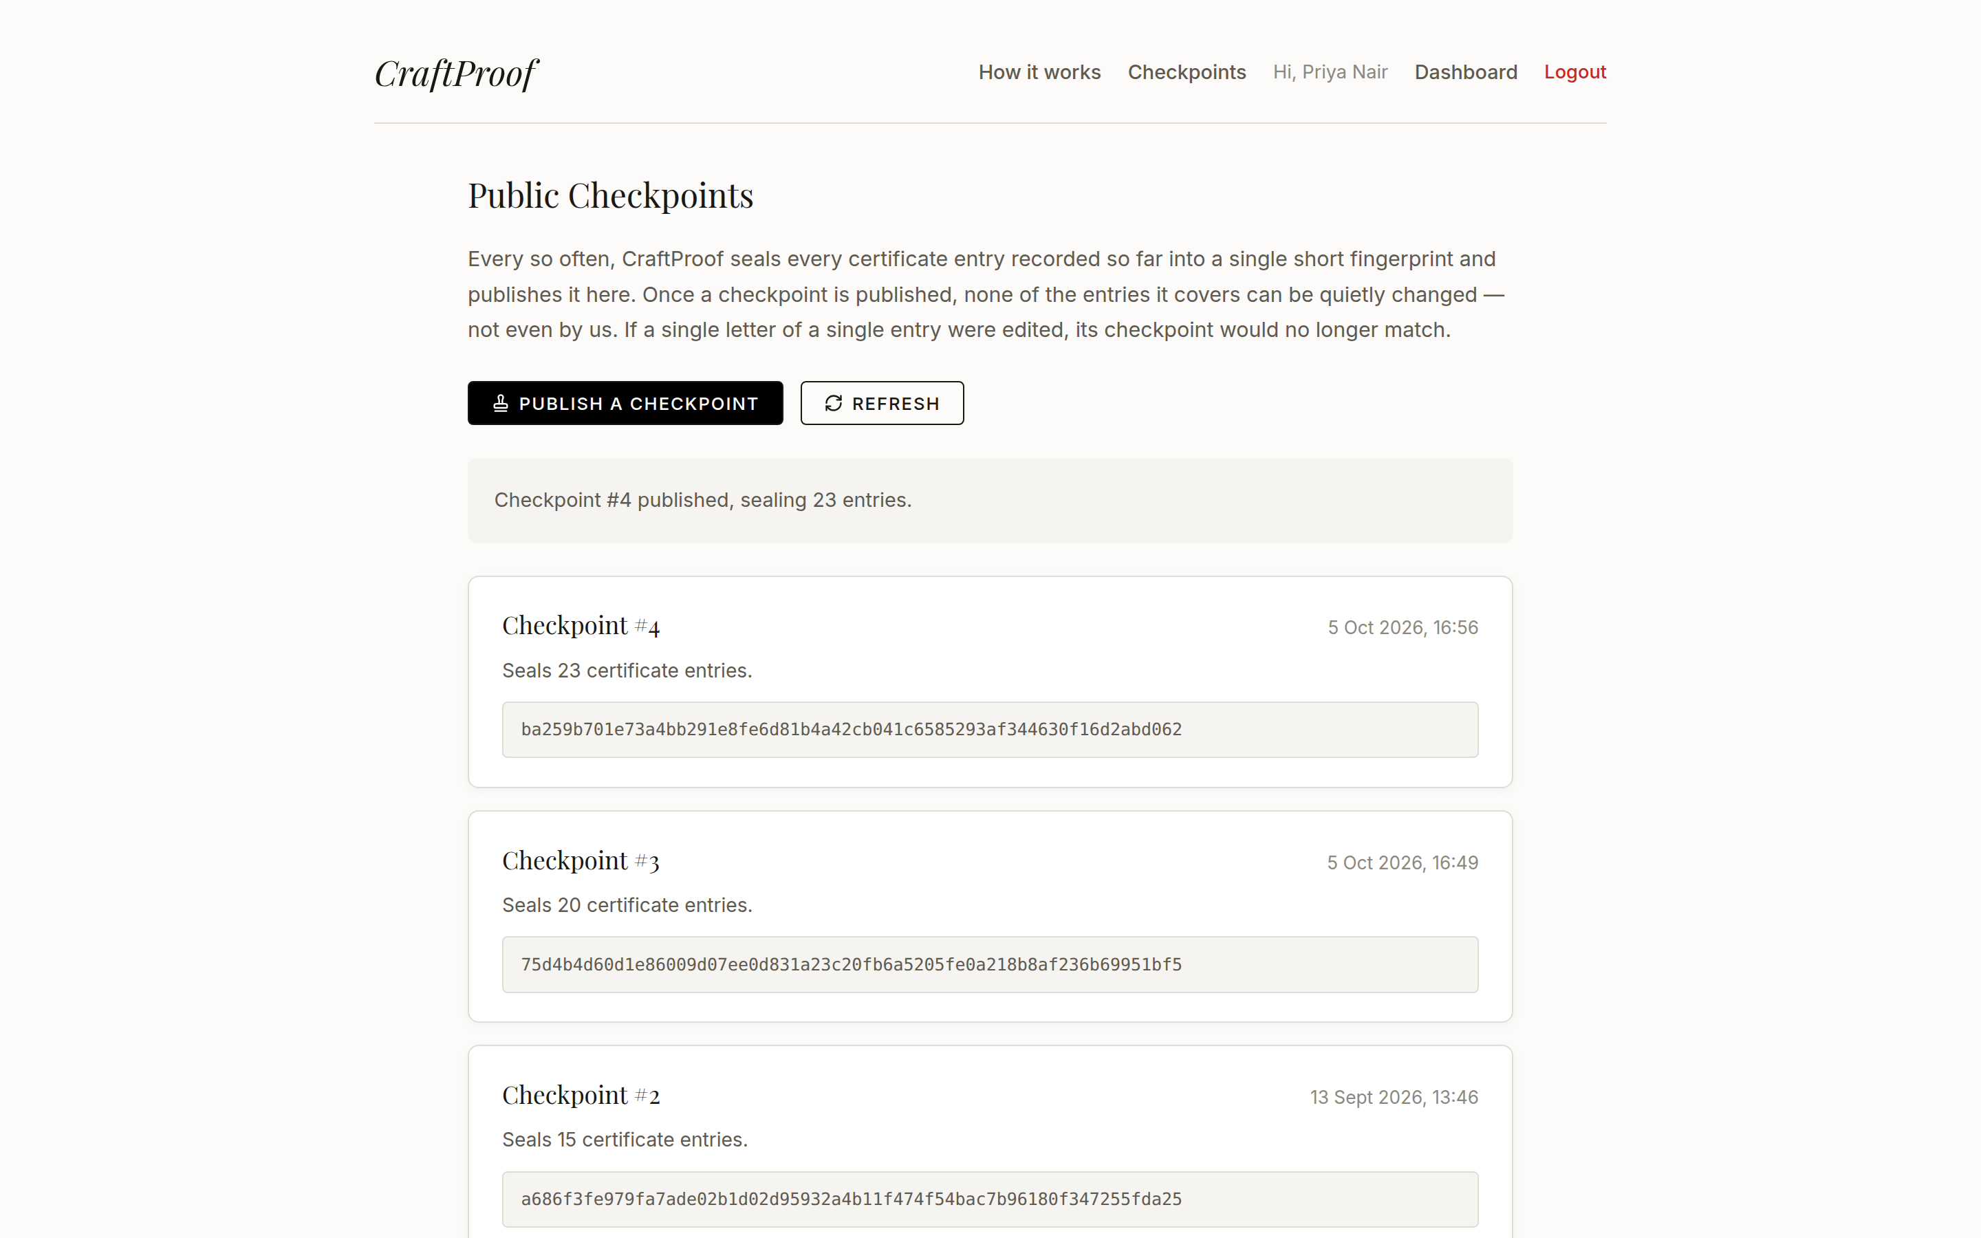
Part: Sealing history: the public ledger • Step 11
Publishing a checkpoint

Slide 27
WORKFLOW WALKTHROUGH
The buyer: verifying with no account

Slide 28
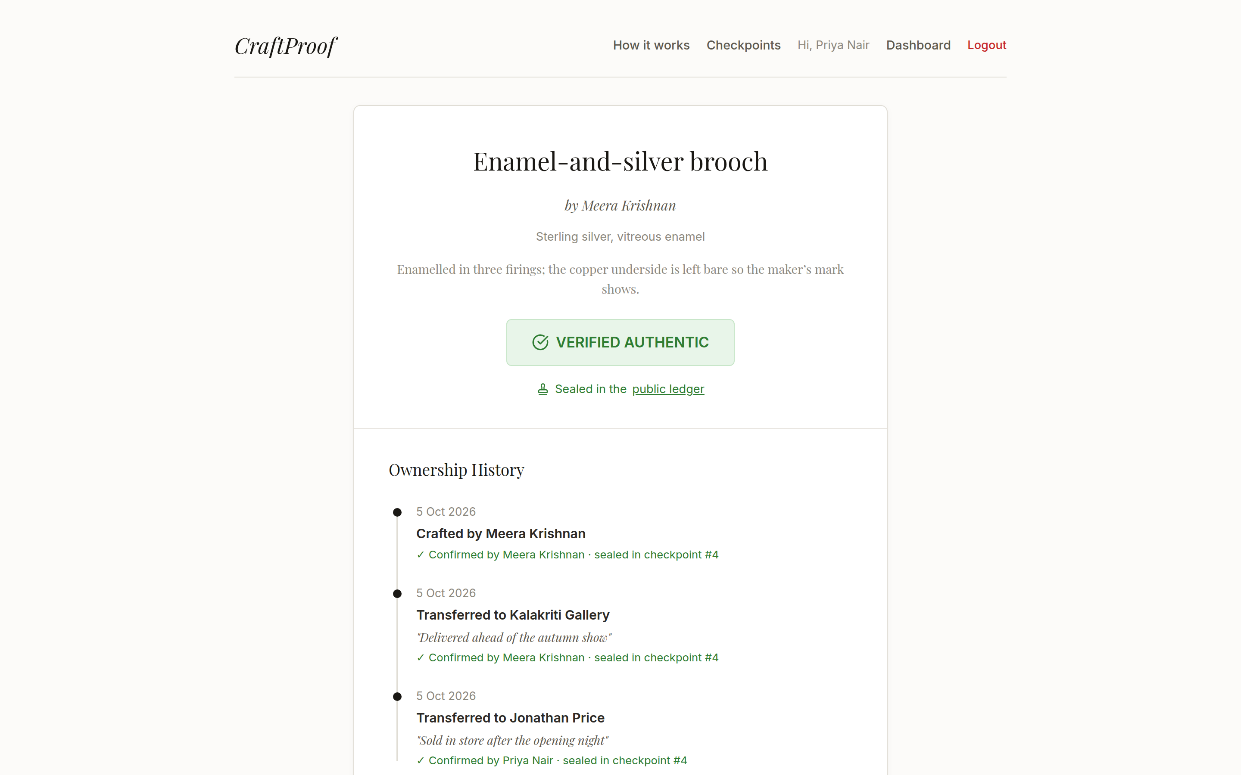
Part: The buyer: verifying with no account • Step 12
The public certificate page

Slide 29
Part: The buyer: verifying with no account • Step 13
"How is this verified?"

Slide 30
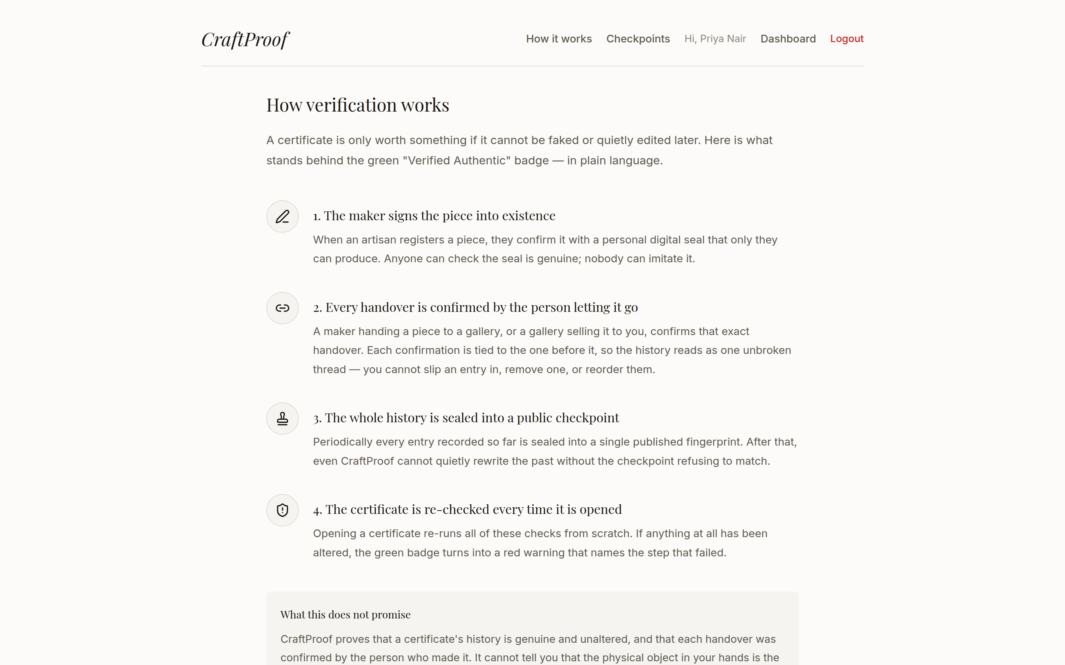
Part: The buyer: verifying with no account • Step 14
How it works page

Slide 31
WORKFLOW WALKTHROUGH
The payoff: catching tampering

Slide 32
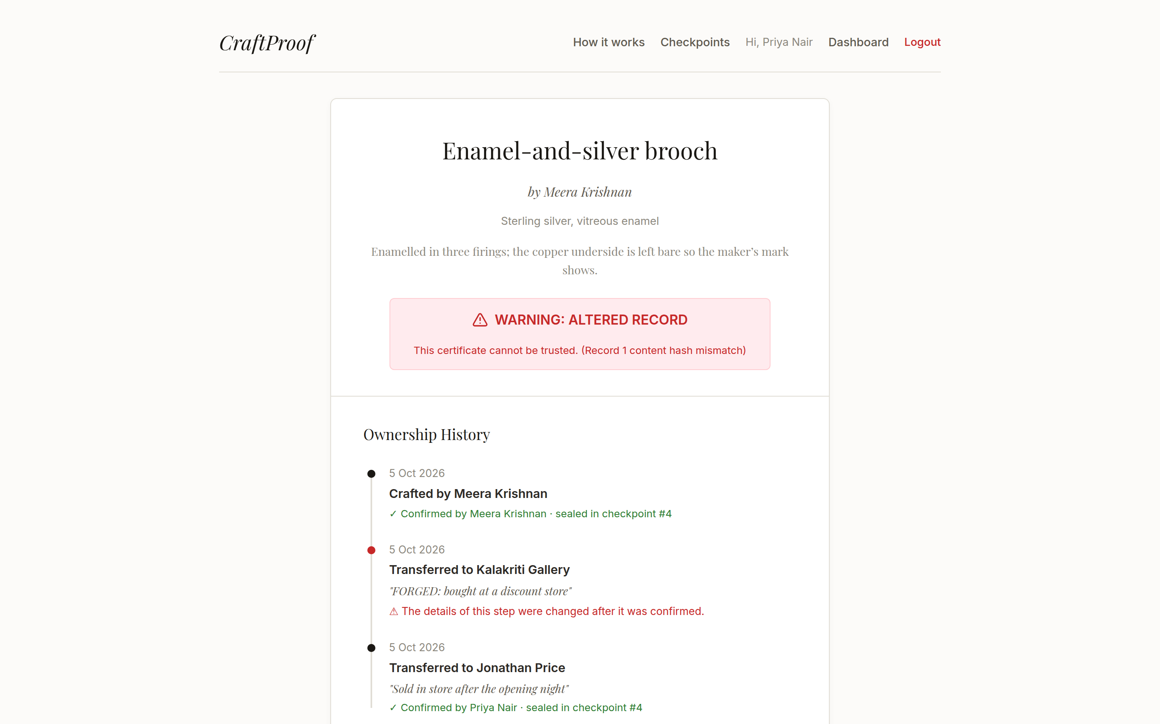
Part: The payoff: catching tampering • Step 16
The certificate turns red

