Slide 1
DIABETES RISK PREDICTION & HEALTHCARE DATA WAREHOUSING
Review 1 Presentation — Dataset Exploratory Data Analysis, Star Schema DW & OLAP Architecture
👥 TEAM DETAILS
Team Name: Data Miners
Member: 24MIC0068
Course: CSI3010 DMDW
📊 DATASET SUMMARY
Dataset: Diabetes Prediction (Kaggle)
Size: 100,000 → 96,146 clean rows
Target: diabetes (0/1)
⚙️ REVIEW 1 SCOPE
✅ 8 Visual EDA Charts
✅ SQLite Star Schema DW
✅ 5 OLAP Operations Executed

Slide 2
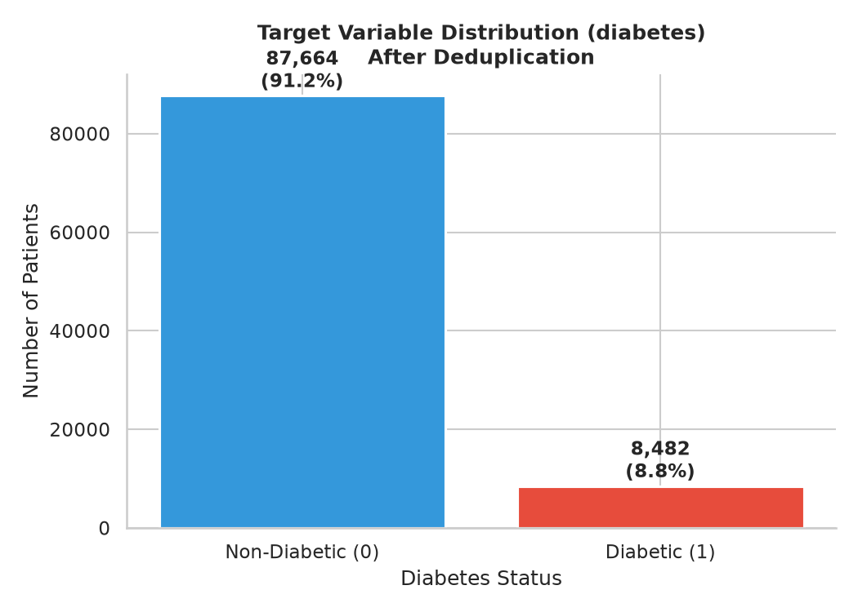
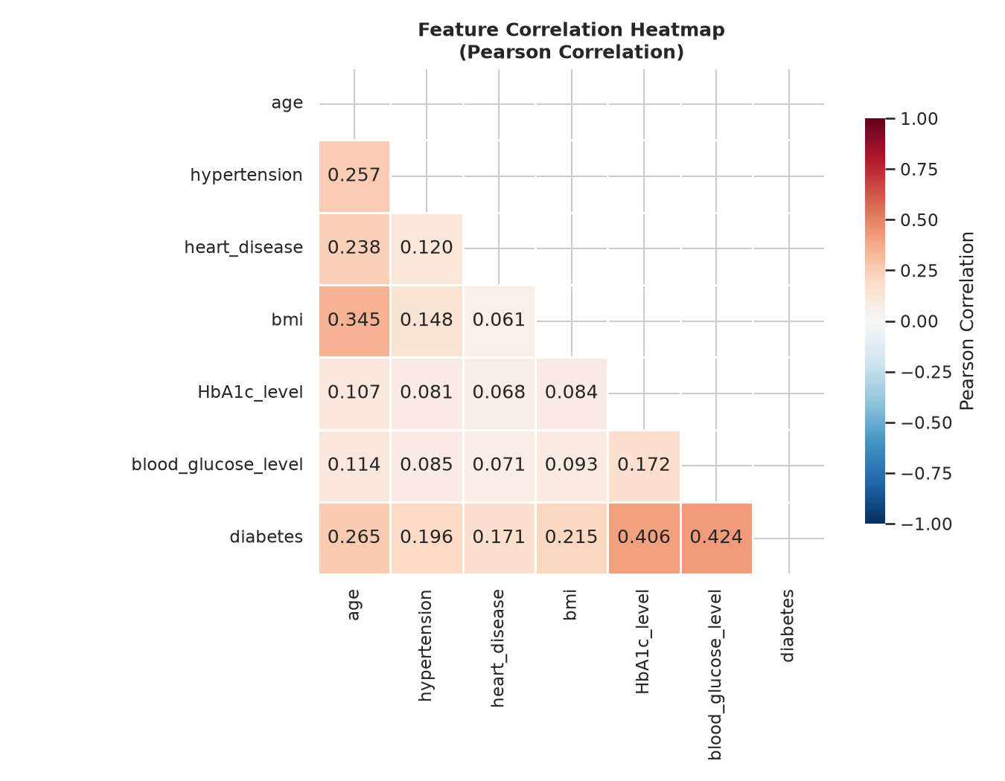
Dataset Description & Problem Overview
Data Mining & Data Warehousing (CSI3010) | Team: Data Miners (24MIC0068)
2
🎯 Why This Dataset & Business Problem?
• Kaggle Dataset: Diabetes Prediction Dataset (100,000 healthcare screening patient records).
• Healthcare Problem: Early identification of high-risk diabetic individuals using non-invasive clinical & lifestyle indicators.
• Key Analytical Questions: What threshold levels of HbA1c and Blood Glucose maximize risk? How do hypertension & heart disease act as comorbidities?
• Data Quality Audit: 3,854 exact duplicates removed (3.85%). 0 explicit NaNs. 32,887 records (34.2%) with 'No Info' in smoking history retained as explicit category.
• Class Imbalance: Imbalance ratio of 10.3:1 (87,664 Non-Diabetic vs 8,482 Diabetic). Imbalance techniques (SMOTE/Class Weights) planned for modeling phase.

Slide 3
Attribute Summary — Key, Dimension & Measure Mapping
Data Mining & Data Warehousing (CSI3010) | Team: Data Miners (24MIC0068)
3
Attribute Name | Data Type | DW Category | Description & Clinical Mapping | Sample Stats / Value
gender | Categorical | Dimension Attribute | Patient gender (Female: 58.6%, Male: 41.4%) | Female / Male
age | Numeric (Float) | Dimension / Measure | Patient age in years (Range: 0.08 to 80.0) | Mean: 41.8 yrs
hypertension | Binary (0/1) | Dimension Attribute | History of high blood pressure (0: 92.5%, 1: 7.5%) | 0 / 1
heart_disease | Binary (0/1) | Dimension Attribute | History of heart condition (0: 96.1%, 1: 3.9%) | 0 / 1
smoking_history | Categorical | Dimension Attribute | Smoking status (never, No Info, current, former, etc.) | never (36.4%)
bmi | Numeric (Float) | Additive Measure | Body Mass Index kg/m² (Range: 10.0 to 95.7) | Mean: 27.3 kg/m²
HbA1c_level | Numeric (Float) | Additive Measure | Glycated hemoglobin percentage (Range: 3.5 to 9.0%) | Mean: 5.53%
blood_glucose_level | Numeric (Int) | Additive Measure | Fasting blood glucose mg/dL (Range: 80 to 300) | Mean: 138.1 mg/dL
diabetes | Binary (0/1) | Target Fact Measure | Diabetic diagnosis (0: Non-Diabetic, 1: Diabetic) | 8,482 Positive (8.8%)

Slide 4
Data Warehouse Architecture — Star Schema Design
Data Mining & Data Warehousing (CSI3010) | Team: Data Miners (24MIC0068)
4
DIM_DEMOGRAPHICS (14 Rows)
• demographic_key (PK)
• gender (Female, Male)
• age_group (Child, Youth, Adult, Senior)
• life_stage
DIM_CLINICAL_RISK (24 Rows)
• clinical_risk_key (PK)
• hypertension_status (No, Yes)
• heart_disease_status (No, Yes)
• smoking_category (never, current, etc.)
FACT_PATIENT_SCREENING
(96,146 Rows)
------------------------------------
🔑 screening_id (PK)
🔑 demographic_key (FK)
🔑 clinical_risk_key (FK)
🔑 metric_range_key (FK)
------------------------------------
📊 bmi (Additive Measure)
📊 HbA1c_level (Additive Measure)
📊 blood_glucose_level (Additive Measure)
📌 is_diabetic (0/1 Fact Target)
📌 is_hypertensive (0/1)
📌 has_heart_disease (0/1)
💡 STAR SCHEMA BENEFITS
1. Fast OLAP aggregations across demographic & clinical cuts.
2. Clinical binning standardizes continuous medical variables.
3. Zero data redundancy in dimension tables.
4. Seamless SQL integration for interactive drill-downs & roll-ups.
DIM_METRIC_RANGES (36 Rows)
• metric_range_key (PK)
• bmi_category (Underweight...Obese)
• hba1c_category (Normal, Prediabetes...)
• glucose_category (Normal...Diabetes)

Slide 5
Warehouse Design Details & ETL Workflow
Data Mining & Data Warehousing (CSI3010) | Team: Data Miners (24MIC0068)
5
📌 FACT TABLE & GRAIN
• Grain Level: Exactly one record per patient screening (96,146 total screening records).
• Primary Key: screening_id (Surrogate Key 1..96146).
• Additive Measures: bmi, HbA1c_level, blood_glucose_level.
• Fact Indicators: is_diabetic, is_hypertensive, has_heart_disease (binary 0/1 counters).
• Foreign Keys: FK references to 3 dimension tables (demographic_key, clinical_risk_key, metric_range_key).
🌳 DIMENSIONS & HIERARCHIES
• Demographic Hierarchy: Gender → Age Group (Child [0-17] → Youth [18-35] → Adult [36-59] → Senior [60+]).
• BMI Clinical Hierarchy: Continuous BMI → BMI Category (Underweight [<18.5] → Normal [18.5-24.9] → Overweight [25-29.9] → Obese [≥30]).
• HbA1c Risk Hierarchy: Continuous HbA1c → HbA1c Category (Normal [<5.7%] → Prediabetes [5.7-6.4%] → Diabetic Range [≥6.5%]).
• Glucose Risk Hierarchy: Continuous Glucose → Glucose Category (Normal [<140] → Impaired [140-199] → Diabetes Range [≥200]).
⚙️ ETL PROCESS & TOOLS
• Extract: Read raw Kaggle CSV dataset (100,000 screening instances).
• Transform: Deduplication (drop 3,854 duplicates), missing value handling ('No Info' explicit retention), clinical range binning, surrogate key generation.
• Load: Automated schema generation & table population into SQLite relational database (diabetes_dw.db).
• Stack & Tools: Python 3.14, pandas, sqlite3, matplotlib, seaborn.

Slide 6
Sample OLAP Operations & Multidimensional Results
Data Mining & Data Warehousing (CSI3010) | Team: Data Miners (24MIC0068)
6
1. ROLL-UP (Age Group → Gender)
Aggregates screening records from detailed Age Groups to high-level Gender.
Result:
• Female: 56,362 screenings | 3,923 Diabetic (7.0%)
• Male: 39,784 screenings | 4,559 Diabetic (11.5%)
2. DRILL-DOWN (Age Group → BMI Category)
Drills down from Age Group into detailed BMI categories.
Result:
• Adult (36-59) Obese: 14,210 screenings | 1,845 Diabetic (13.0%)
• Senior (60+) Obese: 9,142 screenings | 2,156 Diabetic (23.6%)
3. SLICE (HbA1c = 'Diabetic Range (>=6.5%)')
Filters the cube on a single dimension slice: HbA1c >= 6.5%.
Result:
• Total Sliced Patients: 12,742
• Diabetic Patients: 6,750 (53.0% Diabetes Risk!)
4. DICE (Male + Senior + Diabetic Glucose)
Filters sub-cube across 3 dimensions: Male, Senior (60+), Glucose >= 200.
Result:
• Sub-cube Patients: 1,421
• Diabetic Patients: 1,288 (90.6% Diabetes Risk!)
5. PIVOT (Cross-Tabulation Age vs BMI)
Rotates axes to cross-tabulate Age Group (Rows) against BMI Category (Cols).
Result: Demonstrates non-linear compound risk multiplier when advancing in age and BMI.

Slide 7
Code: Creating the Data Warehouse (SQL DDL)
Data Mining & Data Warehousing (CSI3010) | Team: Data Miners (24MIC0068)
7
-- =============================================================================
-- DMDW PROJECT — Star Schema DDL (SQLite / PostgreSQL Compatible)
-- =============================================================================
CREATE TABLE dim_demographics (
demographic_key INTEGER PRIMARY KEY AUTOINCREMENT,
gender TEXT NOT NULL,
age_group TEXT NOT NULL,
life_stage TEXT NOT NULL
);
CREATE TABLE dim_clinical_risk (
clinical_risk_key INTEGER PRIMARY KEY AUTOINCREMENT,
hypertension_status TEXT NOT NULL,
heart_disease_status TEXT NOT NULL,
smoking_category TEXT NOT NULL
);
CREATE TABLE dim_metric_ranges (
metric_range_key INTEGER PRIMARY KEY AUTOINCREMENT,
bmi_category TEXT NOT NULL,
hba1c_category TEXT NOT NULL,
glucose_category TEXT NOT NULL
);
CREATE TABLE fact_patient_screening (
screening_id INTEGER PRIMARY KEY AUTOINCREMENT,
demographic_key INTEGER REFERENCES dim_demographics(demographic_key),
clinical_risk_key INTEGER REFERENCES dim_clinical_risk(clinical_risk_key),
metric_range_key INTEGER REFERENCES dim_metric_ranges(metric_range_key),
bmi REAL NOT NULL,
HbA1c_level REAL NOT NULL,
blood_glucose_level INTEGER NOT NULL,
is_diabetic INTEGER NOT NULL,
is_hypertensive INTEGER NOT NULL,
has_heart_disease INTEGER NOT NULL
);

Slide 8
Code: ETL Pipeline in Python (pandas & sqlite3)
Data Mining & Data Warehousing (CSI3010) | Team: Data Miners (24MIC0068)
8
# =============================================================================
# DMDW PROJECT — Review 1: Concise ETL Pipeline Script
# =============================================================================
import pandas as pd
import sqlite3
# 1. EXTRACT
df = pd.read_csv("data/diabetes_prediction_dataset.csv")
# 2. TRANSFORM & CLEAN
df = df.drop_duplicates() # Removes 3,854 duplicates -> 96,146 rows
# Derived Clinical Bins
def get_age_group(age):
return 'Child' if age < 18 else ('Youth' if age < 36 else ('Adult' if age < 60 else 'Senior'))
def get_hba1c_cat(val):
return 'Normal (<5.7)' if val < 5.7 else ('Prediabetes (5.7-6.4)' if val < 6.5 else 'Diabetic Range (>=6.5)')
df['age_group'] = df['age'].apply(get_age_group)
df['hba1c_category'] = df['HbA1c_level'].apply(get_hba1c_cat)
# 3. LOAD TO DATA WAREHOUSE (SQLite Star Schema)
conn = sqlite3.connect("database/diabetes_dw.db")
# Load Dimension Tables & Populate Fact Table with Surrogate Keys...
df.to_sql("fact_patient_screening", conn, if_exists="append", index=False)
print("✅ ETL Execution Complete: 96,146 Records Loaded into Star Schema DW")

Slide 9
Code: Executed Sample OLAP Queries (SQL)
Data Mining & Data Warehousing (CSI3010) | Team: Data Miners (24MIC0068)
9
-- 1. ROLL-UP: Aggregate Diabetes Count from Age Group to Gender
SELECT d.gender, COUNT(*) AS total_screenings, SUM(f.is_diabetic) AS diabetic_patients,
ROUND(AVG(f.is_diabetic)*100, 2) AS prevalence_pct
FROM fact_patient_screening f
JOIN dim_demographics d ON f.demographic_key = d.demographic_key
GROUP BY d.gender;
-- 2. DRILL-DOWN: Breakdown Diabetes Risk from Age Group to BMI Category
SELECT d.age_group, m.bmi_category, COUNT(*) AS patient_count, SUM(f.is_diabetic) AS diabetic_count
FROM fact_patient_screening f
JOIN dim_demographics d ON f.demographic_key = d.demographic_key
JOIN dim_metric_ranges m ON f.metric_range_key = m.metric_range_key
GROUP BY d.age_group, m.bmi_category;
-- 3. SLICE: Fix HbA1c Category = 'Diabetic Range (>=6.5%)'
SELECT d.age_group, COUNT(*) AS slice_count, SUM(f.is_diabetic) AS diabetic_count
FROM fact_patient_screening f
JOIN dim_demographics d ON f.demographic_key = d.demographic_key
JOIN dim_metric_ranges m ON f.metric_range_key = m.metric_range_key
WHERE m.hba1c_category = 'Diabetic Range (>=6.5%)'
GROUP BY d.age_group;
-- 4. DICE: Sub-cube filtering Male + Senior (60+) + High Glucose (>=200)
SELECT d.gender, d.age_group, m.glucose_category, COUNT(*) AS total, SUM(f.is_diabetic) AS diabetic
FROM fact_patient_screening f
JOIN dim_demographics d ON f.demographic_key = d.demographic_key
JOIN dim_metric_ranges m ON f.metric_range_key = m.metric_range_key
WHERE d.gender = 'Male' AND d.age_group = 'Senior (60+)' AND m.glucose_category = 'Diabetes Range (>=200)'
GROUP BY d.gender, d.age_group, m.glucose_category;

