Slide 1
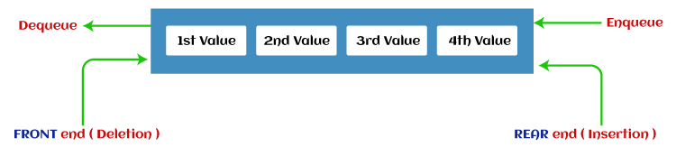
What is a Queue?
Queue is the data structure that is similar to the queue in the real world. A queue is a data structure in which whatever comes first will go out first, and it follows the FIFO (First-In-First-Out) policy. Queue can also be defined as the list or collection in which the insertion is done from one end known as the rear end or the tail of the queue, whereas the deletion is done from another end known as the front end or the head of the queue.

Slide 2
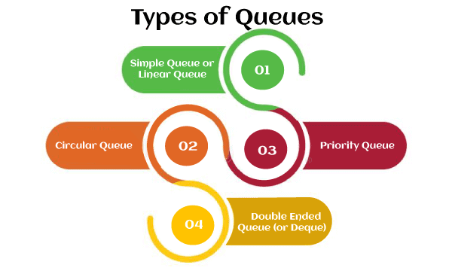

Slide 3
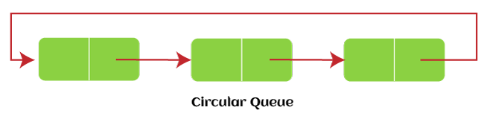
Circular Queue
In Circular Queue, all the nodes are represented as circular. It is similar to the linear Queue except that the last element of the queue is connected to the first element. It is also known as Ring Buffer, as all the ends are connected to another end.

Slide 4
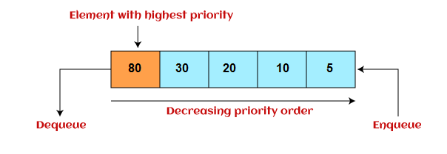
Priority Queue
It is a special type of queue in which the elements are arranged based on the priority. It is a special type of queue data structure in which every element has a priority associated with it. Suppose some elements occur with the same priority, they will be arranged according to the FIFO principle.

Slide 5
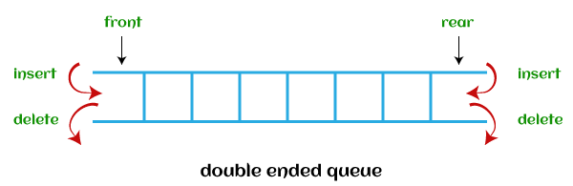
Deque (or, Double Ended Queue)
In Deque or Double Ended Queue, insertion and deletion can be done from both ends of the queue either from the front or rear. It means that we can insert and delete elements from both front and rear ends of the queue. Deque can be used as a palindrome checker means that if we read the string from both ends, then the string would be the same.

Slide 6
Operations performed on queue
Enqueue: The Enqueue operation is used to insert the element at the rear end of the queue. It returns void.
Dequeue: It performs the deletion from the front-end of the queue. It also returns the element which has been removed from the front-end. It returns an integer value.
Peek: This is the third operation that returns the element, which is pointed by the front pointer in the queue but does not delete it.
Queue overflow (isfull): It shows the overflow condition when the queue is completely full.
Queue underflow (isempty): It shows the underflow condition when the Queue is empty, i.e., no elements are in the Queue.

