Slide 1
Progressive Web Apps
Progressive Web Apps
=> Progressive Web Apps (PWAs) are web apps built and enhanced with modern APIs to deliver enhanced capabilities, reliability, and installability while reaching anyone, anywhere, on any device, all with a single codebase.
=> One of the key differences between Progressive Web Apps and classic websites and web apps is installability.
=> PWA enable fast loading (regardless of the network), offline access, push notifications, and other capabilities

Slide 2

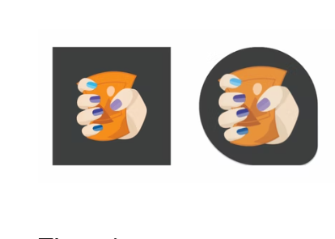
Process To Make PWA
Foundations : it's important that your website has a solid foundation in responsive design, mobile and everything first, intrinsic design, and web performance.
App design : One of the key differences between Progressive Web Apps and classic websites and web apps is installability.
The Icon :
Icon must be multiple and in different size and must be maskable.

Slide 3
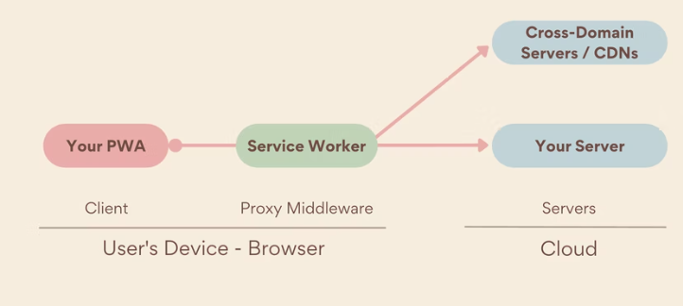
Process To Make PWA
Assets And Data : its assets are the same as on the web, but with new tools to make those assets load fast when online and available when offline.
Service workers : Service workers are a fundamental part of a PWA. They enable fast loading (regardless of the network), offline access, push notifications, and other capabilities.

Slide 4
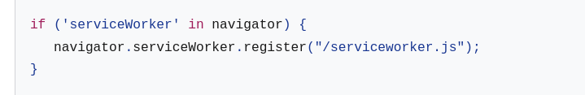
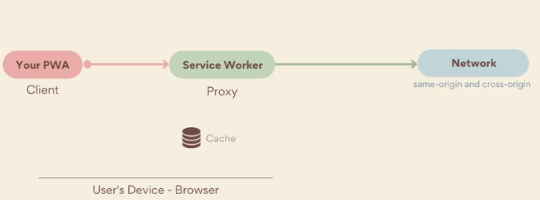
Process To Make PWA
Registering a service worker :
Serving: Using the service worker's fetch event, you can intercept network requests and serve a response using different techniques.

Slide 5
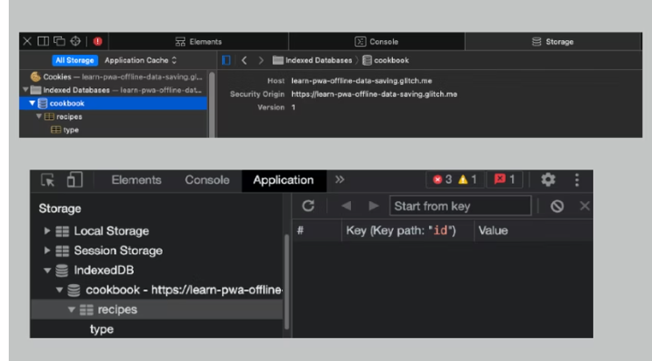
Process To Make PWA
Offline Data : To build a solid offline experience you need to implement storage management. Tools like IndexedDB, Cache, Storage Manager, Persistent Storage, and Content Indexing can help.
IndexedDB :

Slide 6
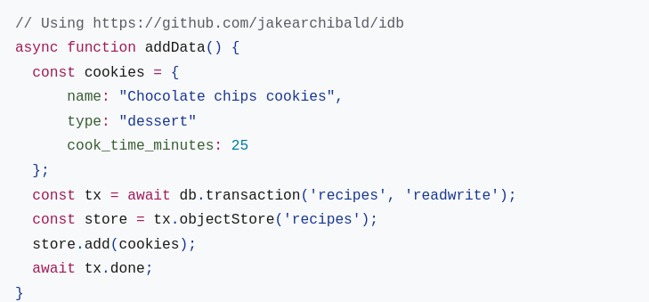
Process To Make PWA
Adding Data :

Slide 7
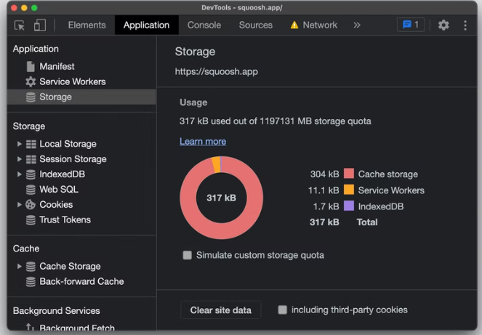
Process To Make PWA
Storage :

Slide 8
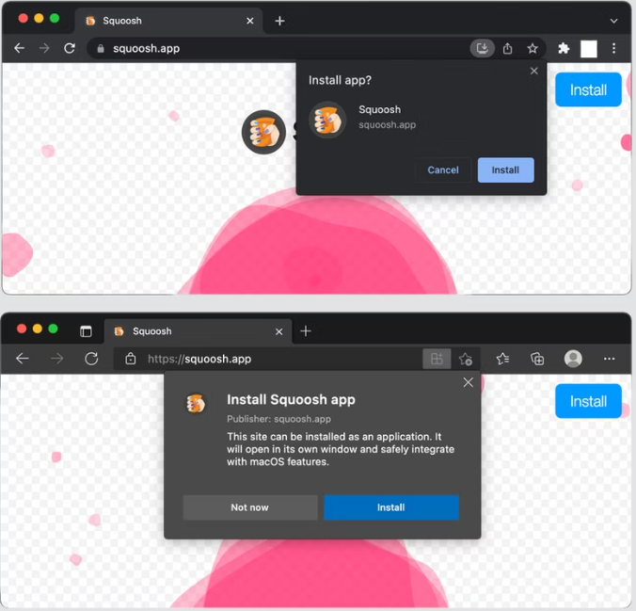
Process To Make PWA
Installation :

Slide 9
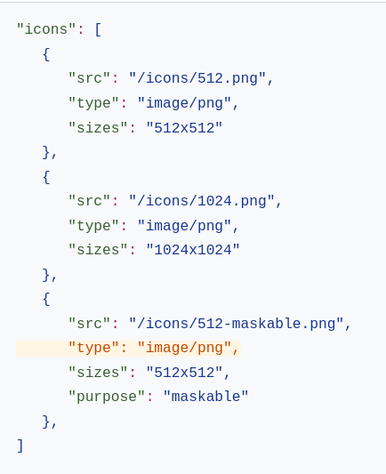
Process To Make PWA
Web app manifest : The web app manifest is a JSON file that defines how the PWA should be treated as an installed application, including the look and feel and basic behavior within the operating system.

Slide 10
Process To Make PWA
OS Integration :
1. Working with the file system.
2. File handling.
3. URL protocol handling.
4. Calling other apps.
5. Web Share.
6. Contact Picker.
7. URL handling.
"url_handlers": [
{"origin": "https://app.web.dev"},
]

Slide 11
Process To Make PWA
Capabilities :
1. Powerful web.
2. Empowering your PWA.
3. You can build a hyperlocal video chat app with WebRTC, geolocation, and push messages.
4. You can even bring it into virtual reality with WebGL and WebXR.
Etc.

Slide 12
Reference
https://web.dev/customize-install/
https://web.dev/learn/pwa/
https://www.youtube.com/watch?v=JQaL5YiSuqE&list=PL4cUxeGkcC9gTxqJBcDmoi5Q2pzDusSL7&index=2
https://www.youtube.com/watch?v=LWRdBywm4Zo
https://www.youtube.com/watch?v=kzJfiKQyD24
Thank You

