Slide 1



Pratibha Poshak IMAS
Information Management and Automation System

Slide 2
Pratibha Poshak – Background
Talent search and nurture initiative for bright students from underprivileged backgrounds, studying in government schools
Focus on equity, continuity, and excellence
Operating at scale across districts, cohorts, and years

Slide 3
Why Process Automation Was Needed
Manual processes were time-consuming and error-prone
Data scattered across spreadsheets and documents
Limited visibility across cohorts and years
High coordination overhead for volunteers and staff

Slide 4
What is Pratibha Poshak IMAS?
A comprehensive browser-based software system
Automates end-to-end Pratibha Poshak processes
Centralized, structured, and searchable data repository
Designed for scalability and long-term continuity

Slide 5
Key Stakeholders & Interfaces
Admin – system configuration and overall control
Batch Coordinators – academic and operational management
Teachers – attendance and teaching activity
Students – relevant academic and event information

Slide 6
Role-Based Access Control
Each user sees only what is relevant to their role
Ensures data security and clarity
Reduces errors and misuse

Slide 7
Major Functional Areas
Student Selection
Academic Batch Management
Reports and Custom Lists
Student Search Across Cohorts
Event Management

Slide 8
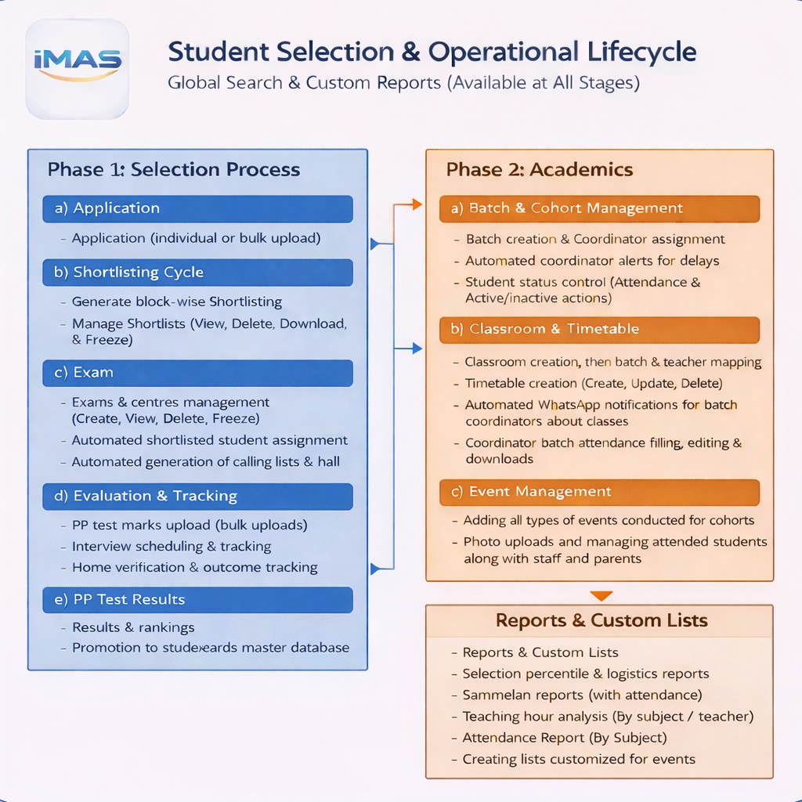
Process Diagram

Slide 9
Student Selection – Overview
End-to-end digitization of the selection process
Transparent, auditable, and scalable workflow

Slide 10
Student Selection – Initial Stages
Upload NMMS data
Automated shortlisting
Generation of call lists
Creation of exam centers and schedules
Hall-ticket generation

Slide 11
Student Selection – Evaluation to Selection
Exam attendance updates
Evaluation and score entry
Interview scheduling and outcome recording
Home visit tracking
Final selection workflow

Slide 12
Academic Batch Management
Creation of academic batches
Batch-wise timetable definition
Subject teacher assignment
Student-to-batch mapping

Slide 13
Attendance Tracking
Session-wise attendance recording
Batch-level visibility
Reliable academic engagement data

Slide 14
Teaching Hours & Analytics
Automatic computation of monthly teaching hours
Teacher-wise and batch-wise reports
Supports planning and review

Slide 15
Reports & Custom Lists
Generation of custom student lists
Commonly required reports available on demand
Eliminates manual compilation

Slide 16
Comprehensive Student Search
Search across cohorts and batches
Multiple search criteria supported
Quick retrieval of complete student history

Slide 17
Event Management
Management of tests, induction programs, and Sammelans
Centralized event information
Historical record maintained

Slide 18
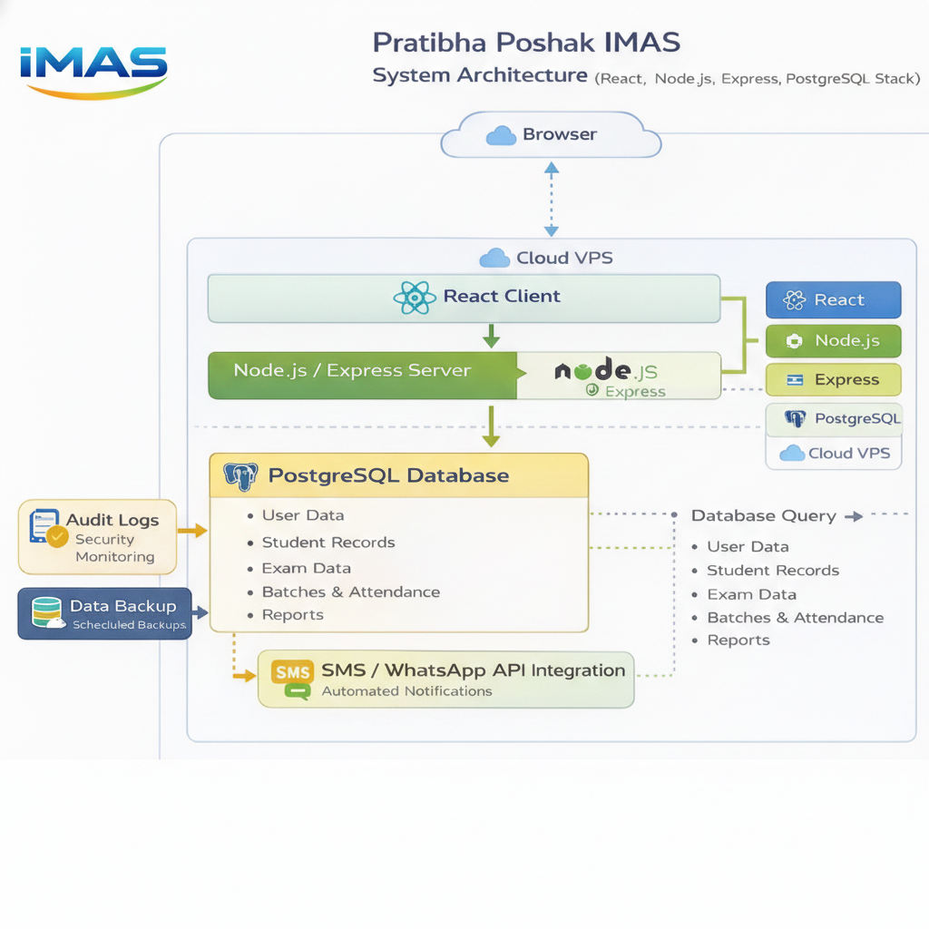
System Architecture

Slide 19
System Architecture – Overview
Browser-based access for all users
Central IMAS web application
Single integrated database
Hosted on a secure Virtual Private Server (VPS)

Slide 20
System Architecture – Workflow
Data entry and uploads
Validation and processing
Central storage in IMAS database
Role-based access and reporting
One-click backup mechanism

Slide 21
Standardized Master Data
Pre-loaded education districts and blocks
Pre-loaded schools with official DISE codes
Ensures consistency in naming and reporting
Avoids duplication and errors

Slide 22
Bulk Data Import Capability
Bulk import options across modules
Standardized bulk import templates provided
Efficient onboarding of large datasets

Slide 23
System Scale Today
More than 1,50,000 NMMS applicant records loaded
Demonstrates robustness and scalability
Designed to grow further

Slide 24
Depth of Student Data Capture
About 50 attributes captured per selection-test student
Academic, demographic, and program-related data
Enables rich analysis and long-term tracking

Slide 25
Data Safety & Backup
Entire system can be backed up with one click
Minimizes risk of data loss
Ensures long-term continuity

Slide 26
Technology & Access
Accessible via any modern web browser
No local installation required
Intuitive and user-friendly interface

Slide 27
Benefits to the Organization
Reduced manual effort and errors
Improved transparency and coordination
Institutional memory preserved
Supports scaling of Pratibha Poshak

Slide 28
Alignment with Pratibha Poshak Vision
Strengthens fair talent identification
Supports sustained academic nurturing
Allows teams to focus on mentoring, not administration

Slide 29
Development Stats for Version 1.0
Tech Stack: All Open Source – React.js, Node.js, Express.js, PostgreSQL ,Git, GitHub, Docker, Git actions(CI/CD)
50 Database Tables, 400+ number of columns (attributes)
More than 58,000+ lines of code
Started in July 2025
More than 1,800 developer-hours

Slide 30
Future Roadmap – Version 2.0
Mobile app for key features on the go
WhatsApp / messaging interface
Device inventory and student mapping
Internet data recharge tracking

Slide 31
Long-Term Impact
Digital backbone for Pratibha Poshak
Foundation for expansion to more regions
Replicable model for similar initiatives

Slide 32
Closing
IMAS is an enabler of efficiency, transparency, and equity
A strategic asset for Pratibha Poshak’s future

