Slide 1
Fandango (Team 6)
Venkata Rishith rayal dande
Pranith kiran Kouda
Vishal vannada
Satish KUMAR gollaprolu
Mangesh tak
MandipSINH gohil

Slide 2
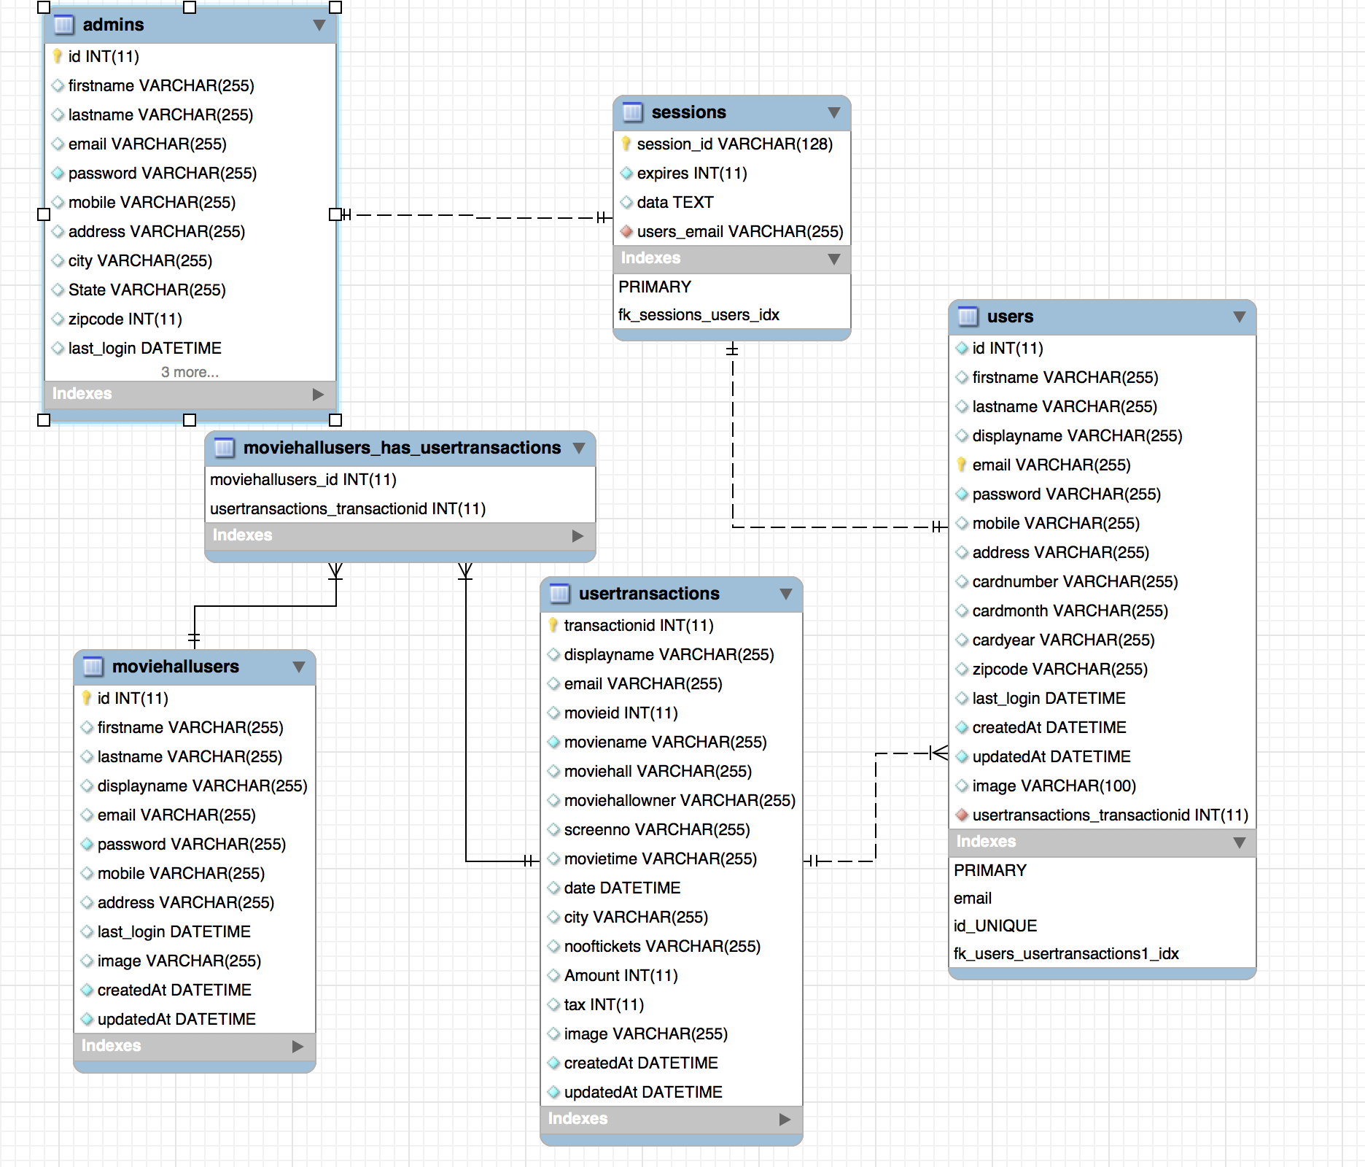
Data base schema
The figure shows the SQL database schema of the project.
Schema consists of the Users, User Transactions , Sessions from express sessions and Movie Hall Users and Admin
Each relationship (Foreign Key) are represented with lines in between the tables.

Slide 3
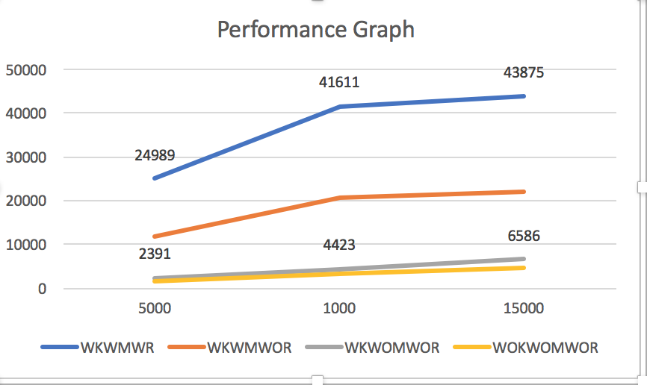
Performance Comparison Graph 1
WKWMWR- With Kafka with Mongo connection pool and with Redis cache
WKWMWOR- With Kafka with Mongo connection pool without Redis cache
WKWOMWOR- With Kafka Without connection pool and without Redis cache
WOKWOMWOR- without kafka without mongo and without redis cache.

Slide 4
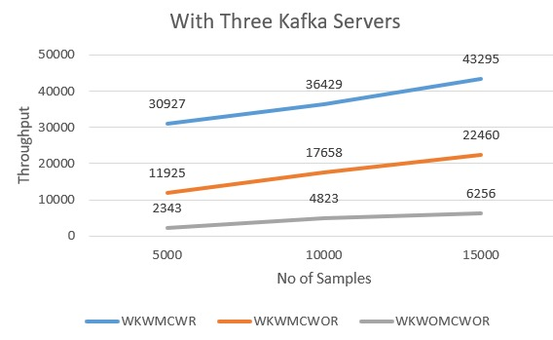
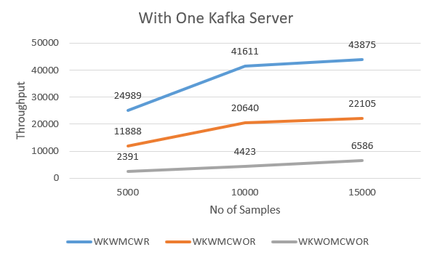
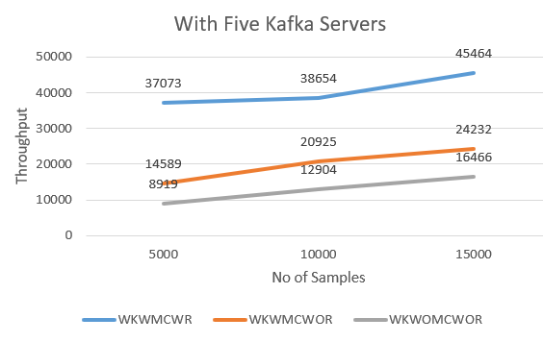
Performance graphs 2(multiple servers)

