Slide 1
Fourier Theory and its Application to Vision
Mani Thomas
CISC 489/689

Slide 2
Road Map of the Talk
Sampling and Aliasing
Fourier Theory Basics
  Signals and Vectors
  1D Fourier Theory
    DFT and FFT
  2D Fourier Theory
    Linear Filter theory
    Image Processing in spectral domain
Conclusions

Slide 3
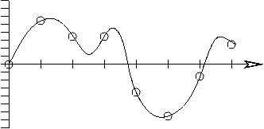
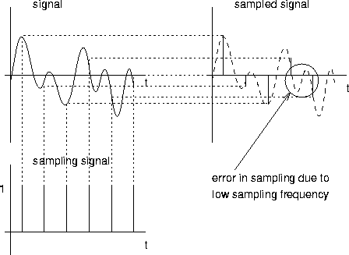
Sampling Theory - ADC
Real signals are continuous, but the digital computer can only handle discretized version of the data.
  Analog to digital conversion and vice versa (ADC and DAC)
Sampling measures the analog signal at different moments in time, recording the physical property of the signal (such as voltage) as a number.
  Approximation to the original signal
  From the vertical scale, we could transmit the numbers 0, 5, 3, 3, -4, ... as the approximation
Courtesy of: http://puma.wellesley.edu/~cs110/lectures/M07-analog-and-digital/
Courtesy of: http://www.cs.ucl.ac.uk/staff/jon/mmbook/book/node96.html

Slide 4
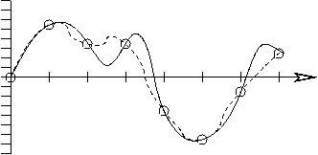
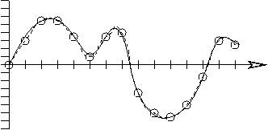
Sampling theory - DAC
Digital to Analog conversion
Reconstruct the signal from the digital signal
  Essentially drawing a curve through the points
Multiple possible curve can be drawn in (a)
  First part appears correct but errors in the latter part
In (b), sampling has been doubled
  Reconstructed curve is much better
  Increased amount of numbers to be transmitted.
Courtesy of: http://puma.wellesley.edu/~cs110/lectures/M07-analog-and-digital/

Slide 5
Nyquist Sampling Theorem
How often must we sample?
  First articulated by Harry Nyquist and later proven by Claude Shannon
Sample twice as often as the highest frequency you want to capture.
f_{s} ¸ 2£ f_{H} (Nyquist rate)
  f_{s} is the sampling frequency and f_{H} is the highest frequency present in the signal
For example, highest sound frequency that most people can hear is about 20 KHz (with some sharp ears able to hear up to 22 KHz), we can capture music by sampling at 44 KHz.
  That's how fast music is sampled for CD-quality music
Courtesy of: http://puma.wellesley.edu/~cs110/lectures/M07-analog-and-digital/

Slide 6
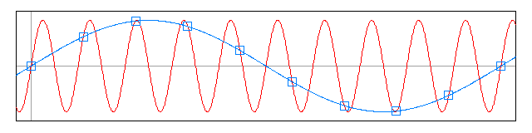
Aliasing
If the sampling condition is not satisfied, then frequencies will overlap
Aliasing is an effect that causes different continuous signals to become indistinguishable (or aliases of one another) when sampled.
Courtesy of http://en.wikipedia.org/wiki/Aliasing

Slide 7
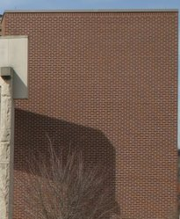
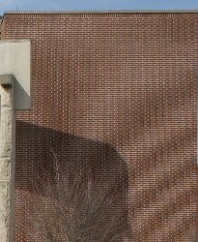
Examples of aliasing
Example1
  The sun moves east to west in the sky, with 24 hours between sunrises.
  If one were to take a picture of the sky every 23 hours, the sun would appear to move west to east, with 24 × 23 = 552 hours between sunrises.
Wagon Wheel effect – Temporal Aliasing
  The same phenomenon causes spoked wheels to apparently turn at the wrong speed or in the wrong direction when filmed, or illuminated with a flashing light source.
Moire pattern – Spatial Aliasing
  Stripes captured on a digital camera would cause aliasing between the stripes and the camera sensor.
    Distance between the stripes is smaller than what the sensor can capture
    Solution to this would be to go closer or to use a higher resolution sensor
Courtesy of http://en.wikipedia.org/wiki/Aliasing

Slide 8
Aliasing
To prevent aliasing, two things can be done
  Increase the sampling rate
  Introduce an anti-aliasing filter
Anti-aliasing filter - restricts the bandwidth of the signal to satisfy the sampling condition.
  This is not satisfiable in reality since a signal will have some energy outside of the bandwidth.
  The energy can be small enough that the aliasing effects are negligible (not eliminated completely).
Anti-aliasing filter: low pass filters, band pass filters, non-linear filters
Always remember to apply an anti-aliasing filter prior to signal down-sampling
Adapted from http://en.wikipedia.org/wiki/Nyquist-Shannon_sampling_theorem

Slide 9











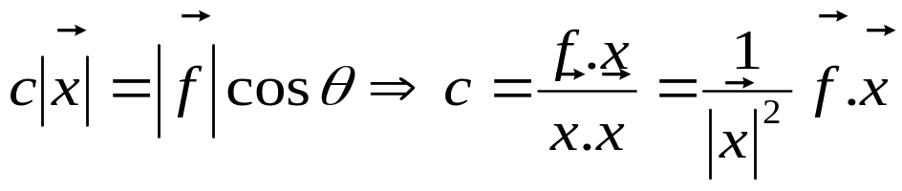
Signals and Vectors
Signals ⬄ Vectors (Perfect analogy)
Projection of one vector on another
Minimum Error when orthogonal

Slide 10



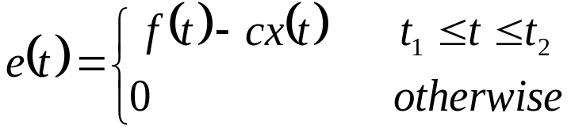
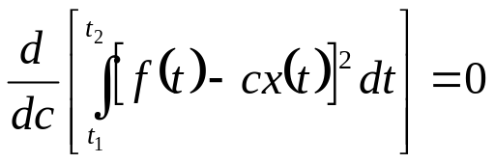
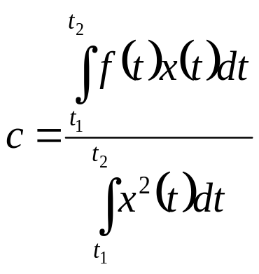
Component of a signal
Approximating in terms of another real signal over an interval
Minimizing the error signal,
Simplification of the above yields the following

Slide 11
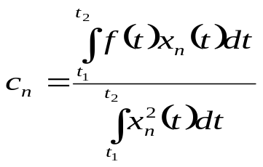
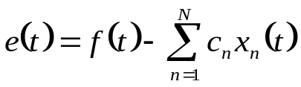


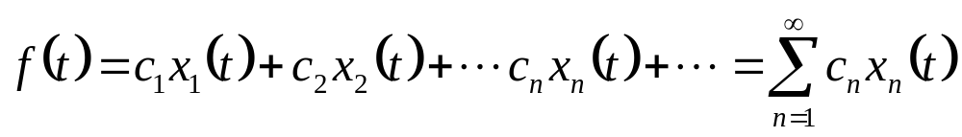
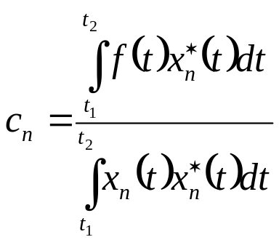
Component of a signal
Generalizing over N-dimensions
As the error energy , which makes the orthogonal set complete i.e.
Generalizing to complex signals we have

Slide 12


Component of a signal
The series so obtained is the GENERALIZED FOURIER SERIES of with respect to
The set is called the basis function or kernel
Some well-known basis signals are
  Trigonometric
  Exponential
  Walsh
  Bessel
  Legendre
  Hermite

Slide 13
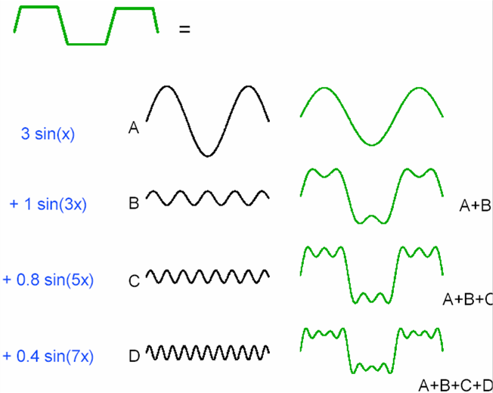
Gibb’s phenomenon
Phenomenon of “ringing”
The series exhibits an oscillatory phenomenon
  The overshoot remained 9% regardless of the number of terms
First explained by Willard Gibbs
  Non uniform convergence at the points of discontinuities
  The 9% was approximately equal to 1/2n where n is the number of terms
courtesy of H. Hel-Or

Slide 14

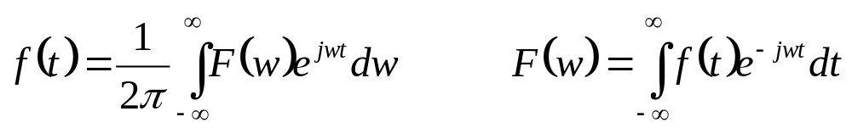
Fourier transform
Using exponential basis of representation
Modeling any aperiodic signal
Forward transform: time signal into frequency domain representation
Inverse transform: frequency representation into the time domain representation
Fourier transform pairs:
  http://130.191.21.201/multimedia/jiracek/dga/spectralanalysis/examples.html

Slide 15
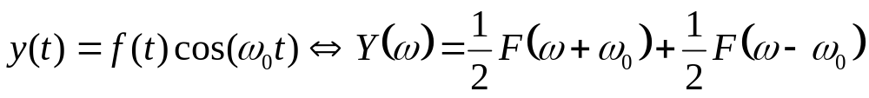
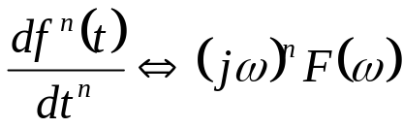
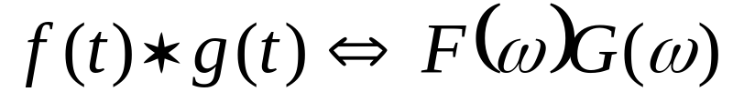
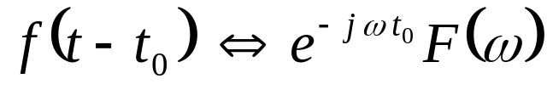
Why the Fourier transform?
Some really useful properties
  Modulation
  Time differentiation
But for computer vision, two of the most important properties are
  Convolution
  Time-shifting property

Slide 16
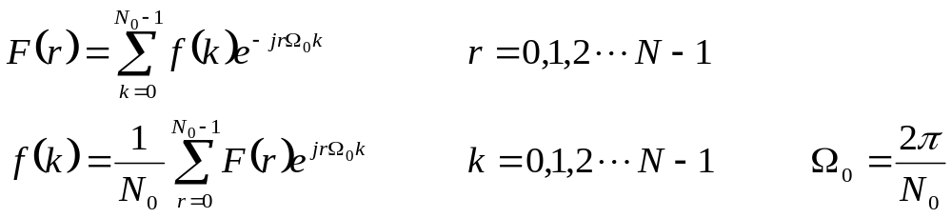
Discrete Fourier Transform
Everything till now was continuous, but computers process digital signals
DFT - sampled Fourier transform of a sampled signal
We thus have the DFT and IDFT pairs
This discrete frequency values can be computed on a digital computer
  Each value of k requires N complex multiplications and N-1 complex additions: O(N²)

Slide 17


Fast Fourier Transform
Can the complexity of DFT be improved?
1965 - Cooley and Tukey reduced the algorithm from O(N²) to O(NlogN)
  The principle based on the fact that have the following two properties
    Symmetry property
    Periodicity Property

Slide 18
FFT
Convolution – O(N²)
Convolution in time == Multiplication in Frequency
FFT(signal₁) – O(NlogN)
FFT(signal₂) – O(NlogN)
FFT(signal₁)FFT(signal₂) – O(NlogN) + O(n) = O(NlogN)

Slide 19
Conclusion
Sampling theorem
  Nyquist rate
Aliasing
  Anti aliasing filters
1D Fourier transform
DFT and FFT

Slide 20
References
“Signal Processing and Linear Systems” B. P. Lathi
“Digital Signal Processing: Principles, Algorithms and Applications”, J. G. Proakis and D. G. Manolakis
“The Fourier Transform and its application” R.N. Bracewell

