Slide 1
Matrices and Determinants
Lecture 1 (21 Oct 2006)
Enrichment Programme for Physics Talent 2006/07
Module I

Slide 2
1.1 | Matrices
1.2 | Operations of matrices
1.3 | Types of matrices
1.4 | Properties of matrices
1.5 | Determinants
1.6 | Inverse of a 3×3 matrix

Slide 3
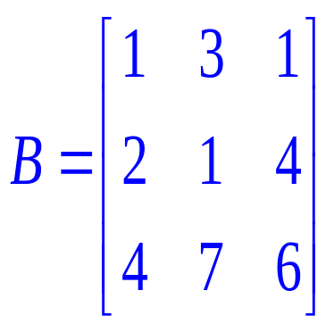
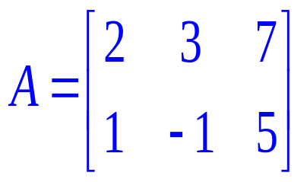
1.1 Matrices
Both A and B are examples of matrix. A matrix is a rectangular array of numbers enclosed by a pair of bracket.
Why matrix?

Slide 4
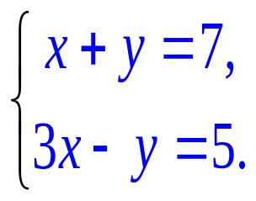
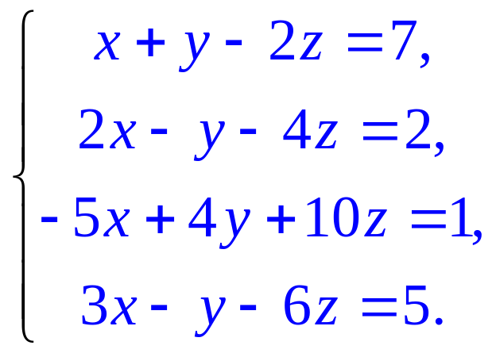
How about solving
1.1 Matrices
Consider the following set of equations:
It is easy to show that x = 3 and y = 4.
Matrices can help…

Slide 5
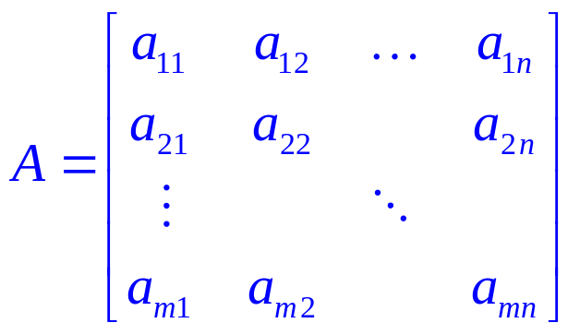
1.1 Matrices
In the matrix
numbers a_{ij} are called elements. First subscript indicates the row; second subscript indicates the column. The matrix consists of mn elements
It is called “the m × n matrix A = [a_{ij}]” or simply “the matrix A ” if number of rows and columns are understood.

Slide 6
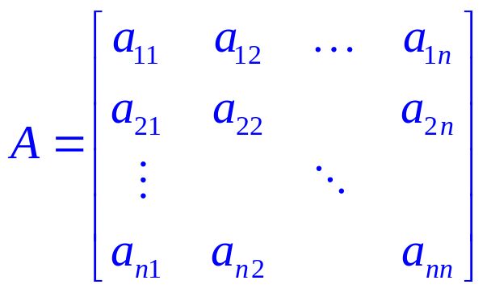
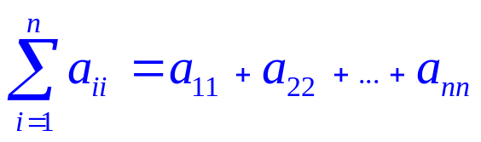
1.1 Matrices
Square matrices
When m = n, i.e.,
A is called a “square matrix of order n” or “n-square matrix”
elements a₁₁, a₂₂, a₃₃,…, a_{nn} called diagonal elements.
is called the trace of A.

Slide 7
1.1 Matrices
Equal matrices
Two matrices A = [a_{ij}] and B = [b_{ij}] are said to be equal (A = B) iff each element of A is equal to the corresponding element of B, i.e., a_{ij} = b_{ij} for 1 ≤ i ≤ m, 1 ≤ j ≤ n.
iff pronouns “if and only if”
if A = B, it implies a_{ij} = b_{ij} for 1 ≤ i ≤ m, 1 ≤ j ≤ n;
if a_{ij} = b_{ij} for 1 ≤ i ≤ m, 1 ≤ j ≤ n, it implies A = B.

Slide 8
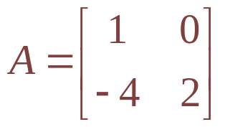
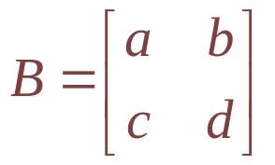
1.1 Matrices
Equal matrices
Example: and
Given that A = B, find a, b, c and d.
if A = B, then a = 1, b = 0, c = -4 and d = 2.

Slide 9
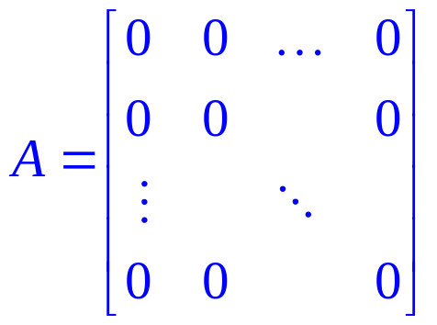
1.1 Matrices
Zero matrices
Every element of a matrix is zero, it is called a zero matrix, i.e.,

Slide 10
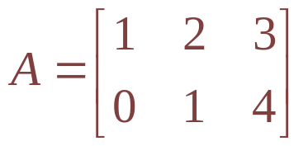
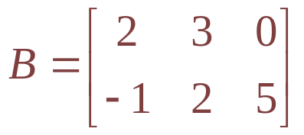
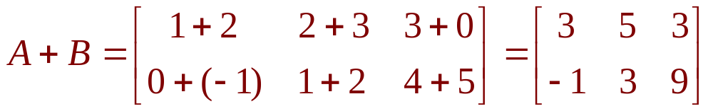
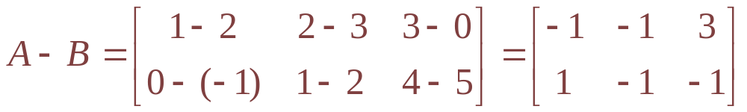
1.2 Operations of matrices
Sums of matrices
If A = [a_{ij}] and B = [b_{ij}] are m × n matrices, then A + B is defined as a matrix C = A + B, where C= [c_{ij}], c_{ij} = a_{ij} + b_{ij} for 1 ≤ i ≤ m, 1 ≤ j ≤ n.
Example: if and
Evaluate A + B and A – B.

Slide 11
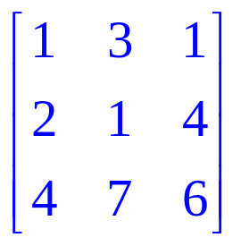
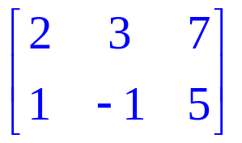
1.2 Operations of matrices
Sums of matrices
Two matrices of the same order are said to be conformable for addition or subtraction.
Two matrices of different orders cannot be added or subtracted, e.g.,
are NOT conformable for addition or subtraction.

Slide 12
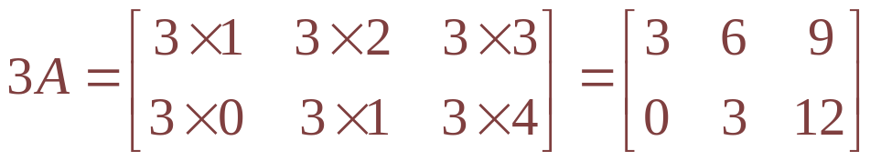
1.2 Operations of matrices
Scalar multiplication
Let λ be any scalar and A = [a_{ij}] is an m × n matrix. Then λA = [λa_{ij}] for 1 ≤ i ≤ m, 1 ≤ j ≤ n, i.e., each element in A is multiplied by λ.
Example: . Evaluate 3A.
In particular, λ = −1, i.e., −A = [−a_{ij}]. It’s called the negative of A. Note: Α − A = 0 is a zero matrix

Slide 13
1.2 Operations of matrices
Properties
Matrices A, B and C are conformable,
A + B = B + A
A + (B +C) = (A + B) +C
λ(A + B) = λA + λB, where λ is a scalar
(commutative law)
(associative law)
(distributive law)
Can you prove them?

Slide 14
1.2 Operations of matrices
Properties
Example: Prove λ(A + B) = λA + λB.
Let C = A + B, so c_{ij} = a_{ij} + b_{ij}.
Consider λc_{ij} = λ (a_{ij} + b_{ij} ) = λa_{ij} + λb_{ij}, we have, λC = λA + λB.
Since λC = λ(A + B), so λ(A + B) = λA + λB

Slide 15
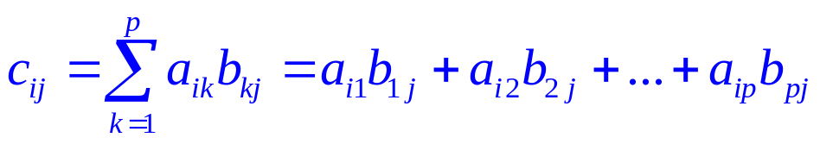
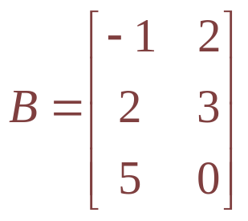
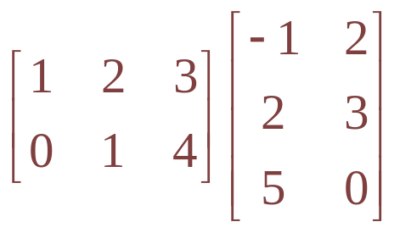

1.2 Operations of matrices
Matrix multiplication
If A = [a_{ij}] is a m × p matrix and B = [b_{ij}] is a p × n matrix, then AB is defined as a m × n matrix C = AB, where C= [c_{ij}] with
for 1 ≤ i ≤ m, 1 ≤ j ≤ n.
Example: , and C = AB. Evaluate c₂₁.

Slide 16
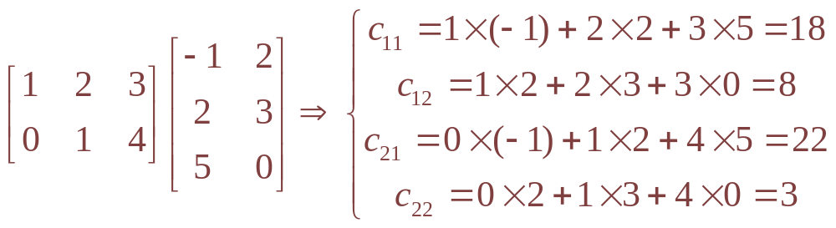
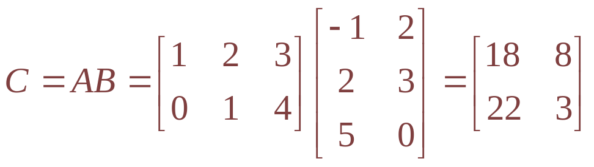
1.2 Operations of matrices
Matrix multiplication
Example: , , Evaluate C = AB.

Slide 17
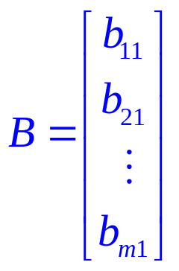

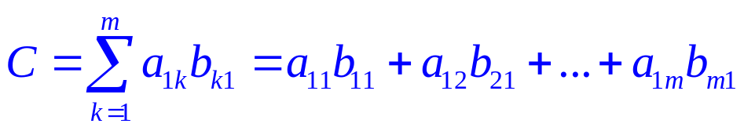
1.2 Operations of matrices
Matrix multiplication
In particular, A is a 1 × m matrix and B is a m × 1 matrix, i.e.,
then C = AB is a scalar.

Slide 18
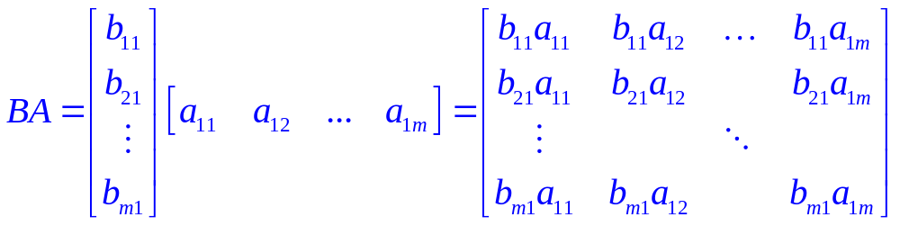
1.2 Operations of matrices
Matrix multiplication
BUT BA is a m × m matrix!
So AB ≠ BA in general !

Slide 19
1.2 Operations of matrices
Properties
Matrices A, B and C are conformable,
A(B + C) = AB + AC
(A + B)C = AC + BC
A(BC) = (AB) C
However
AB ≠ BA in general
AB = 0 NOT necessarily imply A = 0 or B = 0
AB = AC NOT necessarily imply B = C

Slide 20
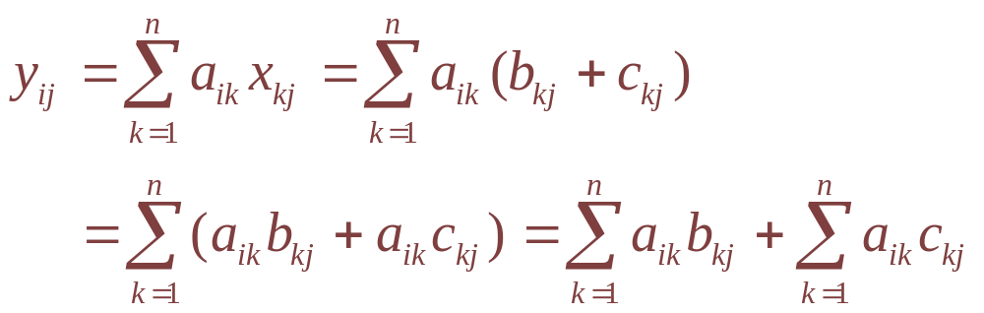
1.2 Operations of matrices
Properties
Example: Prove A(B + C) = AB + AC where A, B and C are n-square matrices
Let X = B + C, so x_{ij} = b_{ij} + c_{ij}. Let Y = AX, then
So Y = AB + AC; therefore, A(B + C) = AB + AC

Slide 21
1.3 Types of matrices
Identity matrix
The inverse of a matrix
The transpose of a matrix
Symmetric matrix
Orthogonal matrix

Slide 22
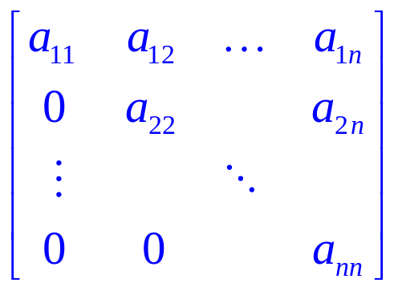
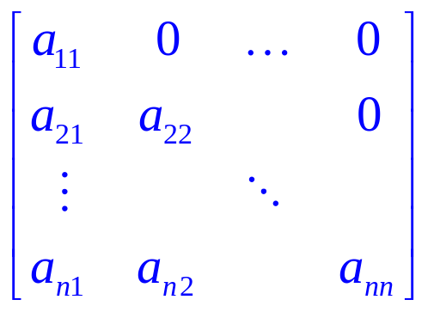
1.3 Types of matrices
Identity matrix
A square matrix whose elements a_{ij} = 0, for i > j is called upper triangular, i.e.,
A square matrix whose elements a_{ij} = 0, for i < j is called lower triangular, i.e.,

Slide 23
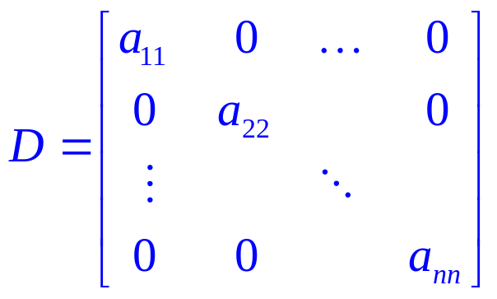

1.3 Types of matrices
Identity matrix
Both upper and lower triangular, i.e., a_{ij} = 0, for i ≠ j , i.e.,
is called a diagonal matrix, simply

Slide 24
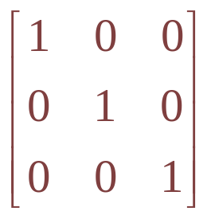
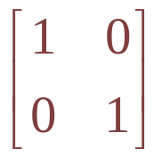
1.3 Types of matrices
Identity matrix
In particular, a₁₁ = a₂₂ = … = a_{nn} = 1, the matrix is called identity matrix.
Properties: AI = IA = A
Examples of identity matrices: and

Slide 25
1.3 Types of matrices
Special square matrix
AB  BA in general. However, if two square matrices A and B such that AB = BA, then A and B are said to be commute.
Can you suggest two matrices that must commute with a square matrix A?
Ans: A itself, the identity matrix, ..
If A and B such that AB = -BA, then A and B are said to be anti-commute.

Slide 26
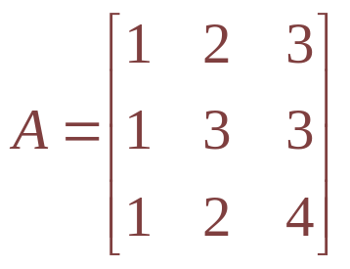
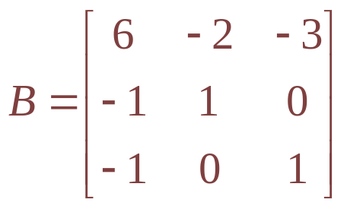
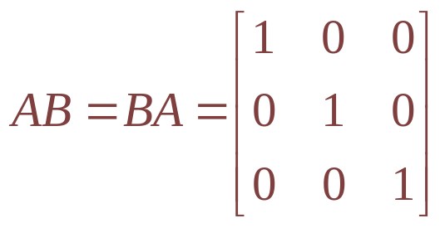
1.3 Types of matrices
The inverse of a matrix
If matrices A and B such that AB = BA = I, then B is called the inverse of A (symbol: A⁻¹); and A is called the inverse of B (symbol: B⁻¹).
Example:
Show B is the the inverse of matrix A.
Ans: Note that
Can you show the details?

Slide 27
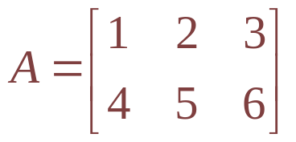
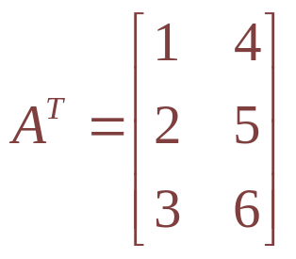
1.3 Types of matrices
The transpose of a matrix
The matrix obtained by interchanging the rows and columns of a matrix A is called the transpose of A (write A^{T}).
Example:
The transpose of A is
For a matrix A = [a_{ij}], its transpose A^{T} = [b_{ij}], where b_{ij} = a_{ji}.

Slide 28
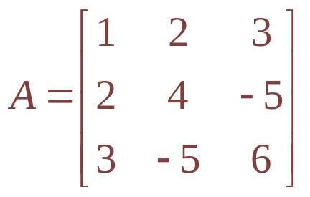
1.3 Types of matrices
Symmetric matrix
A matrix A such that A^{T} = A is called symmetric, i.e., a_{ji} = a_{ij} for all i and j.
A + A^{T} must be symmetric. Why?
Example: is symmetric.
A matrix A such that A^{T} = -A is called skew-symmetric, i.e., a_{ji} = -a_{ij} for all i and j.
A - A^{T} must be skew-symmetric. Why?

Slide 29
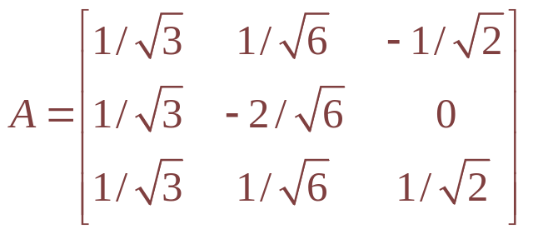
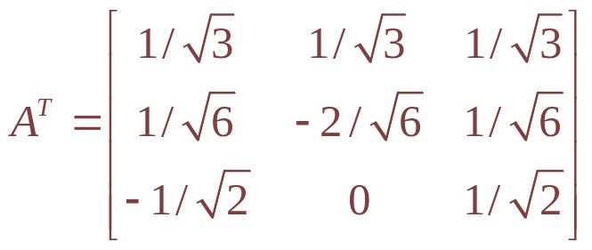
1.3 Types of matrices
Orthogonal matrix
A matrix A is called orthogonal if AA^{T} = A^{T}A = I, i.e., A^{T} = A⁻¹
Example: prove that is orthogonal.
Since, . Hence, AA^{T} = A^{T}A = I.
Can you show the details?
We’ll see that orthogonal matrix represents a rotation in fact!

Slide 30
1.4 Properties of matrix
(AB)⁻¹ = B⁻¹A⁻¹
(A^{T})^{T} = A and (λA)^{T} = λ A^{T}
(A + B)^{T} = A^{T} + B^{T}
(AB)^{T} = B^{T} A^{T}

Slide 31
1.4 Properties of matrix
Example: Prove (AB)⁻¹ = B⁻¹A⁻¹.
Since (AB) (B⁻¹A⁻¹) = A(B B⁻¹)A⁻¹ = I and
(B⁻¹A⁻¹) (AB) = B⁻¹(A⁻¹ A)B = I.
Therefore, B⁻¹A⁻¹ is the inverse of matrix AB.

Slide 32
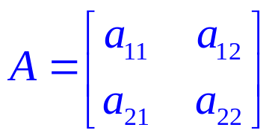

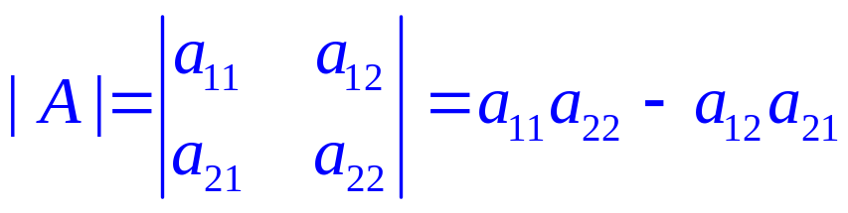
1.5 Determinants
Determinant of order 2
Consider a 2 × 2 matrix:
Determinant of A, denoted , is a number and can be evaluated by

Slide 33
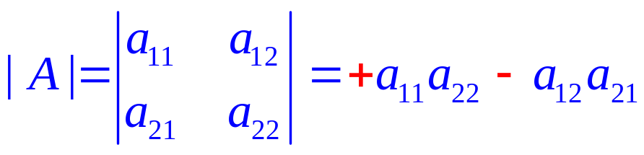
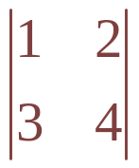
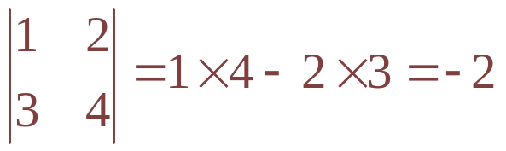
1.5 Determinants
Determinant of order 2
easy to remember (for order 2 only)..
-
+
Example: Evaluate the determinant:

Slide 34
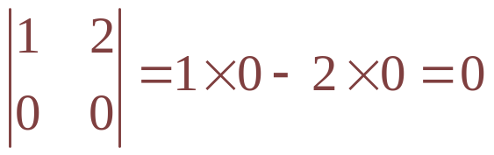
1.5 Determinants
The following properties are true for determinants of any order.
If every element of a row (column) is zero, e.g., , then |A| = 0.
|A^{T}| = |A|
|AB| = |A||B|
determinant of a matrix = that of its transpose

Slide 35
1.5 Determinants
Example: Show that the determinant of any orthogonal matrix is either +1 or –1.
For any orthogonal matrix, A A^{T} = I.
Since |AA^{T}| = |A||A^{T} | = 1 and |A^{T}| = |A|, so |A|² = 1 or |A| = ±1.

Slide 36
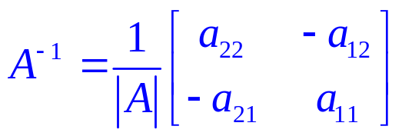
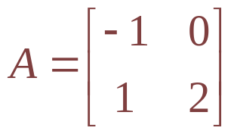
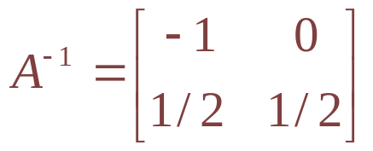
1.5 Determinants
For any 2x2 matrix
Its inverse can be written as
Example: Find the inverse of
The determinant of A is -2
Hence, the inverse of A is
How to find an inverse for a 3x3 matrix?

Slide 37
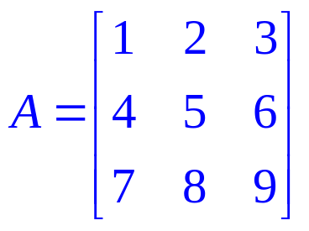
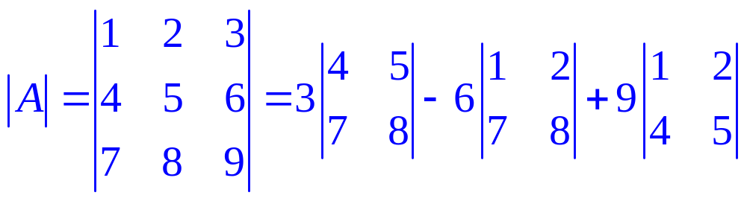

1.5 Determinants of order 3
Consider an example:
Its determinant can be obtained by:
You are encouraged to find the determinant by using other rows or columns

Slide 38










1.6 Inverse of a 3×3 matrix
Cofactor matrix of
The cofactor for each element of matrix A:

Slide 39

1.6 Inverse of a 3×3 matrix
Cofactor matrix of is then given by:

Slide 40


1.6 Inverse of a 3×3 matrix
Inverse matrix of is given by:

