Slide 1
Retail Sentiment Intelligence
Real-Time Social Media Mining and Trust-Aware Sentiment Analysis
Using Large Language Models for Retail Feedback Optimization
BITS ZG628T · Dissertation · Post Mid-Semester Presentation
Faculty Mentor: Ms. Pradnya Kashikar
BITS Pilani (WILP)
Supervisor: Mr. Varunendra Pratap Singh
Principal Software Engineer · Walmart Global Tech, Bengaluru
Candidate: Vishal Singh · 2020AA05641
M.Tech (AI & ML) · Birla Institute of Technology & Science, Pilani (WILP)
August 2026

Slide 2
Agenda
Focus of today — post mid-semester work only
1
Since Mid-Sem — What's New
9
Insights & Competitor Analysis
Post-midsem workstream map
Strategic weekly summaries + cross-brand
2
Review & Validate (HITL)
10
Alert Feed
Human-in-the-loop correction workflow
Live risk detection + editable rule thresholds
3
Smart Reply — Triple Draft
11
Notification Centre
GPT-4o + Mistral 7B + Smart Composer
In-app + email + Slack, group-routed
4
Smart Reply — Prompt & Few-Shot
12
ModernBERT — Final Results
Prompt template + past validated replies
Macro-F1 0.6272 → 0.7642 (+13.7 pts)
5
Smart Reply — Worked Example
13
Vision — Multi-Pass Payoff
One complaint → three drafts
Hallucination 50% → 0%, extraction 25% → 75%
6
Learning Loop
14
Trust-Score Evaluation
Corrections + posted replies → retraining
15% flagged; 12 of 15 confirmed by annotator
7
Post Explorer
15
Live Demo
Multi-facet search across analysed posts
Dashboard walkthrough (screenshots)
8
Post Lifecycle (Kanban)
16
Conclusions & Future Work
Triage → Acknowledged → In-Progress → Resolved
RQ1–RQ4 outcomes + realistic roadmap
Retail Sentiment Intelligence · BITS ZG628T Dissertation · Vishal Singh · Post Mid-Semester Presentation
2 / 24

Slide 3
Since Mid-Sem — What's New
Mid-sem shipped the pipeline; post-midsem made it usable for analysts
DELIVERED AT MID-SEM
ADDED POST-MIDSEM (this deck)
• 6-layer offline-first pipeline (25 subreddits)
• ModernBERT fine-tuning up to Stage 2 (F1 0.7285)
• Multi-pass vision with 0% hallucination on pilot
• Trust-score design + weighted formula
• Brand-Health + Alert Feed dashboard pages
• Group-routed email / Slack notifications
• Review & Validate — human-in-the-loop UI + backend
• Smart Reply Composer — triple-draft (GPT-4o + Mistral + Smart)
• Learning-loop store — corrections & posted replies
• Post Explorer — multi-facet search
• Post Lifecycle — Kanban with 2-step Resolve
• Insights & Competitor Analysis page
• In-app Notification Centre mirroring the digest
• ModernBERT Stage 3 (final) — 0.7285 → 0.7642 (5-fold OOF)
• Trust-score end-to-end evaluation (n = 200)
“
THE FRAMING QUESTION
Mid-sem answered can the pipeline produce trust-weighted sentiment? Post-midsem answers can an analyst act on it, correct it, and feed the corrections back into the model?
Retail Sentiment Intelligence · BITS ZG628T Dissertation · Vishal Singh · Post Mid-Semester Presentation
3 / 24

Slide 4
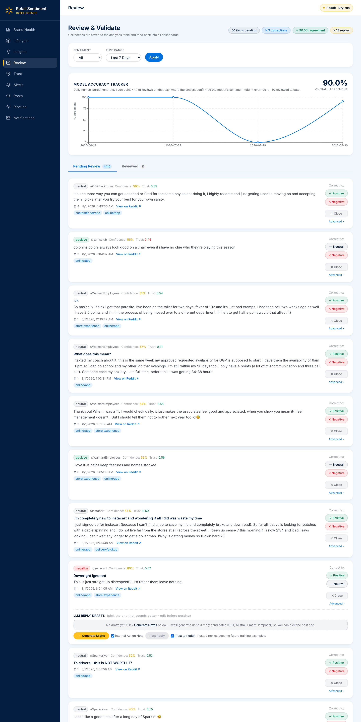
Review & Validate — Human-in-the-Loop
Every prediction can be corrected; every correction is logged
WORKFLOW
• Queue sorted by priority (P1 first) · trust × confidence
• Analyst can override sentiment and aspect tags in one click
• Corrections written to feedback table with analyst + timestamp
• Generate Drafts → three reply options (GPT-4o + Mistral + Smart)
• Analyst picks A, B or C, edits inline, and posts to Reddit
• Posted replies also captured → future few-shot pool
WHY IT MATTERS
Turns a passive dashboard into a training signal — corrections harvested here drive the ModernBERT re-training loop and reply few-shot pool.
NUMBERS TODAY (live capture)
18 posted replies logged · 60 total feedback rows · ≈90 % analyst – model agreement on the last 30 reviews.
Retail Sentiment Intelligence · BITS ZG628T Dissertation · Vishal Singh · Post Mid-Semester Presentation
4 / 24

Slide 5
Smart Reply Composer — Triple Draft
One prompt, three generators; analyst picks the best draft
Draft A
Draft B
Draft C
GPT-4o
Mistral 7B-Instruct
Smart Composer
Walmart LLM Gateway
Local Ollama (:11434)
Deterministic template
Strong reasoning, safest tone
Guardrails via Walmart proxy
~$0.0002 / reply
Fallback: direct OpenAI
Open-weights, free
Runs fully offline
~15 s warm latency
Strong at retail jargon
No LLM, always available
Zero latency, zero cost
Content-aware phrase pools
Safety-net fallback
Fallback logic — no draft is ever missing
• GPT-4o unavailable (no gateway key / consumer-ID / network) → Smart Composer draft in slot A
• Mistral unavailable (Ollama not running) → Smart Composer draft in slot B
• Smart Composer always produces slot C — guaranteed reply
• UI labels each card with the actual model used, plus an offline-fallback badge when applicable
Retail Sentiment Intelligence · BITS ZG628T Dissertation · Vishal Singh · Post Mid-Semester Presentation
5 / 24

Slide 6
Smart Reply — Prompt Design & Few-Shot
Same prompt fed to GPT and Mistral; Smart Composer skips the LLM step
Prompt template (built in _build_reply_prompt)
You are a senior Walmart customer-care analyst replying on Reddit.
Write ONE reply to the customer below. Keep it 2-4 sentences,
empathetic, specific to their complaint, no corporate jargon,
no hashtags, no emojis. Do NOT promise refunds you can't verify;
invite them to DM order details if action is needed.
Sign off as a real person, not a brand.
Example customer post: {past_post_1}
Example analyst reply: {past_reply_1}
… (three example pairs total)
Subreddit: r/{subreddit}
Customer ({author}) complaint about: {aspect_1}, {aspect_2}
Customer post: {post_title + post_body, ≤ 1200 chars}
Reply:
PROMPT ANATOMY
① SYSTEM ROLE
who the model is + tone rules
② FEW-SHOT
3 past validated reply pairs
from the feedback table
③ CONTEXT
subreddit · author · top-2 aspects
④ POST
title + body, truncated to 1 200 chars
⑤ TRIGGER
"Reply:" cues the model to generate
Few-shot source — feedback table
Style guardrails baked into the prompt
• Top-3 past validated replies for the same aspect
• Written by human analysts, already posted to Reddit
• Refreshed on every Generate click → adapts over time
• 2 – 4 sentences, empathetic, specific
• No corporate jargon, no hashtags, no emojis
• No unverifiable refund promises → DM to continue
• Sign off as a person, not a brand
Retail Sentiment Intelligence · BITS ZG628T Dissertation · Vishal Singh · Post Mid-Semester Presentation
6 / 24

Slide 7
Smart Reply — Worked Example (all three drafts real, live-captured)
raw_posts.id = reddit_1u2bgdw · r/samsclub · gateway ✓ · Ollama ✓ · Smart Composer ✓
CUSTOMER COMPLAINT · r/samsclub
Why do you guys sell whole pizzas made hours ago to customers?
"The very few times I've gotten a whole pie, it'll be stuff premade and left in the hot case for like an hour 30mins before it's in my hand. How can I tell? They put a sticker with the date and the pizza looks and taste hours old. Pizza is meant to be made to order and waited for."
ModernBERT: negative (conf 0.9999997) · aspects: customer service · product quality · store experience · trust 0.66
🔗 Open original on Reddit
A · GPT-4o (Walmart Gateway)
B · Mistral 7B (local Ollama)
C · Smart Composer (no-LLM)
Hi u/there, I'm sorry to hear about your experience with the pizzas. I understand how disappointing it must be to get something that feels less fresh than expected. While the hot case is meant to provide convenience, I agree that quality should never be sacrificed. If you'd like, feel free to DM me with the details of your store location so we can look into this and address it properly. – [Your Name]
Hi u/there, I appreciate your concern about the quality of our prepared pizzas. It's important to us that our customers receive fresh and delicious food. The stickers with dates are there to help us manage the rotation of our products, ensuring they are consumed before they become stale. If you ever encounter a pizza that doesn't meet your expectations, please feel free to DM me the details of your order so I can look into it further. Thank you for taking the time to share your feedback.
Hi u/there — thanks for flagging this. completely understand the frustration around your order. Drop us a private message with the order # or store info and we'll take it from here. — Walmart Care
WHAT HAPPENS NEXT
One prompt fed to all three engines. Analyst picks the best draft, edits inline, clicks Save & Open Reddit → the posted reply is written to feedback and becomes the next post's top few-shot example.
Retail Sentiment Intelligence · BITS ZG628T Dissertation · Vishal Singh · Post Mid-Semester Presentation
7 / 24

Slide 8
Learning Loop — Feedback → Retraining
Every human action becomes a training signal — hot loop (live) + warm loop (monthly)
Label / aspect correction
Trust-score override
Posted reply
Lifecycle transition
Review & Validate
Review & Validate
Smart Reply Composer
Kanban board
feedback table — one row per human action, JSON payload, partition_key = analyst_id
HOT LOOP · in-context, live
WARM LOOP · supervised, monthly
• Every Generate Drafts click queries feedback
• SELECT … WHERE kind = 'auto_reply_posted'
• ORDER BY created_at DESC LIMIT 5 → top 3 pairs
• Injected into the prompt as few-shot examples
• Effect visible on the next reply — no training
• Export corrections since last train date
• Append to Walmart-200 → Walmart-N (augmented)
• Rerun ModernBERT Stage-3 with 5-fold OOF CV
• New checkpoint wins only if OOF F1 improves
• Symlink flipped in config/models.yaml
Two failure modes eliminated by design
(1) hot loop uses in-context learning — no retrain, no catastrophic forgetting. (2) warm loop uses 5-fold OOF CV — no leakage between train and eval sets.
Retail Sentiment Intelligence · BITS ZG628T Dissertation · Vishal Singh · Post Mid-Semester Presentation
8 / 24

Slide 9
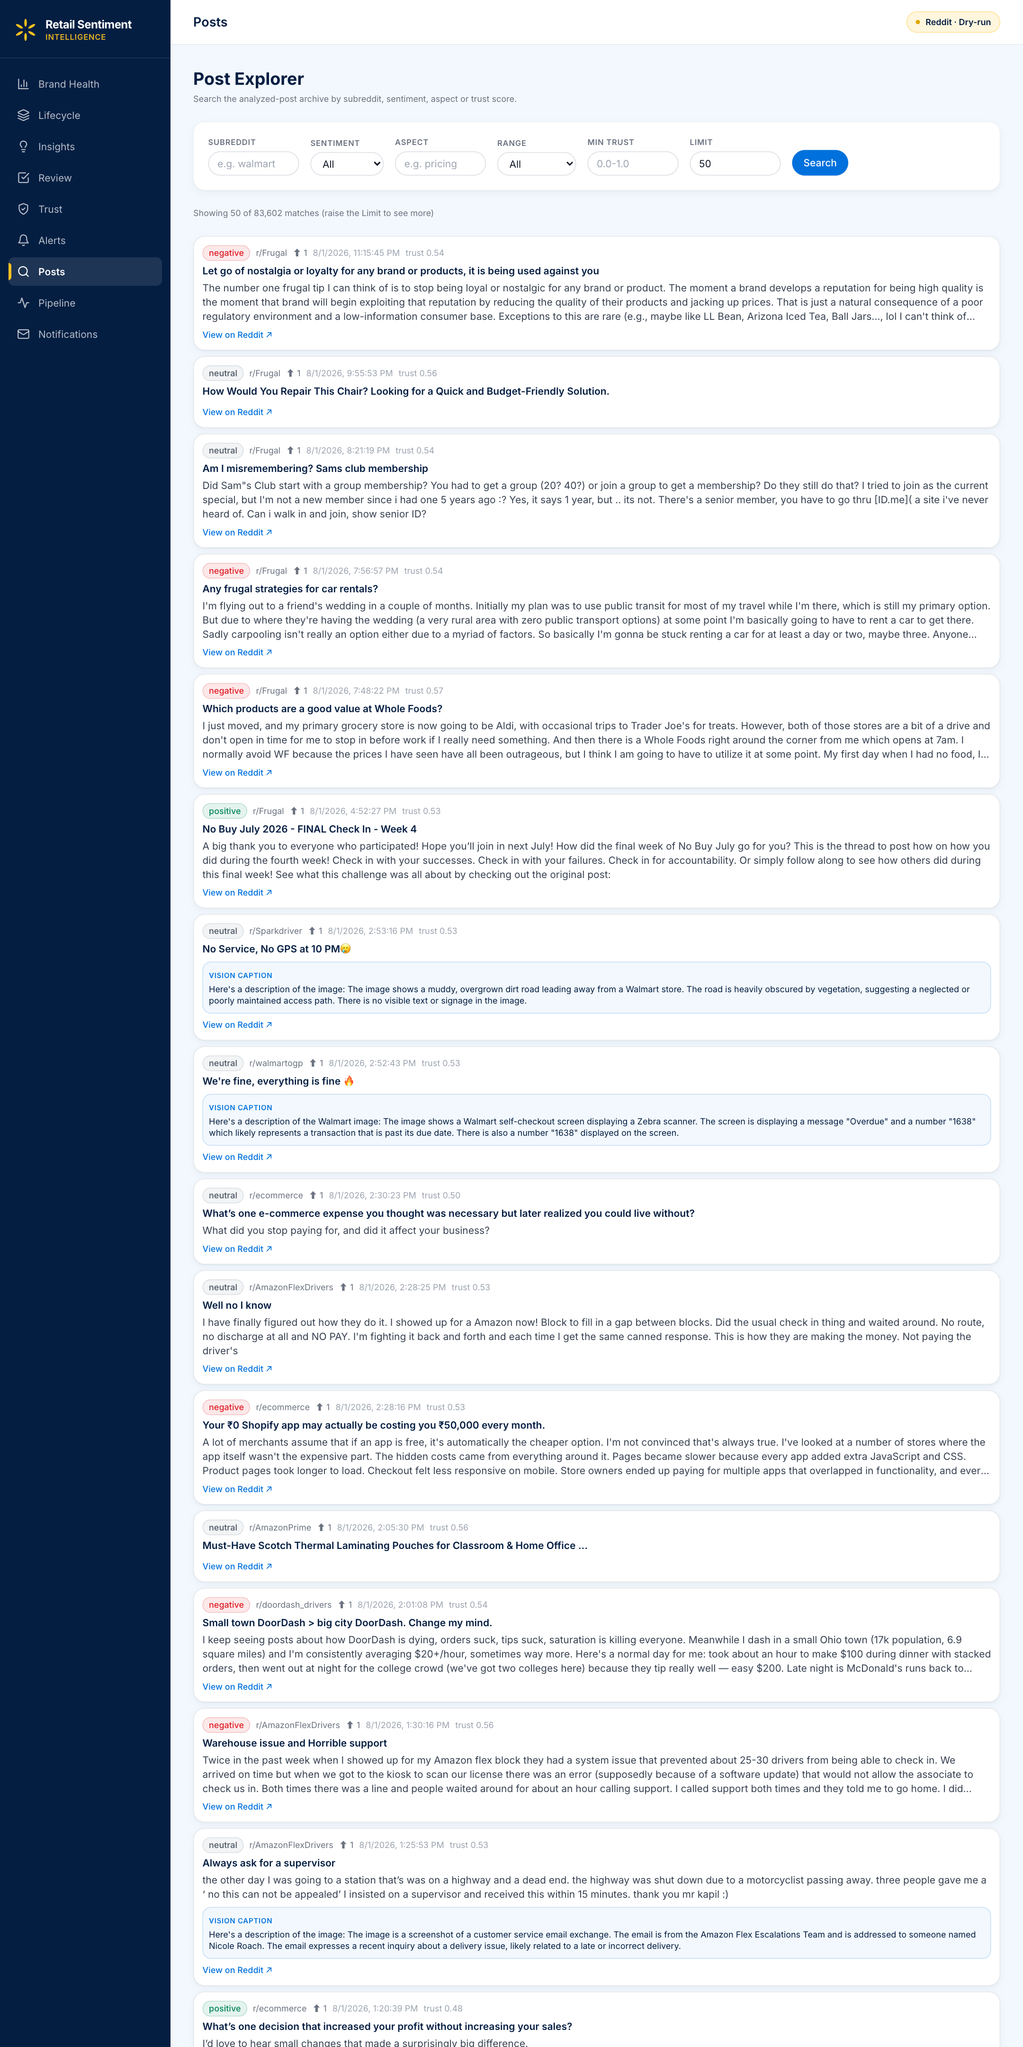
Post Explorer — Multi-Facet Search
Find the exact 20 posts an analyst needs to look at today
FACETS
• Sentiment · neg / neu / pos
• Confidence slider (0.50 – 1.00)
• Trust-score slider (0.00 – 1.00)
• Subreddit — multi-select from 25 tracked
• Aspect — 8-item retail taxonomy
• Date range — today / week / month / custom
• Full-text search — title + body
PER-POST CARD
Title + body excerpt · sentiment badge with confidence % · trust tier (H / M / L) · aspect chips · subreddit + timestamp · actions: Review · Add to Lifecycle · View Details.
CATALOG TODAY (live capture)
83 006 analysed posts · 25 subreddits · 8 aspects · results paginated at 50 / query.
Retail Sentiment Intelligence · BITS ZG628T Dissertation · Vishal Singh · Post Mid-Semester Presentation
9 / 24

Slide 10
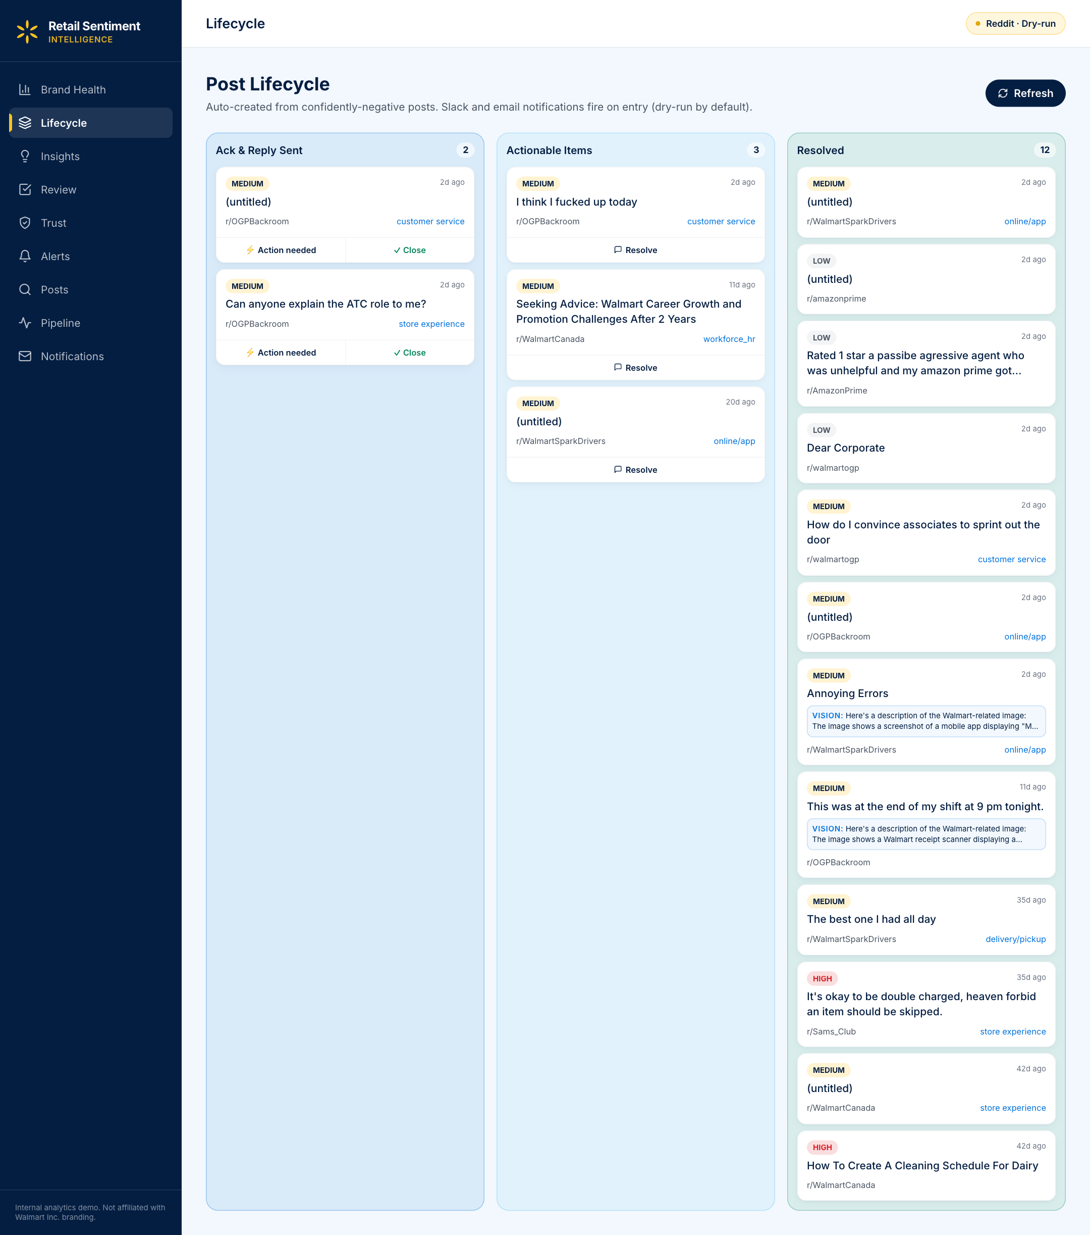
Post Lifecycle — Kanban Workflow
Track a complaint from Triage to Resolved with SLA visibility
TRIAGED
ACKNOWLEDGED
IN PROGRESS
RESOLVED
New P1 / P2
posts land here
Assigned
to analyst
Reply being
drafted / posted
Reply posted or
no-action closed
RESOLVE MODAL — 2-step flow
• Step 1 · save action note + optional LLM reply
• (a) Save & open Reddit → reply copied to clipboard
• (b) OR Resolve (no-reply) → close without posting
• Step 2 · paste on Reddit → Mark Resolved
• All transitions timestamped → SLA analytics
Retail Sentiment Intelligence · BITS ZG628T Dissertation · Vishal Singh · Post Mid-Semester Presentation
10 / 24

Slide 11
Insights & Competitor Analysis
Four-step pipeline over the 8-aspect taxonomy — deterministic, no LLM in the loop
1
Group posts
by aspect
2
Compute
negative rate
3
Compare
to Walmart
4
Priority tag
+ action angle
For each retail aspect,
count posts from competitor
subs by sentiment:
negative · positive · neutral
Divide negatives by total to
get the complaint-rate on
that aspect.
Floor: total ≥ 8 posts
Same recipe on Walmart subs
for the same aspect —
then take the gap.
Catches 'are we better or worse?'
Two threshold checks:
• competitor rate → urgency
• delta → what to do about it
Emit one recommendation card
▸
▸
▸
— counter aggregate —
negative_ratio = neg / total
delta = competitor – Walmart
60 / 40 % and ± 5 % cutoffs
delivery/pickup:
3,546 posts total
1,377 neg · 128 pos · 2,041 neu
1,377 / 3,546 = 0.388
= 38.8 % complaint-rate
(highest of any aspect)
Walmart delivery neg-rate ≈ 24 %
delta = 38.8 % – 24 %
= +14.8 %
Priority = MEDIUM (40 % ≤ 39 % < 60 %)
Angle = 'Marketing angle'
(delta +14.8 % > +5 %)
WORKED EXAMPLE → the recommendation card the analyst sees
“Competitors are struggling with delivery/pickup (39 % negative) much more than Walmart (24 %). Lean into this as a competitive marketing angle.” — priority: MEDIUM · supporting: 3,546 posts
DESIGN PRINCIPLE · why this is defensible
Every number is a Counter aggregate over ModernBERT + DeBERTa-v3-NLI outputs — zero LLM cost, reproducible, and each recommendation traces to specific counts the analyst can click into.
Retail Sentiment Intelligence · BITS ZG628T Dissertation · Vishal Singh · Post Mid-Semester Presentation
11 / 24

Slide 12
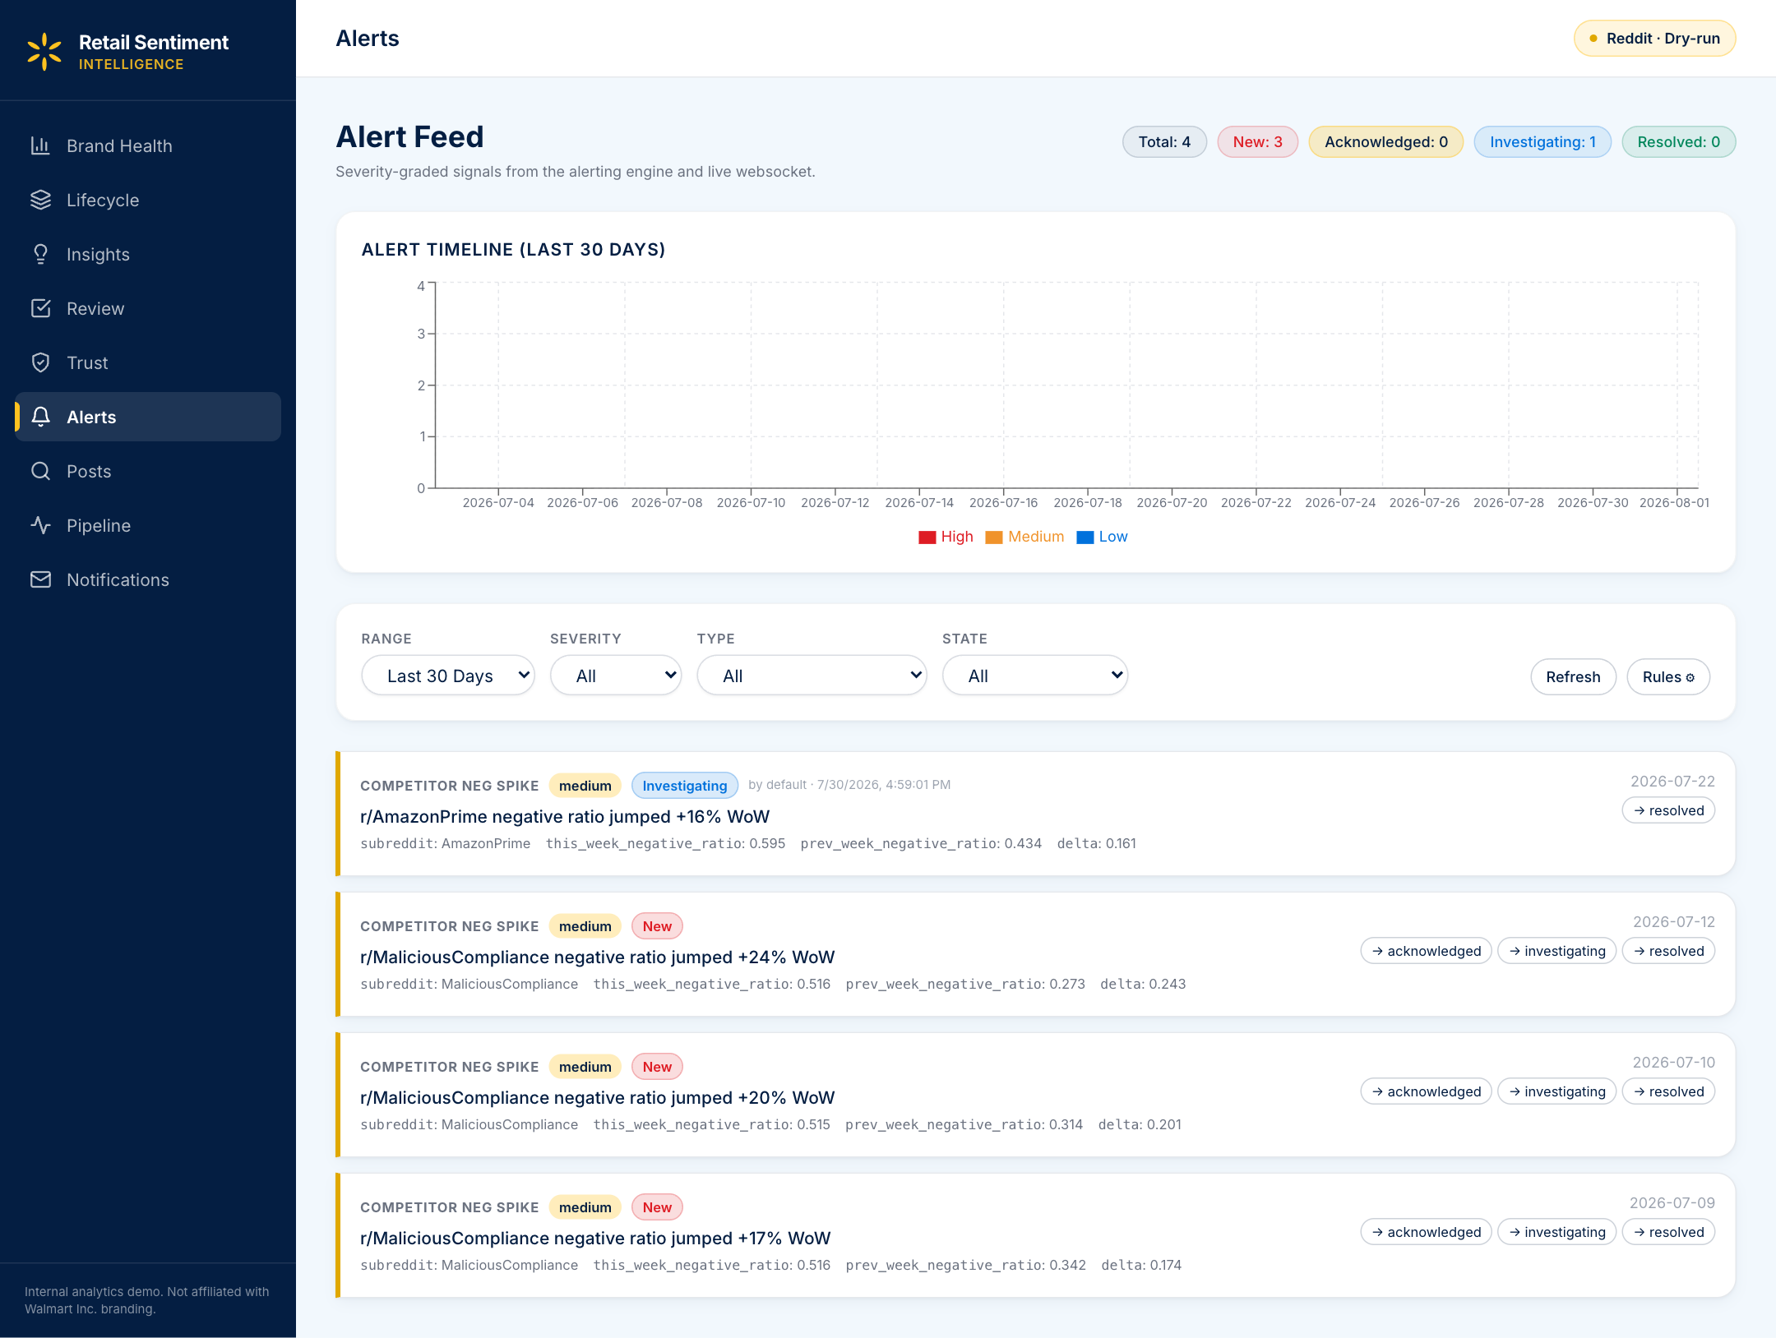
Alert Feed
Live risk detection at /alerts — stored history + WebSocket push, merged and deduped
WHAT IT DOES
• 4 alert types · volume_spike · sentiment_crash · emerging_topic · competitor_negative
• 3 severities · high / medium / low with 30-day stacked timeline
• State machine · new → acknowledged → investigating → resolved
• Filters · range · severity · type · state
• Inline rule editor updates thresholds live (no redeploy)
• sentiment_crash enriched with macro group + WoW deltas + top subs
EDITABLE RULE THRESHOLDS
sigma_threshold · drop_threshold · min_posts · window_hours
delta_threshold · min_posts_per_window
Saved via POST /api/alerts/rules and read by the alert engine.
COMPETITOR-NEGATIVE RULE · worked example
r/target · prev 7 d: 9 / 30 = 0.30 → last 7 d: 20 / 40 = 0.50 → Δ = +0.20
Δ ≥ 0.15 and both windows ≥ 25 posts → fires (severity high if Δ ≥ 0.25).
Retail Sentiment Intelligence · BITS ZG628T Dissertation · Vishal Singh · Post Mid-Semester Presentation
12 / 24

Slide 13
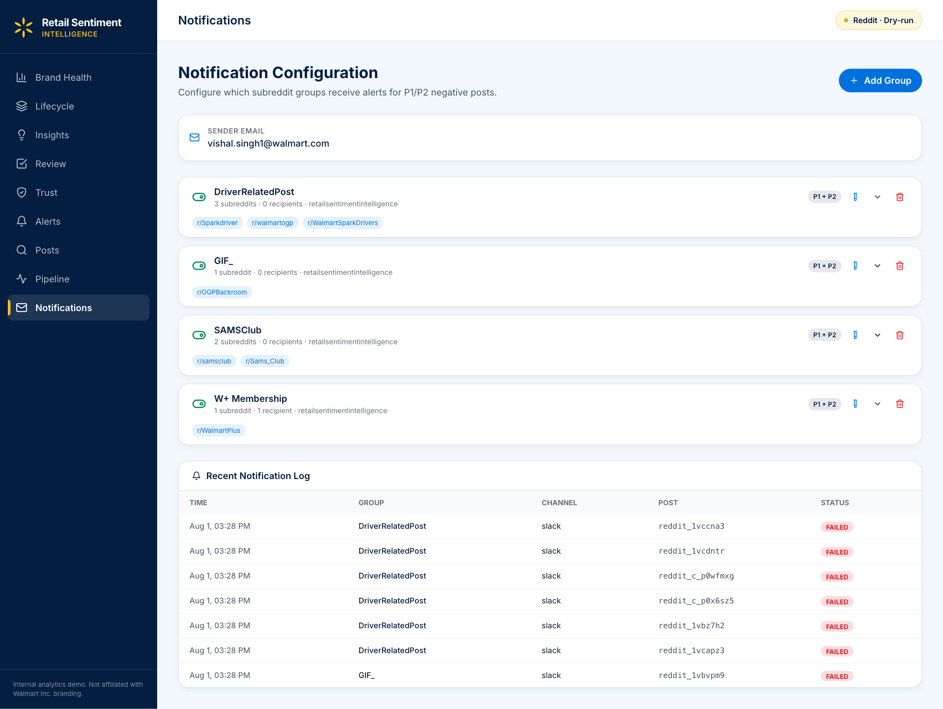
Notification Centre
In-app mirror of the group-routed email / Slack digest
WHAT IT DOES
• Every P1 / P2 email or Slack alert is mirrored in the app
• Notifications grouped by subreddit ↔ business team
• Read / unread state persisted per analyst
• Deep-links open the post in Review & Validate
• Powered by the same alerts rows that drive email/Slack
PRIORITY THRESHOLDS
P1 — trust ≥ 0.70 and confidence ≥ 0.80
P2 — trust ≥ 0.50 and confidence ≥ 0.60
Source: config/models.yaml + dispatcher.py
GROUPS TODAY (live capture)
4 routing groups configured · DriverRelatedPost, GIF_, SAMSClub, W+ Membership · delivery status tracked per row in notification_log.
Retail Sentiment Intelligence · BITS ZG628T Dissertation · Vishal Singh · Post Mid-Semester Presentation
13 / 24

Slide 14
ModernBERT — Final Training Results
3-stage curriculum, 5-fold out-of-fold CV, n = 200
Overall Macro-F1
Long posts (≥ 512 tok, n = 7)
Uplift over baseline
0.6272 → 0.7642
5 / 7 → 7 / 7 correct
+13.7 pts
3-stage curriculum
Stage | Data | Macro-F1 | Δ vs baseline
Baseline (Twitter-RoBERTa) | off-the-shelf | 0.6272 | —
Stage 1 | TweetEval sentiment (~45 k tweets) | 0.6810 | +5.4
Stage 2 | GoEmotions-3class Reddit (~54 k, pseudo) | 0.7285 | +10.1
Stage 3 (final) | Walmart-200 hand-labelled | 0.7642 | +13.7
Per-length-bucket accuracy (5-fold OOF predictions)
Bucket (token count) | Baseline correct | ModernBERT correct | Recovered
Short-to-medium (< 512, n = 193) | 138 / 193 (72 %) | 159 / 193 (82 %) | +21
Long (≥ 512, n = 7, all negative) | 5 / 7 | 7 / 7 | +2
Retail Sentiment Intelligence · BITS ZG628T Dissertation · Vishal Singh · Post Mid-Semester Presentation
14 / 24

Slide 15
Vision Pipeline — Multi-Pass Payoff
Same model (Gemma 3 4B), same hardware, smarter calling strategy
PASS 1
PASS 2
PASS 3
PASS 4
STRUCTURE
TILE
EXTRACT
MERGE
What TYPE of image?
screenshot / photo /
receipt / app / meme
Split into 2–4 crops
→ 2–4× effective
resolution, no resize
Per tile: read ALL
text verbatim
(quotes, prices, UI)
Text-only LLM call
— image REMOVED —
cannot invent visuals
Evaluation on 32 retail screenshots
Metric | Single-pass | Multi-pass | Change
Hallucination rate | 50 % | 0 % | eliminated
Text-extraction success | 25 % | 75 % | 3× better
Retail-signal recall | 40 % | 81 % | 2× better
Fabricated claims | many | 0 | eliminated
Latency / image (warm) | ~5 s | ~15 s | 3× (accepted)
Retail Sentiment Intelligence · BITS ZG628T Dissertation · Vishal Singh · Post Mid-Semester Presentation
15 / 24

Slide 16
Trust-Score — End-to-End Evaluation
On the 200-post gold set, does the trust filter catch bad posts?
Low-trust share (T < 0.4)
Human-agreed (annotator cross-check)
Agreement rate
15 %
12 / 15
80 %
Weighted formula (decomposition shown inline in dashboard)
trust_score = 0.4 × metadata + 0.3 × dedup + 0.3 × llm_credibility
DESIGN PRINCIPLE — flag, don't drop
WHY IT'S DEFENSIBLE
Low-trust posts are surfaced with an explanatory chip (promotional / duplicate / thin-metadata) and can be overridden by an analyst in one click — the override is captured for the learning loop.
• Every constant has a plain-English rationale in config/models.yaml
• Three named components → analyst can see WHY a post is low-trust
• 12 / 15 confirmed by human annotator on the cross-check
• LLM component only invoked in ambiguous zone (cost-controlled)
Retail Sentiment Intelligence · BITS ZG628T Dissertation · Vishal Singh · Post Mid-Semester Presentation
16 / 24

Slide 17
Evaluation Summary — Post-Midsem Numbers
All results reported against the same 200-post retail-Reddit gold set
Area | Metric | Value | Notes
Sentiment | Macro-F1 (final) | 0.7642 | +13.7 pts vs RoBERTa baseline
Sentiment | Long-bucket accuracy (≥ 512 tokens, n=7) | 7 / 7 correct | Baseline 5 / 7 · all negative-class
Sentiment | Cross-validation | 5-fold OOF | No test-set leakage
Vision | Hallucination rate | 0 % | From 50 % on single-pass
Vision | Text extraction success | 75 % | From 25 % on single-pass
Vision | Retail-signal recall | 81 % | From 40 % on single-pass
Trust | Low-trust share (T < 0.4) | 15 % | Of the 200-post set
Trust | Annotator agreement on low-trust | 12 / 15 | 80 %
Ops | Subreddits tracked | 25 | Six community groups
Ops | Scheduler cadence | 6 h + manual | asyncio lifespan task
Ops | Dashboard pages shipped | 8 | Brand Health · Alerts · Explorer · Review · Lifecycle · Insights · Pipeline · Notifications
Retail Sentiment Intelligence · BITS ZG628T Dissertation · Vishal Singh · Post Mid-Semester Presentation
17 / 24

Slide 18
Principal Contributions
What this dissertation delivered — end to end
C1
Offline-first RSI pipeline
Ingestion → trust → sentiment → aspects → vision → aggregation → alerts → dashboard. Zero API cost, modular, deployable to Azure.
C2
Fine-tuned ModernBERT (3-stage curriculum)
Macro-F1 0.6272 → 0.7642 overall; recovers all long posts (≥ 512 tok, n = 7): RoBERTa 5/7 vs ModernBERT 7/7 correct. 5-fold OOF cross-validation, offline training.
C3
Multi-pass vision technique on Gemma 3 4B
Hallucination 50 % → 0 %, extraction 25 % → 75 %. Adapts techniques from 5 recent VLM papers without vendor-blocked models.
C4
Interpretable trust score + admission gate
trust × confidence gate flags rather than drops low-credibility posts. Every constant traceable to English rationale in config.
C5
HITL learning-loop dashboard
Review & Validate, Lifecycle Kanban, Insights, Notification centre. Corrections & posted replies feed few-shot reply generation and future retraining.
Retail Sentiment Intelligence · BITS ZG628T Dissertation · Vishal Singh · Post Mid-Semester Presentation
18 / 24

Slide 19
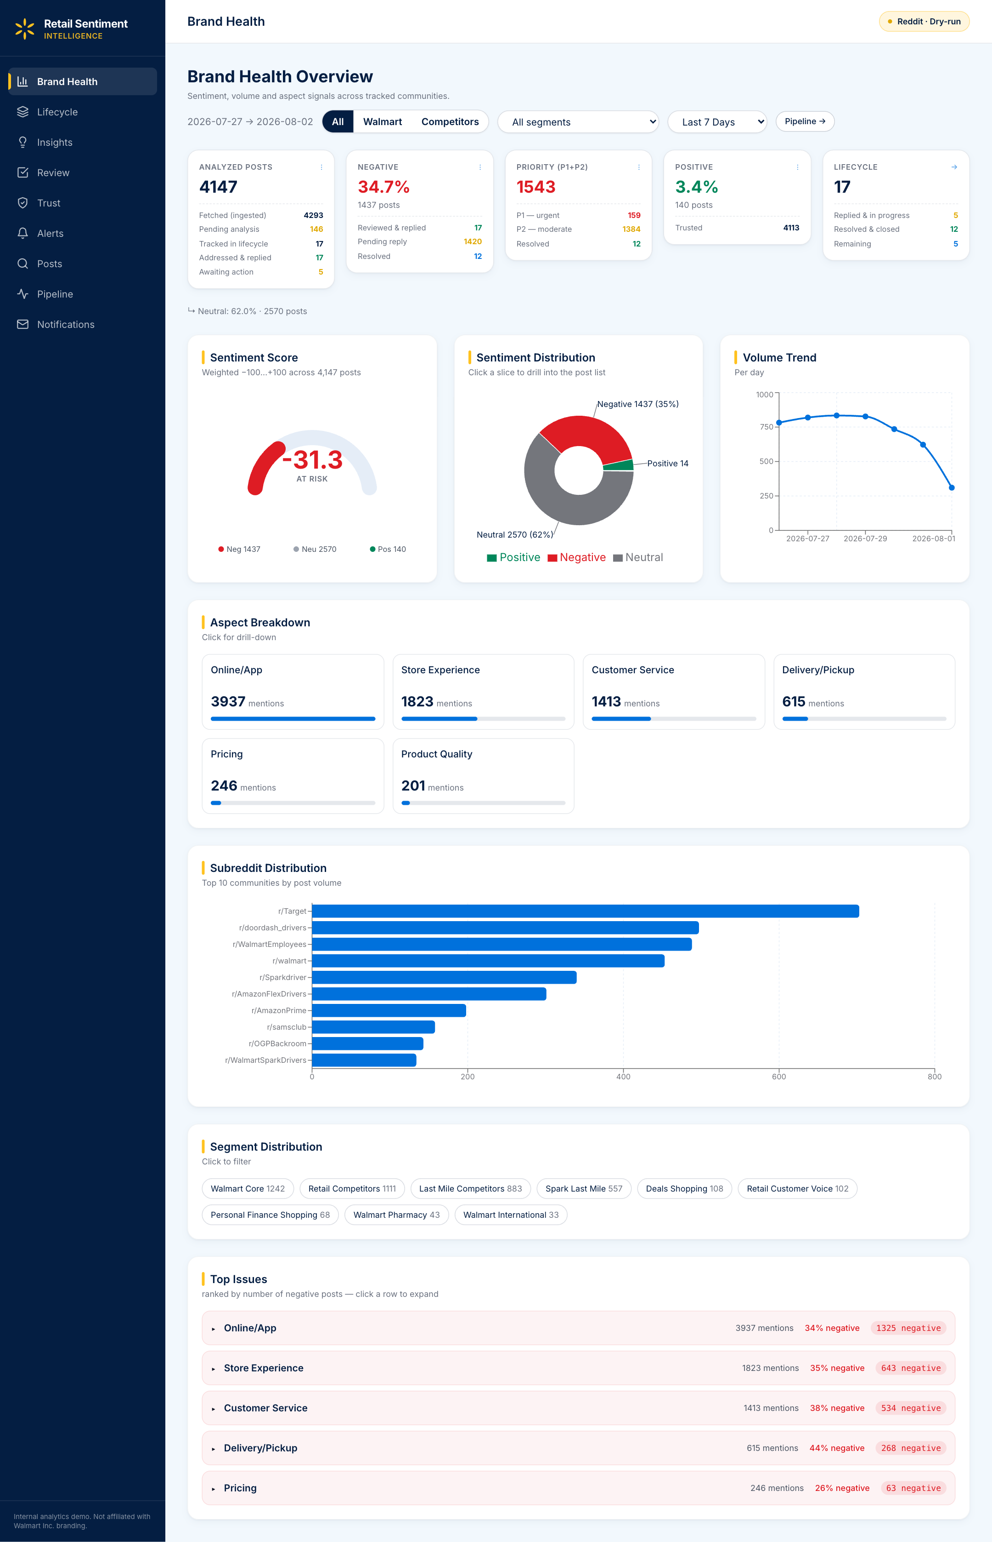
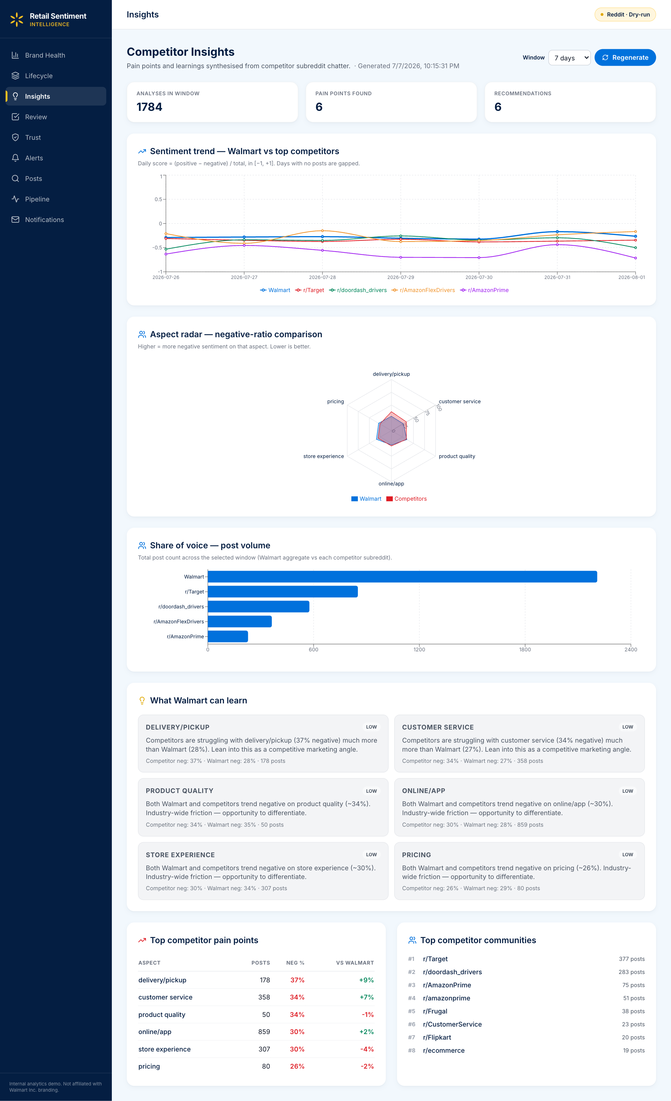
Live Demo — Dashboard Walkthrough
One post → alert → review → reply → lifecycle → resolved
Brand Health
Alert Feed
Post Explorer
Review & Validate
Lifecycle Kanban
Insights
Retail Sentiment Intelligence · BITS ZG628T Dissertation · Vishal Singh · Post Mid-Semester Presentation
19 / 24

Slide 20
Conclusions — What Worked, What's Still Open
Honest read on 5 months of post-midsem work
WHAT WORKED
WHAT'S STILL OPEN (honest)
• 3-stage ModernBERT curriculum landed the sentiment win we set out for (Macro-F1 0.62 → 0.76 on 5-fold OOF).
• Long-post recovery came for free once we switched off truncation (≥1024-tok context): 5/7 → 7/7 correct on the ≥ 512-tok bucket.
• Removing the image on the final vision merge step ended the 50 % hallucination problem — the mechanism, not just the number, makes it credible.
• Trust score as flag-not-drop matched the human annotator on 12 / 15 low-trust posts. Analysts trust it because they can override it.
• HITL feedback table quietly turned into the most useful piece of infrastructure — drives few-shot on every click today, retraining tomorrow.
• 200-post gold set is small. Numbers are OOF-CV, but a bigger blind held-out set is needed before I'd claim generalisation.
• Vision eval is 32 images — enough to sanity-check the mechanism, not enough to claim production-grade quality.
• Long bucket has only 7 posts and they are all negative-class — 7/7 correct is evidence the truncation ceiling is gone, not proof of long-text mastery.
• Reply drafts still need an analyst edit — we track edit-distance but haven't shown it dropping consistently yet.
• Everything runs on one Mac. Multi-analyst concurrency and retraining automation aren't done — in the roadmap on next slide.
THE TAKEAWAY
Mechanism-level wins are what carry the argument; sample-size caveats are what the next horizon of work has to close.
Retail Sentiment Intelligence · BITS ZG628T Dissertation · Vishal Singh · Post Mid-Semester Presentation
20 / 24

Slide 21
Future Work — Track 1 · HITL Reduction (4 Horizons)
One of three tracks: Track 1 HITL · Track 2 Bilingual · Track 3 Multi-Platform (Tracks 2 & 3 on next slide)
Now → 1 month
Grow the gold set
HITL: 100 %
Grow the labelled gold set to ~500 posts using the HITL feedback the team is already producing; rerun 5-fold OOF to check the F1 delta.
1 → 3 months
Automate the retrain loop
HITL: 100 %
Wire the monthly ModernBERT retrain into a Cron / Airflow job with an OOF-F1 promotion gate — new checkpoints ship only when they beat the current one on held-out folds.
3 → 6 months
Walmart-trained model + shared DB
HITL: ~80 %
Fine-tune Mistral 7B on our own posted-reply corpus → a Walmart-trained replier that drops the paid GPT-4o dependency, runs fully in-house, and can be self-hosted. Move the feedback table to a shared managed database so multiple analysts can work concurrently.
6 → 12 months
Confidence-gated auto-reply
HITL: ~30 % → eventually 0 %
Introduce a confidence gate on the reply generator: top-confidence drafts are queued for auto-send and the analyst only reviews the mid- and low-confidence tail. As agreement stays high, gradually raise the auto-send threshold — HITL winds down to sampling / audit only.
GUIDING PRINCIPLE
HITL is the ladder, not the ceiling — every stage produces the training signal that lets the next stage automate more. Each horizon is admissible only when the previous one is measurably successful.
Retail Sentiment Intelligence · BITS ZG628T Dissertation · Vishal Singh · Post Mid-Semester Presentation
21 / 24

Slide 22
Future Work — Track 2 · Bilingual + Track 3 · Multi-Platform
The other two tracks that widen the pipeline's coverage while Track 1 winds HITL down
TRACK 2 · BILINGUAL → MULTILINGUAL
TRACK 3 · MULTI-PLATFORM (Reddit → X / Facebook / Instagram / app-stores)
Why: Indian retail subreddits are ~30 % of Walmart-family mentions but the current langdetect → English-only filter silently drops them.
Why: Reddit is deliberate + long-form; X is real-time viral; Instagram is image-heavy (vision pipeline shines); app-store reviews carry a star-rating ground-truth signal.
Concrete deliverables
Concrete deliverables
•
Extend langdetect to hi + en (later ta / te / bn); code-mixed 'Hinglish' handled with a mixed-script tokenizer.
•
Ingestion adapters: X API v2, Meta Graph API (Facebook + Instagram), Google Play / App Store review scrapers — each behind a common RawPost interface.
•
Ingestion-time translation via NLLB-200 (open-weights, 3.3 B) so downstream models stay English-only — or — fine-tune ModernBERT on native scripts.
•
Per-platform pre-processing: X dedup by retweet lineage; Instagram routed through the vision pipeline first (caption + image); app-store reviews carry a native star_rating field.
•
Extend aspect taxonomy for Indic retail idioms (“bill karo” for billing, “delivery kab” for late shipping).
•
Extend priority classifier: X viral (retweets > 100) → auto P1; app-store 1-star surge → P1; Instagram brand-tagged post from > 10 k follower account → P1.
•
Native-speaker analyst validation loop — same HITL flow, new language pool.
•
Unified raw_posts.source_platform column (already stubbed) so Brand Health / Insights aggregate across platforms out of the box.
Ships as part of Track 1 horizon 1 → 3 mo (bilingual retrain gate) and horizon 3 → 6 mo (Walmart-trained multilingual replier).
Risks: X API tiers ($100 / mo min); Meta Graph needs page-level perms; Instagram image volume needs vision-batching.
Retail Sentiment Intelligence · BITS ZG628T Dissertation · Vishal Singh · Post Mid-Semester Presentation
22 / 24

Slide 23
Source Code & Deliverables
Repository
https://gecgithub01.walmart.com/v0s01jh/Retail_Sentiment_Intelligence
Deliverable | Path in repo | Contents
Final Report (PDF) | docs/Sem_4/final/FINAL_REPORT_VishalSingh_2020AA05641.pdf | 10 chapters + appendices + refs
Final Report (LaTeX) | docs/Sem_4/final/latex/ | Reproducible xelatex source
Pipeline core | src/pipeline.py, src/ingestion/, src/analysis/ | 6-layer async pipeline
Sentiment training | scripts/train_modernbert_sentiment.py | 3-stage curriculum runner
Evaluation notebook | evaluation/trust_score_walmart200.ipynb | Reproducible 5-fold OOF eval
Dashboard | frontend/ (React + Vite + Tailwind) | 8 pages, live via WebSocket
Reproduction | Appendix B of the report · start.sh | Clone → conda → start
REPRODUCE IN 3 STEPS
git clone <repo> → conda create -n rsi python=3.11 && pip install -r requirements.txt → ./start.sh
Retail Sentiment Intelligence · BITS ZG628T Dissertation · Vishal Singh · Post Mid-Semester Presentation
23 / 24

Slide 24
Thank You
Retail Sentiment Intelligence · Post Mid-Semester Presentation
Questions ?
Repository
gecgithub01.walmart.com/v0s01jh/Retail_Sentiment_Intelligence
Report: docs/Sem_4/final/FINAL_REPORT_VishalSingh_2020AA05641.pdf
Vishal Singh · 2020AA05641 · BITS Pilani (WILP) · Walmart Global Tech, Bengaluru

