Slide 1
nopCommerce – Testing & Quality Assurance
Under the Guidance of Mrs. Vaishali Sonanis.

Slide 2
Introduction
nopCommerce is an open-source e-commerce platform offering a wide range of products such as electronics, apparel, digital downloads, and gift cards.
It enables users to register, browse, search, and shop products online with secure and flexible checkout options.
The platform provides features like wishlists, product comparison, community polls, and order tracking to enhance the shopping experience.

Slide 3
Overview
What is nopCommerce?
nopCommerce is an e-commerce platform supporting categories like Computers, Electronics, Apparel, Digital Downloads, and Gift Cards.
The homepage contains organized navigation, featured products, bestsellers, and community polls.
Modules include Registration, Login, Product Search, Shopping Cart, Checkout, and My Account.

Slide 4
Responsibilities
Analyzed requirements and created Epics, Stories, and Tasks in Jira.
Designed test plans and prepared module-wise test cases.
Performed manual and automated testing using Selenium with TestNG/Cucumber and POM.
Reported defects in Jira and maintained execution reports.
Configured and maintained Jenkins for automated builds and test executions.
Ensured successful deployment of automation test results through Jenkins.

Slide 5
Modules
Module 1: Registration/Login Verified email, password, and login validation
Module 2: Product Search Checked product search, filters, and results..
Module 3: Shopping Cart Verified adding/removing items, quantity changes, and total calculation.

Slide 6
Module 4: Checkout Validated billing, shipping, payment, and order confirmation.
Module 5: Wishlist & Compare Products Ensured add/remove functionality works correctly.
Module 6: Community Poll Verified voting and results display.

Slide 7
Defects
During test execution, any functionality that does not behave as expected such as fields, buttons, or features not performing correctly is identified as a defect.
Defects are documented with steps to reproduce, expected vs. actual results, severity, and screenshots.
The defects are then logged in the defect tracking tool (e.g., Jira) for resolution and follow-up by the development team.
This process ensures effective issue management and maintains overall product quality.

Slide 8
Defect Identifier:def_001
Defect Summary: Shipping address field accepts incorrect phone numbers
Test ID: TC_001
Test Case Name: Validate phone number length in shipping address field
Module Name: Order Module
Reproducible: Login to the site → Go to order details page https://demo.nopcommerce.com/orderdetails/238.→ Navigate to shipping address form→ Enter phone number with less than 10 digits and more than 10 digits→ Save/Submit the form → Observe system accepts invalid phone number.
Severity: High
Priority: High
Raised By: Vishal
Assigned To: Developer / Team Lead
Date of Assignment:
Status: In Progress
Snapshots: Attached
Fixed By: Developer
Date of Fixing:

Slide 9
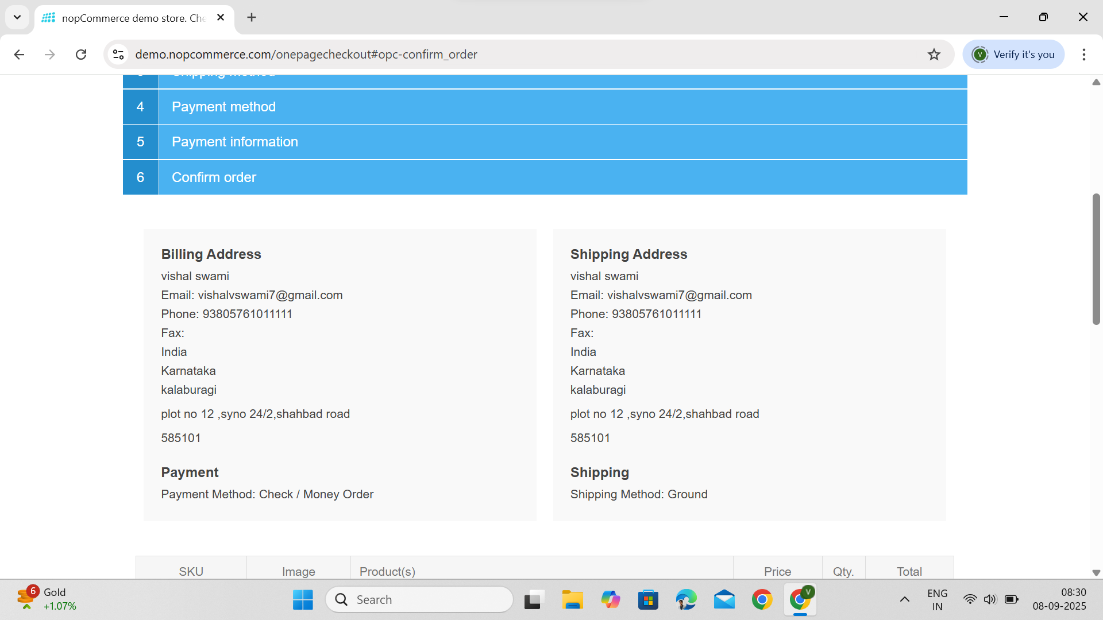

Slide 10
Defect Identifier:def_002
Defect Summary: Order details page does not show options to cancel product or cancel order after placing an order
Test ID: TC_002
Test Case Name: Verify cancel order / cancel product option after order placement
Module Name: Order Management
Reproducible: 1. Login to the site→ Place an order.→ Go to order details page: https://demo.nopcommerce.com/orderdetails/238.--> Check for options to cancel product or cancel order.→. Observe that no cancel options are available.
Severity: High
Priority: High
Raised By: Vishal
Assigned To: Developer / Team Lead
Date of Assignment:
Status: In Progress
Snapshots: Attached
Fixed By: Developer
Date of Fixing:

Slide 11
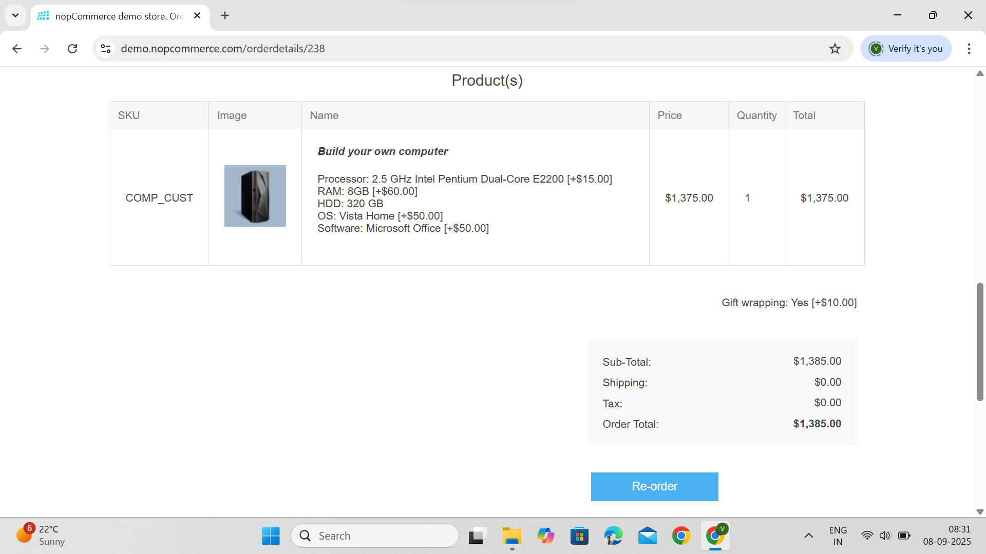

Slide 12
Challenges
Handling dynamic elements across multiple nopCommerce modules.
Identifying defects like incorrect Fields and missing Cancel Order Feature.
Maintaining test stability while executing automation test cases with TestNG/Cucumber.
Documenting and tracking defects systematically in Jira with detailed evidence.
Faced challenges in configuring and executing automated builds in Jenkins.

Slide 13
Experience
Automated key workflows: login, search, add to cart, delete cart, profile update, and shop by category.
Validated multiple submodules of nopCommerce and reported critical defects .
Created structured defect reports with severity, priority, and screenshots for better tracking and resolution.
Gained hands-on experience with TestNG, Cucumber, Jira, and end-to-end validation of e-commerce platforms.
Gained hands-on experience in configuring and managing Jenkins build pipelines for automated test execution.

Slide 14
Thank You.

