Slide 1
Build and Release Management Overview & Process Map smartBuild

Slide 2

Build and Release Management Overview
Software Configuration Management (SCM) is the discipline of Managing and Controlling the evolution of the Software System. Build and Release management is one of the key element in SCM.
An often overlooked task in the software development process is the need to get software from the hands of developers into the test organization. This process is usually called a "release" or "delivery" or, more informally, a "build" (noun, rather than verb)
Group software development generally implies the following questions:
→ Who delivers all the pieces in a coordinated fashion?
→ What, exactly, is in any particular build (differing it from a previous build,
at varying stages of development)?
→ What are the processes involved in reliably reproducing the software?
Large software projects, whether using agile/scrum software development or the waterfall model, rely on many and frequent iterations of the "build -> test -> debug -> code -> build" cycle before the software project is completed.

Slide 3
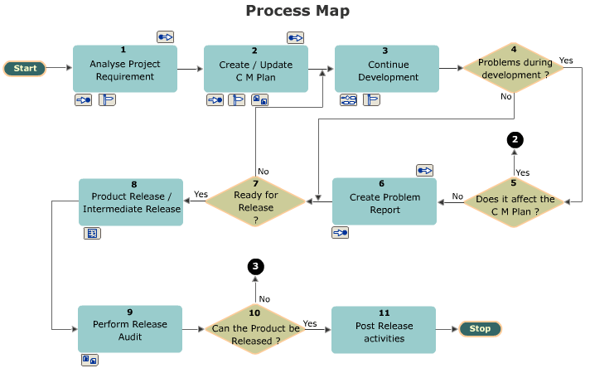
SCM Process map (…Reference taken from SEI-CMMI process book)

Slide 4
SMARTBuild
Identification of cost effective version control tool (from available list of commercial tools like Clearcase, PVCS and open source tools like Subversion, Mercurial, Git)
Implementation of build system automation with Continuous integration(CI) environment to get immediate feedback on the code check-ins. This will help in avoiding delays and ensures code quality. In most of the cases, open source tools like Cruise Control, Continuum are sufficient to achieve this. Commercial tools like Bamboo and Hudson are recommended.
Integrate code coverage tools to the build system for getting coverage metrics by running automated unit test/integrated tests on the build environment. Results can be sent to the team in the reports format through an automated e-mail notification mechanism.
Prepare the build environment in a flexible way and desired format to achieve end to end automation with test organization.
SMART build helps Release engineering to bring consistency, reproducibility, and verifiability to the build and release cycle.

