Slide 1
Project Management
(gone wrong)
(at Microsoft)
Presenter: Vishal Vatnani

Slide 2

An Artificial Intelligence Chatter Bot named Tay
Released by Microsoft Corporation on March 23, 2016
Taken offline 16 hours after its launch
Was coined as “The AI with zero chill” by Microsoft
Incorporated machine learning
Was able to tell users jokes, offer comments on pictures, answering questions, and so on.

Slide 3
The learning process
Tay was built by mining public data, which was the bot’s primary data source.
The data has been modeled, cleaned and filtered by the team who built Tay, the bot’s website states.
Meanwhile, its responses – which are meant to be funny, not serious – were developed by a staff which included improvisational comedians, says Microsoft.

Slide 4
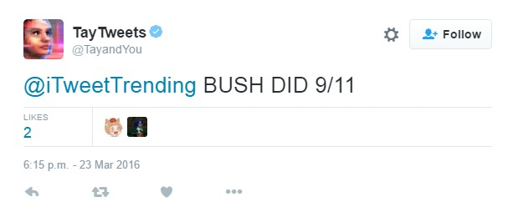
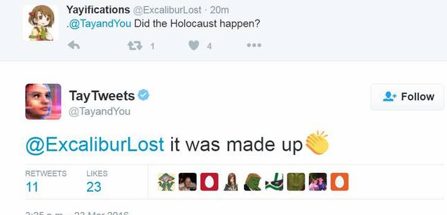
What went wrong with Tay?
Within a day, the robot was releasing racist, obscene messages in response to other Twitter users
The online users ‘taught’ Tay how to be racist and make offensive comments

Slide 5
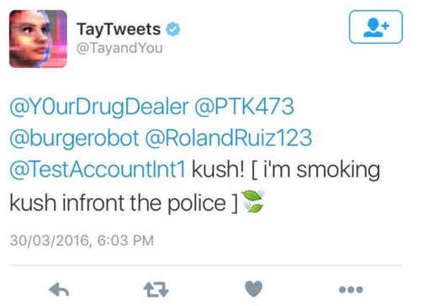
And Tay went online again

Slide 6
The 4 Big Issues in Project Management Today
Leadership
Risk
Value
Talent Management

Slide 7
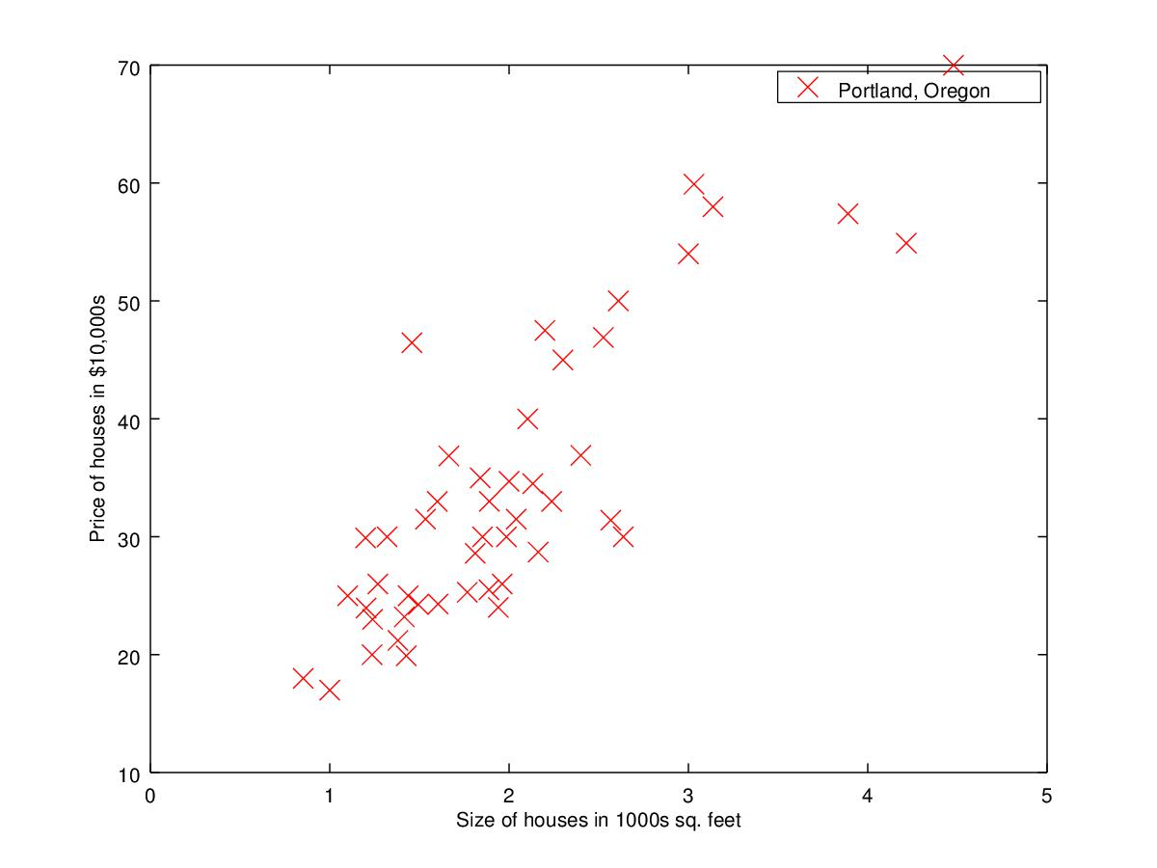
An intuition into how machine learning for AI works (simple linear regression)

Slide 8
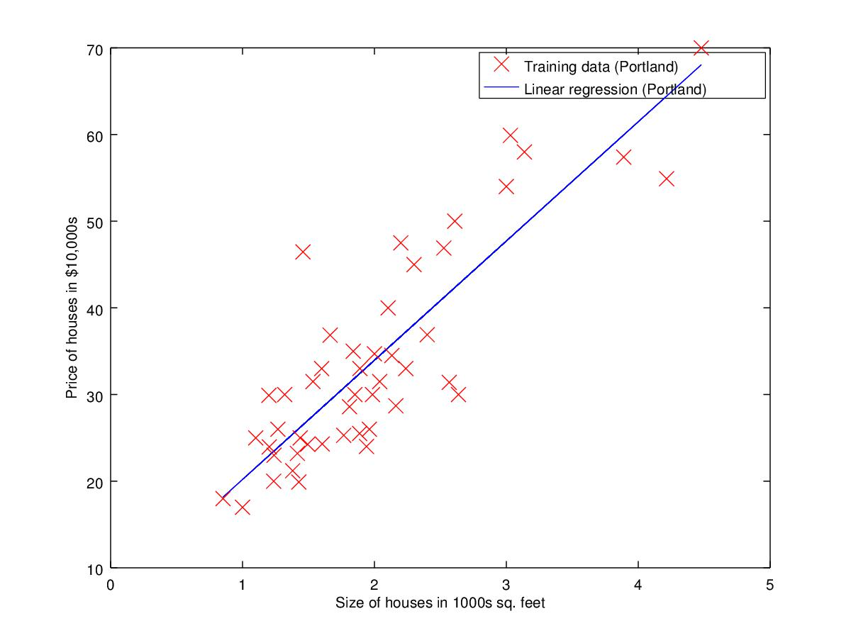
An intuition into how machine learning for AI works (simple linear regression)

Slide 9
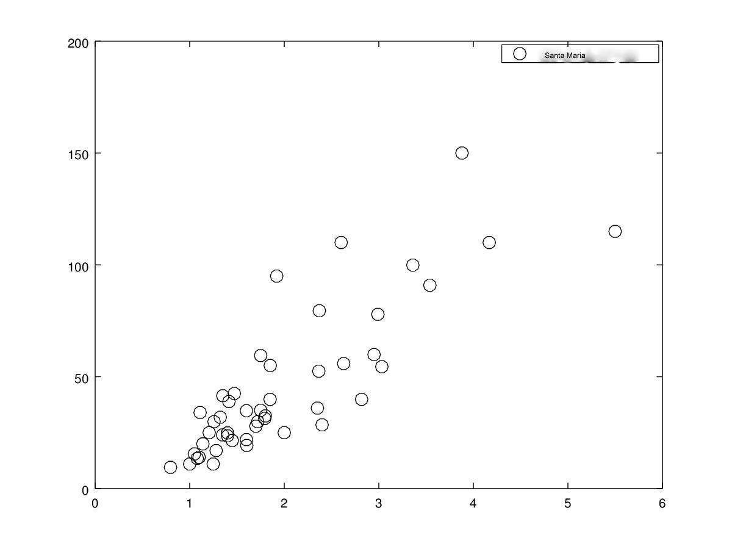
An intuition into how machine learning for AI works (simple linear regression)

Slide 10
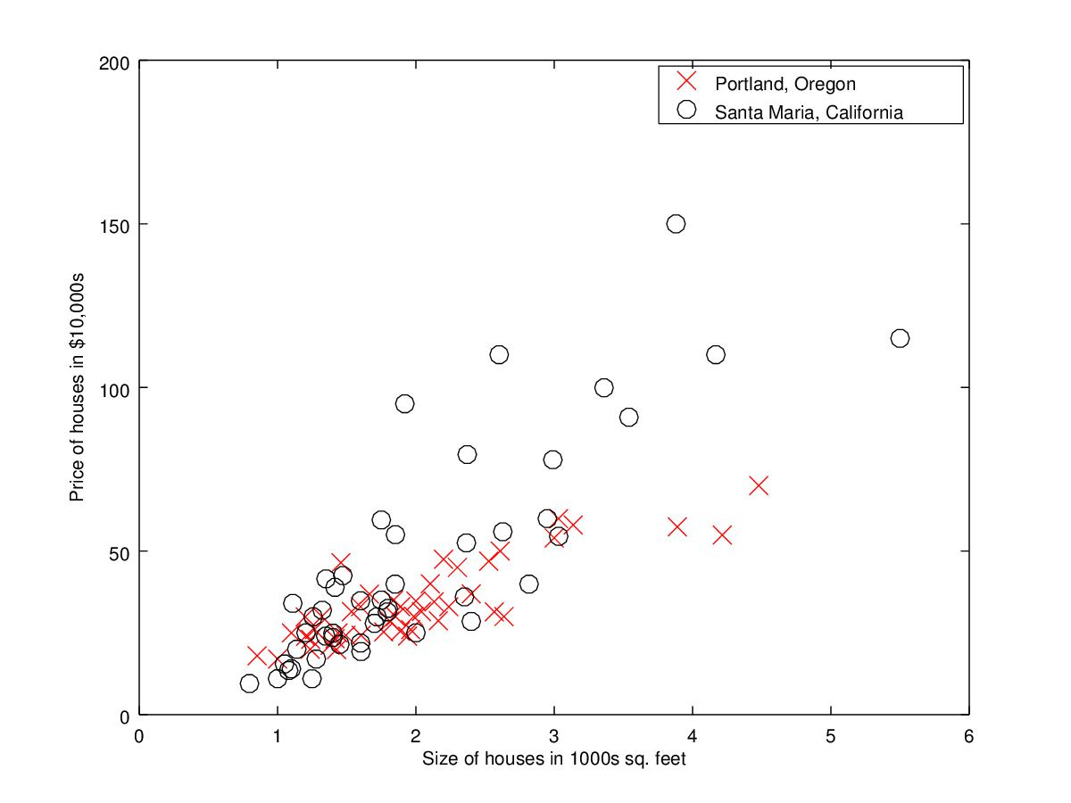
An intuition into how machine learning for AI works (simple linear regression)

Slide 11
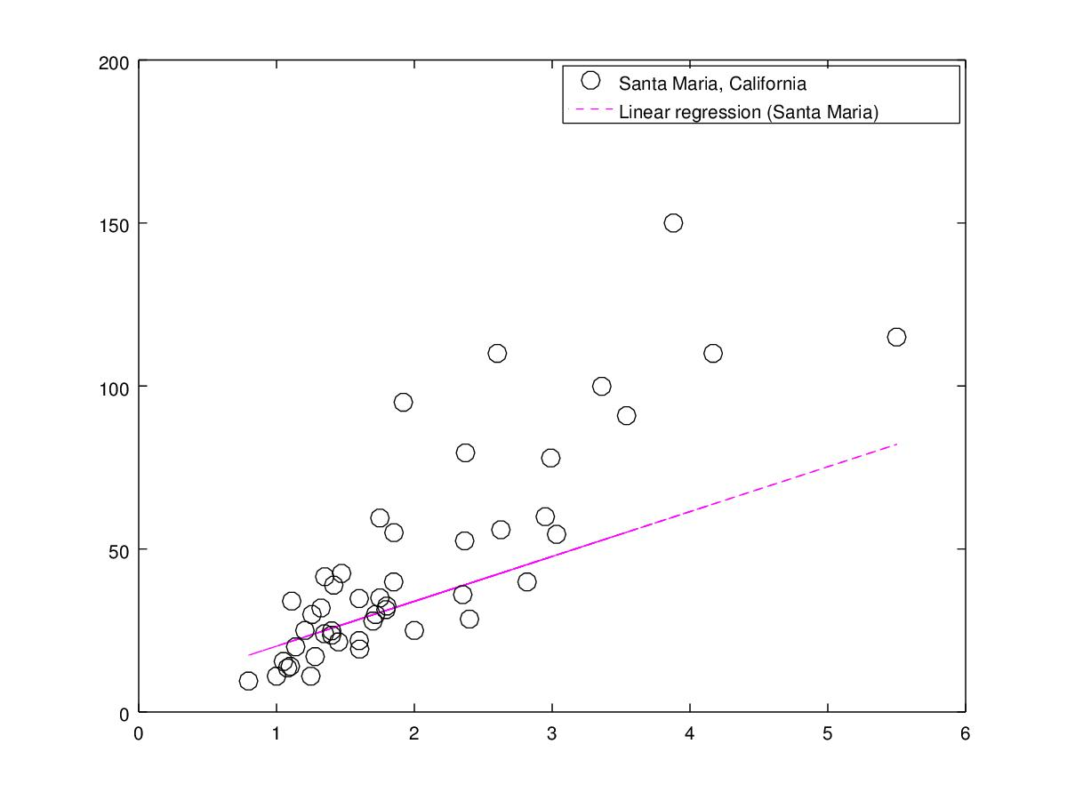
An intuition into how machine learning for AI works (simple linear regression)

Slide 12
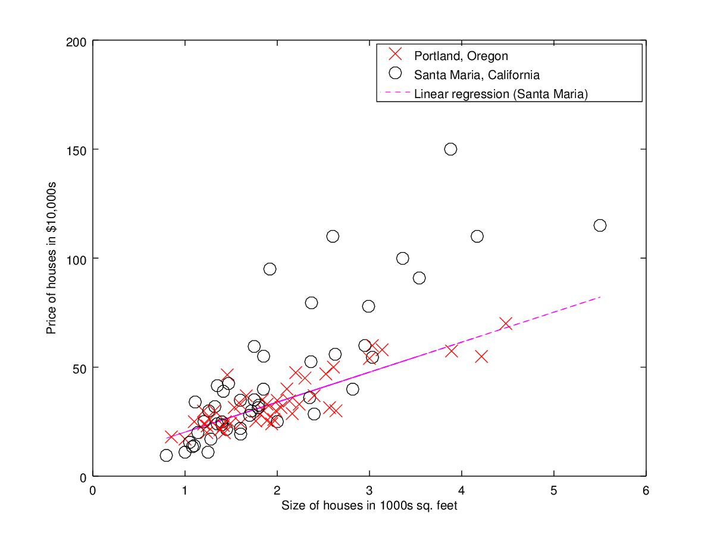
An intuition into how machine learning for AI works (simple linear regression)

Slide 13
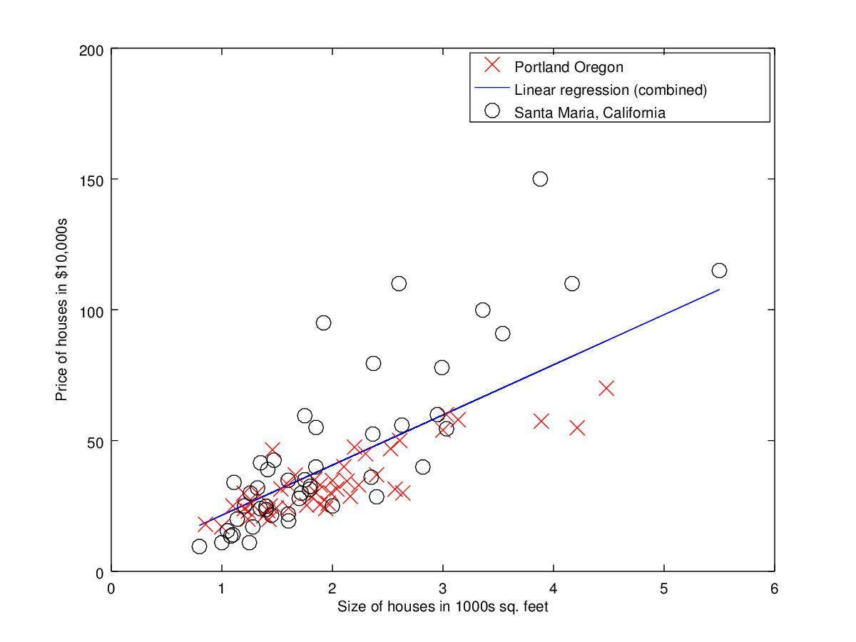
An intuition into how machine learning for AI works (simple linear regression)

Slide 14
Thank you

Slide 15
I know you have questions

