Slide 1
Hello

Slide 2


Slide 3

Communication

Slide 4
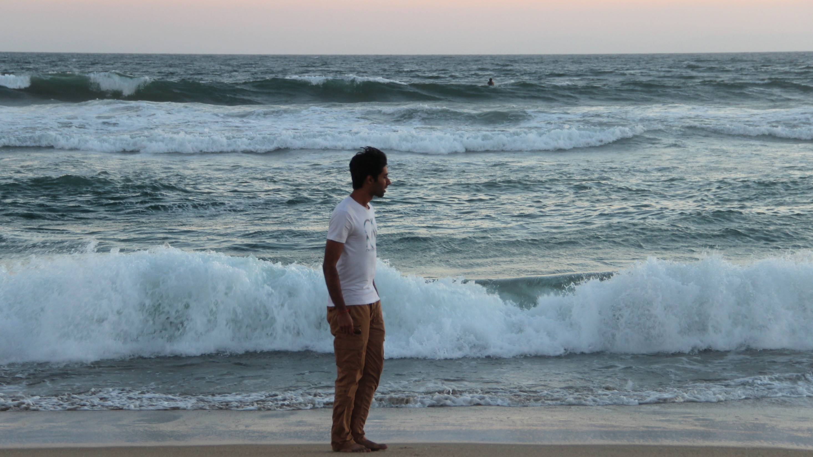
Co-founder at Utonexus.com – A Personality Social Network
Graduate Student Research Assistant at California State University, Fullerton
About me

Slide 5
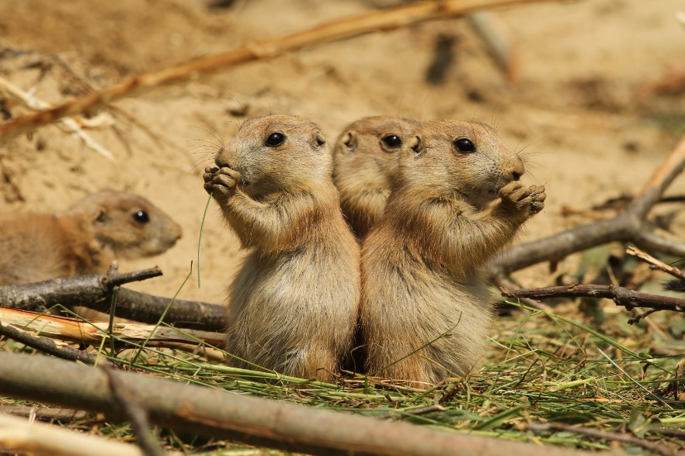
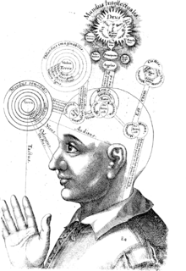

Why do we communicate at all?
The necessity for survival
It is a complex society
A need to feel bigger than our limitations
All communication is inefficient

Slide 6
Do you really need a classroom?
Yes, it may be any room
A classroom reveals your mistakes to you
Try getting trolled on the internet, once in a while

Slide 7
Do you really need a classroom?
Do you have something to say?
Good communication is a quality, not a quantifiable knowledge

Slide 8
My suggestions (do not follow, experiment!)
Speak to yourself in the language you want to become good at
Talk to people about ideas, concepts, business plans
Read a few books, find out what the unfamiliar words mean
Pay close attention to patterns in the language
Text in full English

Slide 9
Do you really need a classroom?
How a decent communication skill made my life more adventurous (in recent times)

Slide 10
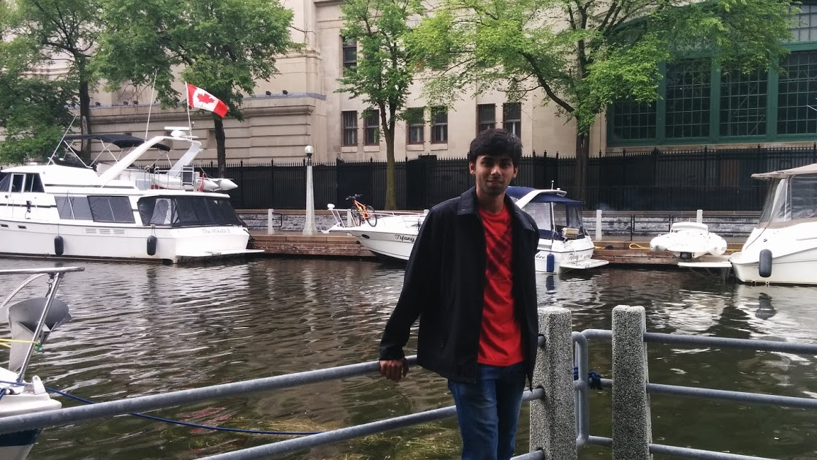
1. It got me into a program called IEP (International Experience Program) by my University, after the deadline had passed.

Slide 11
2. It got me friends like Varun
We should get a picture together sometime.

Slide 12
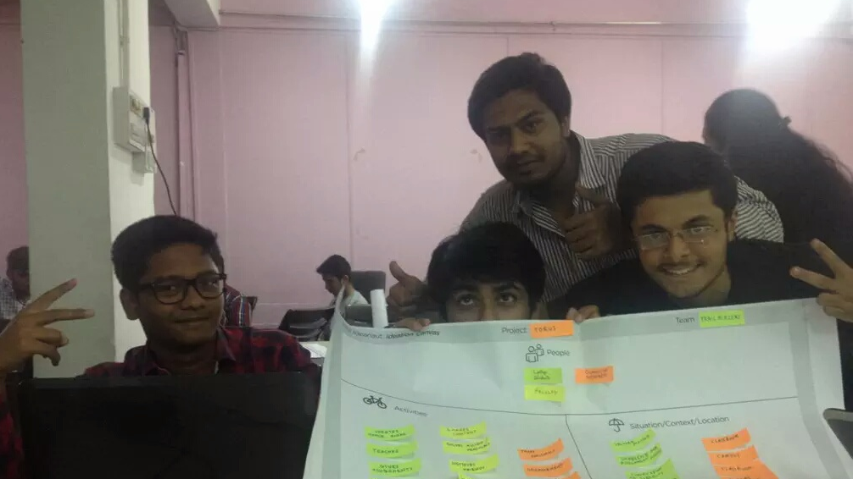
3. It got to meet the people I needed to co-found Utonexus.com

Slide 13
4. It got me a mentor at Cal State Fullerton

Slide 14
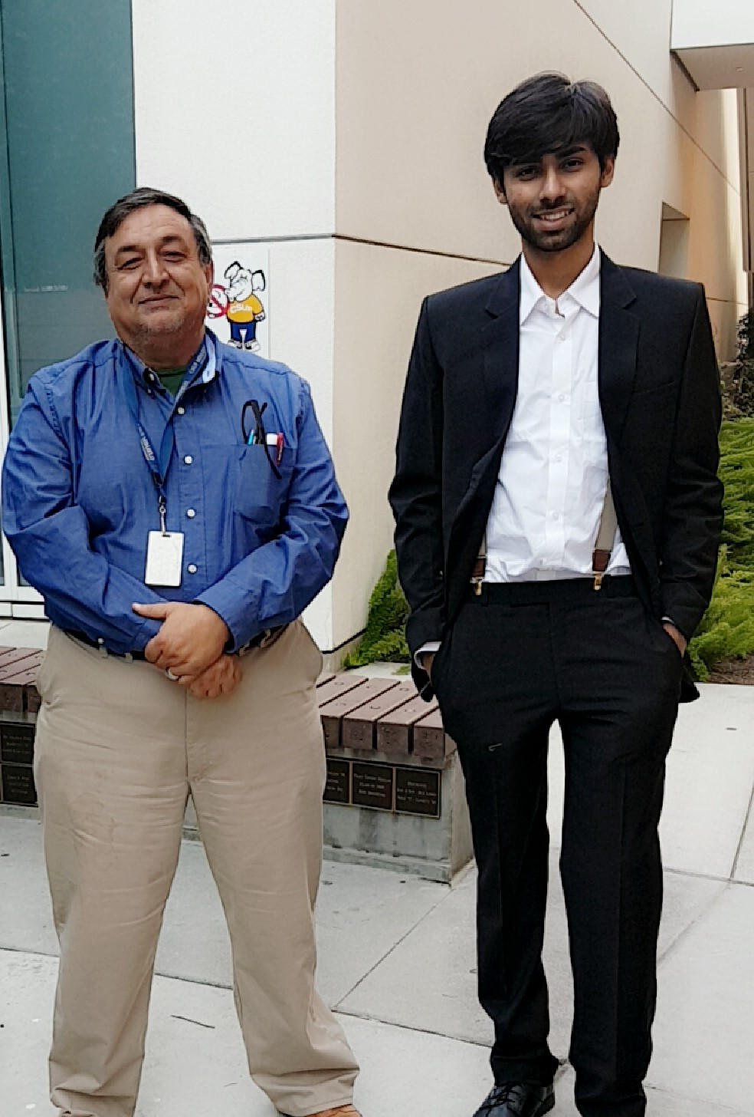
5. I became the favorite (I assume) of my Managerial Communications class’ Professor

Slide 15
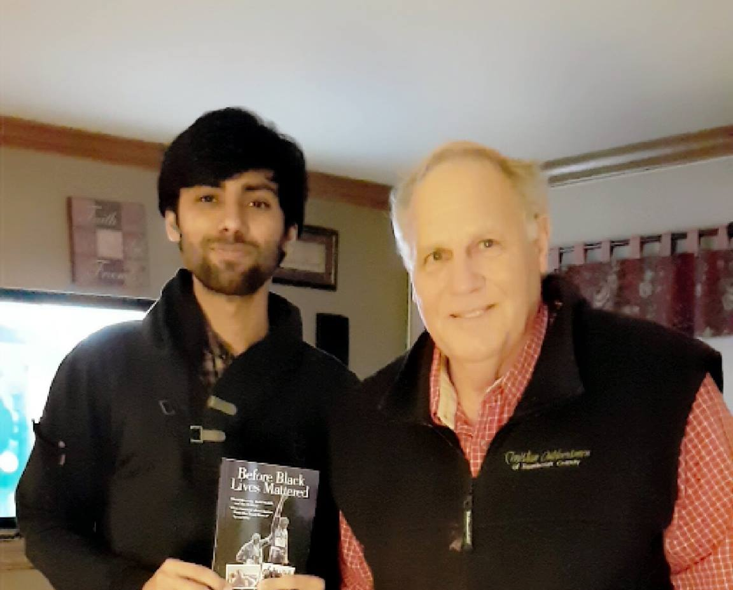
6. I got to meet Jim Adkins (he’s an author)

Slide 16

7. Got a $200 voucher from United Airlines

Slide 17
I think that’s all I could think of (Do Tinder matches count as an achievement?)

Slide 18

And if you like, try Utonexus.com and give us your feedback!

Slide 19
Thank you
Questions? Connect with me on http://Vatnani.com

