Slide 1

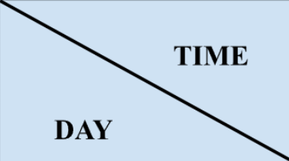

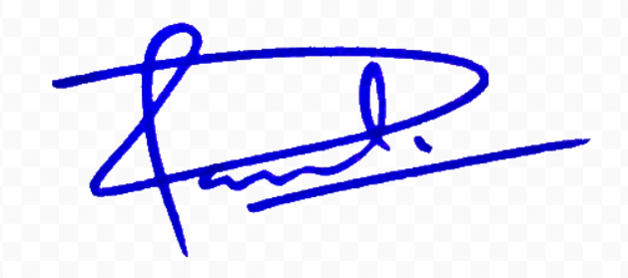
COER UNIVERSITY
College of Smart Computing
w.e.f: 15/07/26
Computer Science and Engineering
Year: Diploma 2nd Year
Academic Session 2026-27 (ODD Semester)
Semester: III
TIME TABLE
 | II | III | IV | V | VI | VII | VII | VIII
 | 9:00-09:55 AM | 10:00-10:55 AM | 11:00-11:55 AM | 12:00-12:55 PM | 1:00-01:55 PM | 2:00-02:55 PM | 03:00-03:55 PM | 04:00-04:55 PM
Monday | DCS381 NT A 110 |  | DCS302 ND A 110 | Mentor mentee meeting NR | Lunch | DCS305 DM A 110
Tuesday | DCS382 ND A 110 |  | DCS303 DAK A 110 | DCS301 NT A 110 | Lunch
Wednesday | DCS306 AG A 110 | DCS304 KS A 110 | DCS383 NR A 110 |  | Lunch | DCS303 DAK A 110 | Community Engagement **
Thursday | DCS303 DAK A 110 | DCS304 KS A 110 | DCS306 AG A 110 | DCS302 ND A 110 | Lunch | DCS301 NT A 110 | DCS305 DM A 110
Friday | DCS306 AG A 110 | DCS301 NT A 110 | DCS304 KS A 110 | Lunch | DCS305 DM A 110 | DCS302 ND A 110 | Sports and Wellness Activities **
Saturday | NSS/NCC |  | Community Engagement ** |  | Lunch | Library and Self-Study ** |  | Sports and Wellness Activities **
\
SUBJECT CODE | CREDIT | SUBJECT NAME | ABBREVIATION | FACULTY NAME
DCS301 | 3 | Data Structure Using C | NT | Mrs. Neetu
DCS302 | 3 | Internet and Web Technology | ND | Mrs. Nidhi
DCS303 | 3 | Data Communication and Computer Network | DAK | Dr. Arvind Kumar
DCS304 | 3 | Digital Electronics | KS | Ms. Komal Singh
DCS305 | 3 | Operating Systems | DM | Dr. Divya Mishra
DCS306 | 3 | Universal Human Values | AG | Dr. Anita Goswami
DCS381 | 1 | Data Structure Using C Lab | NT | Mrs. Neetu
DCS382 | 1 | Internet and Web Technology Lab | ND | Mrs. Nidhi
DCS383 | 1 | Office Automation Tools Lab | NR | Ms. Nidhi Rana
OC Time Table
Head of the Department
Dean
Pro Vice Chancellor

Slide 2
COER UNIVERSITY
College of Smart Computing
w.e.f: 15/07/26
Computer Science and Engineering
Year: Diploma 3rd Year
Academic Session 2026-27 (ODD Semester)
Semester: V
TIME TABLE
 | II | III | IV | V | VI | VII | VII | VIII
 | 9:00-09:55 AM | 10:00-10:55 AM | 11:00-11:55 AM | 12:00-12:55 PM | 1:00-01:55 PM | 2:00-02:55 PM | 03:00-03:55 PM | 04:00-04:55 PM
Monday |  |  | DCS503 AJ A110 | DCS506 HB A 110 | Lunch | DCS504 YP A 301 | DCS505 AS A 207
Tuesday |  |  |  | Lunch | DCS503 AJ A 110 |  | DCS581 SS A 110 | DCS506 HB A 110
Wednesday |  |  | Library and Self-Study ** | Lunch | DCS501 SS A 110 | DCS502 DP A 110 | DCS504 YP A 110 | DCS584 NR A 110
Thursday | DCS504 YP A 207 | DCS501 SS A 207 | DCS505 AS A 207 | Lunch |  | DCS582 AT Lab 4 | DCS503 AJ A 207 | DCS502 DP A 110
Friday | DCS502 DP A 107 | DCS506 HB A 107 |  | DCS583 YP Lab 4 | Lunch | DCS505 AS A 310 | DCS501 SS A 110
Saturday |  | NSS/NCC |  | Community Engagement ** | Lunch |  | Library and Self-Study ** | Sports and Wellness Activities **
SUBJECT CODE | CREDIT | SUBJECT NAME |  |  |  |  | ABBREVIATION | FACULTY NAME
DCS501 | 3 | Python Programming |  |  |  |  | SS | Mr. Sunil Singh
DCS502 | 3 | Operating System |  |  |  |  | DP | Dr. Deepak Painuli
DCS503 | 3 | Data Mining and Warehousing |  |  |  |  | AJ | Dr. Akshay Juneja
DCS504 | 3 | Web Development Using Android |  |  |  |  | YP | Ms. Yadika Prasad
DCS505 | 3 | Network Security |  |  |  |  | AS | Dr. Anurag Singh
DCS506 | 3 | Data Analytics |  |  |  |  | HB | Ms. Himani
DCS581 | 1 | Python Programming Lab |  |  |  |  | SS | Mr. Sunil Singh
DCS582 | 1 | Operating System Lab |  |  |  |  | AT | Ms. Ankita
DCS583 | 1 | Web Development Using Android Lab |  |  |  |  | YP | Ms. Yadika Prasad
DCS584 | 1 | Mini Project |  |  |  |  | NR | Ms. Nidhi Rana
DSI001 | 1 | Industrial Training Assessment |  |  |  |  | NR | Ms. Nidhi Rana
OC Time Table
Head of the Department
Dean
Pro Vice Chancellor

