Slide 1

Title :Von
Neumann
Architectur
e
COLLEGE PRESENTATION BY
: VISHAL YADAV

Slide 2
Introduction –
•Von Neumann Architecture is a computer design model proposed by John von
Neumann in 1945.
•It introduced the stored program concept, where both data and instructions are
stored in the same memory.
•It is the foundation of most modern computer systems.
•Communication between the CPU and memory takes place through a single bus.
•Consists of five main components:
Input Unit Output Unit
Memory Unit Arithmetic Logic Unit (ALU)
Control Unit.

Slide 3
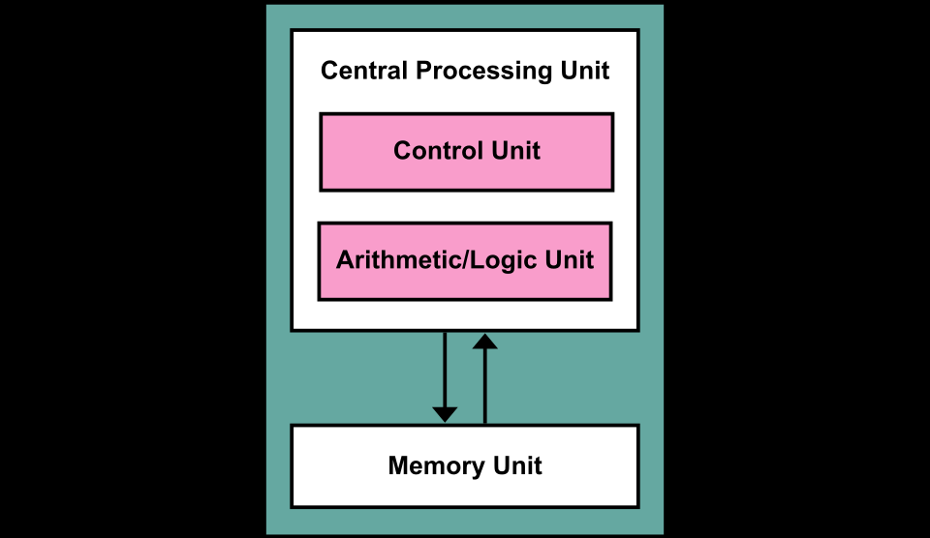
Block Diagram

Slide 4
Working principle
Fetch
1️⃣
Execute
3️⃣
• Control Unit takes the instruction
from memory
• ALU performs arithmetic or logical
operation
• Instruction is loaded into the CPU
• Result is produced
Decode
2️⃣
Store
4️⃣
• Control Unit understands what
operation to perform
• Result is stored back into memory
• Output is sent to output unit if
required
• Identifies data and operation type

Slide 5
Advantages or Disadvantages
• Simple and easy to design
architecture
• Suffers from Von Neumann
bottleneck
• Uses a single memory for
data and instructions
• Slower performance
• Data and instructions share
the same bus
• Low hardware cost
• No parallel execution of data
and instructions
• Easy to program and modify
• Suitable for general-purpose
computers
• Not suitable for high-speed
processing

Slide 6
Applications
• Used in early computer systems
• Basis of most modern general-purpose computers
• Used in personal computers (PCs)
• Used in laptops and desktops
• Used in simple embedded systems
• Used in educational and research systems

Slide 7
Thank You

