Slide 1

Title :Von
Neumann
Architectur
e
COLLEGE PRESENTATION BY
: VISHAL YADAV

Slide 2
Introduction –
•Von Neumann Architecture is a computer design model proposed by John von
Neumann in 1945.
•It introduced the stored program concept, where both data and instructions are
stored in the same memory.
•It is the foundation of most modern computer systems.
•Communication between the CPU and memory takes place through a single bus.
•Consists of five main components:
Input Unit Output Unit
Memory Unit Arithmetic Logic Unit (ALU)
Control Unit.

Slide 3
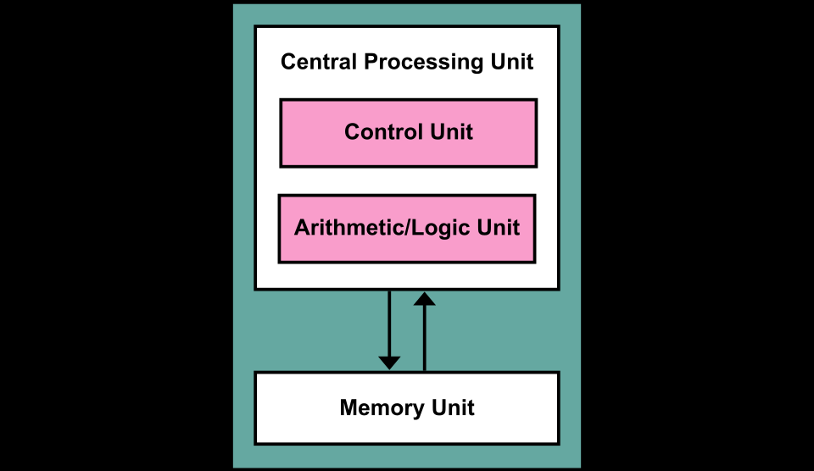
Block Diagram

Slide 4
Working principle
Fetch
1️⃣
Execute
3️⃣
Control Unit takes the instruction
ALU performs arithmetic or logical
from memory
operation
Instruction is loaded into the CPU
Result is produced
Decode
2️⃣
Store
4️⃣
Control Unit understands what
Result is stored back into memory
operation to perform
Output is sent to output unit if
Identifies data and operation type
required

Slide 5
Advantages or Disadvantages
• Simple and easy to design
• Suffers from Von Neumann
architecture
bottleneck
• Uses a single memory for
• Slower performance
data and instructions
• Data and instructions share
• Low hardware cost
the same bus
• No parallel execution of data
• Easy to program and modify
and instructions
• Suitable for general-purpose
• Not suitable for high-speed
computers
processing

Slide 6
Applications
• Used in early computer systems
• Basis of most modern general-purpose computers
• Used in personal computers (PCs)
• Used in laptops and desktops
• Used in simple embedded systems
• Used in educational and research systems

Slide 7
Thank You

