Slide 1
Insurance AI Pro+
End-to-End Data Science Project
Name: Vishal Yadav
Register No:24BCE1488

Slide 2
Abstract & Introduction
Abstract
Insurance AI Pro+ is an intelligent multi-domain insurance quotation system. It predicts insurance premiums and claim amounts using machine learning while providing Explainable AI (XAI) insights to users.
Introduction
Traditional actuarial models lack transparency for end-users. This project aims to bridge the gap by deploying dynamic, real-time prediction models across health, life, motor, property, business, specialty, and travel insurance.

Slide 3
DataSet Detail
Data Characteristics
Source: Custom statistical generation mirroring epidemiological/real-world distributions.
Records: Over 120,000 composite records.
Domains: Claim (50k rows), Health, Life, Motor, Business, Property, Travel, Specialty (each 10k rows).
Features: Core biological (Age, BMI, Blood Pressure), Categorical (Region, Smoker Status), Financial (Coverage Amount, No_Claim_Years).
Target Variable: Premium / Claim Amount.

Slide 4
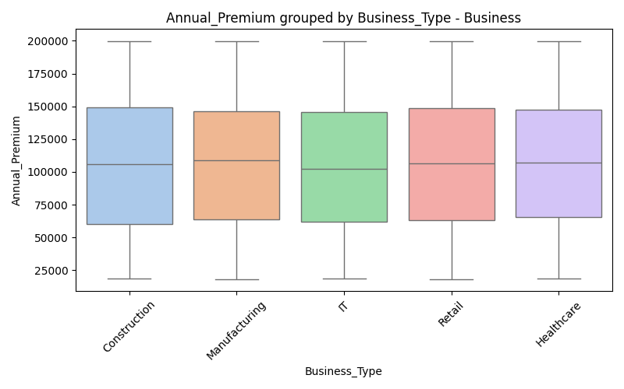
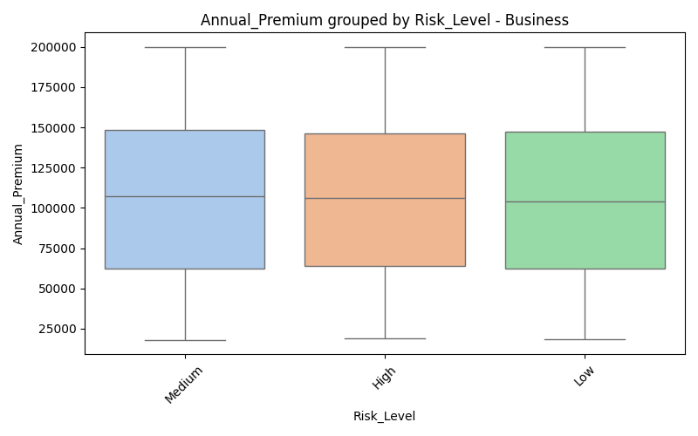
EDA Visualization: Business Dataset (Part 1)
Business box Business Type
Business box Risk Level

Slide 5
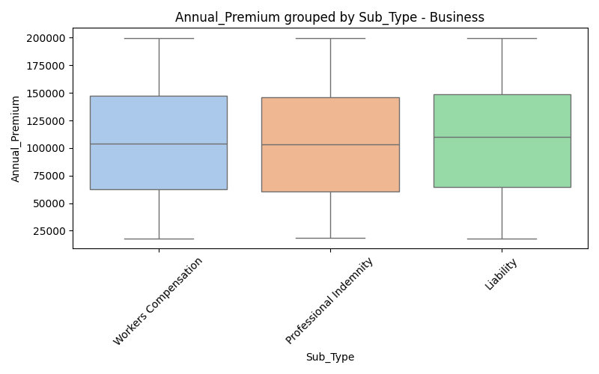
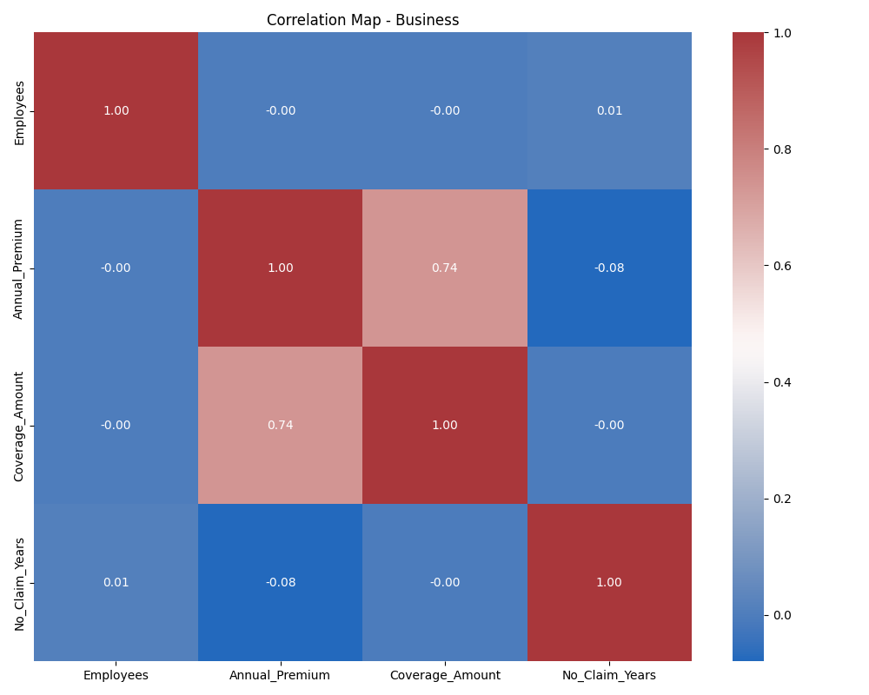
EDA Visualization: Business Dataset (Part 2)
Business box Sub Type
Business correlation matrix

Slide 6
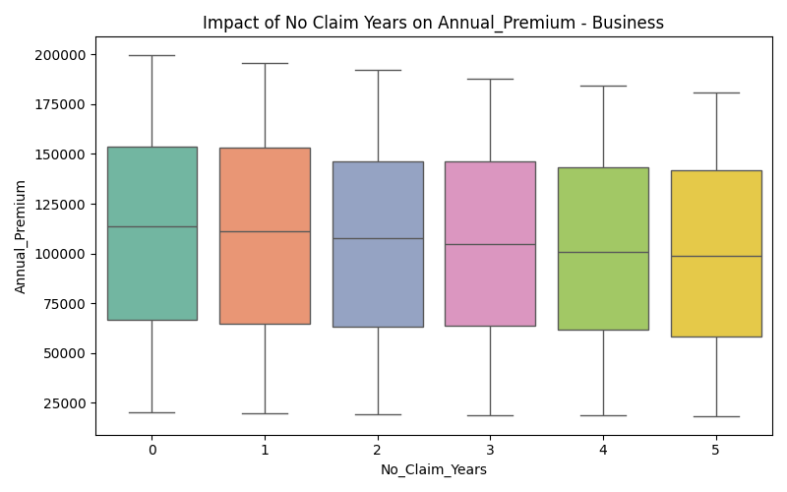
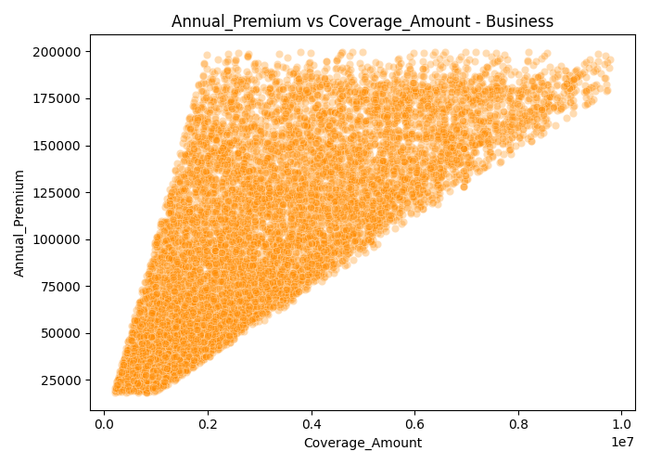
EDA Visualization: Business Dataset (Part 3)
Business ncb impact
Business scatter vs Coverage Amount

Slide 7
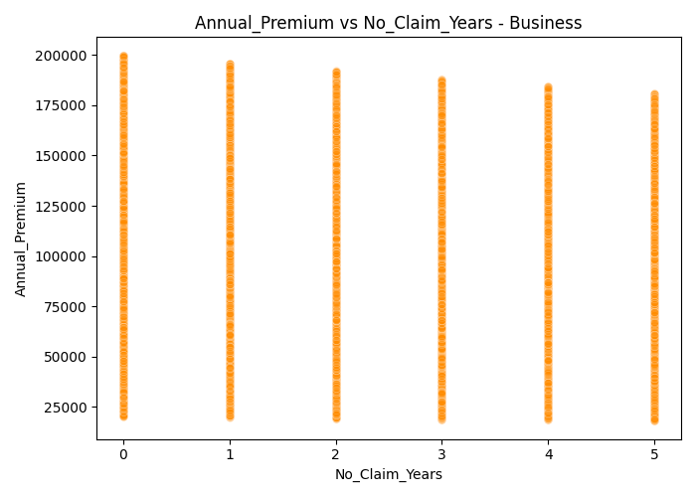
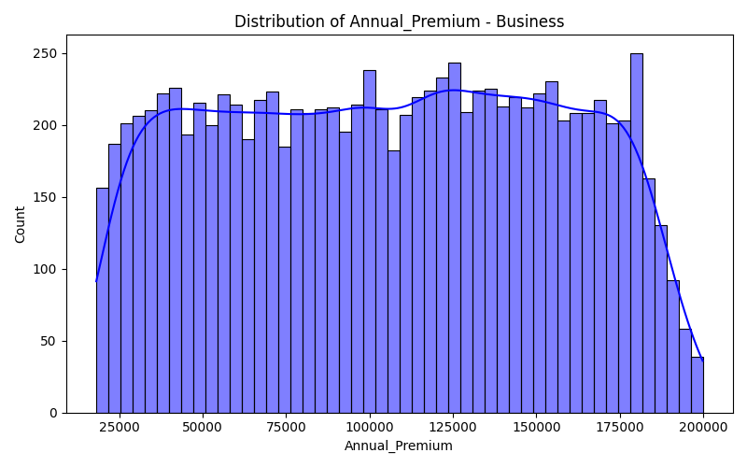
EDA Visualization: Business Dataset (Part 4)
Business scatter vs No Claim Years
Business target distribution

Slide 8
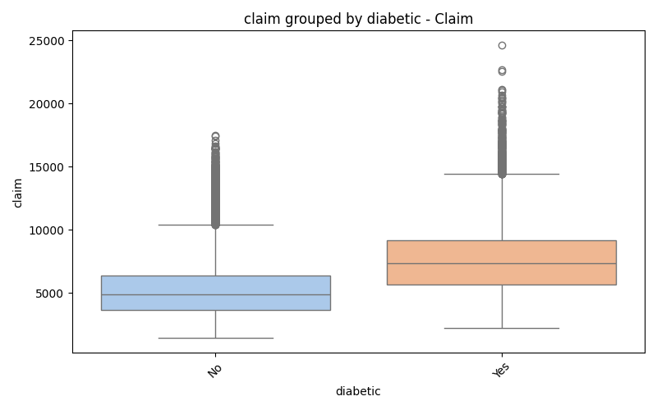
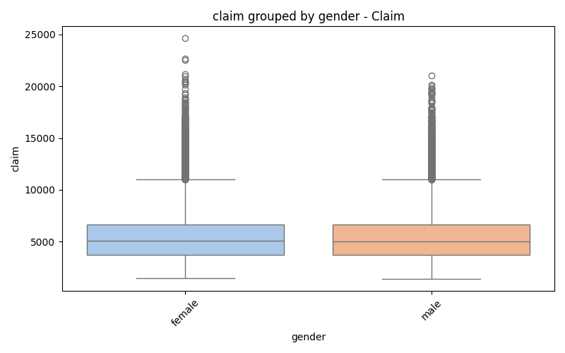
EDA Visualization: Claim Dataset (Part 1)
Claim box diabetic
Claim box gender

Slide 9
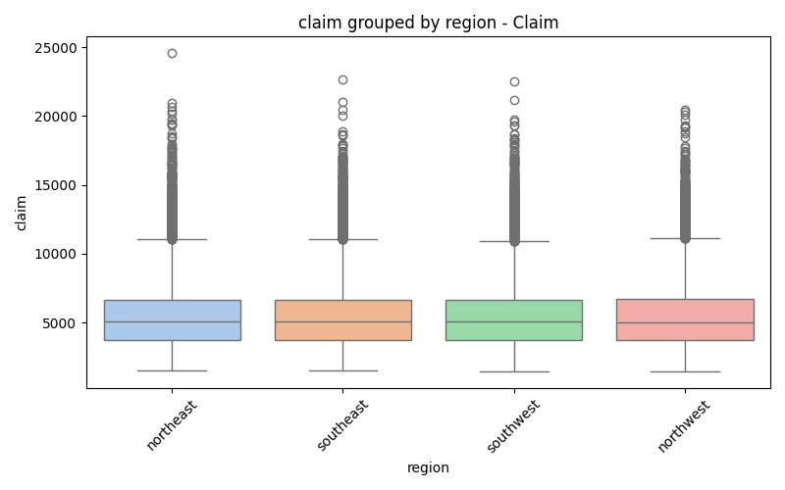
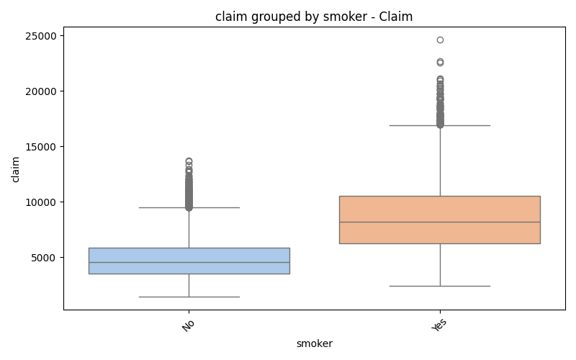
EDA Visualization: Claim Dataset (Part 2)
Claim box region
Claim box smoker

Slide 10
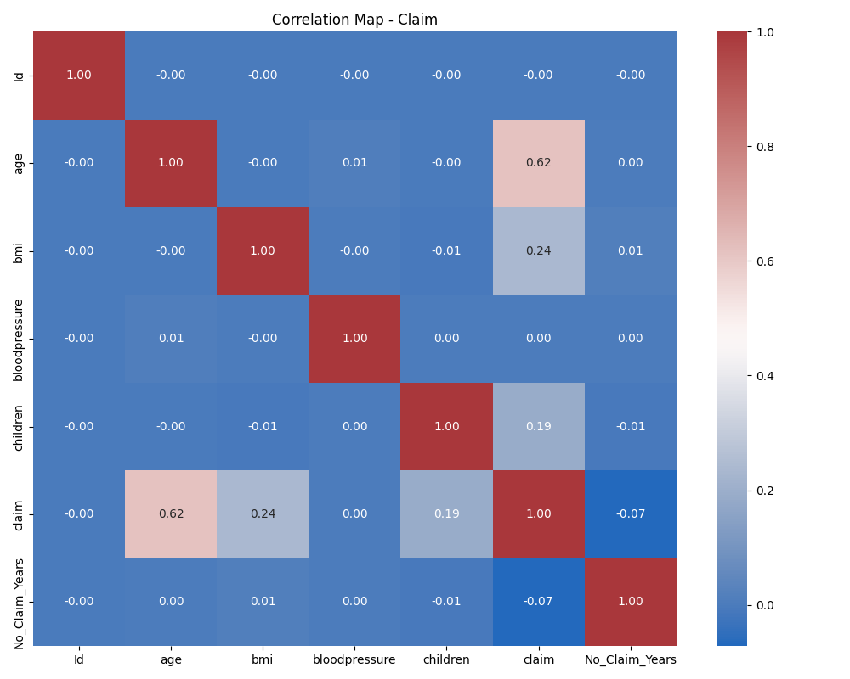
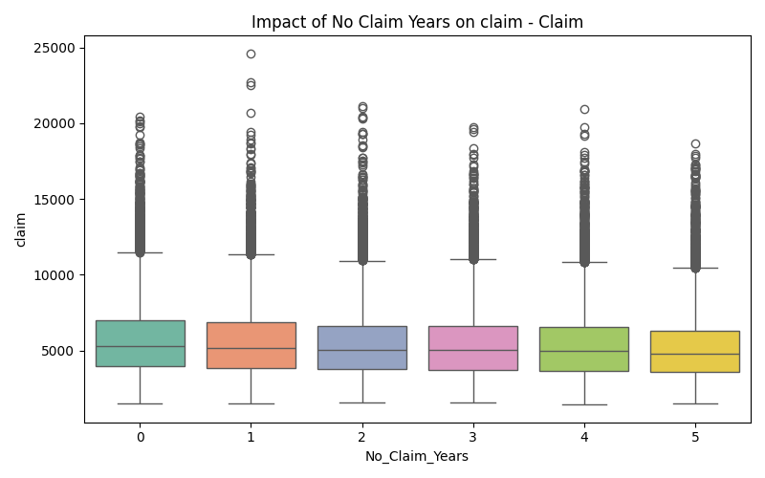
EDA Visualization: Claim Dataset (Part 3)
Claim correlation matrix
Claim ncb impact

Slide 11
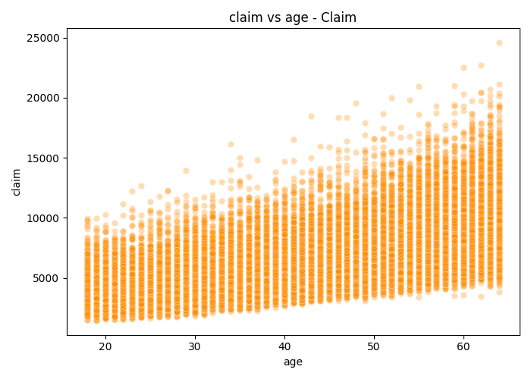
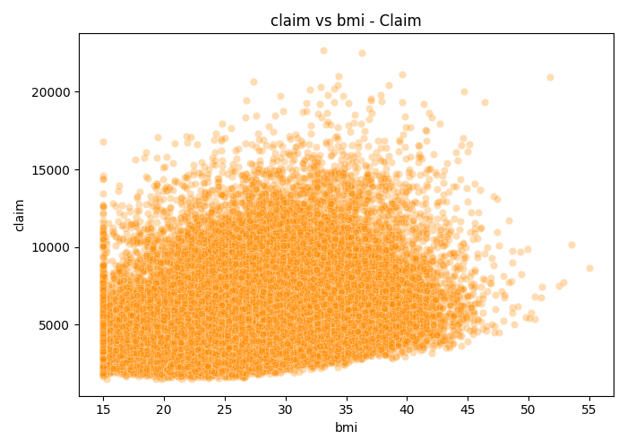
EDA Visualization: Claim Dataset (Part 4)
Claim scatter vs age
Claim scatter vs bmi

Slide 12
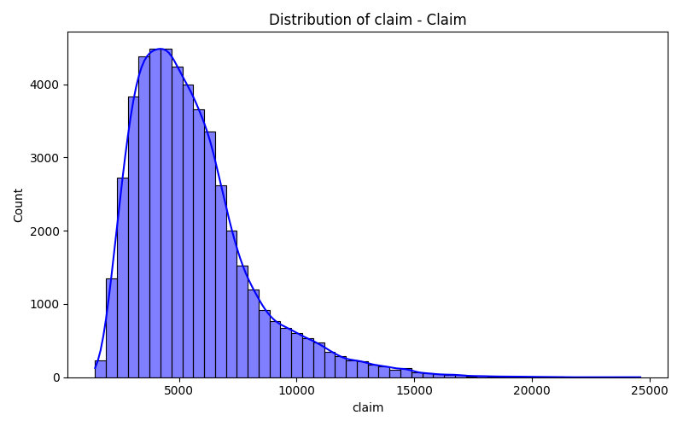
EDA Visualization: Claim Dataset (Part 5)
Claim target distribution

Slide 13
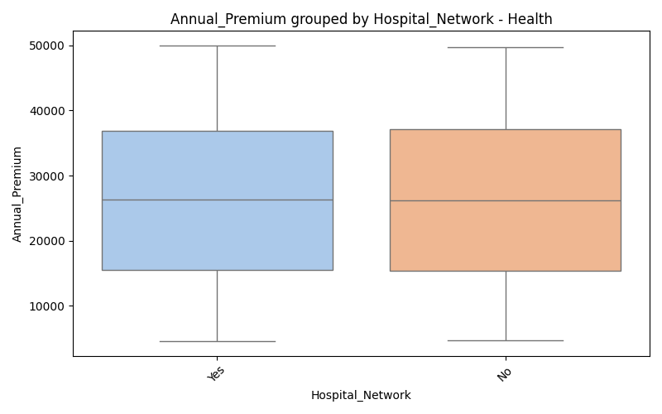

EDA Visualization: Health Dataset (Part 1)
Health box Hospital Network
Health box Pre Existing Disease

Slide 14
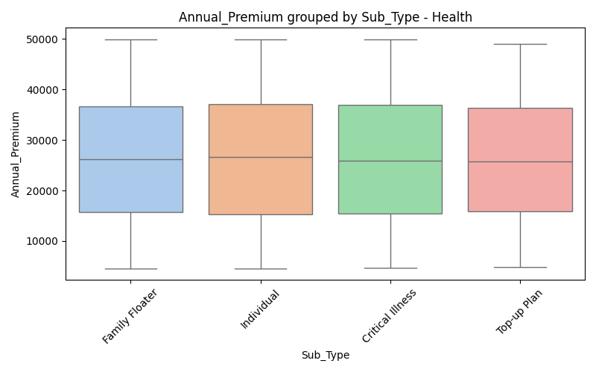
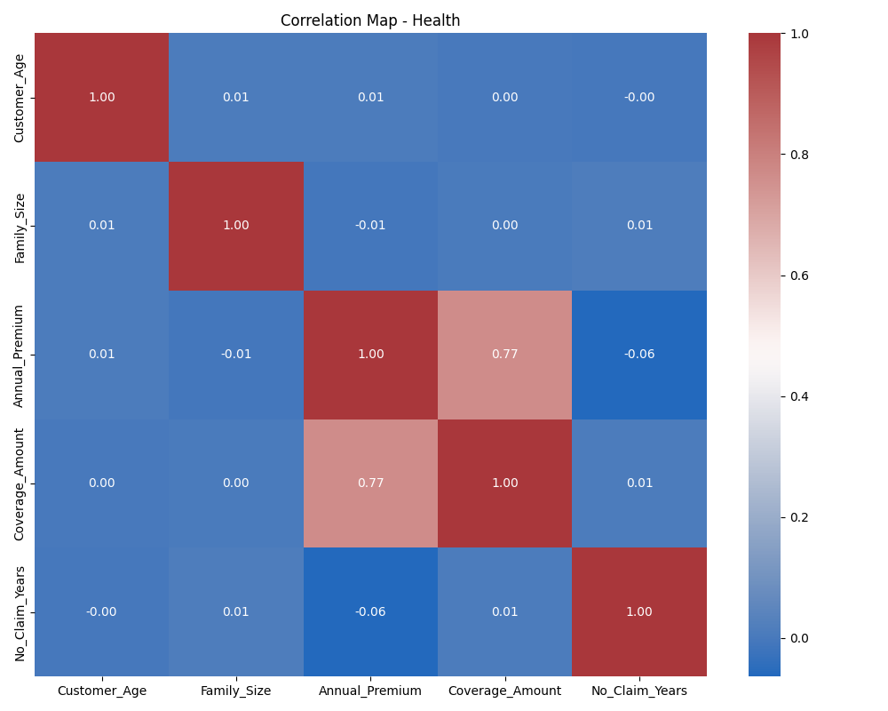
EDA Visualization: Health Dataset (Part 2)
Health box Sub Type
Health correlation matrix

Slide 15
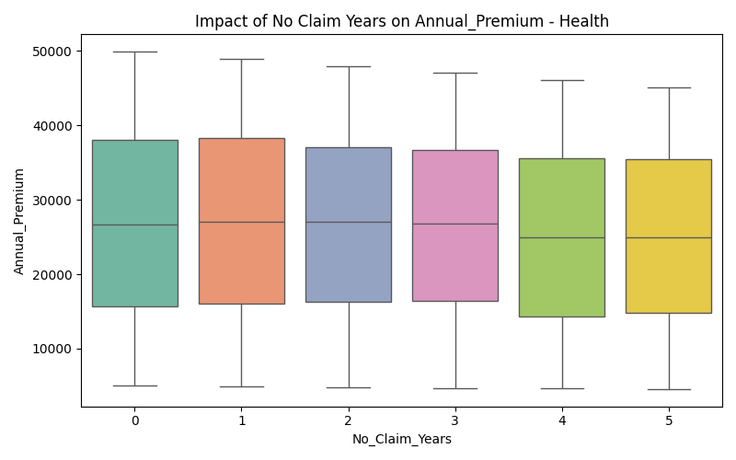
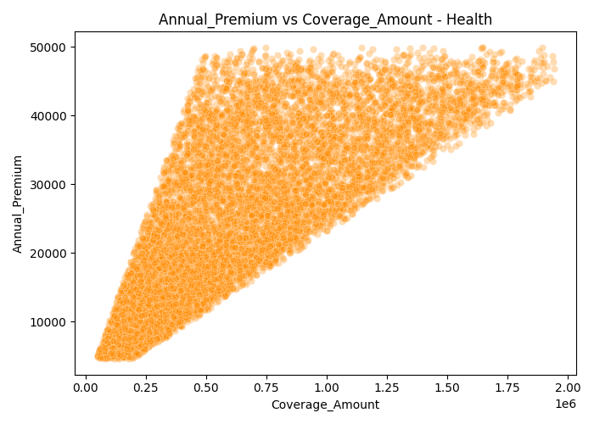
EDA Visualization: Health Dataset (Part 3)
Health ncb impact
Health scatter vs Coverage Amount

Slide 16
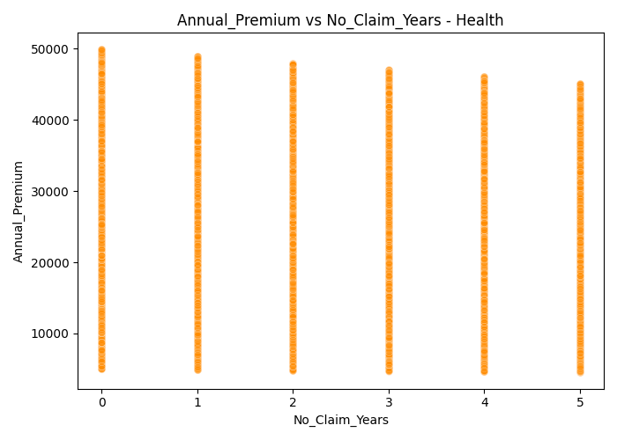
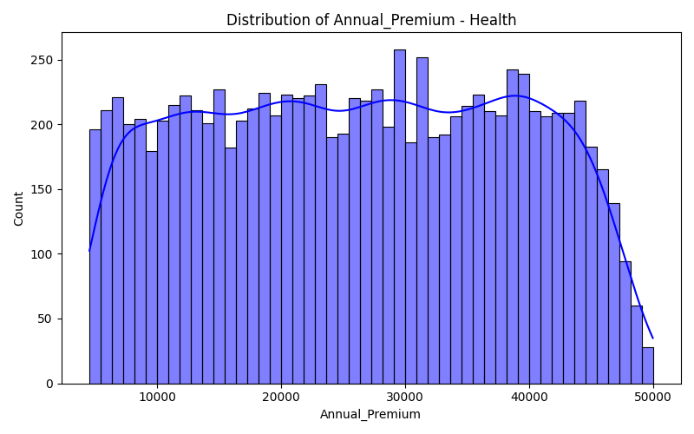
EDA Visualization: Health Dataset (Part 4)
Health scatter vs No Claim Years
Health target distribution

Slide 17
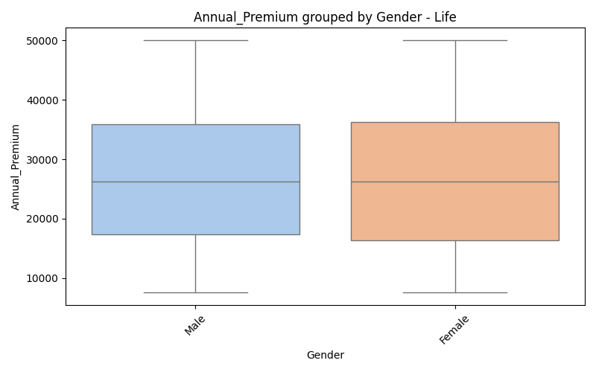
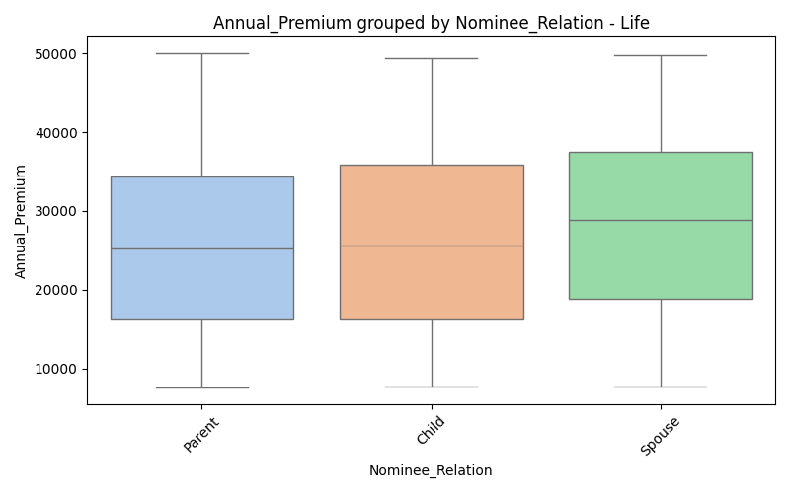
EDA Visualization: Life Dataset (Part 1)
Life box Gender
Life box Nominee Relation

Slide 18
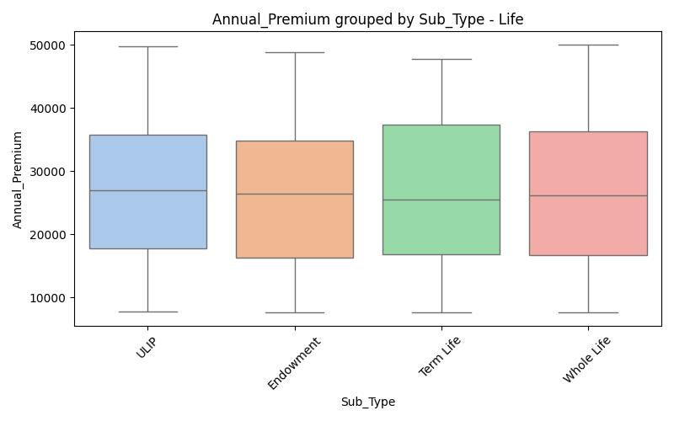
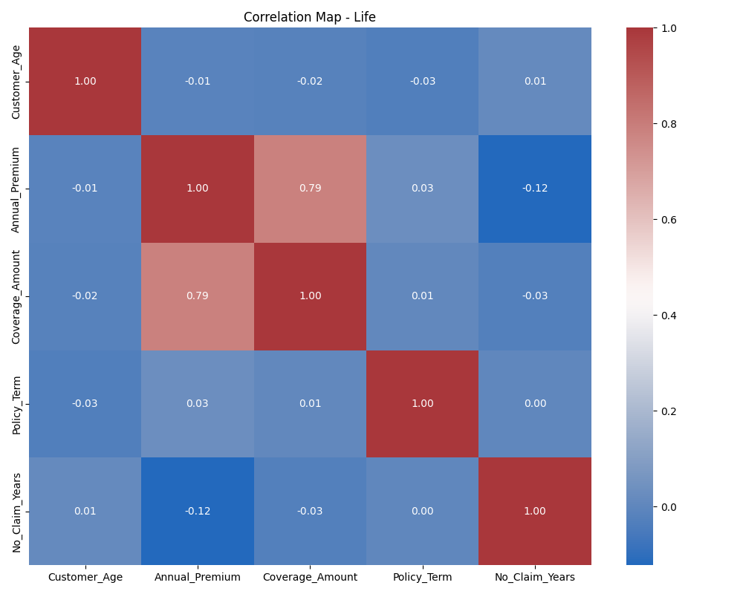
EDA Visualization: Life Dataset (Part 2)
Life box Sub Type
Life correlation matrix

Slide 19
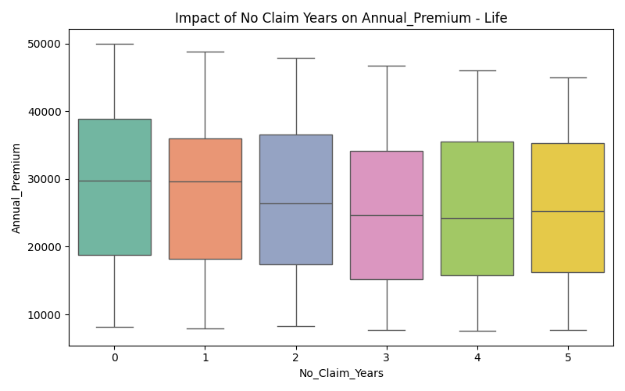
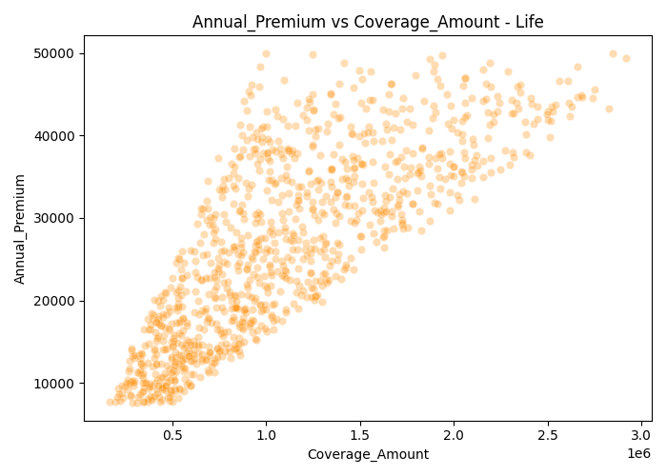
EDA Visualization: Life Dataset (Part 3)
Life ncb impact
Life scatter vs Coverage Amount

Slide 20
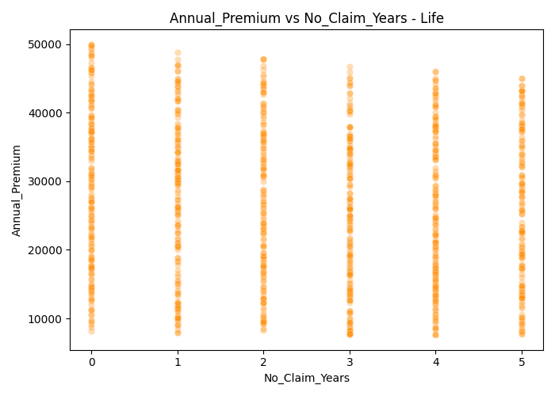
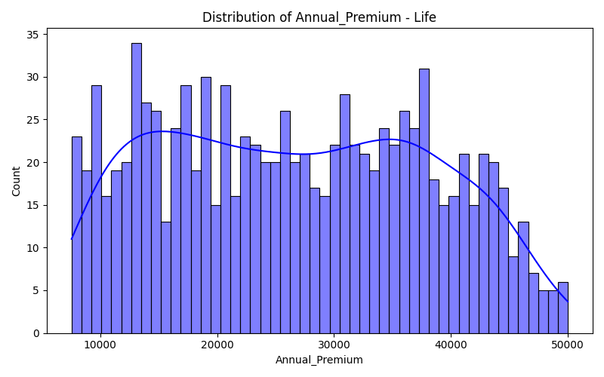
EDA Visualization: Life Dataset (Part 4)
Life scatter vs No Claim Years
Life target distribution

Slide 21
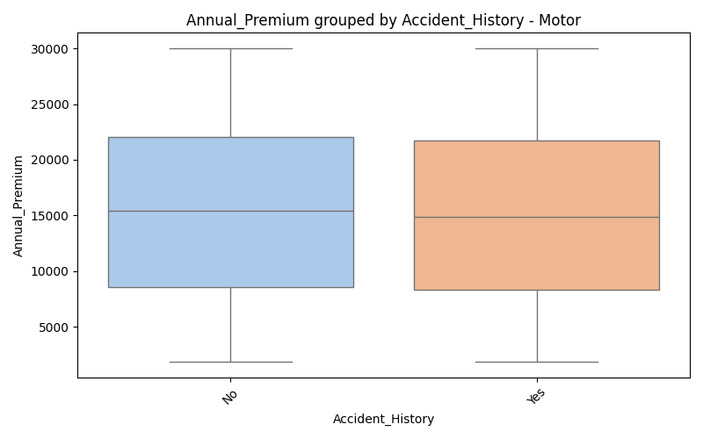
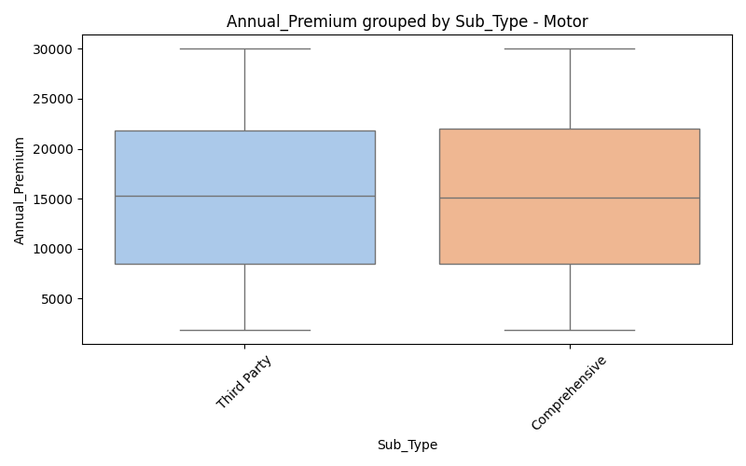
EDA Visualization: Motor Dataset (Part 1)
Motor box Accident History
Motor box Sub Type

Slide 22
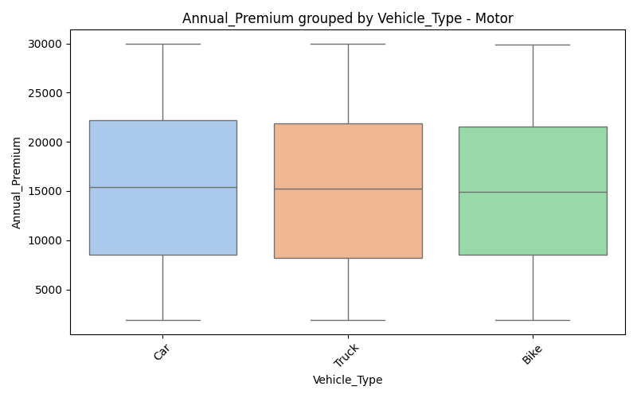
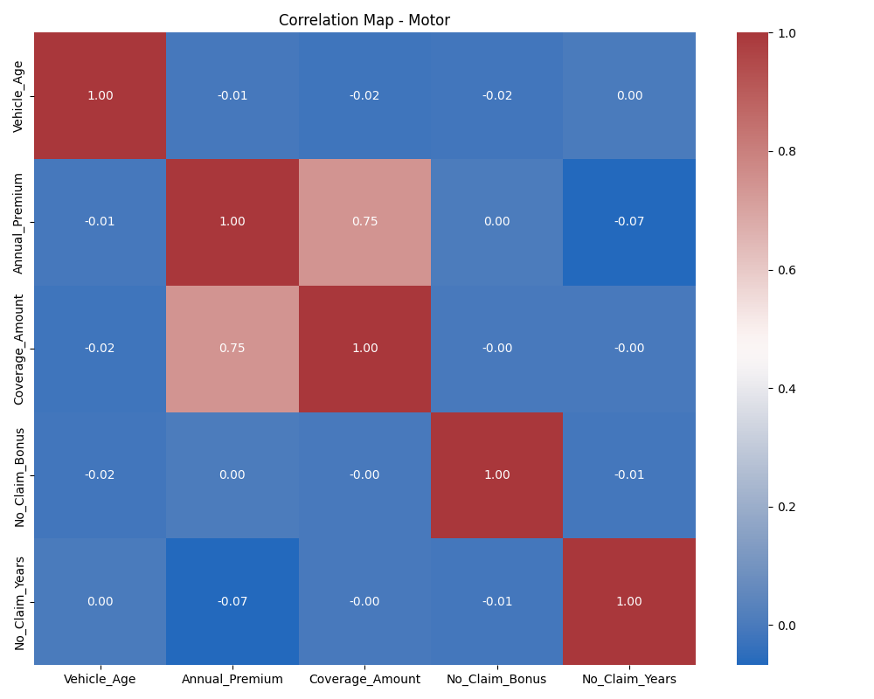
EDA Visualization: Motor Dataset (Part 2)
Motor box Vehicle Type
Motor correlation matrix

Slide 23
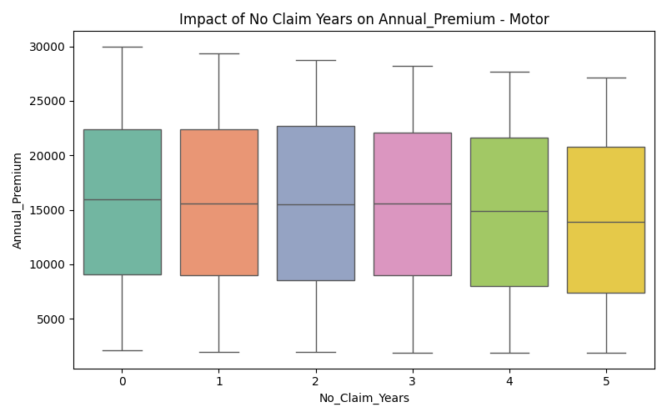
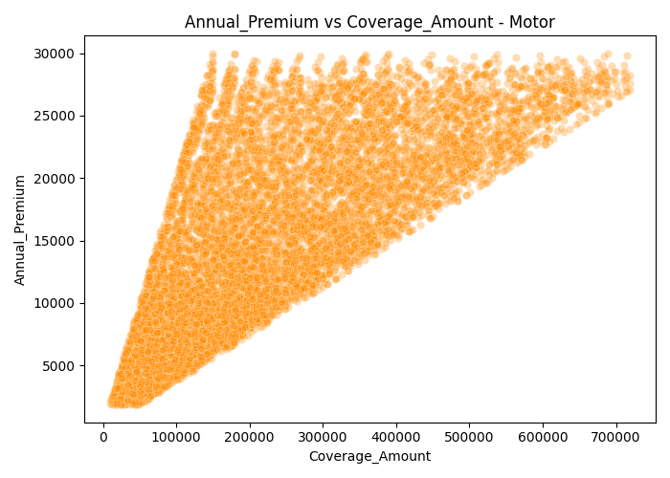
EDA Visualization: Motor Dataset (Part 3)
Motor ncb impact
Motor scatter vs Coverage Amount

Slide 24
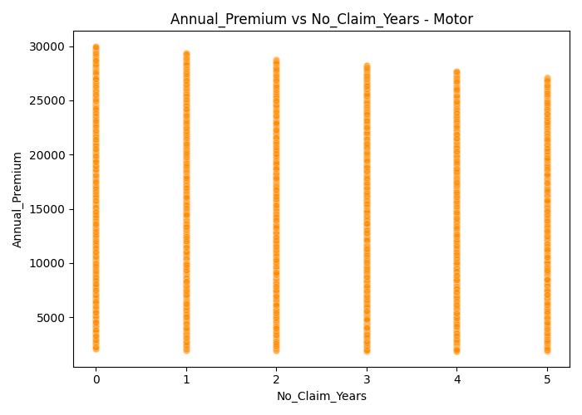
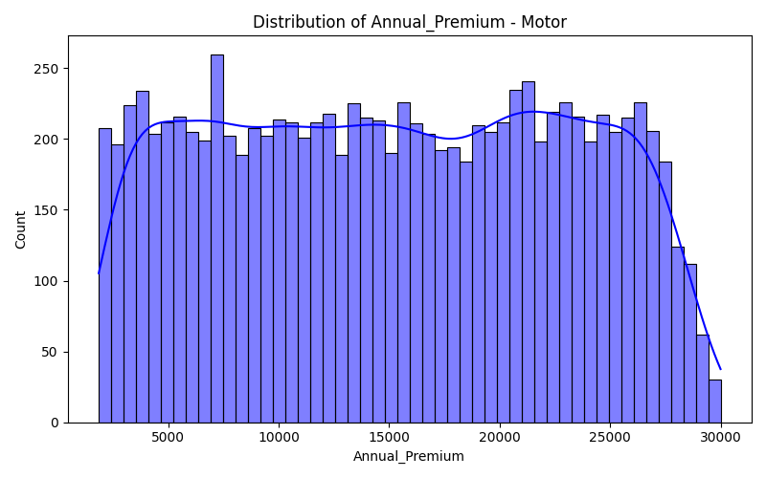
EDA Visualization: Motor Dataset (Part 4)
Motor scatter vs No Claim Years
Motor target distribution

Slide 25
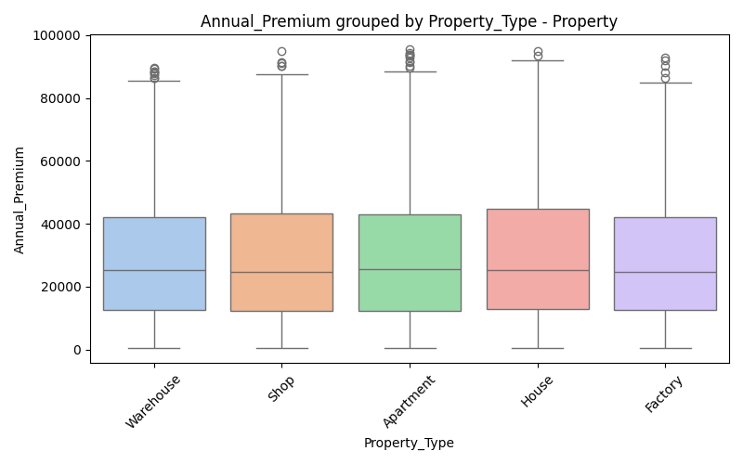
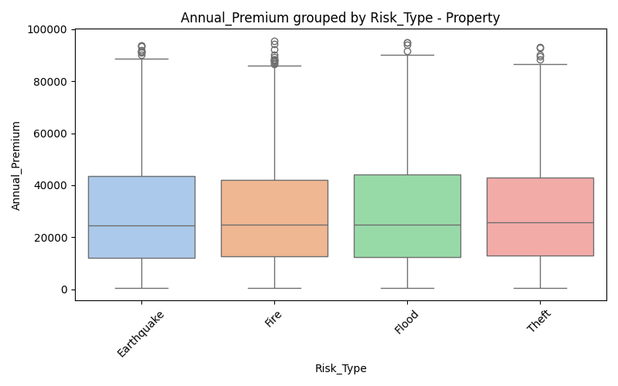
EDA Visualization: Property Dataset (Part 1)
Property box Property Type
Property box Risk Type

Slide 26
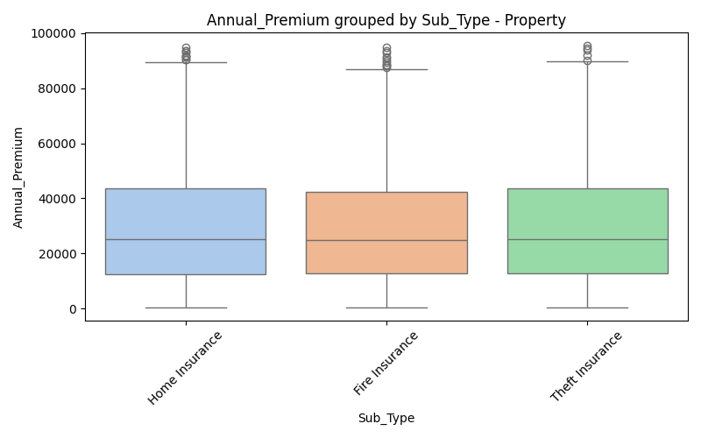
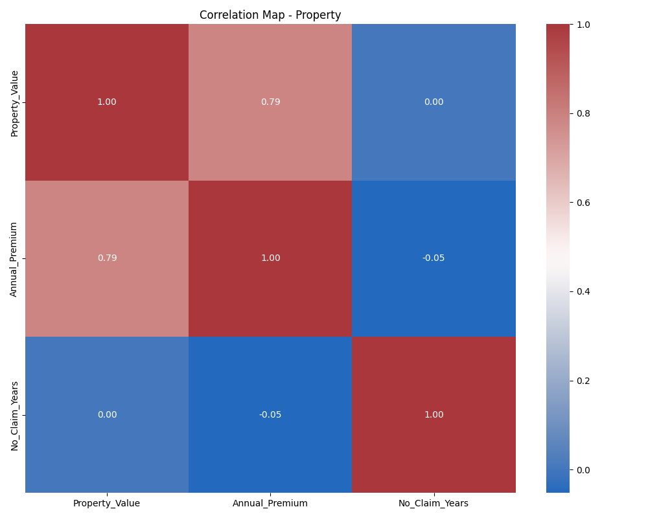
EDA Visualization: Property Dataset (Part 2)
Property box Sub Type
Property correlation matrix

Slide 27
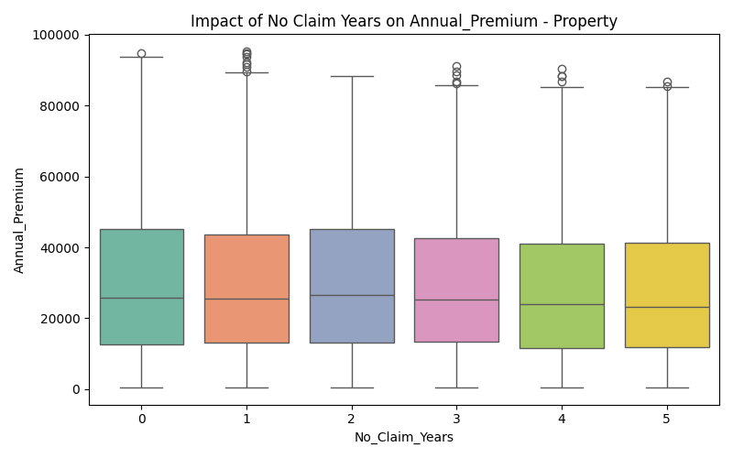
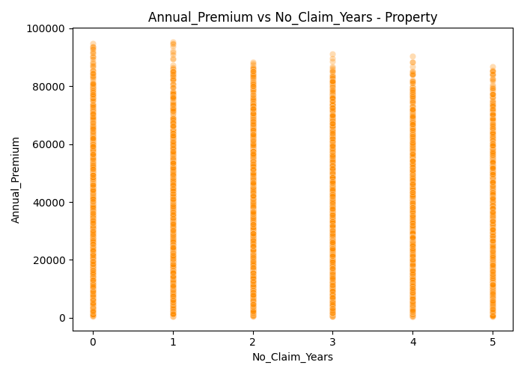
EDA Visualization: Property Dataset (Part 3)
Property ncb impact
Property scatter vs No Claim Years

Slide 28
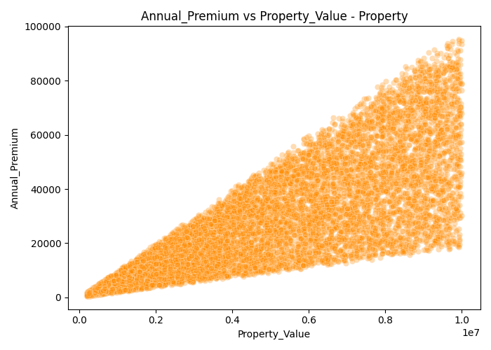
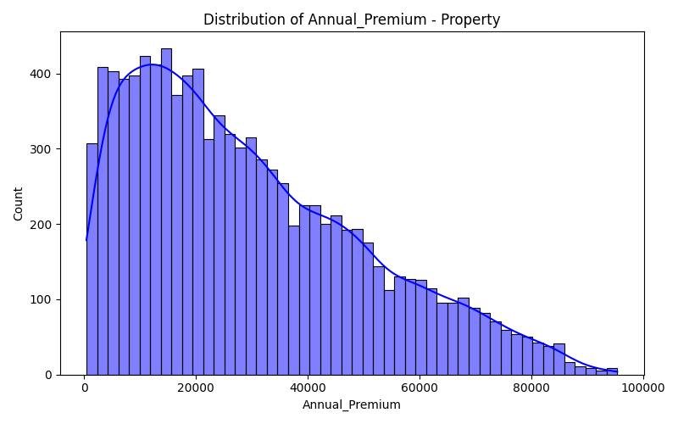
EDA Visualization: Property Dataset (Part 4)
Property scatter vs Property Value
Property target distribution

Slide 29
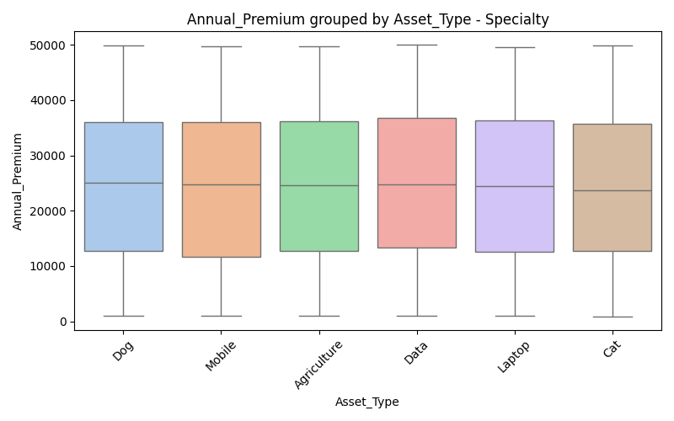
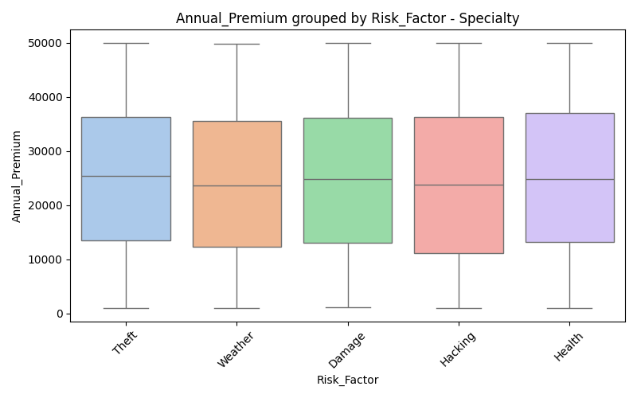
EDA Visualization: Specialty Dataset (Part 1)
Specialty box Asset Type
Specialty box Risk Factor

Slide 30


EDA Visualization: Specialty Dataset (Part 2)
Specialty box Sub Type
Specialty correlation matrix

Slide 31


EDA Visualization: Specialty Dataset (Part 3)
Specialty ncb impact
Specialty scatter vs Coverage Amount

Slide 32


EDA Visualization: Specialty Dataset (Part 4)
Specialty scatter vs No Claim Years
Specialty target distribution

Slide 33


EDA Visualization: Travel Dataset (Part 1)
Travel box Destination
Travel box Medical Cover

Slide 34


EDA Visualization: Travel Dataset (Part 2)
Travel box Trip Type
Travel correlation matrix

Slide 35


EDA Visualization: Travel Dataset (Part 3)
Travel ncb impact
Travel scatter vs Coverage Amount

Slide 36


EDA Visualization: Travel Dataset (Part 4)
Travel scatter vs No Claim Years
Travel target distribution

Slide 37
Data Pre-Processing
Transformation Strategies
Missing Values: Median strategy for numericals (SimpleImputer) and Constant strategy ('Unknown') for categoricals.
Outliers: Variables mathematically capped via np.clip to prevent variance skew.
Scaling: Normalization via StandardScaler targeting optimal geometric space for distance algorithms (e.g. KNN/SVR).
Encoding: LabelEncoder (binary) & OneHotEncoder for multi-class categorical configurations.
Feature Engineering: Synthesized variables via PolynomialFeatures (e.g. Compound actuarial risk of Age + Smoking).

Slide 38
Methodology Built vs Expected
Machine Learning Evaluation Baseline:
Linear Algorithms: Linear Regression, SVR, KNN.
Tree Ensembles: Random Forest, Decision Tree.
Boosting Mechanisms: Gradient Boosting, XGBoost.
Final Output Profiles:
Accuracy Benchmark: Maximum accepted Mean Absolute Error capped safely under ~$550 tolerance.
Best Method Found: Gradient Boosting mapped non-linear incentives successfully (R²: 0.9362 with MAE: $473).
Risk Profiler: Binary mapping users via Random Forest as High/Low risk yielded a highly resilient 99.71% test accuracy.

Slide 39
Prediction Outcomes by Dataset
Model Performace (R² Score) Extrapolated Across Domains:
Core Claim Dataset: Gradient Boosting successfully achieved 0.9362 R² ($473 MAE).
Travel Insurance: Top model yielded 0.7209 R².
Life Insurance: Top model yielded 0.6828 R².
Health Insurance: Top model yielded 0.6576 R².
Motor Insurance: Top model yielded 0.6301 R².
Property Insurance: Only dataset where Linear Regression prevailed (0.6253 R²).
Business Insurance: Top model yielded 0.5967 R².
Specialty Insurance: Top model yielded 0.5927 R².
Conclusion: Non-linear boosting models drastically outperform standardized distance formulas for insurance computation.

