Slide 1
CAPSTONE PROJECT(EDA)
Hotel Booking Analysis
By
Vishant Kumar

Slide 2
Problem Statement
We are give a hotel booking dataset and this dataset contains booking information for a city hotel and a resort hotel, and includes information such as when the booking was made, length of stay, the number of adults, children, and/or babies, and the number of available parking spaces, among other things.
Our main aim here is to analyse the Hotel booking dataset that contains information about thousands of guests across the globe and gain some insight.

Slide 3
Understanding the data
To increase the efficiency of our analysis we will first have to understand our data and also check if there are any corruptions and if any found try to treat it.
Our dataset has 119390 rows and 32 columns.
Each observation includes information about an individual booking from the guests.
Let’s see some of the features.

Slide 4
Features in the Dataset
The dataset has a lot of features some of them are described below:
hotel: The category of hotels, which are two resort hotel and city hotel.
is_cancelled: The value of column show the cancellation type. If the booking was cancelled or not. Values[0,1], where 0 indicates not cancelled.
lead_time: The time between reservation and actual arrival.
stayed_in_weekend_nights: The number of weekend nights stay per reservation
stayed_in_weekday_nights: The number of weekday nights stay per reservation.
meal: Meal preferences per reservation.[BB,FB,HB,SC,Undefined]
Country: The origin country of guest

Slide 5
Features in the Dataset(Cont.)
market_segment: This column show how reservation was made and what is the purpose of reservation. Eg, corporate means corporate trip, TA for travel agency.
distribution_channel: The medium through booking was made.[Direct,Corporate,TA/TO,undefined,GDS.]
Is_repeated_guest: Shows if the guest is who has arrived earlier or not.Boolean values[0,1]-->0 indicates no and 1 indicated yes person is repeated guest.
days_in_waiting_list: Number of days between actual booking and transact.
customer_type: Type of customers( Transient, group, etc.)

Slide 6
Steps involved
Dealing with null values- There are two main ways of dealing with the null values, one is to delete the null values and the other is to impute with some meaningful values. In this case I have just deleted the observations with the null values since they are not many and deleting them would not affect our analysis much.
Dealing with duplicated values- Duplicated values can be detrimental to our analysis therefore I have deleted the duplicated values.
Feature selection- I have deleted columns that I believe won’t add any value to our analysis.

Slide 7
Steps involved(contd)
Outliers removal: Removed outliers from the few of the columns and created a few columns for better analysis.(average_daily_rate,total_members).
Figuring out the correlation: I have tried to figure out the correlation between variables by plotting correlation between variables by plotting correlation matrix using a heat map we have got few insights as mentioned.
Analysis and observations : Here I will present some of the basic as well as advanced observations that are retrieved from the dataset from visualization of the data.

Slide 8
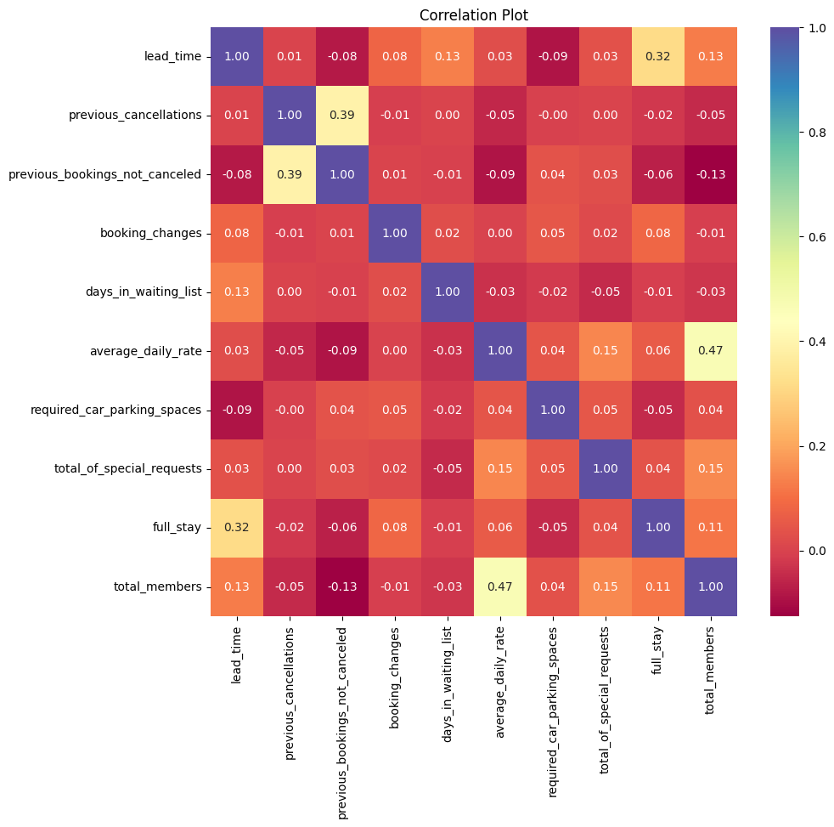
The visualization of correlation matrix
We can see that there is correlation between total_members and average_daily_rate which means higher the number of people higher the revenue and hence the average_daily_rate.
We can see that there is correlation between full_stay and lead_time, which means people who are planning to stay in hotels for a longer time actually like to make the hotel booking beforehand.

Slide 9
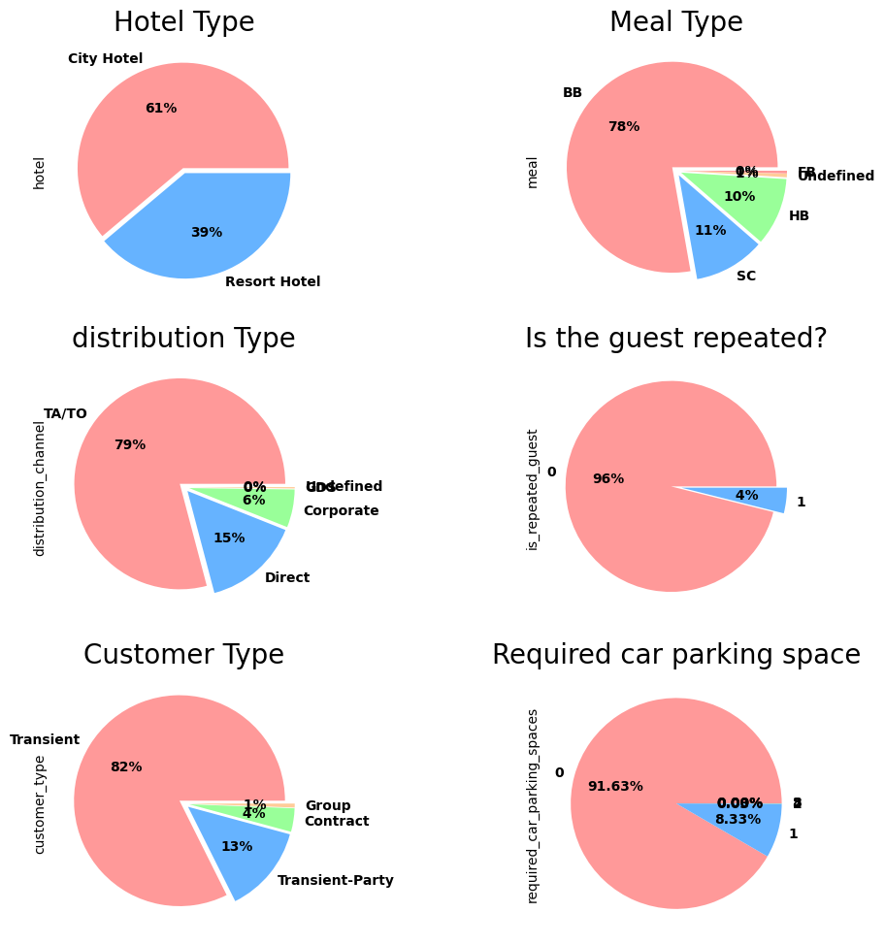
Analysis and observations
We can see that 61% of guests prefer the City Hotel and 39% guests prefer the Resort.
We can see that most of the guests (78%) prefer breakfast in bed as meal type.
We can see that most of the guests used TA/TO (79%) for booking the hotel.
We can see that only 4% of the guests are repeat customers.
We can see that most of the customers (82%) are transient type customers.
We can see that only 8% of the customers require car parking

Slide 10
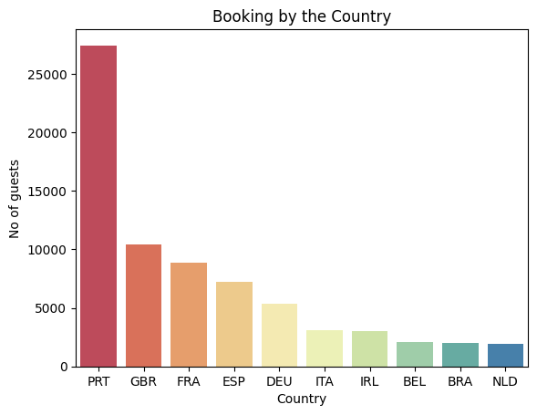
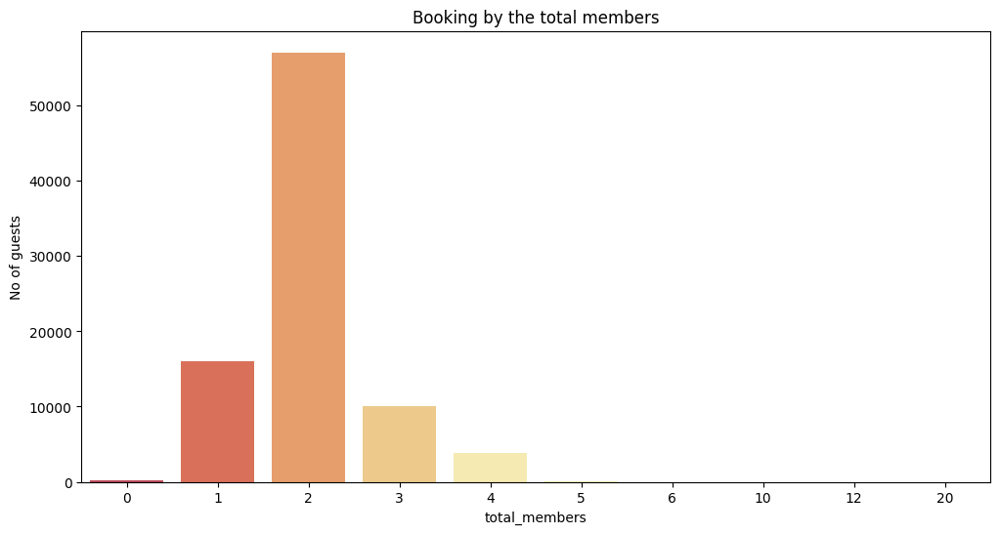
Analysis and observations
We can see that most of the guests are coming from Portugal followed by UK and France. Hence, hotel facilities should be more focused on Europe clients.
We can see most of the guest like to come as a pair of 2.

Slide 11
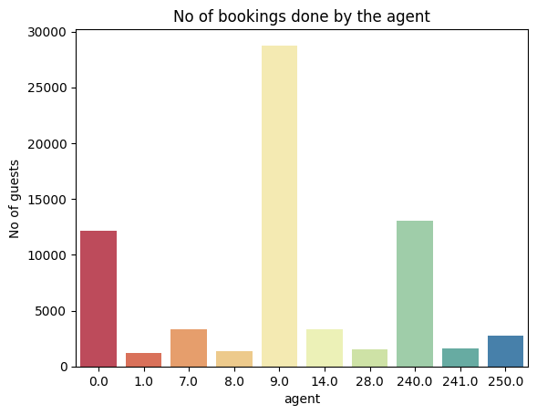
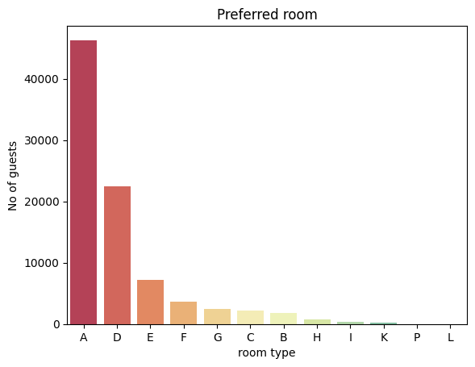
Analysis and observations
We can see that agent 9.0 has done most of the bookings.
We can see that most preferred room in type A

Slide 12
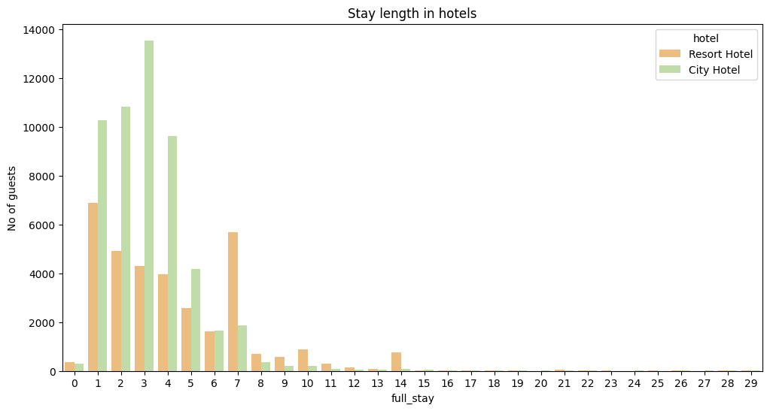
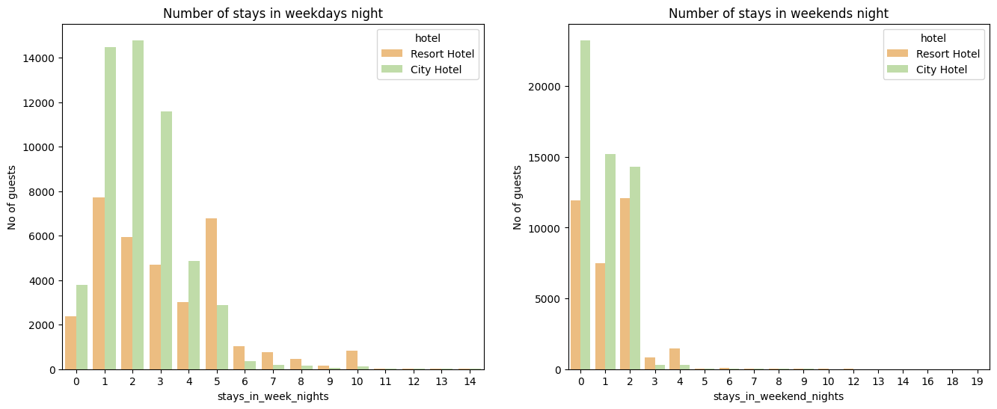
Stay length analysis
We can see that most common stays are 3 days for city hotel and 1 day for resorts, also people prefer resort over city hotel for longer stay.
We can see that most people prefer city hotels over resorts irrespective of weekend and week nights.

Slide 13
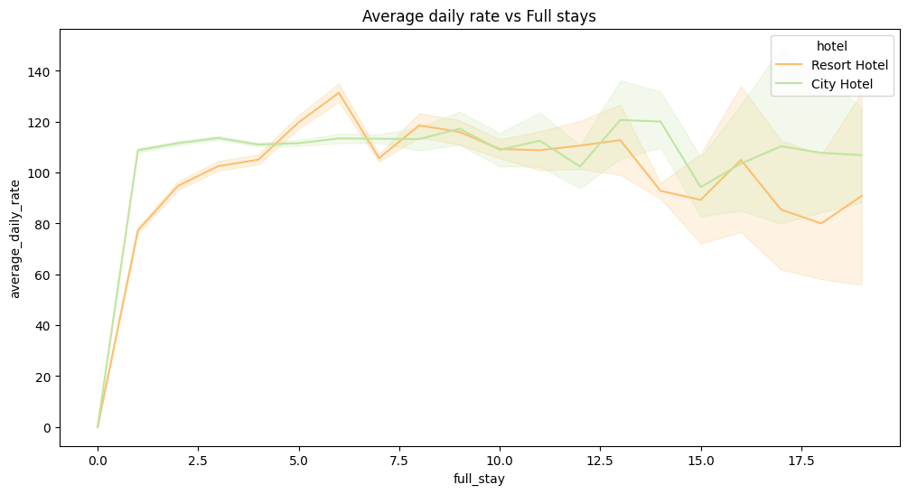
Stay length analysis(contd.)
We can see that after 2 days average_daily_rate for both city hotel and resort is in the range of 100 to 130. To get minimum average_daily_rate for in both city and resort hotels we should plan our stay for atleast 6-7 days,also average_daily_rate decreases after 14 days.

Slide 14
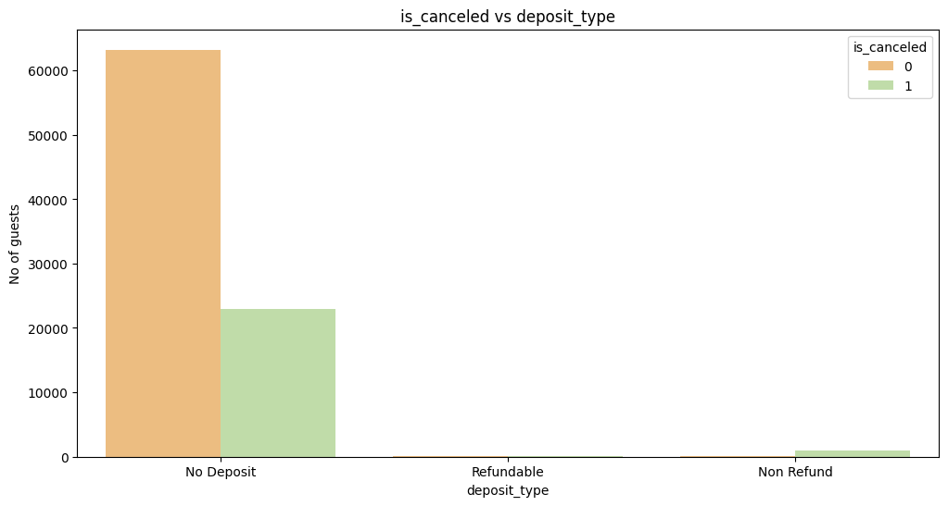
Cancellation Analysis
We can see that most bookings are 'No deposit' and most cancellation are 'No deposit' as well.

Slide 15
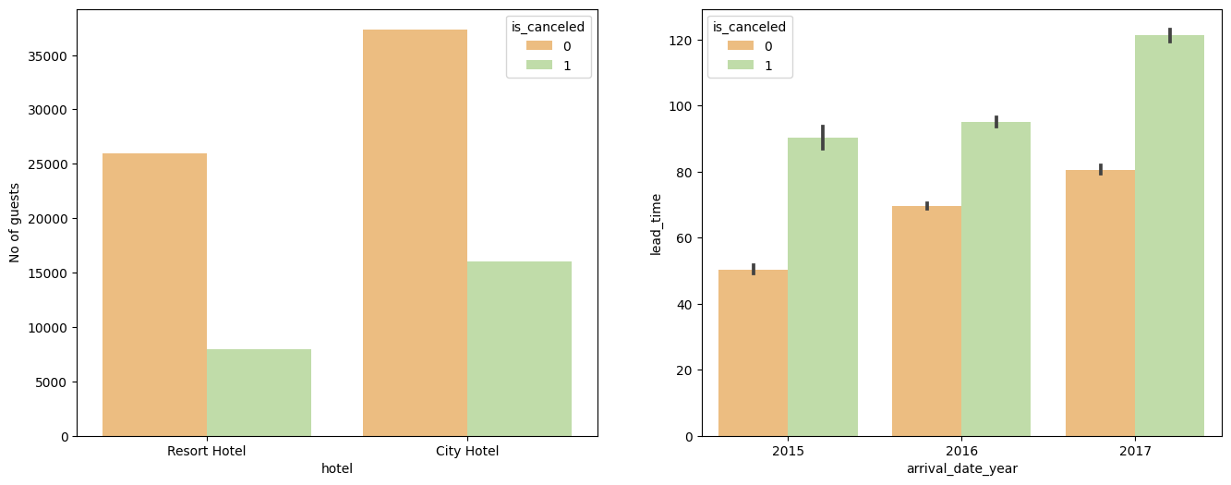
Cancellation Analysis(contd.)
We can see that cancellation is higher in the city hotels than in the resorts.
Also with more leadtime there is higher possibility of cancellation.

Slide 16
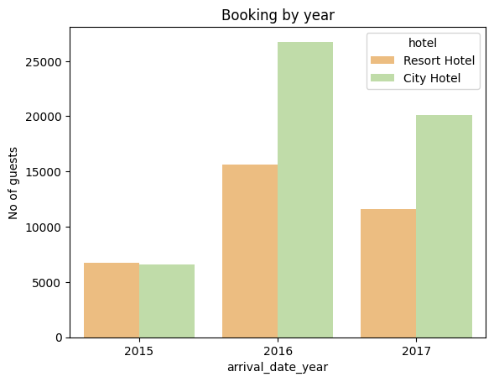
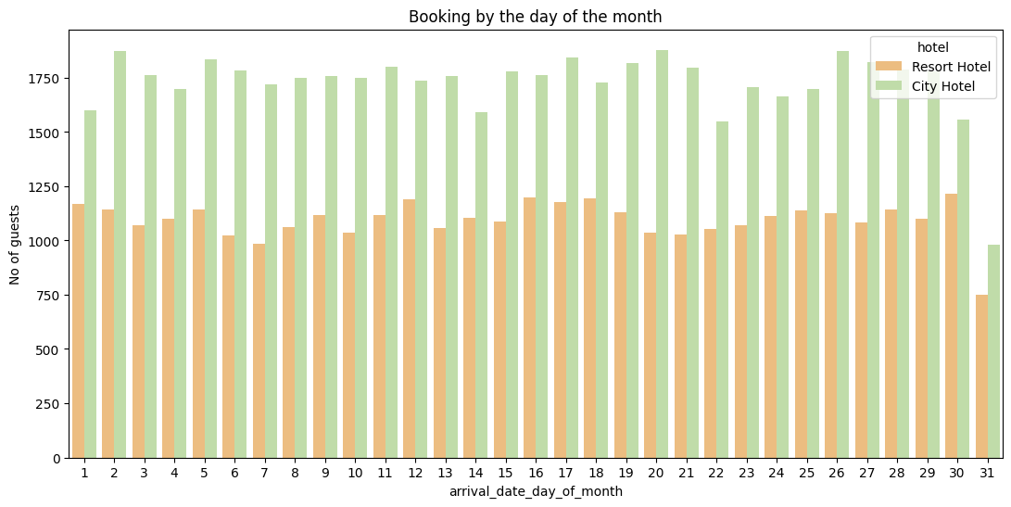
Hotel wise booking data on date, month and year
We can see that most of the guests arrived in 2016 and least number of guests arrived in 2015 for both resort and city hotels.
We can see that no of guests decreases by the end of the month

Slide 17
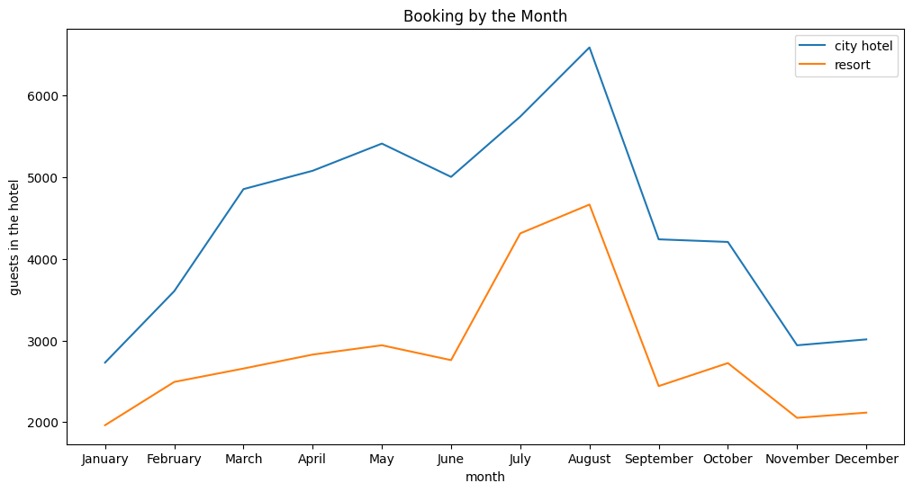
Hotel wise booking data on date, month and year(contd.)
We can see that May, June, July and August are the busiest of months for both resorts and city hotels.

Slide 18
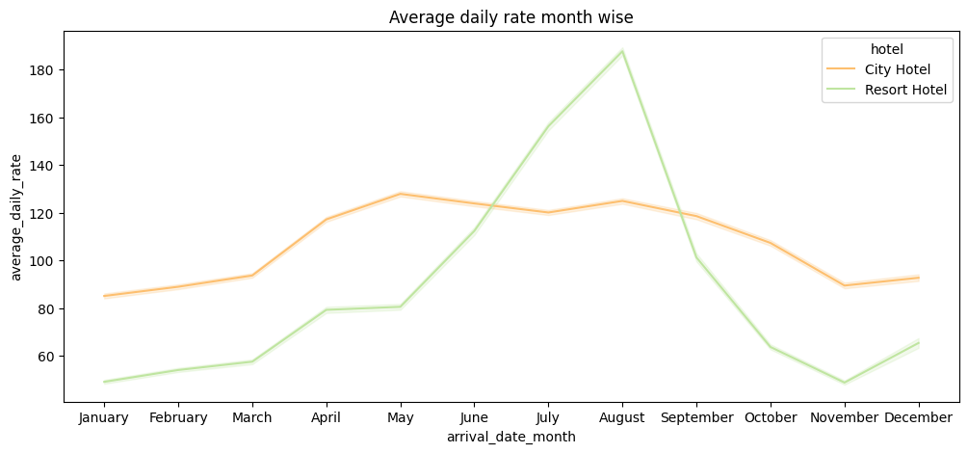
Hotel wise booking data on date, month and year(contd.)
We can see that for resorts the average rate is more expensive during August, July and September while for city hotels average rate is more expensive during august, July, June and may.

Slide 19
Conclusions
Around 60% bookings are for City hotel and 40% bookings are for Resort hotel, therefore city Hotel is busier than Resorts.
Most of the bookings are from May to Aug, incentives for attracting guests in this period can gain significant profits.
There are very less repeat customers therefore hotels should focus more on providing better service or incentives so that this number can be improved.
Most bookings are done by TA/TO.
Most common stay length is less than 4 days and generally people prefer city hotel for short stay, but for long stays, Resorts are preferred.
Least bookings are done in November, December, January and February therefore it is beneficial for the guests to book the hotel in these months for easy bookings and lower prices.

Slide 20
THANK YOU

