Slide 1
JOB MARKET ANALYSIS
Data-driven insights on data science hiring, pay, and skills
Presented by Vishanth M S

Slide 2
Executive Summary
CA & MA
Python / SQL / Excel
$50.7K
Biotech & Pharma
Lead in both job volume and pay
Near-universal baseline skills
Salary gap: senior vs. junior roles
#1 hiring industry (112 postings)
This report analyzes 742 data-science job postings to identify where the jobs are, what they pay, and what employers expect — guiding job seekers and informing employer hiring strategy.
2

Slide 3
Methodology
1
Extracted 742 rows / 42 features from the project MySQL database
2
Removed an empty stray column and cleaned company-name artifacts
3
Treated -1 placeholders in Rating, Founded, and Age as missing and imputed with the median
4
Fixed a data-entry corruption in company Size ("Jan-50" → "1-50")
5
Normalized job title and seniority text for consistent analysis
3

Slide 4
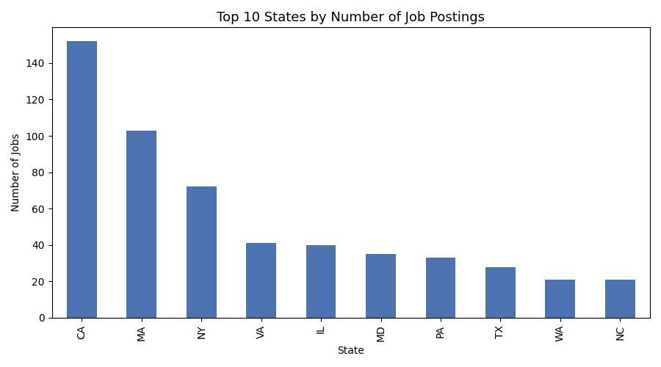
Where the Jobs Are
California leads decisively with 152 postings — 45% ahead of #2 Massachusetts
Top 5 states (CA, MA, NY, VA, IL) account for over 45% of all postings nationally
4

Slide 5
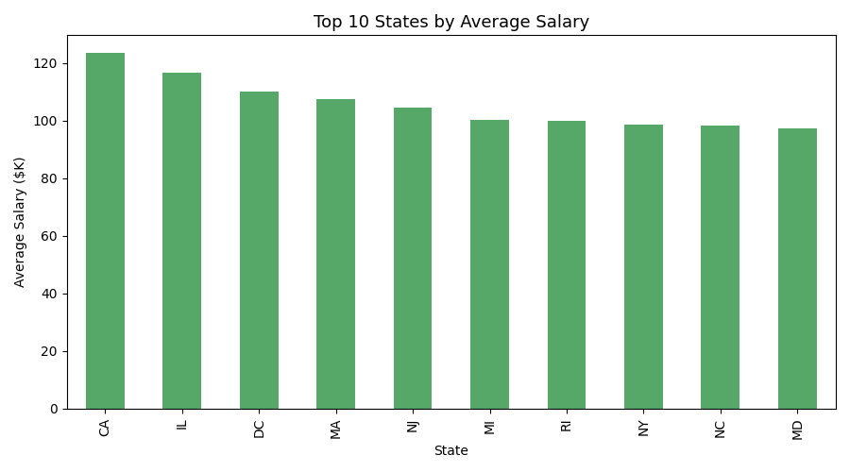
Where the Pay Is Best
California tops both volume AND pay — avg. salary $123.5K
Illinois ($116.7K) and Washington DC ($110.2K) round out the top 3
High job-volume states also tend to pay the most — a rare seeker-friendly overlap
5

Slide 6
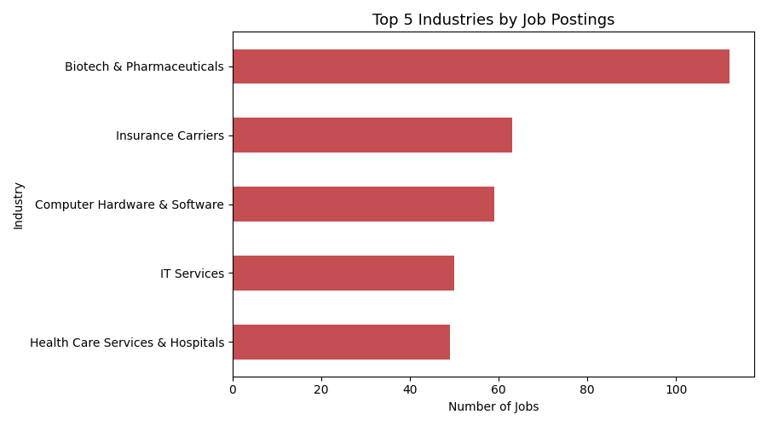
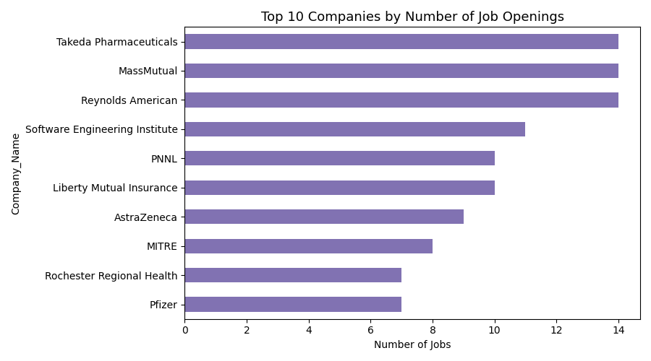
Who's Hiring
Biotech & Pharmaceuticals dominates (112 postings) — nearly double #2 Insurance Carriers. No single employer dominates: Takeda, MassMutual, and Reynolds American tie for the most openings at just 14 each, showing a fragmented, employer-diverse market.
6

Slide 7
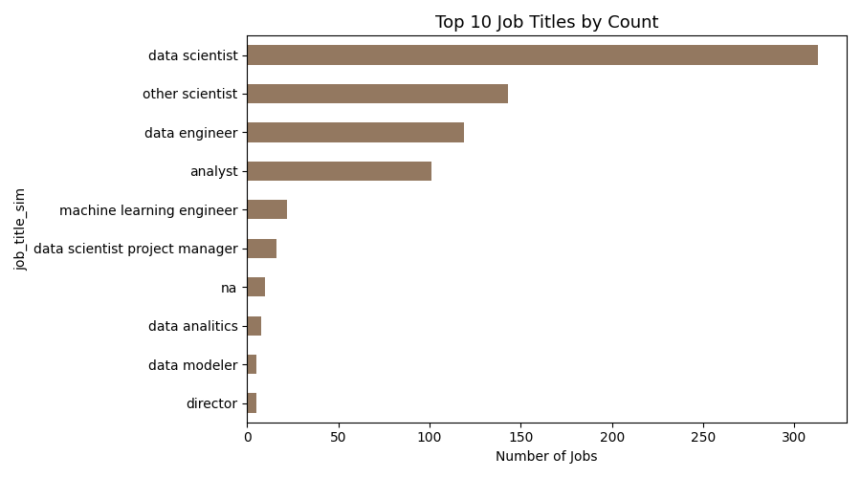
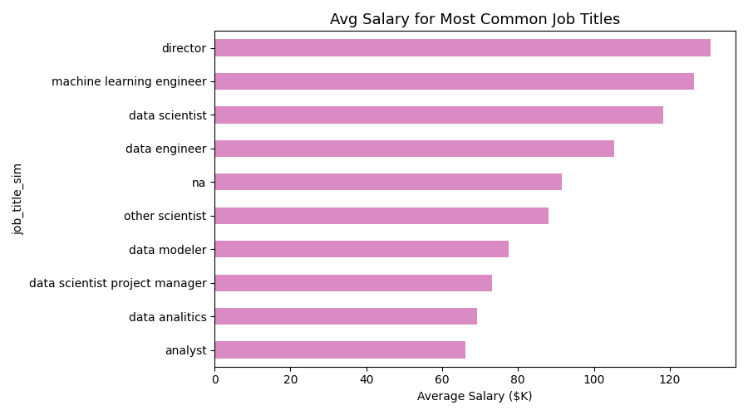
Job Titles & What They Pay
“Data Scientist” is the most common title (313 postings, 42%) and pays well ($118.3K avg). Analysts are common but pay least ($66.1K) — less than half of Director-level pay ($130.8K). Specialization (ML Engineer, $126.4K) outpays generalist roles.
7

Slide 8
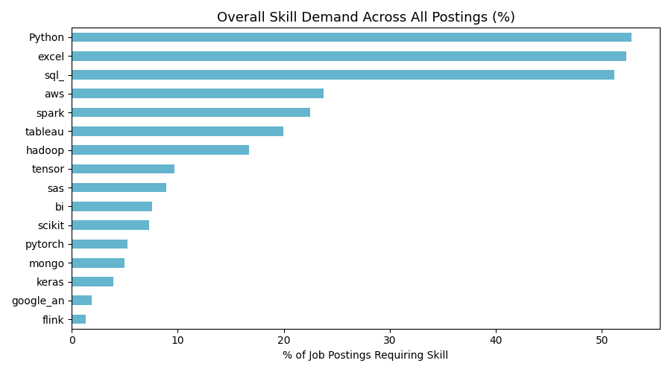
The Baseline Skill Stack
Python (53%), Excel (52%), and SQL (51%) are near-universal requirements
Cloud/big-data tools (AWS 24%, Spark 22%, Tableau 20%) form a clear second tier
Deep-learning frameworks are rare overall but concentrated in ML Engineer & Data Scientist roles
8

Slide 9
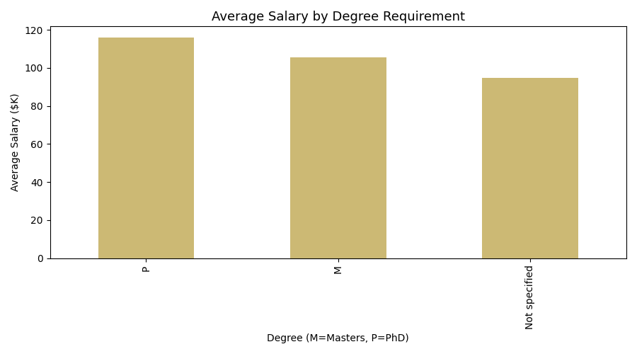
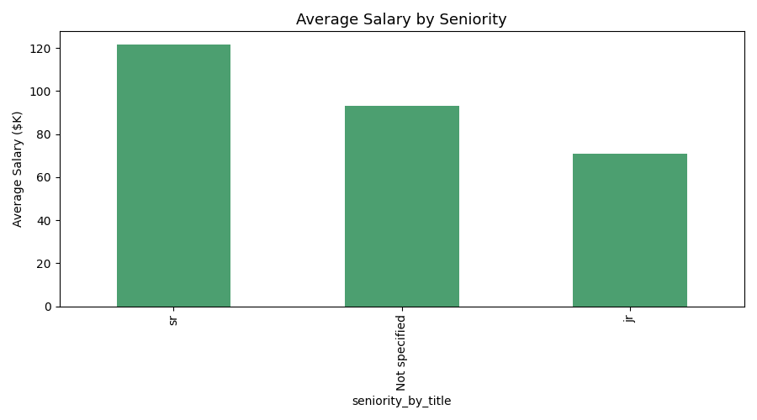
What Really Drives Pay: Seniority vs. Degree
A PhD preference adds ~$21K over no degree preference ($116.0K vs. $94.7K). But seniority matters more: senior roles average $121.7K vs. $71.0K for junior — a $50.7K gap, over twice the degree effect.
9

Slide 10
Recommendations
For Job Seekers
For Employers
Build strong Python, SQL, and Excel fundamentals first
Differentiate postings by seniority and growth path, not just tools
Target CA, MA, or NY for the deepest, best-paying markets
Compete on compensation and clarity — no single employer dominates hiring
Specialize (ML Engineer) or move into leadership for above-average pay
Benchmark biotech/insurance pay against state-level tech-sector averages
Job Market Analysis | PRDA-04

