Slide 1

WHATSAPP AUTOMATION USING
ANDROID DEBUGGING BRIDGE
Name of the supervisor : Dr. S. Prayla Shyry
Name of the student : Vishanthan shree R
Register number : 39111107
29 April 2022 Department of CSE page : 1

Slide 2
PRESENTATION OUTLINE
Introduction
Objectives
System Architecture / Ideation Map
Module Implementation
Application Snapshots
Results and Discussions
Conclusion & Future work
References
29 April 2022 Department of CSE page : 2

Slide 3
INTRODUCTION
Android Debug Bridge (adb) is a versatile command-line tool that lets you communicate with a device. The adb command facilitates a variety of device actions, such as installing and debugging apps, and it provides access to a Unix shell that you can use to run a variety of commands on a device. It is a client-server program that includes three components:
A client, which sends commands. The client runs on your development machine. You can invoke a client from a command-line terminal by issuing an adb command.
A daemon (adbd), which runs commands on a device. The daemon runs as a background process on each device.
A server, which manages communication between the client and the daemon. The server runs as a background process on your development machine.
29 April 2022 Department of CSE page : 3

Slide 4
OBJECTIVES
Project Objective :
- WhatsApp Messenger, or simply WhatsApp, is an internationally available American freeware, cross-platform centralised instant messaging and voice-over-IP service owned by Meta Platforms. WhatsApp is the common application used for sharing the messages and media. We are going to automate the WhatsApp Mobile application using ADB services and Python.
- To implement all these things in a single dictionary with some new features is the goal of this project.
29 April 2022 Department of CSE page : 4

Slide 5
OBJECTIVES
Achieving Project Objectives :
- Configure the device for Android Debugging Bridge(ADB) using adb commands wirelessly.
- install adb on our computer in terminal using Command-Line-Interface(CLI).
- Using adb commands, code the automation script using Python IDE.
- Finally test our Script using some python testing tools.
29 April 2022 Department of CSE page : 5

Slide 6
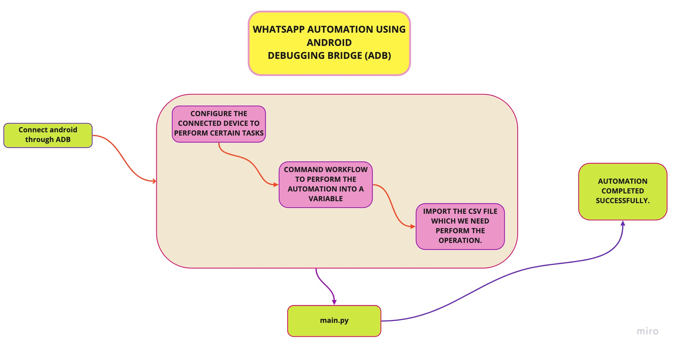
IDEATION MAP
29 April 2022 Department of CSE page : 6

Slide 7
PROJECT IMPLEMENTATION
Dependencies:
- The following dependencies are needed
ADB
CSV package
Python
Time Module
subprocess
29 April 2022 Department of CSE page : 7

Slide 8
PROJECT IMPLEMENTATION
Hardware and Software Requirements:
Hardware :
- PC/ Laptop
- Core i3 6th gen processor
- Tablet/Mobile devices
- Minimum 3G/WiFi stable internet connection.
Software :
- Good Python IDE (PyCharm, VScode) recommended.
- Android 6.0 or later.
- Android SDK manager.
- Android Debugging Bridge(ADB).
29 April 2022 Department of CSE page : 8

Slide 9
PROJECT IMPLEMENTATION
Construction :
- Create a project and open main.py using PyCharm IDE.
- Import some required packages at the beginning and install the package.
- Define a function for adb click event and pass the co-ordinates as arguments.
- Define a function for sending message and pass the Phone number and message as arguments.
- Define a function for sending message with image and pass the name, image name, image path as arguments.
- Define a function for running the adb commands and pass the adb commands as arguments.
- Get the co-ordinates of the search icon of whatsapp using co-ords app and save the co-ordinates in a variable and pass it in click function.
29 April 2022 Department of CSE page : 9

Slide 10
PROJECT IMPLEMENTATION
- Get the co-ordinates of the contact name of WhatsApp using co-ords app and save the co- ordinates in a variable and pass it in click function.
Get the co-ordinates of the Send icon of WhatsApp using co-ords app and save the
coordinates in a variable and pass it in click function.
Get the co-ordinates of the Text box of WhatsApp using co-ords app and save the co
ordinates in a variable and pass it in click function..
- Get the co-ordinates of the Send icon of WhatsApp using co-ords app and save the co- ordinates in a variable and pass it in click function.
29 April 2022 Department of CSE page : 10

Slide 11
PROJECT IMPLEMENTATION
Defined functions are,
1. def click(tap_x, tap_y)
2. def adb(command)
3. def send_msg(phone,message)
4. def send_img(name,img_name,img_path)
5. def csv_to_dict(csv_file)
- The above methods request multiple APIs and yield a response, which are again stored in variables and rendered in the respective templates.
29 April 2022 Department of CSE page : 11

Slide 12
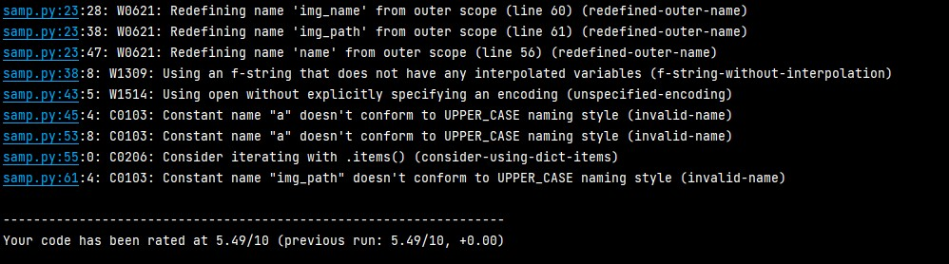
PROJECT IMPLEMENTATION
4.1 PERFORMANCE ANALYSIS:
The performance of this script is very efficient on stable processing speeds (i3 Recommended).
- On i5 processors CPU typically takes less than 30 seconds to complete one loop.
- On i3 processors CPU typically takes less than 45 seconds to complete one loop.
- The script scored 8.49 points in pylint python testing tool.
29 April 2022 Department of CSE page : 12

Slide 13
METHODOLOGY
Waterfall Model is the method of approach behind this.
Requirements
Design
Development
Testing
Deployment
29 April 2022 Department of CSE page : 13

Slide 14
METHODOLOGY
Requirements :
- Adb key events, Student Dataset as .csv file and Images for sending.
- Easily accessible in all sort of devices and all levels of bandwidth.
Design:
- Android Debugging Bridge is chosen as the Automation framework to use.
- Python is chosen for running the ADB commands in terminal using Subprocess.
- CSV package is chosen for reading the data from the csv file.
Development :
-Develop the code in main.py file to process the ADB commands.
- Templates are coded for all created components.
- Methods are created for the events like click, send image, send message, etc,.
29 April 2022 Department of CSE page : 14

Slide 15
METHODOLOGY
Testing :
- The SCRIPT is first tested locally using a development server.
- PYLINT tool is used to test the contrast issues.
- Website is tested with a real user on a wide array of devices.
Deployment :
- The source files are then bundled using PyCharm IDE.
- The venv folder can be install the required packages for our project.
29 April 2022 Department of CSE page : 15

Slide 16
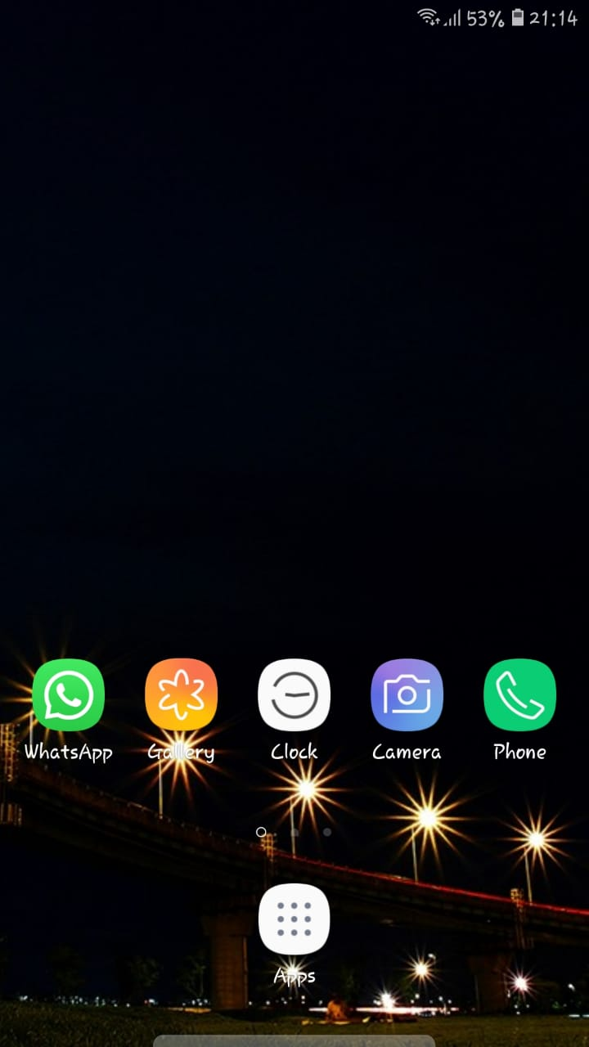
RESULTS AND DISCUSSION
FIG: 1.0 : HOMEPAGE
This is the first process of our project
The above output shows the final output of how the homepage looks and works
This image shows the app that we’ve automated using android debugging bridge
29 April 2022 Department of CSE page : 16

Slide 17
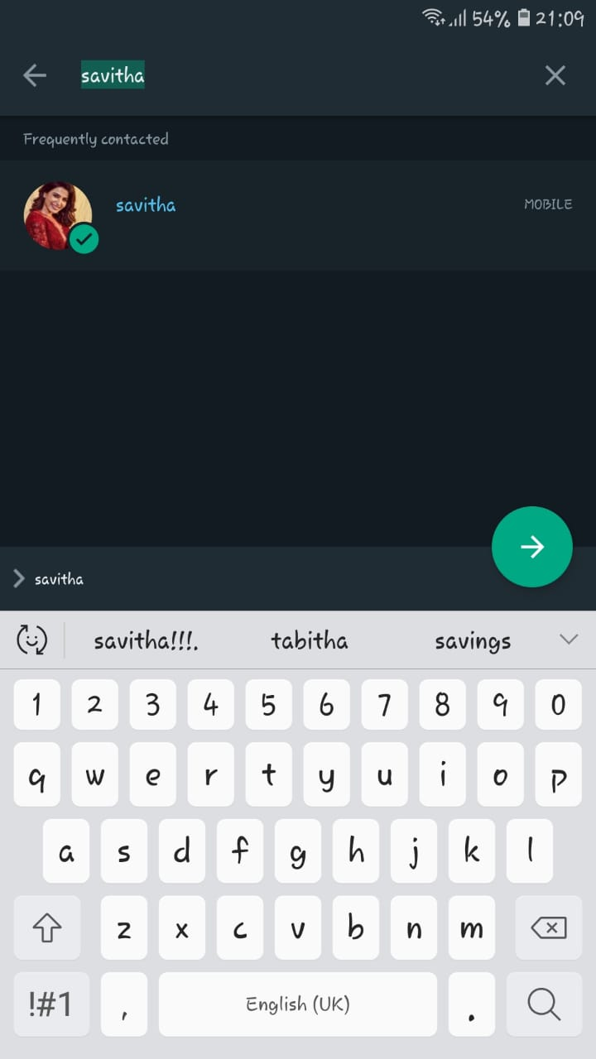
RESULTS AND DISCUSSION
FIG : 1.1 WHATSAPP PAGE
This is the second major process In our automation
in this image the requested person is selected in WhatsApp.
The person’s name is typed and searched through an automation Script
29 April 2022 Department of CSE page : 17

Slide 18
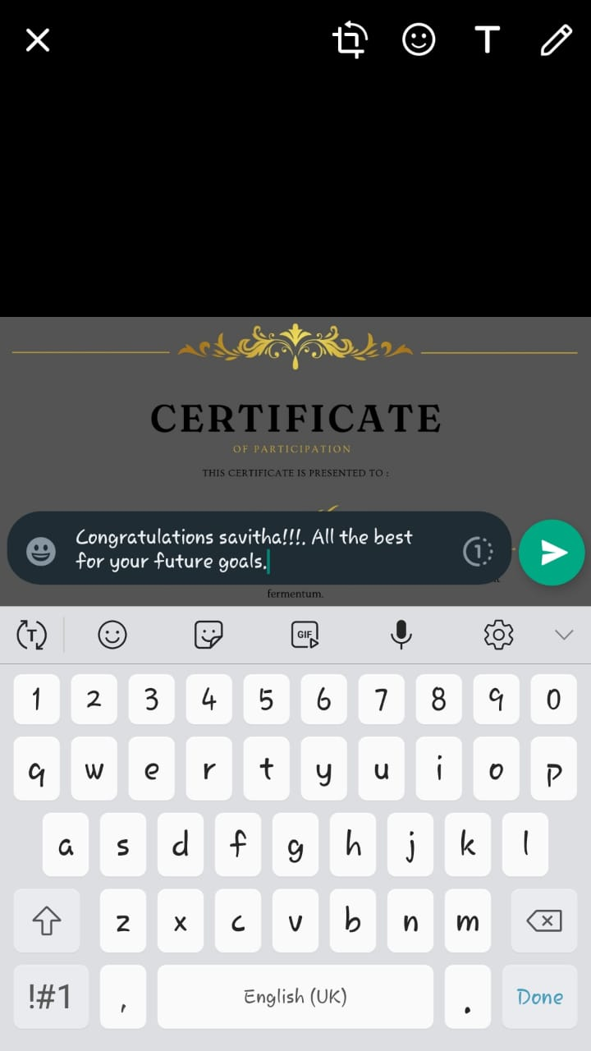
RESULTS AND DISCUSSION
FIG : 1.2 SEND SCREEN
This is the third major process in our automation
This is the process where the requested image will be selected to the requested person.
And also the requested message will be typed through an automation script.
And also this is the process where the send button is pressed, so it is one of the most important processes of all.
29 April 2022 Department of CSE page : 18

Slide 19
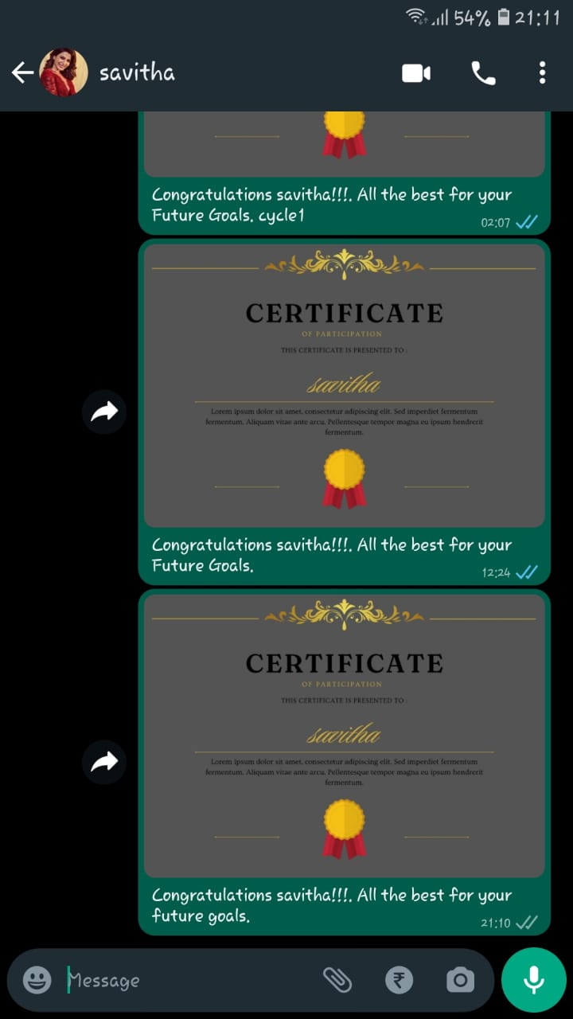
RESULTS AND DISCUSSION
FIG : 1.3 THE IMAGE HAS BEEN SENT SUCCESSFULLY
This is the fourth major process in our automation
In this part of the processes the requested image will be sent to requested person.
And the loop continues to the next person in request until the end.
29 April 2022 Department of CSE page : 19

Slide 20
CONCLUSION
To summarize, this automation is built using ADB Framework, with python and csv as dependency.
The automation poses as a one stop destination for sending multiple messages to multiple people.
The accessibility and responsiveness of the automation, guarantee a large user base on various android device levels.
The use of python, proves to be lightweight on the machine, and enables fast loading.
To conclude, the project meets the aim for which it was built. Proving to be positive in all aspects of managing the time in sending multiple WhatsApp messages .
29 April 2022 Department of CSE page : 20

Slide 21
REFERENCES
https://developer.android.com/studio/command-line/adb : Official documentation for Android Debugging Bridge (ADB)
2. https://docs.python.org/3/library/subprocess.html : Official documentation for module Subprocess
3. https://docs.python.org/3/library/csv.html : Official documentation for module Comma Separated Values (CSV)
4. https://developer.android.com/studio/command-line/sdkmanager : Official documentation for Android SDK Manager
5. https://docs.python.org/3/ : Official documentation for python3
29 April 2022 Department of CSE page : 21

