Slide 1

Blockchain technology
IN HEALTHCARE

Slide 2
TEAM MEMBERS (Group-30)
Rupsa Dhar (2018A7PS0376H)
Pranavi Marripudi (2018A7PS0507H)
Pranay Pant (2018A7PS0161H)
Saksham Chauhan (2018AAPS0370H)
Vishesh Badjatya (2018A7PS0270H)

Slide 3

Problem faced by healthcare industry
Medical errors are estimated to be one of the leading causes of death around the world, which means improvements in the handling of health data is time critical.
The inefficiencies and unnecessary expenditures of the healthcare system are need for the secure, high-integrity, neutral third party nature of blockchain.
Also an important necessity of this ever-evolving industry is a strong relationship between patient and doctor based on trust and integrity. Thus to ensure a stress free experience to patients is the need of the hour.

Slide 4

Objectives of our project
The main objective of our project is to produce confidentiality to patient medical records using Blockchain technology.
Protecting the personal details of a patient isn’t simply a matter of ethical respect, it’s essential to bond trust between the doctor and also the patient.
We hence provide the same through our project where both doctors and patients have access to medical records remotely and securely. While doctors can only access data pertaining to only their patients, patients can only access their own records.
Each transaction is unique and secure and hence cannot be modified nor can they be used by third-party entities for personal gain.
Blockchain undoubtedly will provide a feasible solution to this problem by ensuring storage of medical records while maintaining its integrity and consistency.

Slide 5
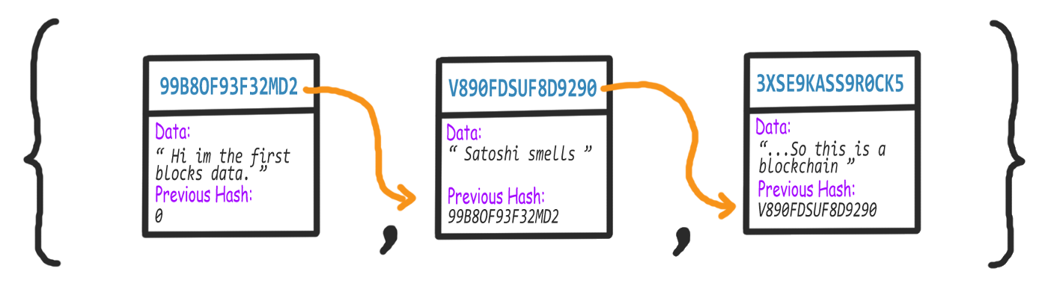
Making the Blockchain
A blockchain is just a chain/list of blocks. Each block in the blockchain will have its own digital fingerprint, contain digital fingerprint of the previous block, and have some data ( this data could be transactions for example ).
This means that it becomes very hard to change the contents of any block without then needing to change every subsequent one; hence where the blockchain essentially gets its immutable properties.
Diabetes
Arthritis
Thyroid

Slide 6
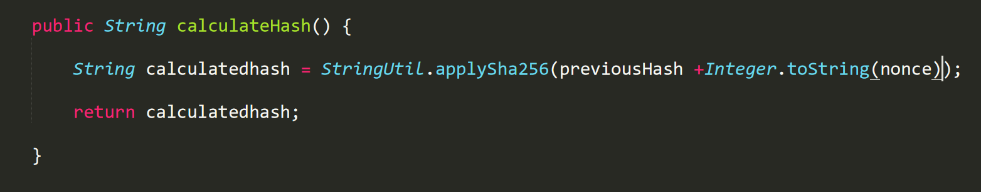
Each block doesn’t just contain the hash of the block before it, but its own hash is in part, calculated from the previous hash. If the previous block’s data is changed then the previous block’s hash will change ( since it is calculated in part, by the data) in turn affecting all the hashes of the blocks there after. Calculating and comparing the hashes allow us to see if a blockchain is invalid. Changing any data in this list, will change the signature and break the chain.

Slide 7
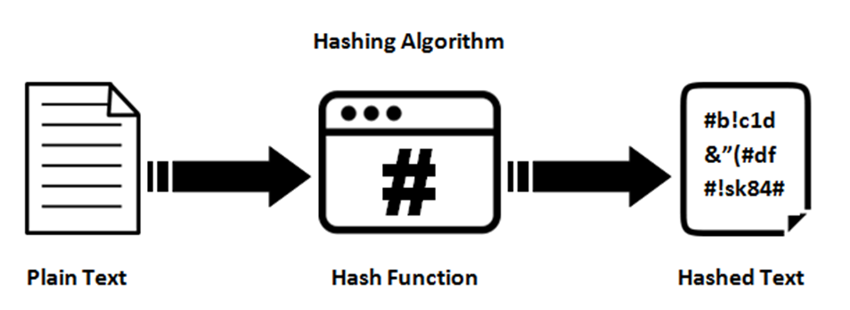
Our basic Block contains a String hash that will hold our digital signature(or present hash). The variable previous Hash to hold the previous block’s hash and String data to hold our block data.
Next we will need a way to generate a digital fingerprint, there are many cryptographic algorithms. Here we have used SHA256. SHA-256 is one of the successor hash functions to SHA-1 (collectively referred to as SHA-2), and is one of the strongest hash functions available.

Slide 8
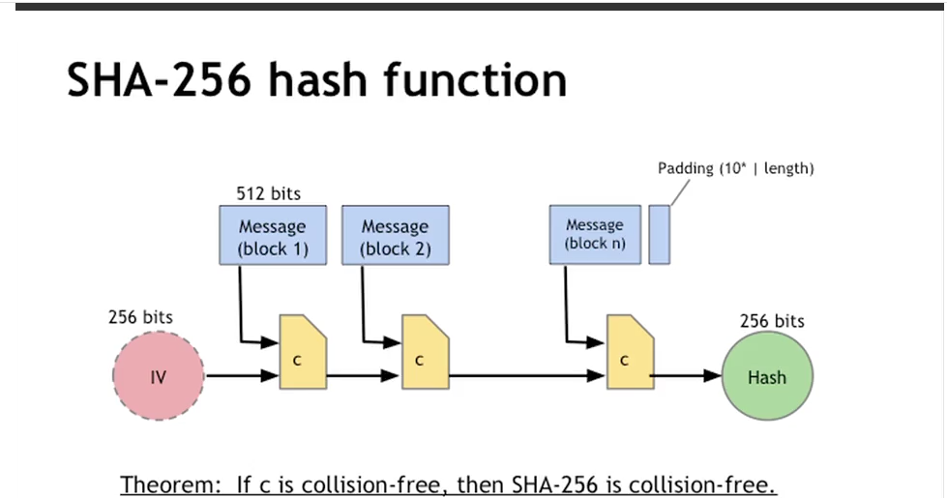
About SHA-256 algorithm
SHA-256, is one of the cryptographic hash function which has digest length of 256 bits. It's a keyless hash function. SHA (Secure Hash Algorithm) was developed by the National Institute of Standards & Technology, and further, they came with a new version called SHA-256 (the SHA-2 family), where the number is represented as the hash length in bits.
In Cryptography, SHA is cryptographic hash function which takes input as 20 Bytes and rendered the hash value in hexadecimal number, 40 digits long approx.
In our project we use the java.security package to implement this algorithm.

Slide 9
Message Digest Class: To calculate cryptographic hashing value in Java, MessageDigest Class is used, under the package java.security.
MessagDigest Class provides following cryptographic hash function to find hash value of a text, they are:
MD5
SHA-1
SHA-256
This Algorithms are initialized in static method called getInstance(). After selecting the algorithm it calculate the digest value and return the results in byte array.

Slide 10
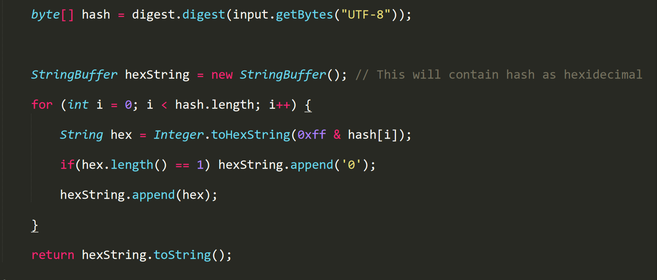
Code snippet showing implementation of SHA-256

Slide 11
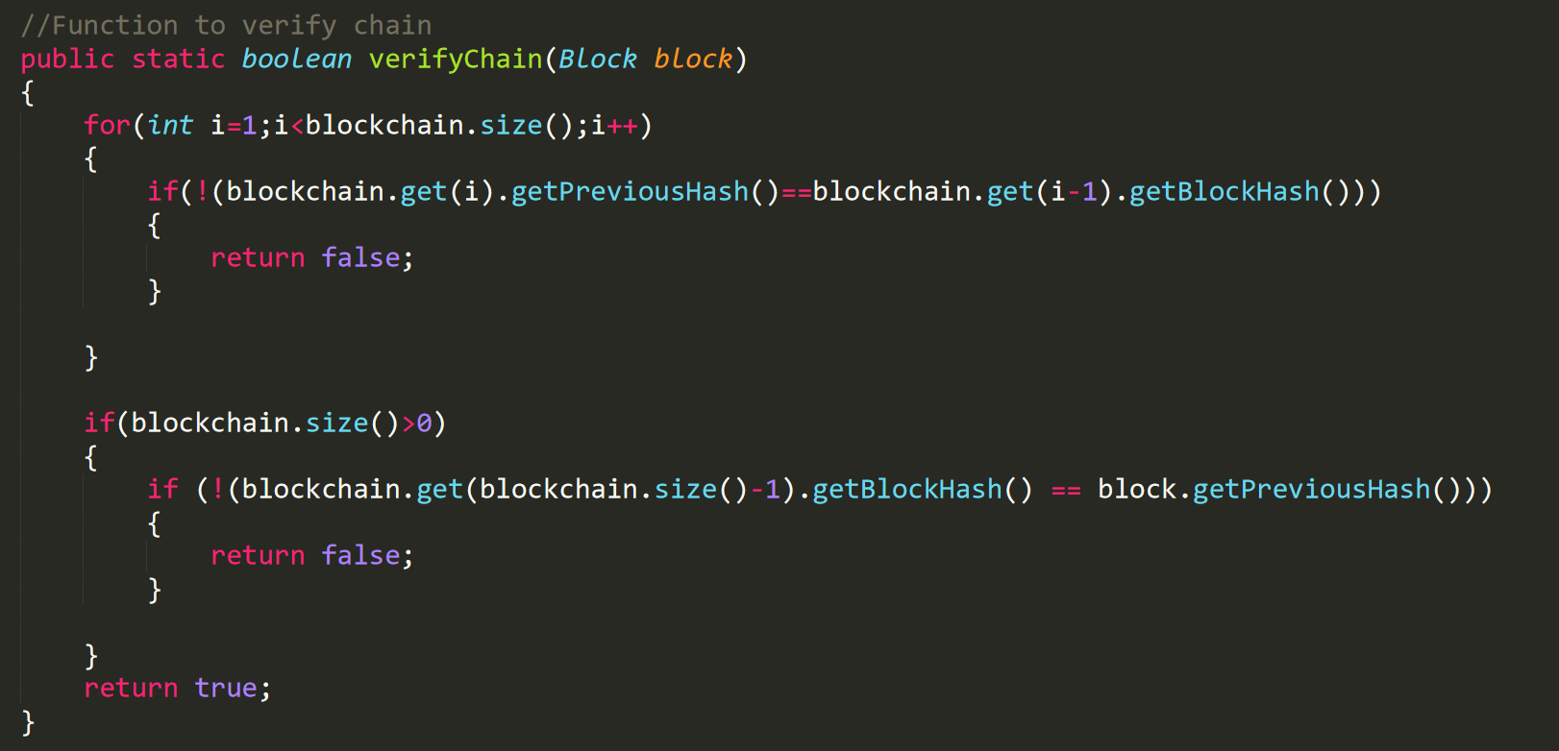
Integrity of the blockchain
verifyChain() Boolean method in the Main class, that will loop through all blocks in the chain and compare the hashes. This method will need to check the hash variable is actually equal to the calculated hash, and the previous block’s hash is equal to the previousHash variable.

Slide 12
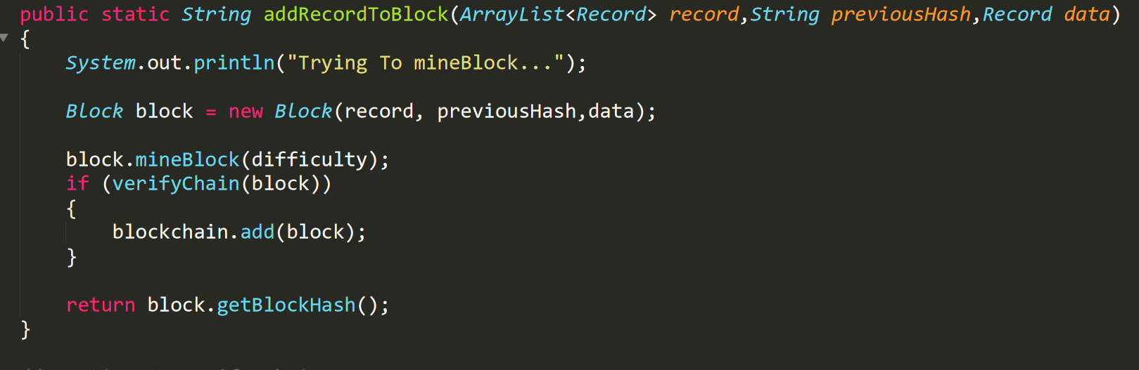
Adding a block to the blockchain

Slide 13
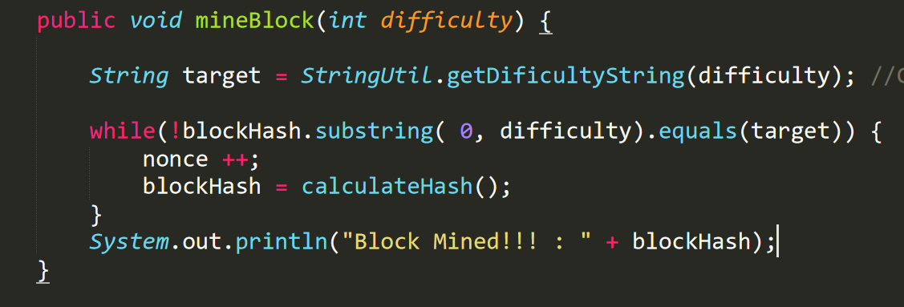
Mining Blocks
We will require miners to do proof-of-work by trying different variable values in the block until its hash starts with a certain number of 0’s (dependent on the level of difficulty).
We have added an int called nonce to be included in our calculateHash() method. This value is updated( that is incremented) after every block mined.
The mineBlock() method takes in an int called difficulty, this is the number of 0’s they must solve for. Low difficulty like 1 or 2 can be solved nearly instantly on most computers.

Slide 14
The implementation of zero knowledge proof(zkp)
A zero-knowledge proof is a digital protocol that allows for data to be shared between two parties without the use of a password or any other information associated with the transaction.
In its most basic sense, a zero-knowledge proof (also commonly referred to as ZKP) can be thought of as a protocol through which a digital authentication process can be facilitated without the use of any passwords or other sensitive data. As a result of this, no information, either from the sender’s or receiver’s end, can be compromised in any way.

Slide 15


We have implemented this form of proof and have used it to verify patient password in the Add and View options. The steps used are as follows:
Patient has password (as sensitive data x). We choose two numbers p and g. Here p can be a large prime and g is a generator. For simplicity we have used p=11 and g=2.
Now a variable y is calculated as
Now the following steps are done to create a zero knowledge proof for x
The user chooses a random number between 0 and 9.
User then computes h=(2^r)(mod 11) and inputs it.
The system receives it and sends back a random bit (could be 0/1).
User then sends the value of s=(r+b*x)mod(10). Here x is the number you are proving you know(i.e the password).
The system computes and
Both the values must be equal for the patient to be verified. Hence the password of patient is verified without actually getting to know what it is.

Slide 16
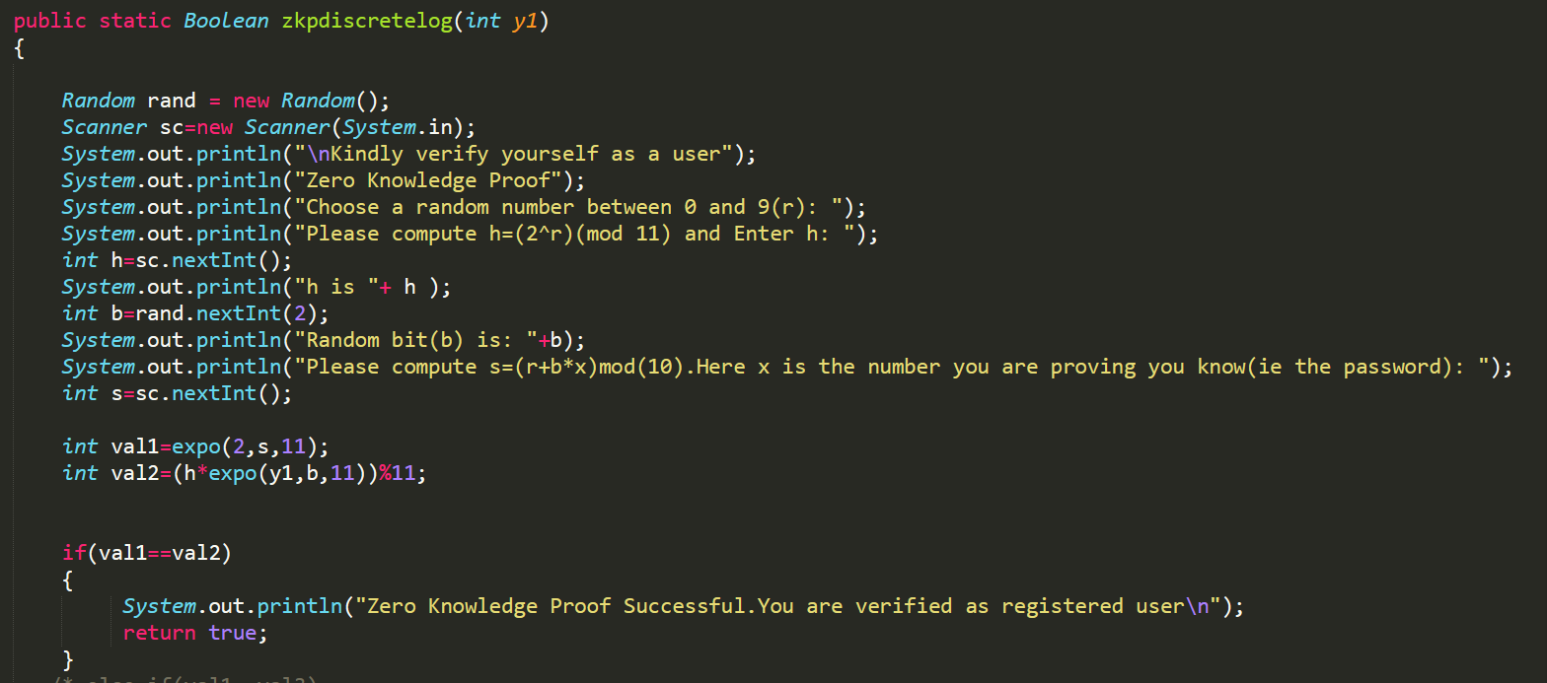
Code snippet showing zero knowledge proof

Slide 17

How we have designed the user interface
After executing the program, you will encounter 3 choices
Register
Add
View
This interface has been designed for both doctors and patients. While doctors are pre-registered and have been included in the code, patients need to be registered uniquely during every transaction. None of the data is being stored in files and hence dynamic for every execution of the code.
The following slides explain each option in detail.

Slide 18
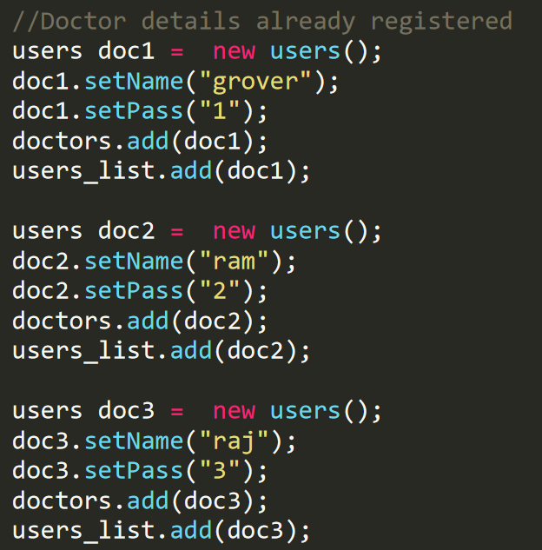
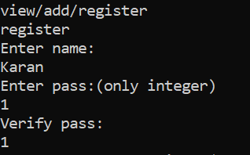
Register
Patients whose details are to be entered subsequently have to be registered first. You will have to provide patient name and a numeric password(between 1-10) only.
Doctors on the other hand have been provided in the code. We have registered 3 doctors by default.

Slide 19
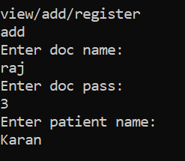
Add
Now that a patient has been registered, the doctor treating the patient can add medical records. To maintain integrity so that both patient and doctor are in accordance with the data, both doctor and patient passwords are taken as input.
Doctor can go on adding data hence ensuring all medical problems are recorded. Press ‘y’ to enter data.
After data has been entered, the block is mined and hence added to the blockchain. This record can further no longer be tampered with.

Slide 20
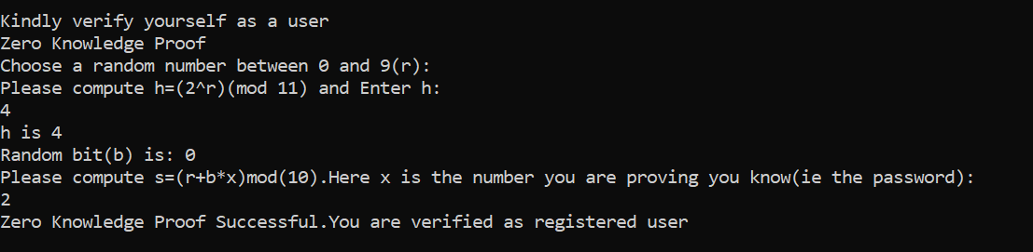
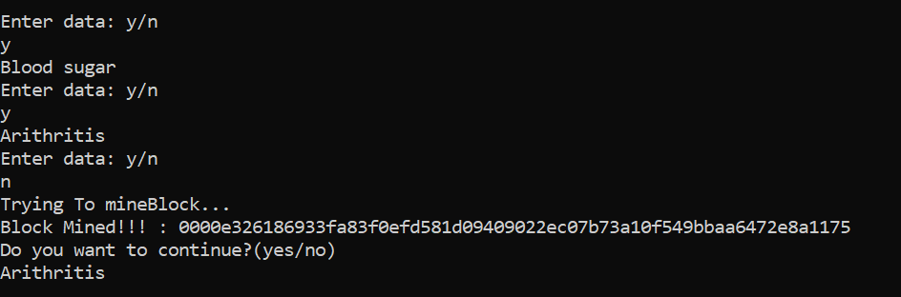

Slide 21
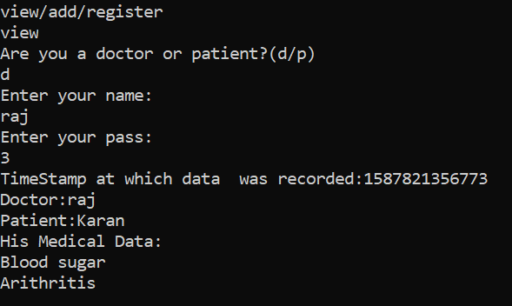
View
This option allows both doctors and patients to view the records. Doctors can view only patients they are treating.
From doctor’s view

Slide 22
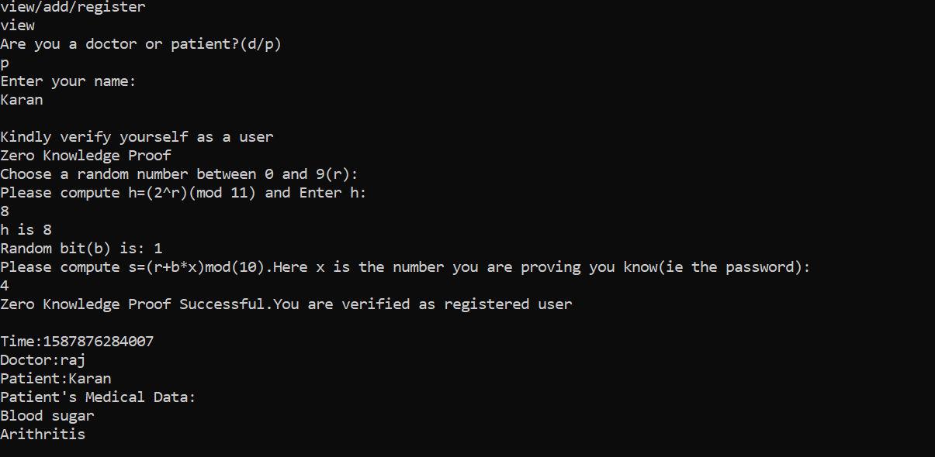
From patient’s view

Slide 23

Conclusion
By implementing blockchain for storing medical records we hope to achieve confidentiality and efficiency in the same. This is a prototype for something that can be implemented on a large scale.

