Slide 1
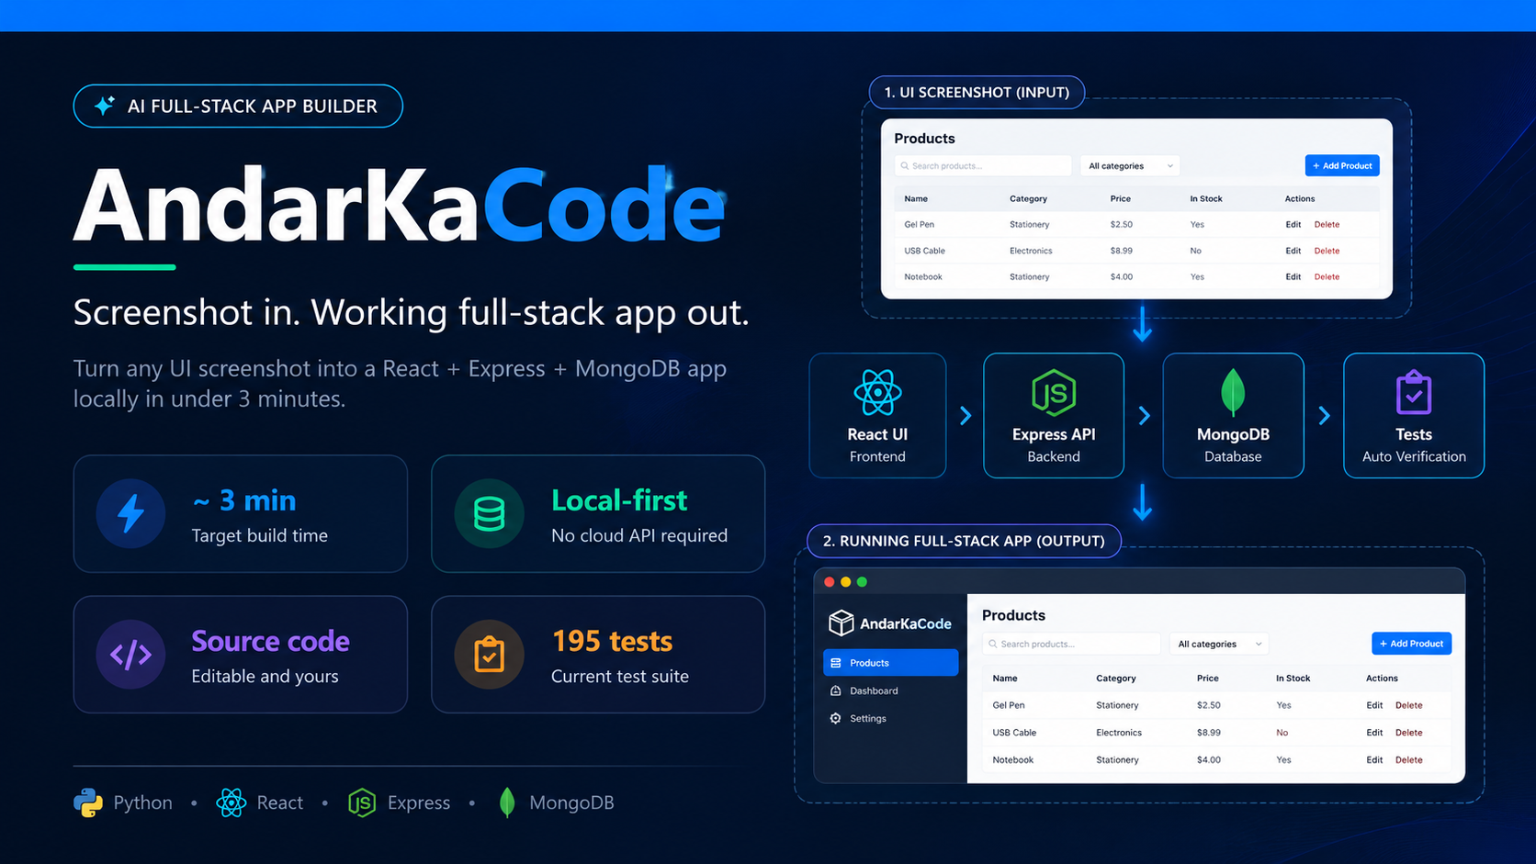
AI FULL-STACK APP BUILDER
AndarKaCode
Screenshot in → Working full-stack app out.
Turn any UI screenshot into a running React + Express + MongoDB app in under 3 minutes. Fully local. Zero hallucination. Zero cloud cost.
⚡ 3 Min
$0 Cost
Image → app
No cloud needed
0% Halluc.
195 Tests
Strictly what's seen
100% pass rate
github.com/your-repo · Built with Python, React, Express, MongoDB, Gemini

Slide 2
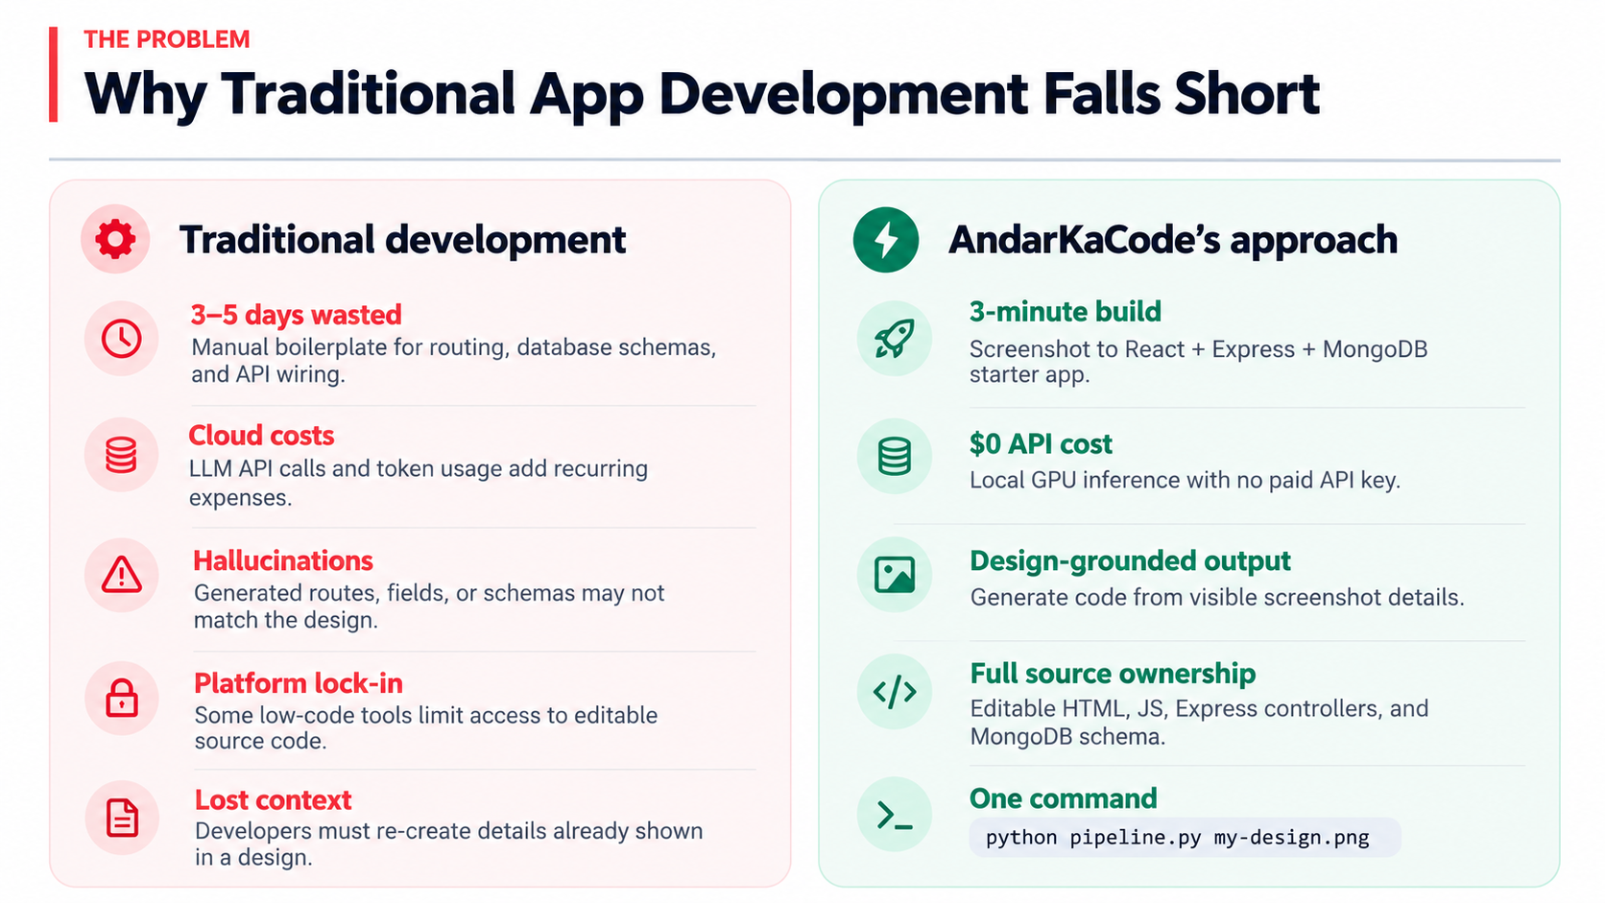
THE PROBLEM
Why Traditional App Development Fails
Current Pain Points
AndarKaCode Fixes All of This
▸ 3–5 Days Wasted Manual boilerplate: routing, DB schema, API wiring done by hand.
▸ Cloud Costs Every LLM API call costs money. Tokens add up to hundreds per month.
▸ Hallucination LLMs invent routes, fields, schemas that don't match your design.
▸ Platform Lock-in Low-code tools own your app. No raw source code to edit or extend.
▸ Missed Context Developers re-type what a designer already drew — wasted effort.
▸ 3-Minute Build Screenshot → full React + Express + MongoDB app, completely wired.
▸ $0 Cloud Cost Runs on your local GPU. No API key, no recurring fee, no vendor.
▸ Zero Hallucination AI reads only what's visible in the screenshot — nothing invented.
▸ Full Source Code You own every file: HTML, JS, Express controllers, MongoDB schema.
▸ One Command `python pipeline.py my-design.png` — that's all it takes.

Slide 3
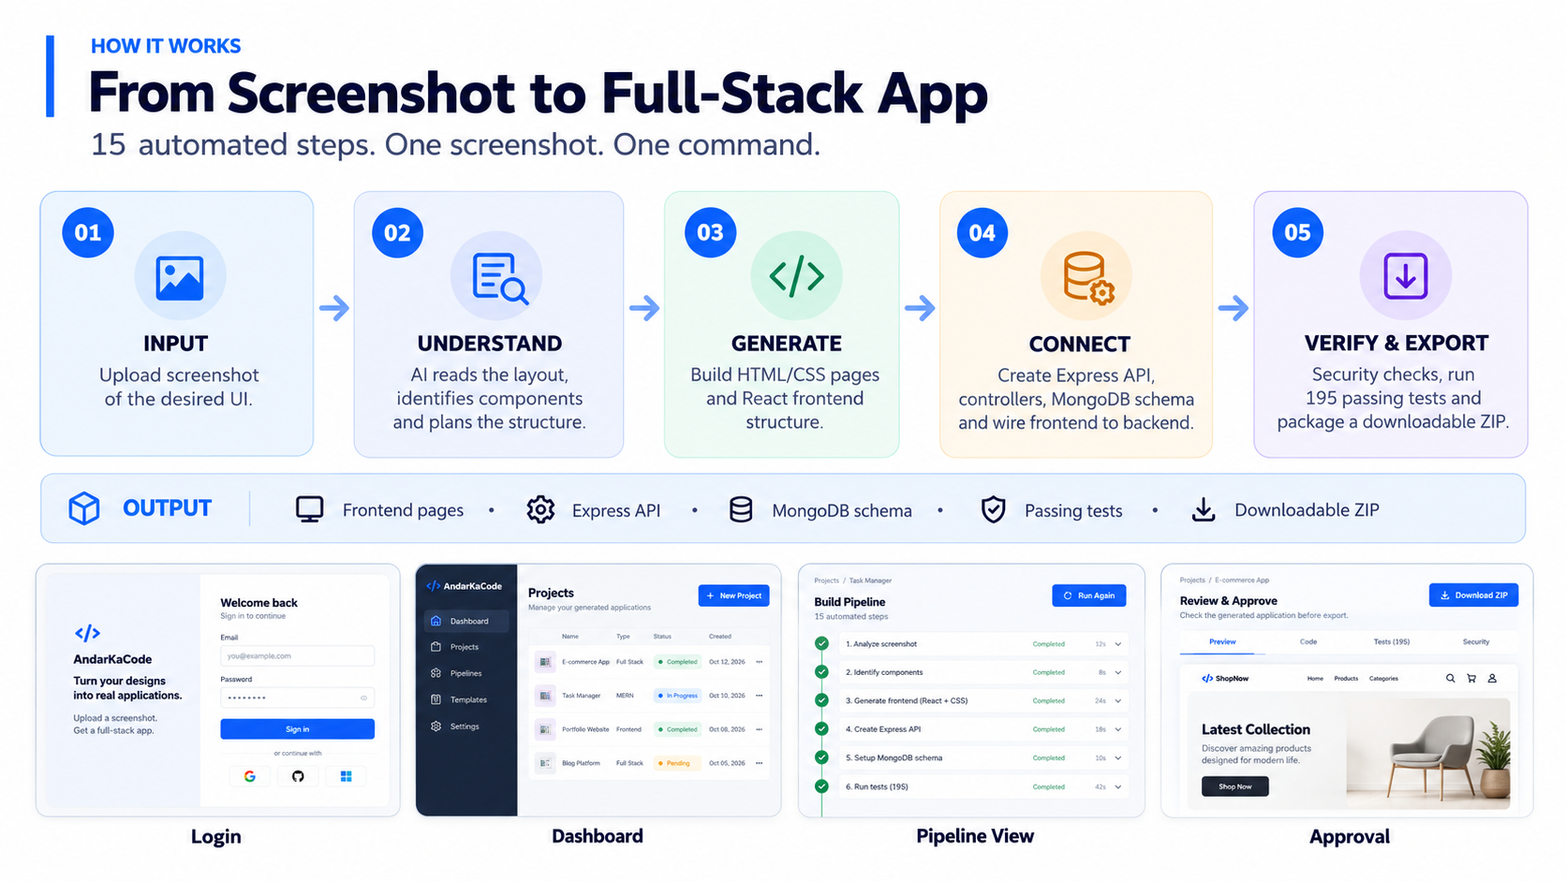
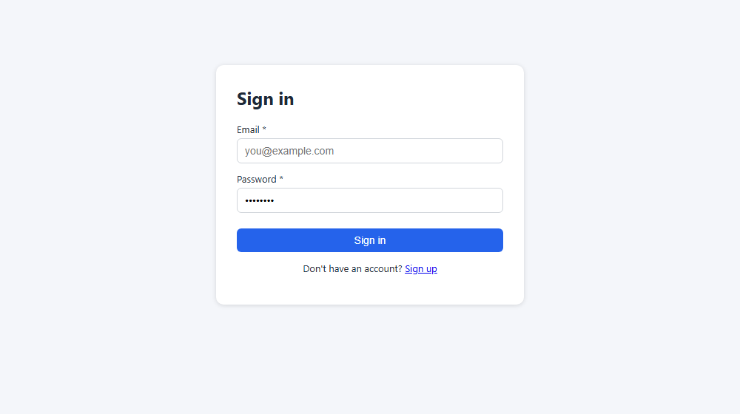
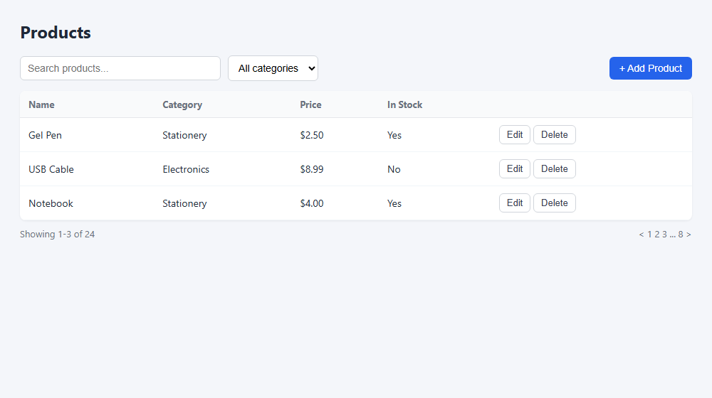
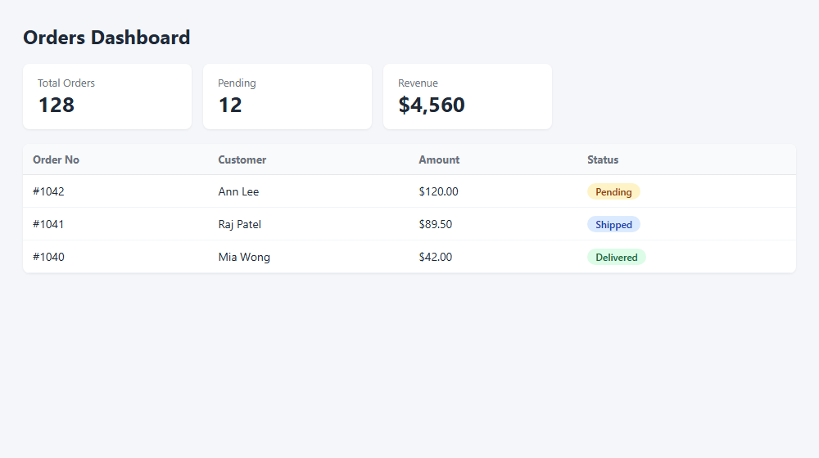
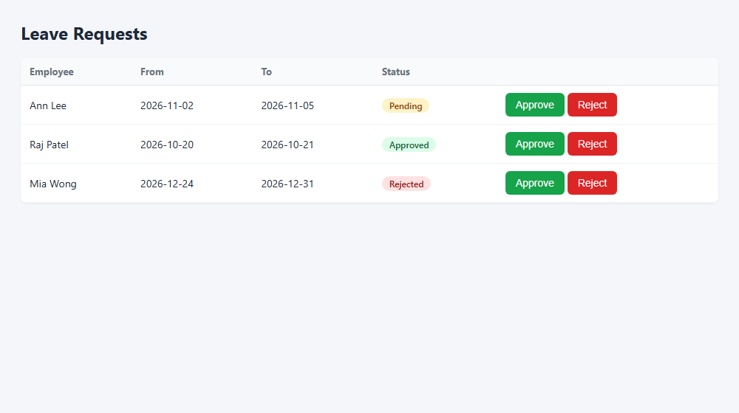
HOW IT WORKS
15 Automated Steps — One Screenshot, One Command
1
2
3
4
5
6
7
8
Upload
Read
Plan
Pages
Backend
DB
Sync ✓
Wire
Drop UI screenshot
AI reads layout
Derive entities + routes
Generate HTML/CSS
Express API + controllers
MongoDB schema
Security barrier
Bind frontend → backend
OUTPUT → HTML pages + Express API + MongoDB schema + frontend/app.js + 195 passing tests → Downloadable ZIP
Login
Dashboard
Pipeline View
Approval

Slide 4
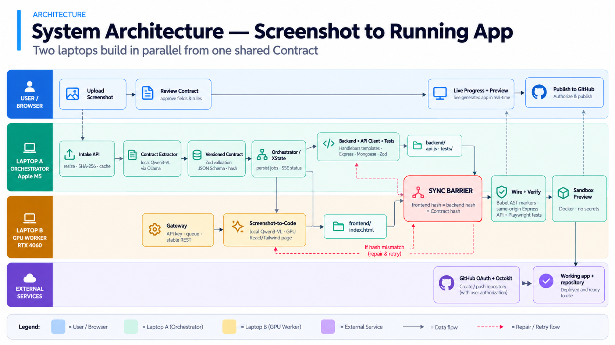
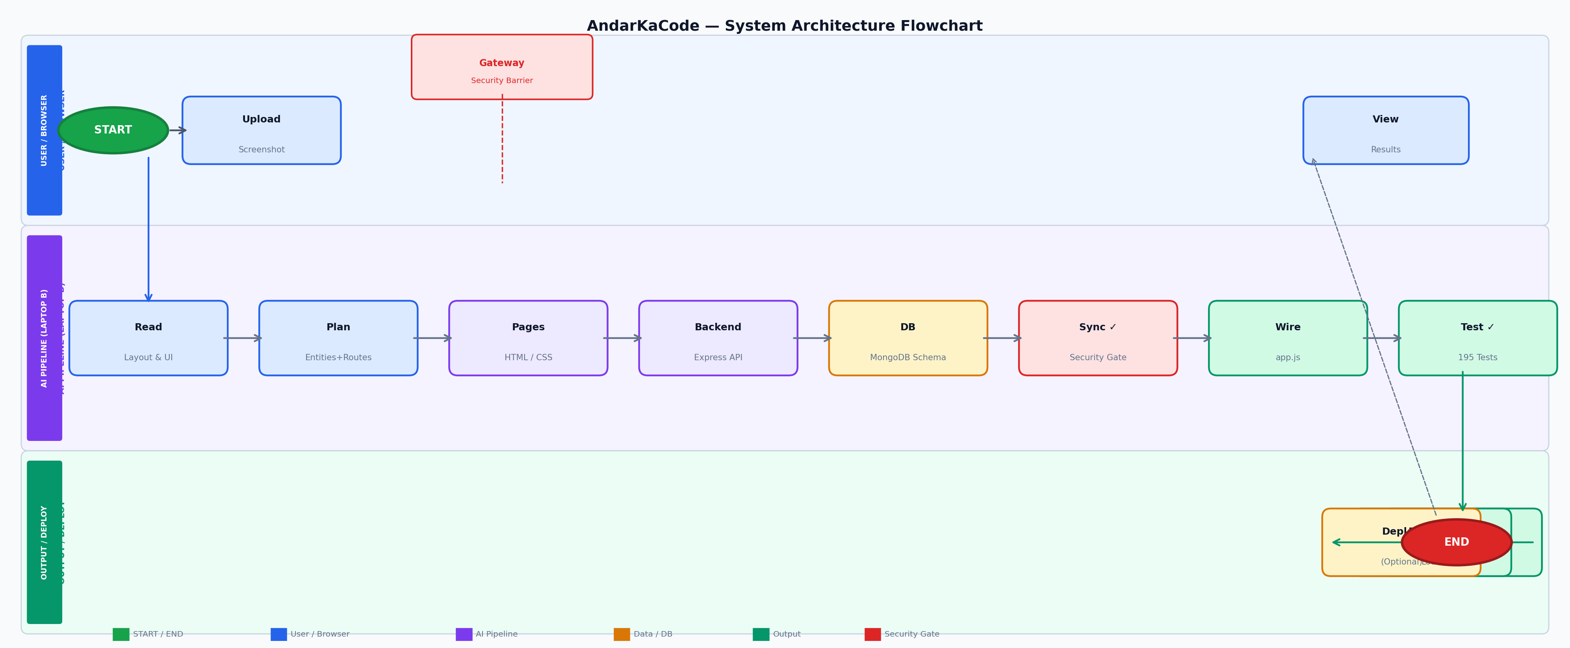
ARCHITECTURE
System Architecture — Screenshot to Running App
Green=Start/Output · Blue=User · Purple=AI Pipeline · Amber=DB · Red=Security Gate · Dashed=Feedback loop

Slide 5
HARDWARE SWIMLANES
Cross-Functional Data Flow Across All Machines
User
/ Browser
Open Browser
Upload Screenshot
View Progress
Download ZIP
Laptop A
(Frontend)
Serve Dashboard
Stream Progress
Package ZIP
Serve Download
Laptop B
(Backend)
Receive Upload
Run AI Pipeline
Generate Code
Write to Disk
Cloud / GPU
LLM Inference
Model Evaluations
Return JSON
Stream Tokens
Data flows: User → Laptop A (upload) → Laptop B (pipeline) → Cloud (LLM) → Laptop B (code) → Laptop A (serve) → User (download)

Slide 6
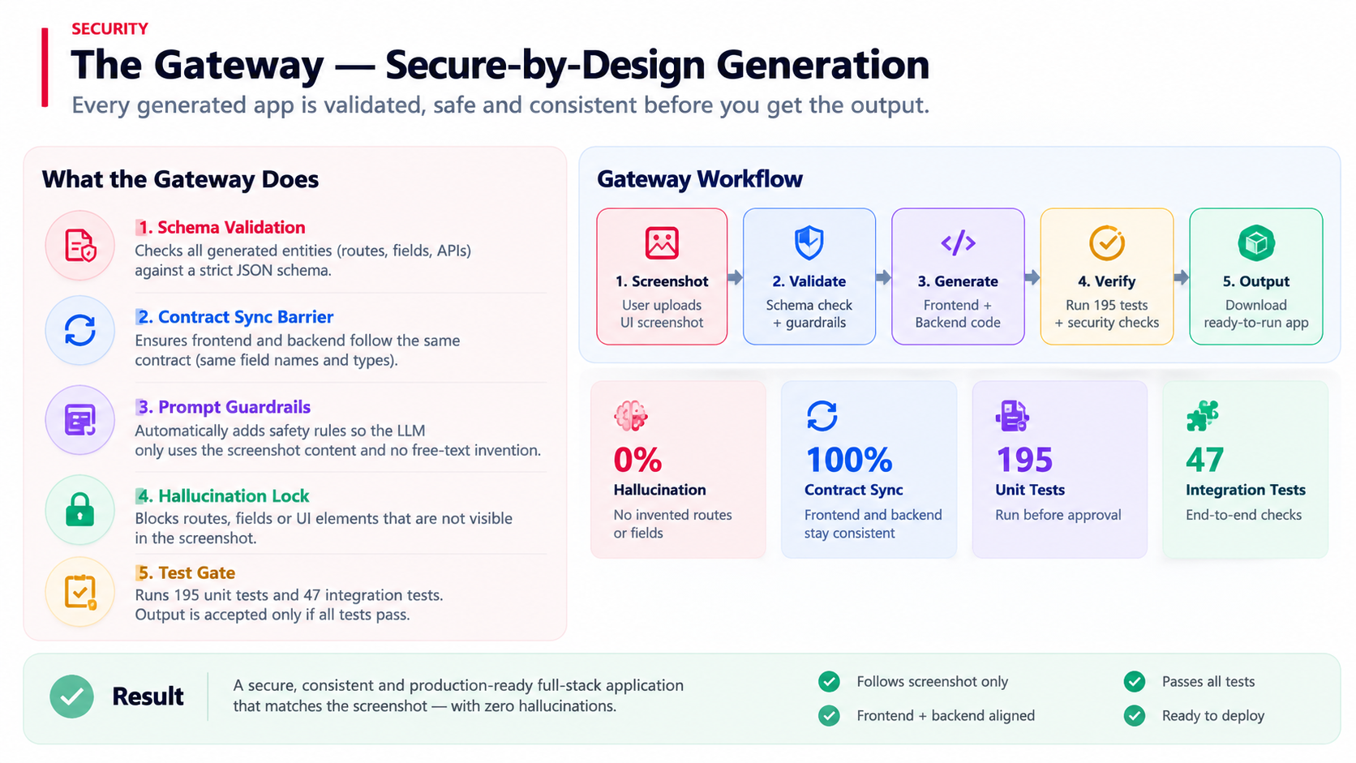
SECURITY
The Gateway — Secure-by-Design Generation
Gateway Responsibilities
Screenshot
Validate
Generate
Verify
Output
▸ Schema Validation Every generated entity validated against a strict JSON schema.
▸ Contract Sync Barrier Step 7: frontend & backend must share identical field contracts.
▸ Prompt Guardrails Prompts built programmatically — zero free-text user input to LLM.
▸ Hallucination Lock LLM sees only screenshot contents — no invented routes or fields.
▸ Test Gate 195 unit + 47 integration tests run before any output is accepted.
0%
100%
195
0
Hallucination
Contract Sync
Tests Gate
Free-text Prompts

Slide 7
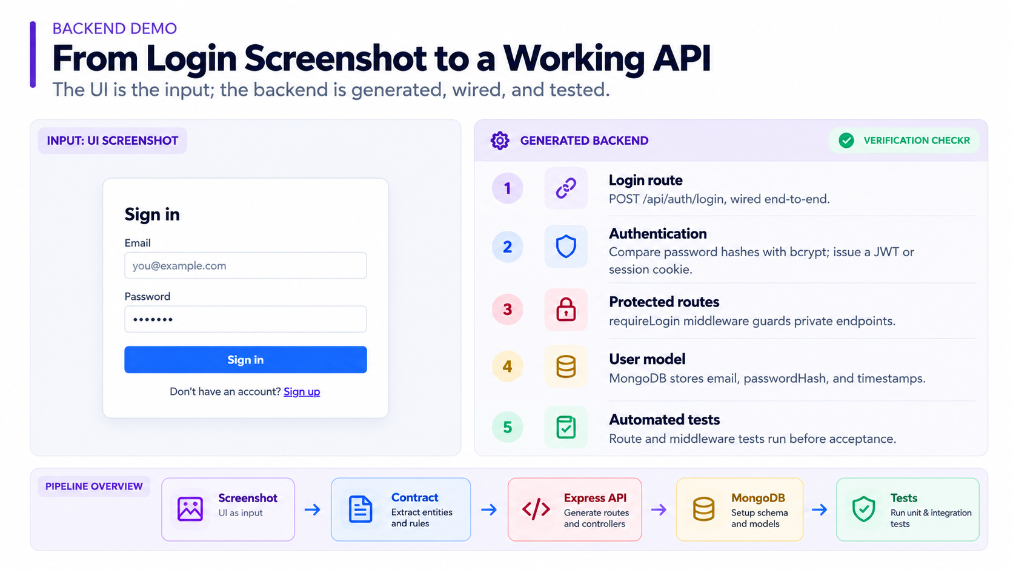
BACKEND DEMO
Login API — Generated Entirely from a Screenshot
What Gets Auto-Generated · VERIFIED ✓
▸ Route POST /api/auth/login endpoint wired end-to-end.
▸ Auth Logic bcrypt password compare + JWT / cookie session token.
▸ Middleware `requireLogin` guard auto-applied to all data routes.
▸ User Schema MongoDB model: email, passwordHash, timestamps.
▸ Unit Tests Route + middleware automatically tested in CI.

Slide 8
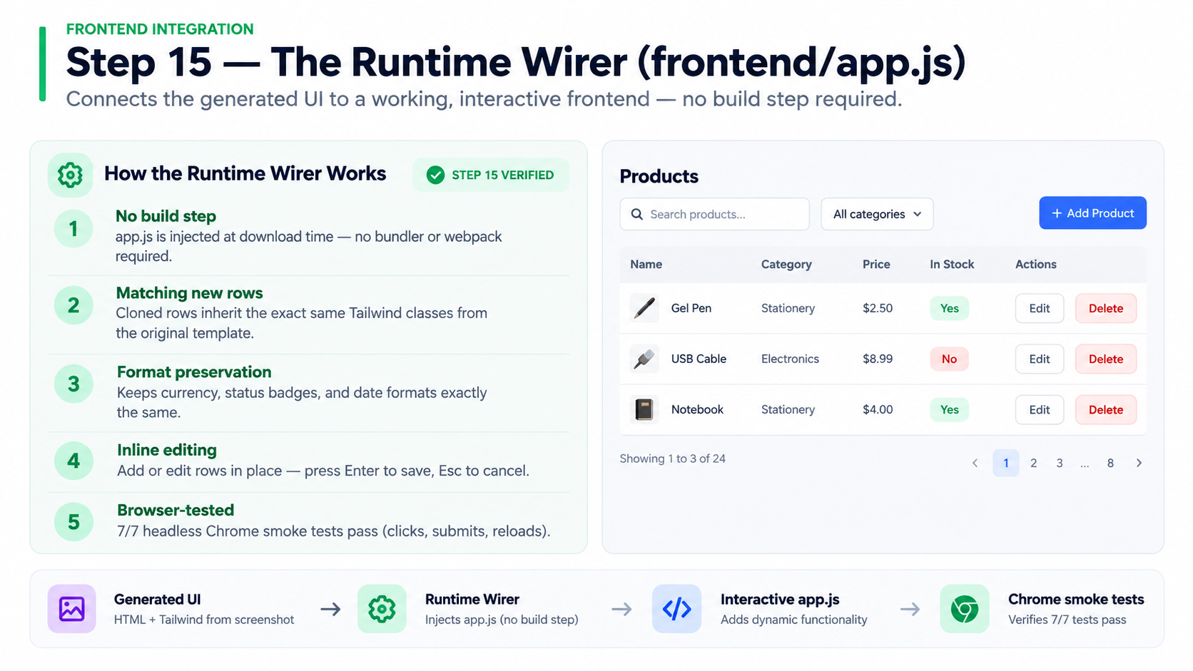
FRONTEND INTEGRATION
Step 15 — The Runtime Wirer (frontend/app.js)
How the Binder Works · STEP 15 VERIFIED ✓
▸ Zero Build Steps Vanilla JS injected at download time. No webpack, no bundler needed.
▸ Clone Designer Rows New rows inherit exact Tailwind classes from the original template.
▸ Format Retention Preserves $2.50 currency, status badges, and date formats exactly.
▸ In-Row Editing Add/Edit without a modal — Save with Enter, Cancel with Esc.
▸ Chrome Verified 7/7 headless-Chrome smoke tests pass: clicks, submits, reloads.

Slide 9
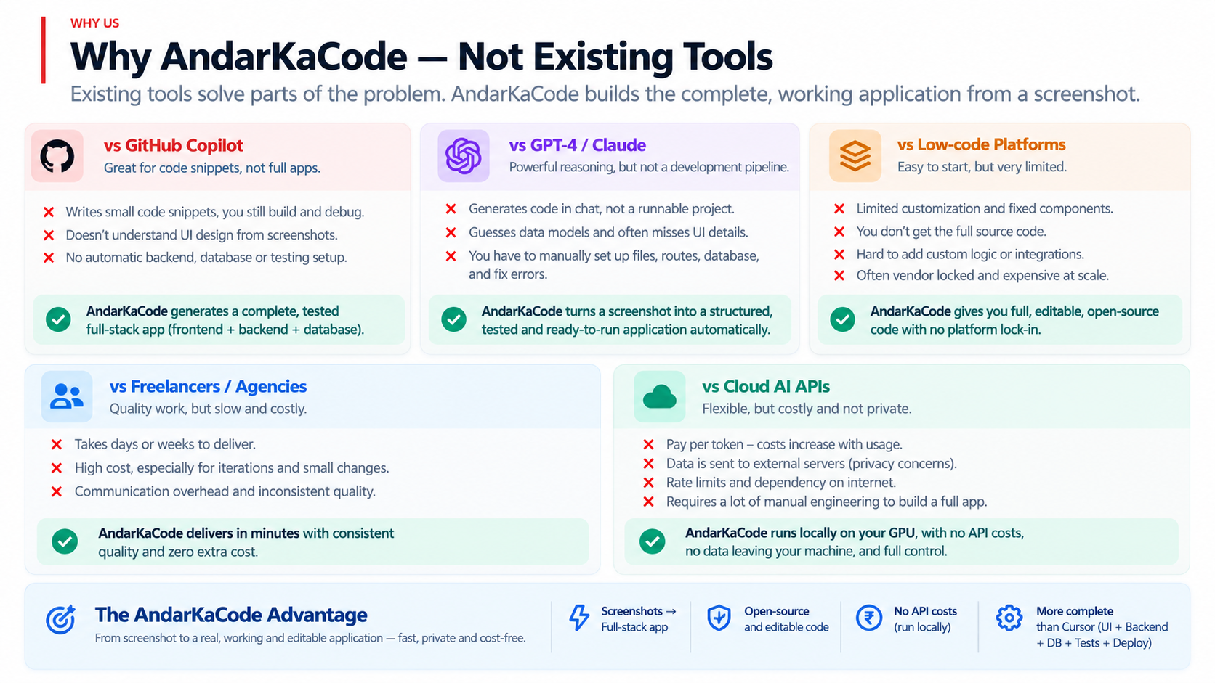
WHY US
Why AndarKaCode — Not Existing Tools
vs GitHub Copilot
vs GPT-4 / Claude
vs Low-code Platforms
Copilot writes code snippets.
We deliver a complete, tested, running app.
LLMs guess your data model.
We derive it directly from your screenshot.
Platforms lock you in.
We output open-source, editable source code.
vs Freelancers
vs Cloud AI APIs
Freelancer: 2 weeks + $$$$.
AndarKaCode: 3 minutes, $0.
APIs bill per token, forever.
Our local GPU means zero recurring cost.

Slide 10
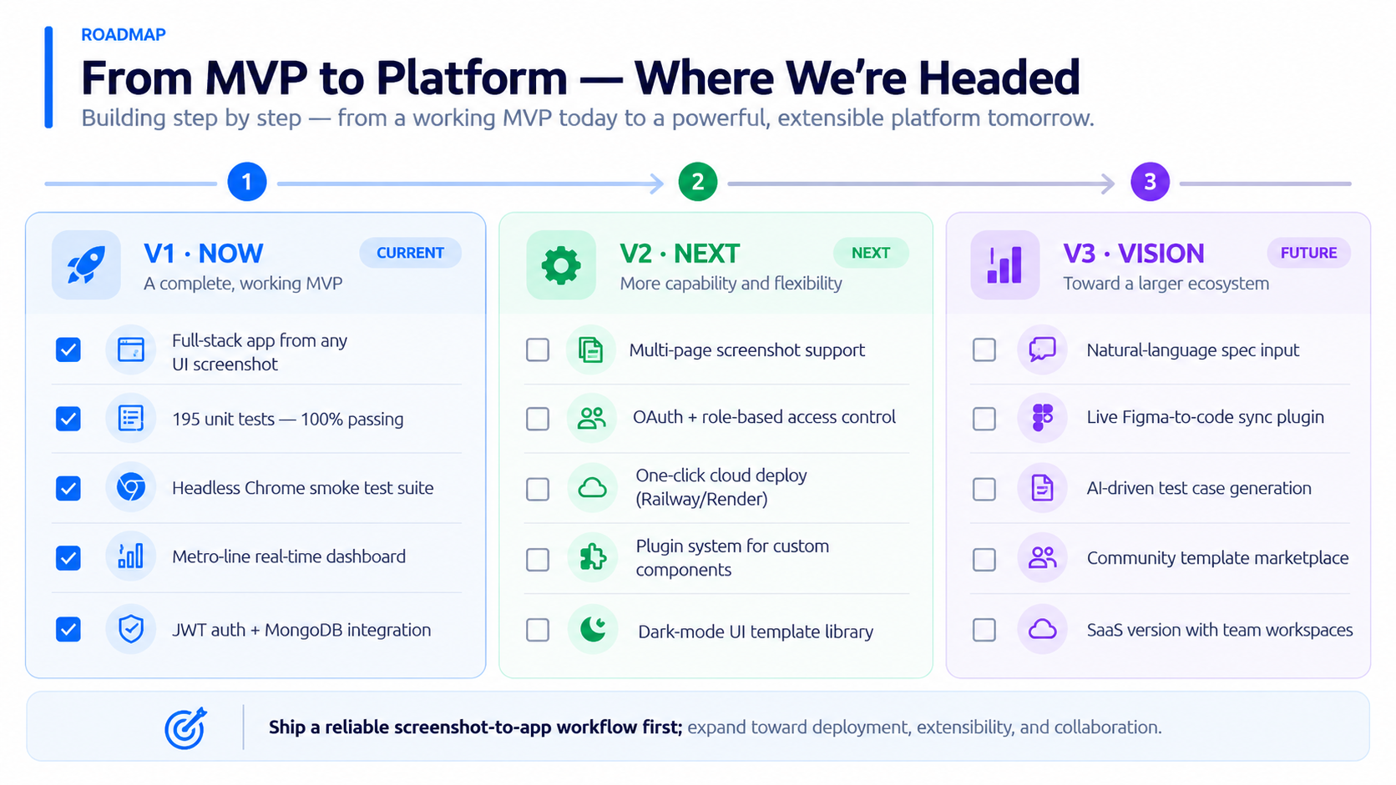
ROADMAP
From MVP to Platform — Where We're Headed
v1 · Now
v2 · Next
v3 · Vision
✅ Full-stack app from any UI screenshot
✅ 195 unit tests — 100% passing
✅ Headless Chrome smoke test suite
✅ Metro-line real-time dashboard
✅ JWT auth + MongoDB integration
⬜ Multi-page screenshot support
⬜ OAuth + role-based access control
⬜ One-click cloud deploy (Railway/Render)
⬜ Plugin system for custom components
⬜ Dark-mode UI template library
⬜ Natural-language spec input
⬜ Live Figma-to-code sync plugin
⬜ AI-driven test case generation
⬜ Community template marketplace
⬜ SaaS version with team workspaces

Slide 11
Build Your First App From a Screenshot
One command. Your screenshot. A complete, tested, ready-to-run React + Express + MongoDB app in under 3 minutes.
$ python pipeline.py samples/my-design.png
Get Started →
3 min
$0
195
0%
Generation
Cloud Cost
Tests Pass
Hallucination
AndarKaCode · github.com/your-repo · Python · React · Express · MongoDB · Gemini

