Slide 1
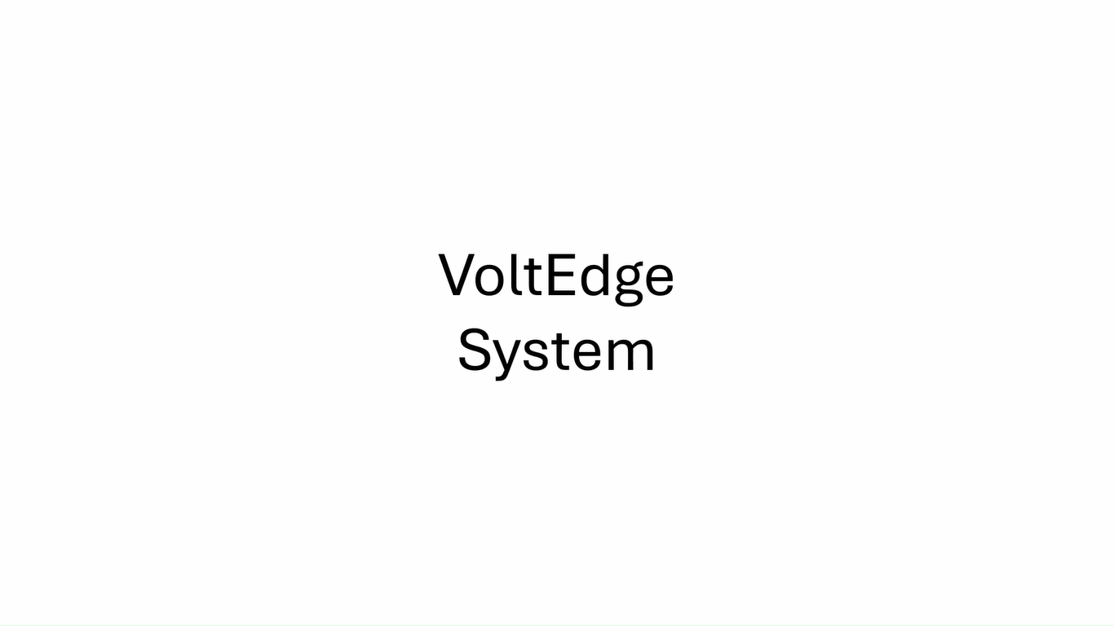

Slide 2
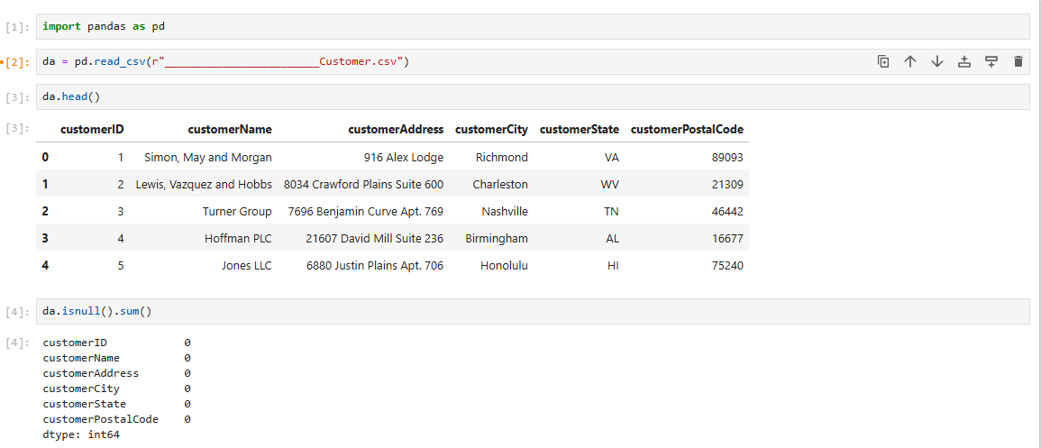

Slide 3
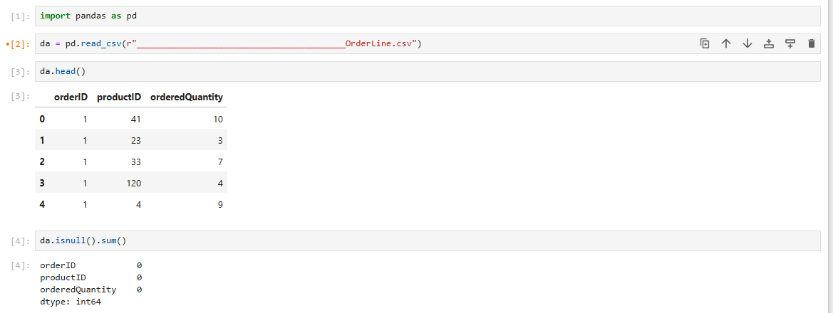

Slide 4
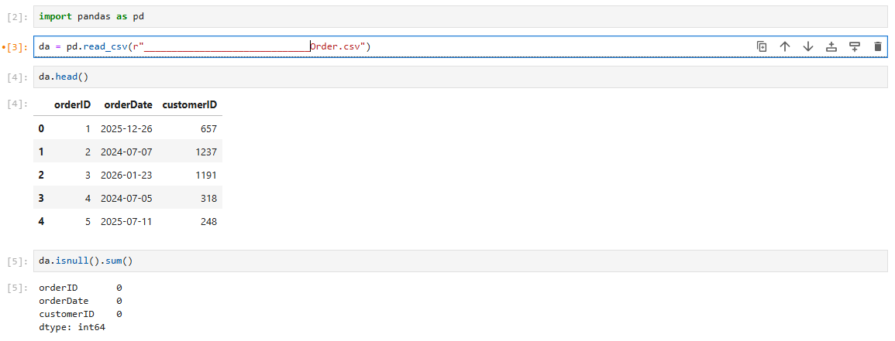

Slide 5
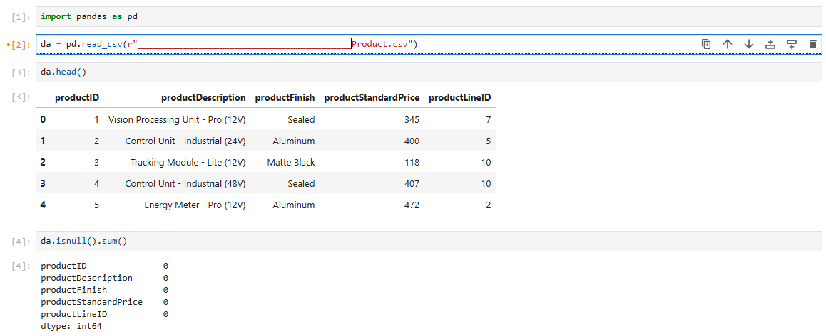

Slide 6
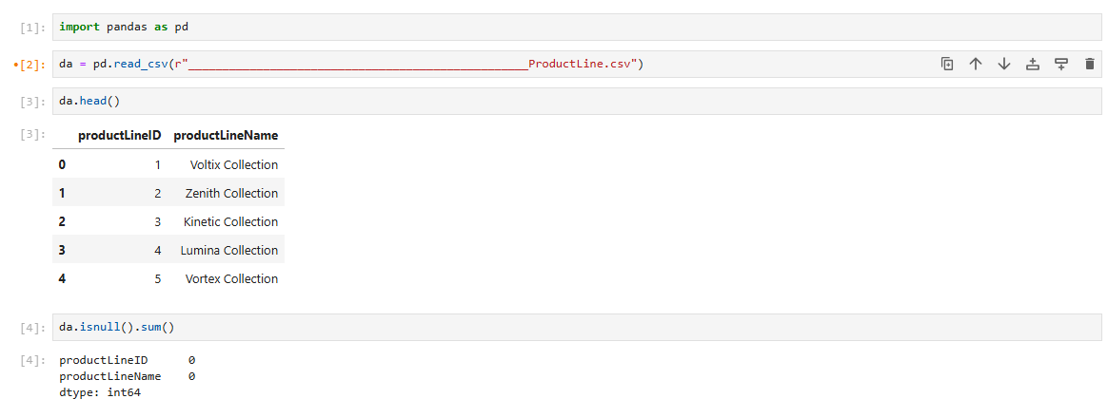

Slide 7
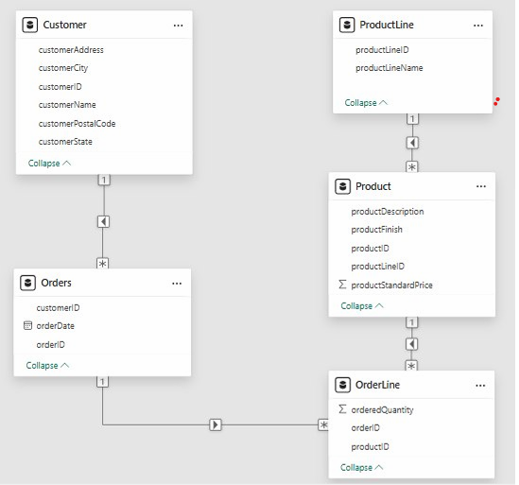

Slide 8
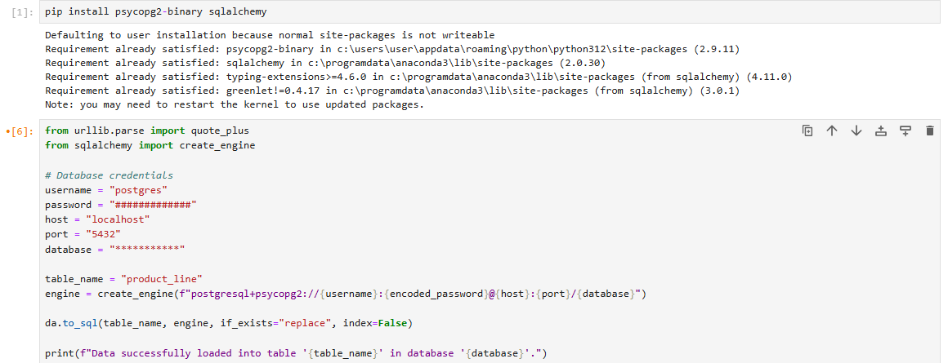

Slide 9
• Overall average product price: 356.9
• Products exceeding average price: Several industrial-grade and advanced system components
• Category examples: Control units, IoT gateways, and smart controllers
• Specific high-priced products:
IoT Gateway - Industrial (48V)
Smart Controller - Industrial (24V)
• Pricing pattern: Higher prices are associated with more complex, industrial-use equipment

Slide 10
• Dataset composition: 396 customers out of 1,489 total customers
• Inactive customer rate: 26.5% have no recorded transactions/orders
• Customer status: Represent untapped or inactive accounts
• Specific examples: Lewis, Vazquez, Hobbs, and Turner Group
• Strategic value: Important for re-engagement strategies and targeted marketing
• Business insight: May indicate potential onboarding issues in the sales funnel

Slide 11
• Top 10 Sales contribution: 14.3% of total revenue
• Dominant product categories: Industrial automation and sensor-related equipment
• Top 3 revenue-generating products:
Automation Controller - Industrial (48V) (~398K revenue)
Sensor Module - Industrial (48V) (~396K revenue)
Sensor Module - Industrial (5V) (~335K revenue)
• Primary revenue drivers: Automation controllers, sensor modules, and communication/driver circuits
• Market insight: Strong demand in industrial and IoT infrastructure markets

Slide 12
• Average Order Value (AOV): Approximately 17,428
• Sales contribution: Sub total of 16,243,107 accounts for 73% of total sales
• Above-average transactions: Orders exceeding the AOV threshold
• Highest order value: Maximum transaction reaches 35,424
• Upper quartile: Orders above ~20,557 indicate high-value purchases
• Customer pattern: High-value orders likely from business clients purchasing industrial components in bulk quantities
• Purchase behavior: Significant number of orders in upper quartile suggest enterprise-level buying patterns

Slide 13
• Ranking methodology: Products ranked in descending order based on total quantity ordered
• Top 3 highest-demand products:
Communication Module - Standard (12V) (leading demand)
Charging Controller - Lite (12V)
Power Supply Unit - Pro (48V)
• Tie handling: Products with equal quantities receive tied ranks
• Demand patterns: Communication and charging-related products show highest preference
• Insight: These categories represent key high-demand segments within the Apex Collection
• Market indication: Consumer preference heavily concentrated in communication and charging infrastructure products

Slide 14
• Customer segmentation: Q6 customers divided into high, mid, and low-value categories based on total spending
• Overall spending metrics: Average spending: 37,321.87 Total spending: 1,36,22,482
• High-value customers:
Contribute significant share of total revenue
Key focus for retention strategies
• Low-value customers: Form the majority of customer base
Average spending: 6,411.85
Total count: 23,33,912
• Strategic opportunity: Focus on retaining high-value customers while converting low-value customers into higher spenders
• Growth potential: Upselling and cross-selling opportunities within the low-value segment to increase their average order value

Slide 15
• Order composition varies widely: Number of products per order ranges from single items to multi-item purchases
• Diverse buying behavior: Customers show different purchasing patterns
• Minimal purchasers: Some customers prefer buying single products
• Bulk buyers: Other customers tend to purchase multiple items in one order
• Strategic opportunities: Diverse order patterns create opportunities for:
Product bundling strategies
Cross-selling initiatives
• Customer segmentation insight: Order size can be used to identify and target different customer types with appropriate marketing approaches

Slide 16
• Order linking: Each order is connected to its previous and next order dates
• Boundary conditions:
First order has no previous date
Last order has no next date
• Purchase tracking capabilities:
Purchase frequency monitoring
Gap analysis between orders
• Pattern identification: Enables identification of repeat buying behaviors
• Retention opportunities: Data supports customer retention initiatives and timing strategies
• Behavioral insights: Purchase timeline helps understand customer buying cycles and habits

