Slide 1
HEALTHCARE-P643

Slide 2
GROUP MEMBERS
DEVANSHI SINGH
MUNUGALA BHARGAV PRASAD
SAYALI RAJIV PAJANKAR
SHRUSTI INGALE
SUBITHA B

Slide 3
KPI’S
TOTAL DISCHARGES
PATIENT DAYS
NET TOTAL REVENUE
PATIENT STAYS
HOSPITALS
AVAILABLE BEDS
TOTAL GRIP
TOTAL GROP

Slide 4
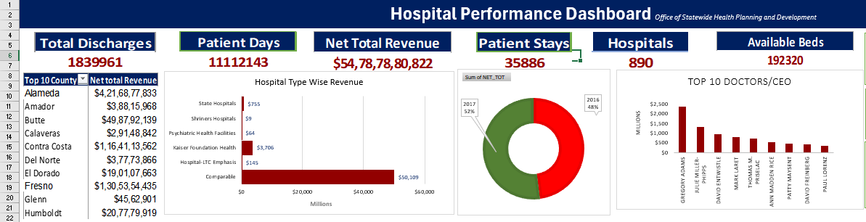
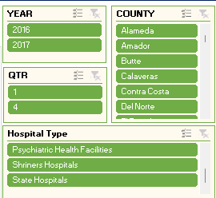
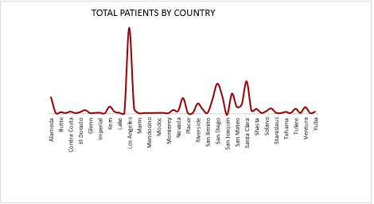
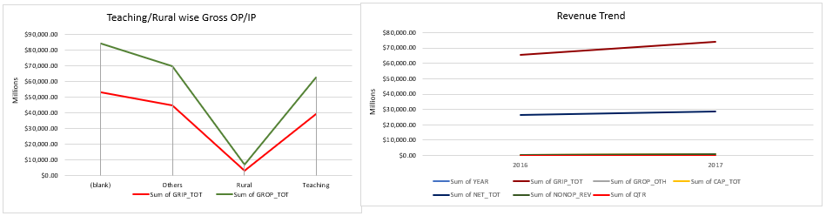
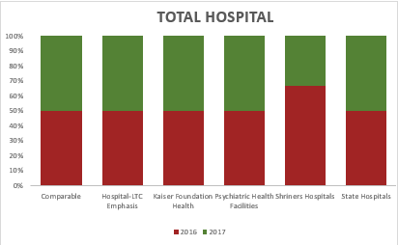

Slide 5
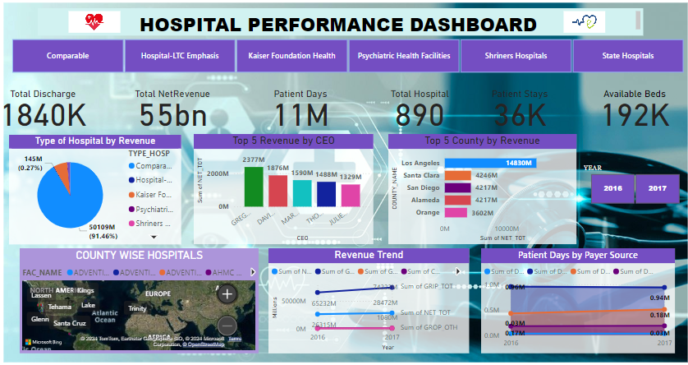

Slide 6
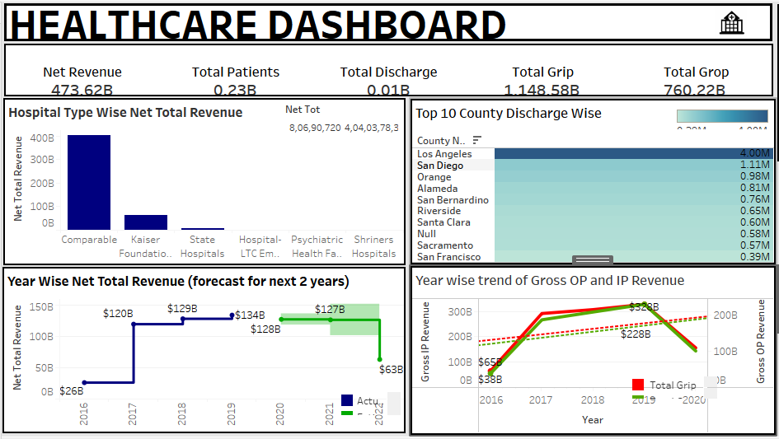
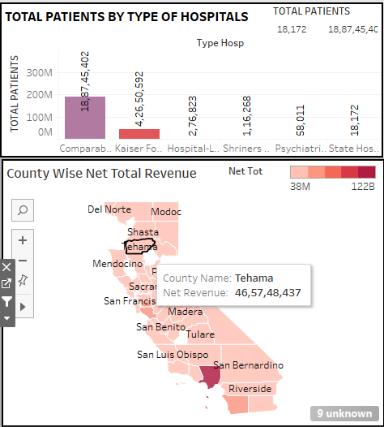

Slide 7
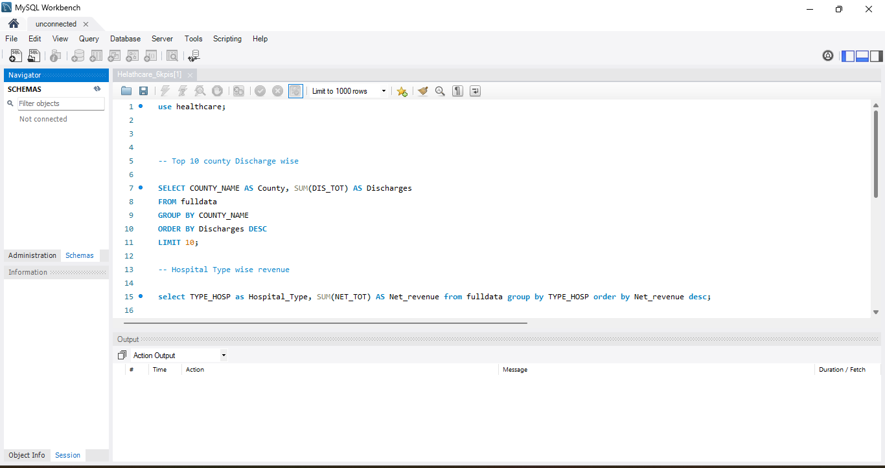
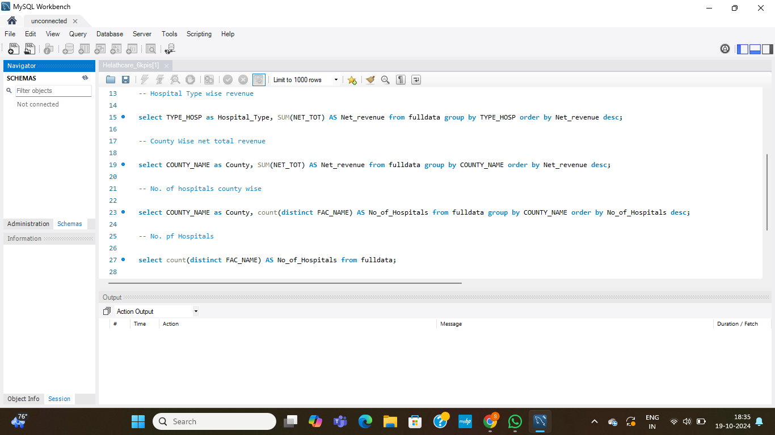

Slide 8
THANK YOU

