Slide 1




Based on easy and user friendly Google Assistant

Slide 2

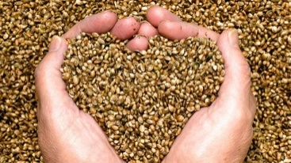
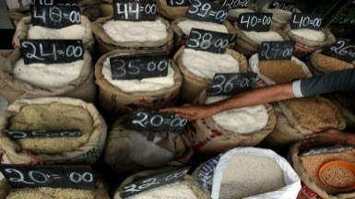

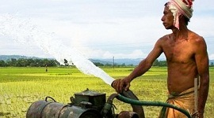





Severe and chronic Farmers Problems
Unaware of Schemes and facilities
Purchase of seeds and fertilizers
Outdated with market price
Burdensome Loan procedure
Unfamiliar with subsidies provided by government
.

Slide 3




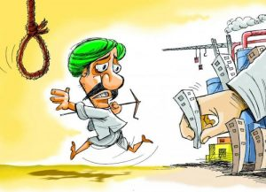
Severe and chronic Farmers Problems
Conti…
Weather change
Crop insurance
Doubts and qouries
Education for children
Suicides**

