Slide 1
Brain MRI classification
Baseline replication and compact model adaptation
Final capstone project
Vishesh Rao, Pranay Vishwakarma and Manu Vahan
Sajjan Agarwal School of Technology, Rishihood University
01
Notes:
Source: Disci, Gurcan and Soylu (2025), DOI 10.3390/cancers17010121. https://doi.org/10.3390/cancers17010121
Measured source: results/disci2025/summary.csv and runs/. Four Colab runs, five epochs, seed 42. Saved predictions independently verified.
Opening: We establish a selected baseline and report an unfavorable proposed-model comparison honestly.

Slide 2
Introduction
Task: classify MRI slices as glioma, meningioma, no tumor or pituitary tumor.
Transfer learning provides a baseline for a limited MRI dataset.
Our experiment measures predictive performance together with model size and evaluation reliability.
02
Notes:
Source: original Phase 1 literature-survey report. Broader radiomics and explainability proposals remain future work.

Slide 3
Selected base paper
Disci, Gurcan and Soylu
Cancers 17(1), 121, 2025
Advanced Brain Tumor Classification in MR Images Using Transfer Learning and Pre-Trained Deep CNN Models
Selected baseline: Xception
Published test accuracy: 95.27%
Baseline comparison uses the published Table 8 test score.
03
Notes:
Source: Disci, Gurcan and Soylu (2025), DOI 10.3390/cancers17010121. https://doi.org/10.3390/cancers17010121
The source compares six CNNs. Our revised scope selects Xception as baseline, not the whole six-model comparison.

Slide 4
Correct dataset version
Masoud Nickparvar Brain Tumor MRI Dataset, version 1
Partition | Glioma | Meningioma | No tumor | Pituitary | Total
Training | 1,321 | 1,339 | 1,595 | 1,457 | 5,712
Testing | 300 | 306 | 405 | 300 | 1,311
Pinned version 1: 7,023 images. All project stages use this dataset.
04
Notes:
Source: https://www.kaggle.com/datasets/masoudnickparvar/brain-tumor-mri-dataset/versions/1
Version 1 archive SHA256 recorded in results/disci2025/dataset_source.json. Version 2 has 7,200 images and is excluded.

Slide 5
Original and audited protocols
Protocol | Training | Validation | Testing
Paper-based | 5,712 | None | 1,311
Leakage-audited | 4,518 | 798 | 1,311
Audit: 263 training images identical to test images; 207 redundant training copies.
Audited training excludes exact overlap and redundant copies. Reliable patient IDs are unavailable.
05
Notes:
Measured source: results/disci2025/summary.csv and runs/. Four Colab runs, five epochs, seed 42. Saved predictions independently verified.
Source: results/disci2025/data_audit.json. 1,254 perceptual near-match candidates remain unresolved. No patient IDs. Test contains 30 redundant images.

Slide 6
Replicated training method
Grayscale, Gaussian blur and foreground crop. Resize to 128 × 128, replicate three channels and scale to [0,1].
ImageNet backbone with Flatten, Dropout 0.3, Dense 128 ReLU, Dropout 0.2 and four-class Softmax.
Adam 0.0001, batch 20, five epochs. Brightness and contrast factors 0.8–1.2. Final-epoch checkpoint.
Crop settings and full fine-tuning are disclosed assumptions. Foreground cropping is not validated tumor segmentation.
06
Notes:
Source: Disci, Gurcan and Soylu (2025), DOI 10.3390/cancers17010121. https://doi.org/10.3390/cancers17010121
Disclosed assumptions: Gaussian kernel 5, threshold 45, bounding-rectangle crop retaining blurred grayscale, seed 42, full backbone fine-tuning. Source leaves these choices incomplete. Crop fallback count: zero of 7,023.

Slide 7
Paper-based Xception replication
Clean accuracy is 1.60 percentage points below the paper.
This establishes an approximate baseline under disclosed assumptions.
07
Notes:
Source: Disci, Gurcan and Soylu (2025), DOI 10.3390/cancers17010121. https://doi.org/10.3390/cancers17010121
Measured source: results/disci2025/summary.csv and runs/. Four Colab runs, five epochs, seed 42. Saved predictions independently verified.
Published held-out accuracy .9527. Our clean accuracy .9366895499618612; fixed transformed .9328756674294432. The transformed view reflects the paper stated test augmentation without ensembling.

Slide 8
Previous milestone outcome
Original audited model | Test accuracy | Macro-F1
Xception reference | 91.76% | 0.9176
MobileNetV2 replacement | 74.29% | 0.7372
H1: stay within 0.02 macro-F1 of Xception with fewer parameters.
Observed gap: 0.1804. Parameter reduction: 80.52%.
The original joint target was not met.
08
Notes:
Sources: results/disci2025/runs/leakage_audited/{Xception,MobileNetV2}. Original five-epoch final-checkpoint experiment. H1 requires a macro-F1 gap at most0.02 and fewer total parameters; it was unsupported. Original results are preserved.

Slide 9
Changes for the final project
1. Corrected MobileNetV2 input scaling to [-1,1].
Five epochs: 81.92% accuracy; 0.8062 macro-F1.
Still below the original performance target.
2. Tested longer training with validation checkpoints (A).
3. Tested a smaller head with staged fine-tuning (B).
Same audited split, crop, augmentation, input size and seed.
09
Notes:
Sources: results/training_extension/comparison.csv; control/proposed runs/leakage_audited/MobileNetV2 metadata.json, metrics_clean.json, history.json and predictions_clean.csv. All 1,311 test predictions were checked. Same audited data fingerprint 7d26f705e2895e05fbebdcb5487f2fa011ebc27ee71d2d04a2a93598d50af571, seed42. One exploratory run on a previously evaluated test set. Historical Xception uses different input scaling, training budget, checkpoint selection and recorded runtime; no matched architecture superiority claim.
Normalization-only follow-up: results/final_project/comparison.json. Normalized accuracy.8192219679633868 andmacroF1.8061998029082713. Different recorded runtime from original MobileNetV2 prevents attributing the improvement solely to normalization. All later settings were predetermined; no test-based checkpoint selection.

Slide 10
Training control and compact proposal
Setting | A: training control | B: compact proposal
Aggregation | Existing Flatten | Global Average Pooling
Warm-up | None | 5 epochs, frozen backbone
Fine-tuning | All layers at 1e-4 | Non-BatchNorm layers at 1e-5
BatchNorm statistics | Updated | Frozen throughout
Both: up to 20 epochs; patience 4; minimum validation-loss checkpoint.
H2: improve normalized MobileNetV2 macro-F1 with fewer parameters.
Secondary target: within 0.02 of the saved Xception reference.
10
Notes:
Sources: results/training_extension/comparison.csv; control/proposed runs/leakage_audited/MobileNetV2 metadata.json, metrics_clean.json, history.json and predictions_clean.csv. All 1,311 test predictions were checked. Same audited data fingerprint 7d26f705e2895e05fbebdcb5487f2fa011ebc27ee71d2d04a2a93598d50af571, seed42. One exploratory run on a previously evaluated test set. Historical Xception uses different input scaling, training budget, checkpoint selection and recorded runtime; no matched architecture superiority claim.
Established methods: https://keras.io/guides/transfer_learning/ . Both fresh ImageNet initialization, batch20, Adam and same Dense128/dropout/output. B uses five fixed warm-up epochs then up to15low-rate fine-tuning. Freeze all52BatchNormlayers throughout fine-tuning; only head trained at warmup. A versus B evaluates combined changes, not individual causal effects.

Slide 11
Final audited results
Audited model | Accuracy | Macro-F1 | Total parameters
Xception reference | 91.76% | 0.9176 | 25,056,428
Normalized MobileNetV2 | 81.92% | 0.8062 | 4,880,068
A: training control | 88.71% | 0.8841 | 4,880,068
B: compact proposal | 92.68% | 0.9256 | 2,422,468
B uses 90.33% fewer parameters than the Xception reference.
Reference uses different input scaling and training settings.
11
Notes:
Sources: results/training_extension/comparison.csv; control/proposed runs/leakage_audited/MobileNetV2 metadata.json, metrics_clean.json, history.json and predictions_clean.csv. All 1,311 test predictions were checked. Same audited data fingerprint 7d26f705e2895e05fbebdcb5487f2fa011ebc27ee71d2d04a2a93598d50af571, seed42. One exploratory run on a previously evaluated test set. Historical Xception uses different input scaling, training budget, checkpoint selection and recorded runtime; no matched architecture superiority claim.
Proposed parameters2422468; reduction90.33194994913082%. Improvement overnormalized0.1194092148021777, overA0.04147461966599242. XceptionminusB-0.00802493559208206. H2 andsecondarytargetmetobservationally,notstatisticalnoninferiority. Original H1 unchanged. Exact counts are shown; numbers derive from saved JSON. Publicationpaper95.27% is different protocol and is not exceeded by92.68%.

Slide 12
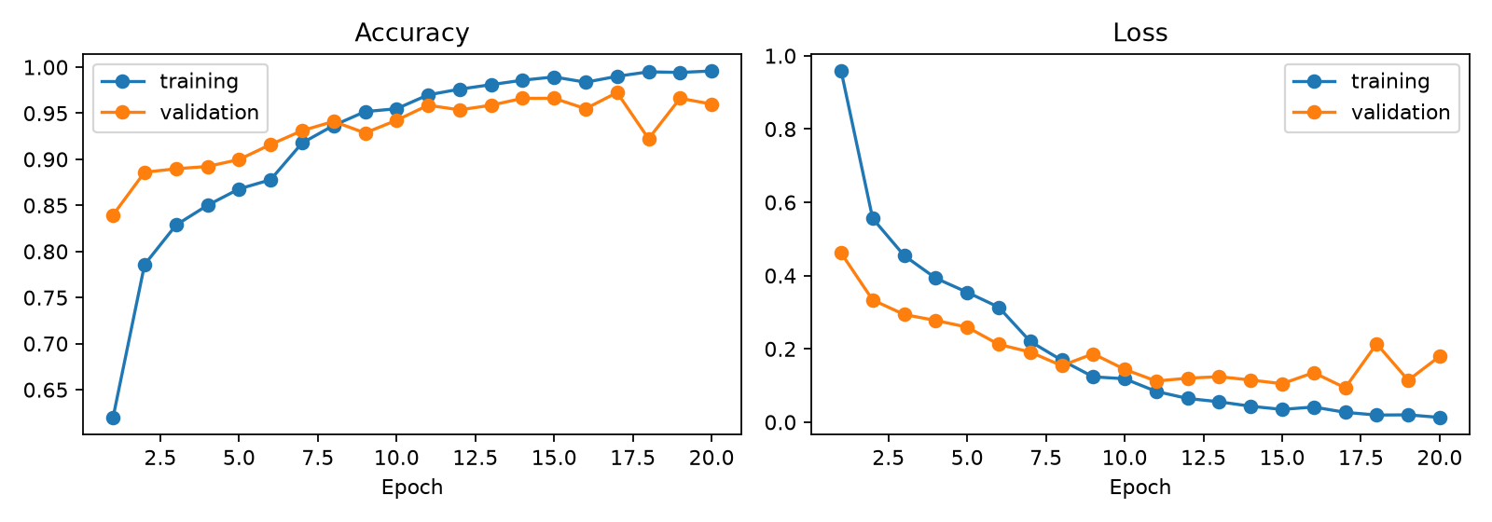
Validation selects the checkpoint
B: 20 epochs completed; epoch 17 has the lowest validation loss.
Recorded training time: B 6.37 minutes; A 10.72 minutes.
12
Notes:
Sources: results/training_extension/comparison.csv; control/proposed runs/leakage_audited/MobileNetV2 metadata.json, metrics_clean.json, history.json and predictions_clean.csv. All 1,311 test predictions were checked. Same audited data fingerprint 7d26f705e2895e05fbebdcb5487f2fa011ebc27ee71d2d04a2a93598d50af571, seed42. One exploratory run on a previously evaluated test set. Historical Xception uses different input scaling, training budget, checkpoint selection and recorded runtime; no matched architecture superiority claim.
Proposed learning_curves.png is copied unchanged from the accepted run. B completed20, selected17, minimumval0.09367641061544418; Acompleted19,selected15,minimumval0.2617324888706207. Global best includes both stages. B is chosen by lower validation loss, not test ranking. TrainingsecondsB382.3112907169998,A643.0698063719999. HistoricalXception239.2sfiveepochs isdifferentbudget: no claimBtrainsfasterthanXception.

Slide 13
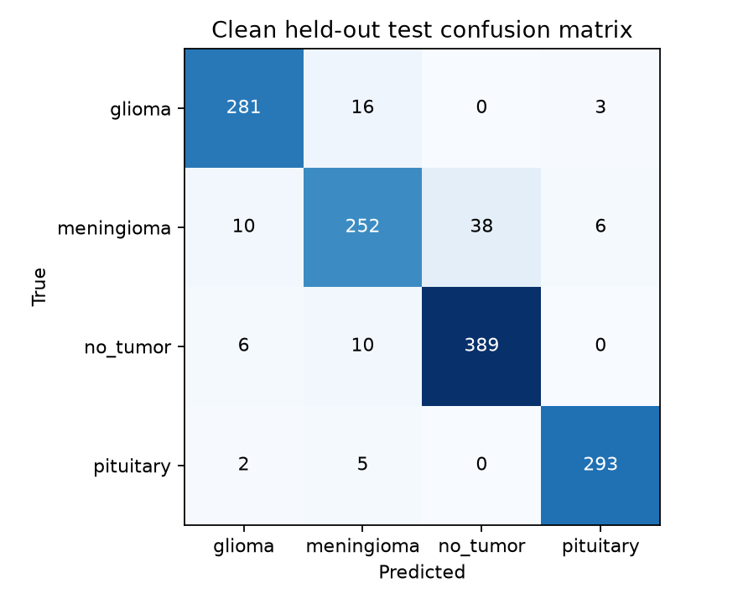
Class performance and remaining errors
Pituitary recall
Normalized: 61.67%
B: 97.67%
Meningioma recall: 82.35%
38 slices predicted as no tumor.
Some class recalls remain lower than A.
13
Notes:
Sources: results/training_extension/comparison.csv; control/proposed runs/leakage_audited/MobileNetV2 metadata.json, metrics_clean.json, history.json and predictions_clean.csv. All 1,311 test predictions were checked. Same audited data fingerprint 7d26f705e2895e05fbebdcb5487f2fa011ebc27ee71d2d04a2a93598d50af571, seed42. One exploratory run on a previously evaluated test set. Historical Xception uses different input scaling, training budget, checkpoint selection and recorded runtime; no matched architecture superiority claim.
Proposed confusion_matrix.png is copied unchanged from accepted run. Rowsdatasetlabels,columnspredictions. Pituitary recall normalized185/300andB293/300. MeningiomaB252/306with38predictedno_tumor. Meningioma andno_tumorrecallslightlylowerthanA. Do not infer uniform per-class improvement.

Slide 14
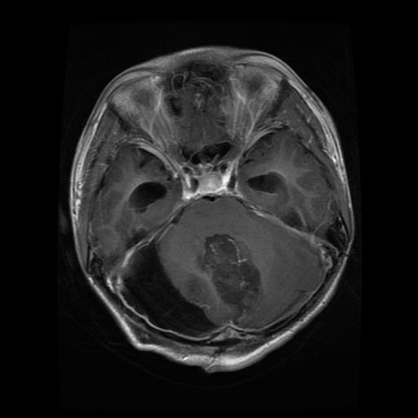
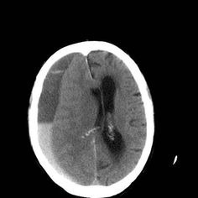
Prediction examples from the saved model
Dataset label: glioma
Prediction: glioma
Dataset label: no tumor
Prediction: meningioma
Verified examples illustrate a correct prediction and a retained error.
14
Notes:
Sources: results/training_extension/comparison.csv; control/proposed runs/leakage_audited/MobileNetV2 metadata.json, metrics_clean.json, history.json and predictions_clean.csv. All 1,311 test predictions were checked. Same audited data fingerprint 7d26f705e2895e05fbebdcb5487f2fa011ebc27ee71d2d04a2a93598d50af571, seed42. One exploratory run on a previously evaluated test set. Historical Xception uses different input scaling, training budget, checkpoint selection and recorded runtime; no matched architecture superiority claim.
Imageprovenance: docs/latex/figures/provenance.json. Deterministic firstglioma andno_tumor testexamples, pixelhashverified. Firstglioma matchesuserattachedMRI. Both predictedclassesmatchsavedColab andcheckedMacCPU. No_tumor→meningioma is retained error. B3/4firstperclassexamplescorrect,all4classesmatchColab,maximumscoresdiffer.0144955; notindependentaccuracyorprobabilityparity. Labels are dataset annotations,notclinicallyverified diagnoses.

Slide 15
Final project outcome
92.68% accuracy 0.9256 macro-F1
2,422,468 parameters; 90.33% fewer than historical Xception.
Original H1: target not met.
Final exploratory H2: improvement and size targets met.
Completed: notebooks, verified results, saved models, report and prediction demo.
15
Notes:
Sources: results/training_extension/comparison.csv; control/proposed runs/leakage_audited/MobileNetV2 metadata.json, metrics_clean.json, history.json and predictions_clean.csv. All 1,311 test predictions were checked. Same audited data fingerprint 7d26f705e2895e05fbebdcb5487f2fa011ebc27ee71d2d04a2a93598d50af571, seed42. One exploratory run on a previously evaluated test set. Historical Xception uses different input scaling, training budget, checkpoint selection and recorded runtime; no matched architecture superiority claim.
Completeddeliverables: notebooks/training_extension_colab.ipynb withstoredoutputsandtrainingdisabled; configs/training_control.yaml/training_proposed.yaml; compactresultsevidence; savedkerasmodelsinlocalresultsbundle; docs/latex/main.tex andcompiledreport; savedmodelprediction. 44tests passed. Original fiveepochH1notmet; finalexploratoryH2improvementandfewerparamsmetandsecondary0.02referencegapmet. No statistical superiorityornewalgorithmclaim.

Slide 16
Limitations and next steps
One seed and a test set already examined during development.
Missing patient IDs and unresolved image near-matches.
Combined changes need separate component experiments.
Next: repeat seeds and validate on independent patient data.
16
Notes:
Sources: results/training_extension/comparison.csv; control/proposed runs/leakage_audited/MobileNetV2 metadata.json, metrics_clean.json, history.json and predictions_clean.csv. All 1,311 test predictions were checked. Same audited data fingerprint 7d26f705e2895e05fbebdcb5487f2fa011ebc27ee71d2d04a2a93598d50af571, seed42. One exploratory run on a previously evaluated test set. Historical Xception uses different input scaling, training budget, checkpoint selection and recorded runtime; no matched architecture superiority claim.
Baselinepaper: DisciR,GurcanF,SoyluA,Cancers17(1)121,doi10.3390/cancers17010121. Datasetpinnedversion1:https://www.kaggle.com/datasets/masoudnickparvar/brain-tumor-mri-dataset/versions/1. Kerasguide:https://keras.io/guides/transfer_learning/. Images/acquisitionmodalitiesandclinicalannotationsnotindependentlyverified. No patient-independent, clinical, statistical superiority or global algorithmic novelty claim. Future repeatseedsandcomponentablationsandexternal/patientvalidation.

